Slide 1
Chinese Understanding of Life
Life in Chinese comprised by two characters: sheng 生 and ming 命
生:
命 Ideogram compound: 口 + 令
命: Life; Destiny, Fate; Order, Instruction
growing

Slide 2
The original writing of sheng 生

Slide 3
What is Life?
Life is the aspect of existence that processes, acts, reacts, evaluates, and evolves through growth (reproduction and metabolism).
The crucial difference between life and non-life (or non-living things) is that life uses energy (Qi) for physical and conscious development.
Life is anything that grows and eventually dies, i.e., ceases to proliferate and be cognizant.

Slide 4
Hun and Po as Yang and Yin Qi
“魂魄，神灵之名，本从形气而有；形气既殊，魂魄各异。附形之灵为魄，附气之神为魂也。附形之灵者，谓初生之时，耳目心识、手足运动、啼呼为声，此则魄之灵也；附所气之神者，谓精神性识渐有所知，此则附气之神也。
Hun Po, names of the spirits who originated from the Qi that are connecting to physical form. The reason why Hun-po in different being are different is because the Qi to form their forms are different. The soul attaching to the physical form is called as Po while the spirt attaching to the Qi is called as Hun. (Kong Yingda commentary on Zuozhuan.zhaogong year 25)

Slide 5
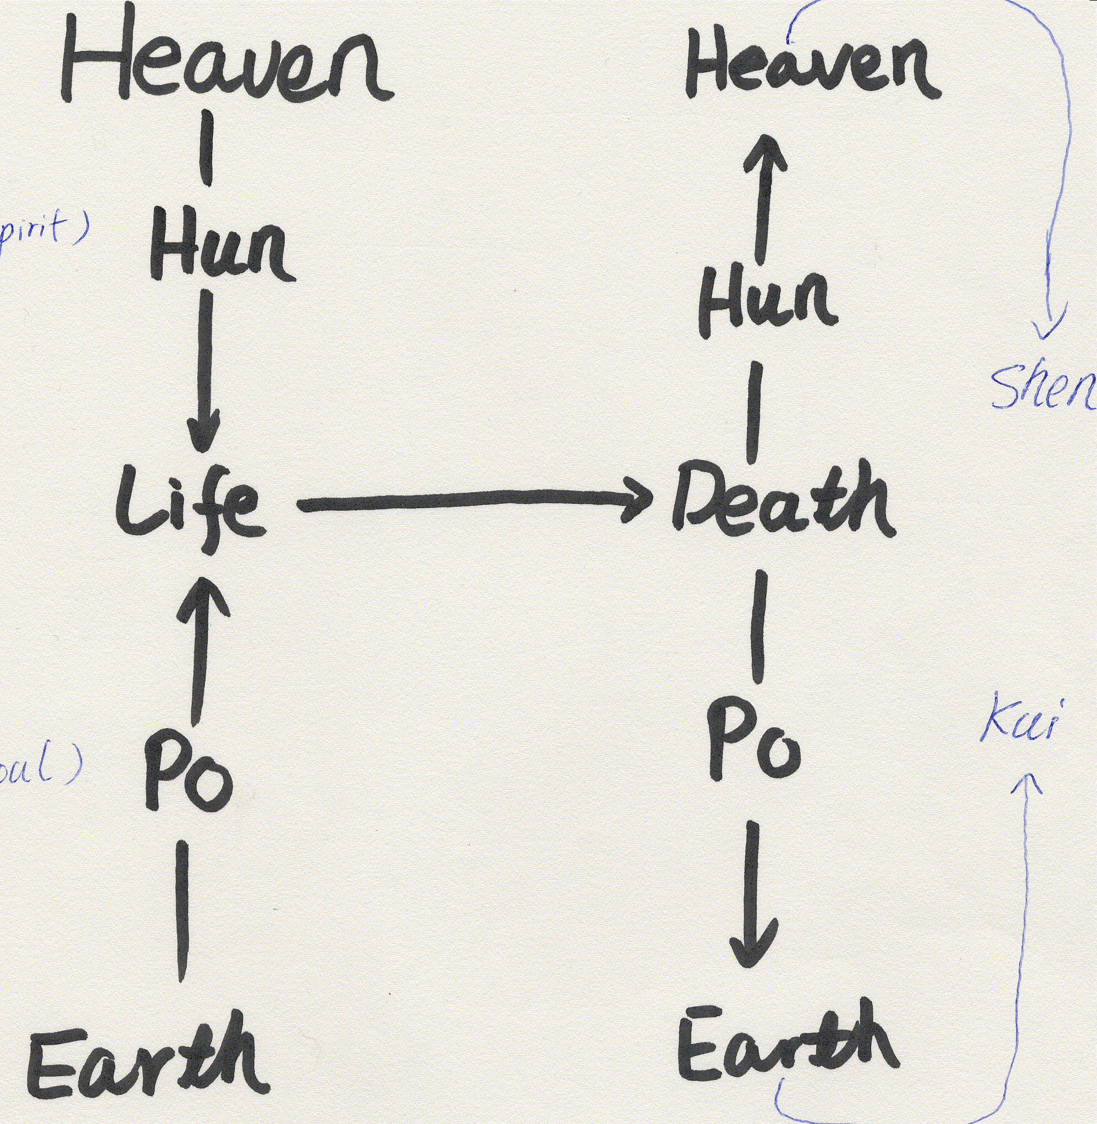
Shen, Gui, Hun and Po
《内观经》曰：“动以营身之谓魂，静以镇形之谓魄。”《

Slide 6
Three HUNs and Seven POs
人身有三魂，一名胎光，太清阳和之气也；一名爽灵，阴气之变也；一名幽精，阴气之杂也。
There 3 Huns within a human body, one is names as Taiguang, which is the great clarity and yang harmony Qi; one is named as Shuangling, which the changed form of Yin Qi; the other is named as Youjing, which is the mixture of Yin Qi.
第一魂胎光，属之于天，常欲得人清净，欲与生人，延益寿算，绝秽乱之想，久居人身中，则生道备矣；
The first Hun Taiguang belongs to heaven, and it always want people to be clear and pure, and want to keep the living human individual to prolong life and avoid people to think unclean and chaotic things. Therefore, if Taiguang is living in the human body, this person will live in a long and happy life.
第二魂爽灵，属之于五行，常欲人机谋万物，摇役百神，多生祸福灾衰刑害之事；
The second hum is named as Shuangling, belongs to five phases, and always want a person to calculate and manipulate other beings and labour and control hundreds of spirit, therefore it generate disasters and harm and punishments to the human body.
爽灵欲人生机，生机则心劳，心劳则役百神，役百神则气散，气散则太清一气不居，人将丧矣；
Shuangling want a person to raise opportunities and raising opportunities will labor ones heart. An busy Heart will push the hundred spirits to work, which will result a scatter the Qi and if the Qi within a body is scattered, one great clarity Unity of Qi will unsettled, which will lead one to die.
第三魂幽精，属之于地，常欲人好色、嗜欲、秽乱昏暗、耽著睡眠。
The third hun is named as youling, belongs to Di, and it always want the body to be amorousness, indulgent into desires, unclear even dark thinking and action and always in a condition of sleepy
幽精欲人合杂，合杂则厚于色欲，厚于色欲则精华竭，精华竭则名生黑簿鬼录，罪著，死将至矣。夫人重色欲，必昏邪秽乱，不避三光、四明、雷霆、神察，为四司所录，五帝所责，延累九玄七祖、父母长居幽途，荣禄长生不可睹矣。(张君房：云笈七签卷五十四 魂神部一

Slide 7
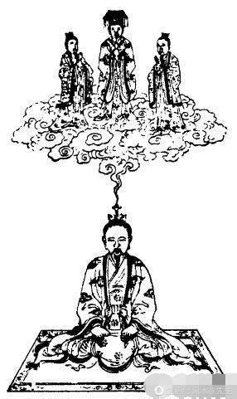
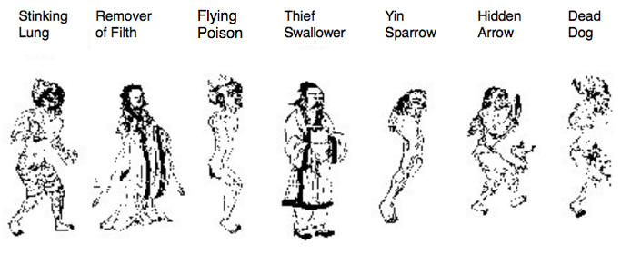
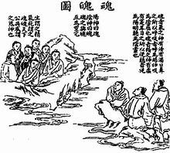
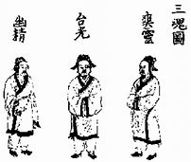

Slide 8
Life as the Destiny of A Living Being
Life = Life Span = Fate/Destiny (the time length) of an living creature when it is being alive between its Birth and its Death
Shengming生命 belongs to every living being:
Rensheng人生: human life
Chusheng畜牲/畜生: life of animals
Cao-ben sheng草本生: life of grass and tree

Slide 9
Confucian understanding of life and Human life
Fire and water possess energy [qi] but are without life [sheng].
Grass and trees have life but no intelligence [zhi].
Beasts have intelligence but no sense of duty [yi].
Man possesses energy, life, intelligence, and, in addition, a sense of duty. Therefore he is the noblest [gui--most valuable, most precious] being on earth. (Xunzi: Wang Zhi)
Human is the one has not only flesh body, consciousness but also morality and wisdom/intelligence
Human is the one can joint with Heaven and Earth as an Unified trinity: sage is the one who can stand side by side with the Heaven and Earth and give the universe a meaning of existence

Slide 10
Why Human Life Is a Treasure? 赵台鼎 (Ming Dynasty): 脉望
Xing belongs to the consciousness, while Ming belongs to form and material existence, 性者属知觉,命者属形质.
Ghosts and Gods have xing [consciousness] but do not have ming [form and material existence] 鬼神有性无命;
Grasses and Tresses have ming [form and material existence] but don’t have xing [consciousness or spirit] 草木有命无性;
Animals have less ming [consciousness/spirit] but have more ming [form and material existence] 禽兽性少命多;
Only humankind is able to possess both ming [form and material existence] and xing[consciousness/spirit] 惟人能全之.

Slide 11
Daoist Understanding of Human Life
From Daoist perspective, an alive body/life of humans is the unification of the three aspects Xing 形(jing精), Qi气, Shen 神:
Xing 形: Physical/ biological form of one’s Body. Xing and Ti are always combined together to refer one’s body.
Jing 精: Fine materials of a body that is essential for personal life force, body growing and reproduction.
Qi 气：the energy of Life Force flowing through the physical body
Shen神: the spirit combined by hun魂 and po 魄 soul.

Slide 12
Daoist Understanding of Life
Life =生命=sheng生 (alive, birth, generate, produce)+ ming 命(fate, destiny)
Life =性命=xing性 (nature, essence) + ming命 (fate, destiny, essential elements for physical existence)
Life =形气神= xing 形(form) +qi 气(vital energy)+ shen 神(spirit)
Life =精气神= jing 精 (refined productive part of physical body)+气(vital energy)+神 (spirit)

Slide 13
Human Life is形气神 (xing +qi+ shen) or 精气神 (jing +qi +shen)
Xing = form/ structure of human body
=material source manifested by Qi
=material base of the spirit
Jing generally refers to the refined part of materialized human body
it especially refers to the fundamental energy of human life (sperm or semen)
Qi = Life energy and source of being and life
Shen= spirits or consciousness

Slide 14
The Original Meaning of Jing 精
Jing originally is a pictogram of the germ of a grain, its extended meaning are germ of life, life essence, sexual energy, the most refined, quintessential form of anything.
Physical manifestation of jing:
In Qigong, jing is the most yin form of qi.
It tends to flow downward, like water, moving toward the genitals and finding expression in fluids related to reproduction: semen, sperm, vaginal lubricants, ova, menstrual blood.
Jing is essentially a subtle energy. Same as Qi is air but it is more than air, the jing is sperm but more than sperm.

Slide 15
The Characteristic of Jing
Jing corresponds to sexual energy and manifests in the body as sexual fluids;
Jing is yin and moves downward, filling the lower dantian丹田 and kidneys.
Jing energy tends to drain outward leaving its energetic gate (the genitals) whether one is sexually stimulated or not, though it will be lost more if sexual relationship is inharmonious.
Jing circulates through the bones, brain and mind. (Kenneth S. Cohen, 1997:39)

Slide 16
The Gender of Jing
Jing has yin and yang expressions:
The Yin (earthly) aspect of Jing, is the reproductive and sexual fluids.
The Yang aspect of Jing is saliva.
Although saliva is physically composed of digestive enzymes and protective antibodies, it is energetically linked to sexuality.
Kenneth S. Cohen, The Way of Qigong: the Art and Science of Chinese Energy Healing, New York: Ballantine Books, 1997, p.37

Slide 17
The Character of Shen
Shen is spiritual and psychic energy, the divine part of one’s being and has an essentially luminous nature (Catherine Despeux, in Kenneth S. Cohen, 1997:40)
Shen is the subtle energy of spirit. It is yang and move upward, like fire.
Shen is stored in the upper dantian, between the eyebrows, and escapes through eyes, unless checked by introspection and meditation.
Shen descends during meditation, the eyes are turned within, illuminating the microcosm.

Slide 18
The Characteristic of Qi
Qi is the omnipresent energy of life, manifests as breath and easily escapes through the nose and month unless conserved by practicing quiet, meditative breathing.
Qigong is sometimes described as method of ‘inner alchemy’ in which fire (yang) flows down and water (yin) flows up, meeting and producing the steam (the qi).
Kenneth S. Cohen, 1997:39

Slide 19
The relationship of Jing Shen and Qi
Jing and Shen are types of Qi (yin and yang respectively).
Although
Shen is connected to the mind and spirit,
Jing, which nourishes the brain, is also related to spirit, and
Qi as respirations, affects our mood state.

Slide 20
Three Treasures of Human Life
(Kenneth S. Cohen, 1997: 38)
 | Jing 精 | Qi 气 | Shen 神
Energy | Sexual | Life | Spirit
Organ-Source | Kidneys and lungs | Spleen | Liver and Heart
Element | Water | Earth | Fire
Form | Sexual fluid, saliva | Breath | Light and Spirit
Character | Yin | Yin, Yang , Neutral | Yang
Movement | Down | Down and Up | Up
Reservoir | Lower Dantian | Middle Dantian | Upper Dantian
Circulatory System (TCM) | Bones | Meridians | Extra Meridians
Associated System (WM) | Reproductive Endocrine | Respiratory | Nervous
Gate | Genitals | Nose and Month | Eyes
Cultivation Practice | Sexual | Qigong | Meditation

Slide 21
The Meaning of xing ming 性命
性则神也, 命则精与气也.
<玄肤论•性命论> <道教五派丹法精选> 第三集, 中医古籍出版社, 250页)
Xing性 (nature, essence)= Shen神 (spirit)
Ming命 (fate destiny)= Jing 精 (Essence=refined part of xing形)+ Qi 气 (vital energy)
性者是元神, 命者是元气, 名曰性命也.
<重阳授丹阳二十四诀> <道藏> 25册,807页.
Xing性 (nature, essence)= Yuan Shen元神 (congenital spirit)
Ming命 (fate destiny)= Yuan Qi元气 (congenital vital energy)
Why ming = jing +qi?
精是生命的基础，气是生命的动力，所以命是精与气。
Jing is the base of life and Qi is the force of life, therefore Life= Jing+ Qi

Slide 22
Daoist Understanding of Xing 性
荀子：生之所以然者谓之性; 凡性者天之就也，不可学，不可事; 不可学，不可事而在人者谓之性.
Xing is something one to be born with, something inherently unchangeable, un-learnable and cannot be waiting upon
性者，人身一点余元灵之神也 （还真集•性命混融论）《道藏》卷24， 103页
Xing is the bit of congenital spirit left in human body
.

Slide 23
Daoist Understanding of Ming 命
大凡生于天地之间者皆曰命 （礼记，祭法）
Things to live between heaven and earth all can be called as fate/destiny
死生，命也，其有夜旦之常，天也 （庄子，大宗师）
Death and birth are fate. They are as certain as the dawn that comes after the night, established by the decree of heaven.
从道受生谓之命 （太上老君内观经）
To be born according to the Dao is called as fate.
气者， 命也。在天为气， 受之于人为命。（刘一明，《百字碑注》《藏外道书》，第8册，438页
Qi is equal to the Fate. When it exists in its natural form, it is called as Qi; when it manifested in human form, it is called as fate.
夫所谓命者，气之宗也。 凡人之生，须藉乎气；有气则生， 无气则死，故人死曰断气， 气断则命绝。
Ming is the ancestor and root of Qi. Every human life need to base on the Qi; one will live by having Qi and will die by without of Qi, therefore die is called as broken of Qi flow, when the flow of Qi is broken one’s ming will be finished.

Slide 24
What is meant by death
gù ( 故 ), past
shì ( 逝 ), gone
sĭ ( 死 )= 一+夕 +已
wáng ( 亡 ), lost
yŭn ( 陨 ), fall

Slide 25
Gui鬼 and Hun and Po
Hun 魂= spirit, a heavenly spirit coming from Heaven
Po 魄 = soul, an earthly spirit coming from the essence of Earth.
The combination of a spirit and a soul = birth of a life
The separation of spirit and soul = come of death
Gui鬼 is a figure with a mask and a tail ornament = returned spirit and soul
They may be recalled by their descendants through ritual and sacrifices, by music and wine respectively

Slide 26
Returned Spirit and Soul
The spirit and soul that have returned are called gui.
Literally gui 鬼meaning 归=‘returning’.
Returned spirits or soul take two forms:
  when they are taken care of properly, they are good and kind, blessing and protecting their descendents
  Otherwise they would bring harm to the living
haunting ghosts(恶鬼) and special religious ceremonies

Slide 27
Chinese understanding of life and Death
Heaven Heaven
Hun
shen
Hun
Death
Sacrifice/ ancestor worship
Life
Po
Gui
Po
Earth
Earth

Slide 28
Chinese attitude of Death
Yang Zhu杨朱 and Zhuangzi庄子: Natural Process
Wang Chong王充: death like light of candle has been put out
Confucius孔子: wei zhi sheng, yan zhi si未知生, 焉知死(don’t know life how can you know death);
ji ru zai 祭如在(worship ghost as if it is present there)
Xunzi荀子: Ritual is for polish human virtue and memory the past

Slide 29
Treasure Life in Lushi Chunqiu
The sages pondered over all things in the world and found that nothing is treasured more than life.
Physical organs such as ears, eyes, nose, and mouth, they are merely servants of one’s life. Thus, although ears like sound, eyes like colours, nose likes fragrance, and mouth likes flavour, they would be prohibited if they are going to harm one’s life. …
Regarding to benefit, gaining a world is great enough yet one will not harm one’s life to gain it, how could one let other things be prior to one’s life? (Chen Qiyou 2002, 75)

Slide 30
Jing in Chinese Medicine
Jing is the energy of growth and development, slowly increasing during childhood, reaching its peak at age twenty-one and then decreasing, unless checked or supplemented by qigong training.
Diminishing jing is associated with many of the signs of aging, particularly osteoporosis, less responsive immune cells, loss of libido, gray hair, slower reflexes and poorer memory.
Kenneth S. Cohen, The Way of Qigong: the Art and Science of Chinese Energy Healing, New York: Ballantine Books, 1997, p.37

Slide 31
还精补脑 Reverse the Jing to Repair the Brain in Daoist Yangsheng Practices
Jing is the energy that creates bone marrow and the gray matter of the brain. The brain is the sea of marrow
Reverse the jing to repair the brain is a famous Qigong practice: instead of flowing down toward the genitals, the jing is pushed upward through meditative exercises.
Although it is unlikely that damaged brain cells can be repaired, there is a wealth of evidence proving that individuals can slow the rate of destruction and are capable of awakening new areas of the brain.
Kenneth S. Cohen, The Way of Qigong: the Art and Science of Chinese Energy Healing, New York: Ballantine Books, 1997, p.37

