Slide 1
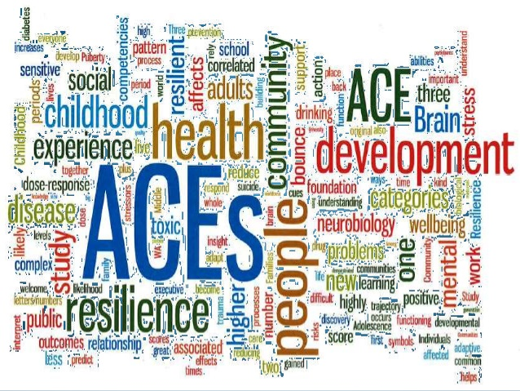
Adverse Childhood Experiences (ACEs)

Slide 2
What are ACEs?
Adverse childhood experiences, or ACEs, are potentially traumatic events that occur in childhood (0-18 years).
(Centers for Disease Control and Prevention (CDC), 2019a)
Can you give some examples?

Slide 3
Traumatic events in childhood
Experiencing violence or abuse
Witnessing violence in the home or community
Having a family member attempt or die by suicide
(CDC, 2019a)

Slide 4
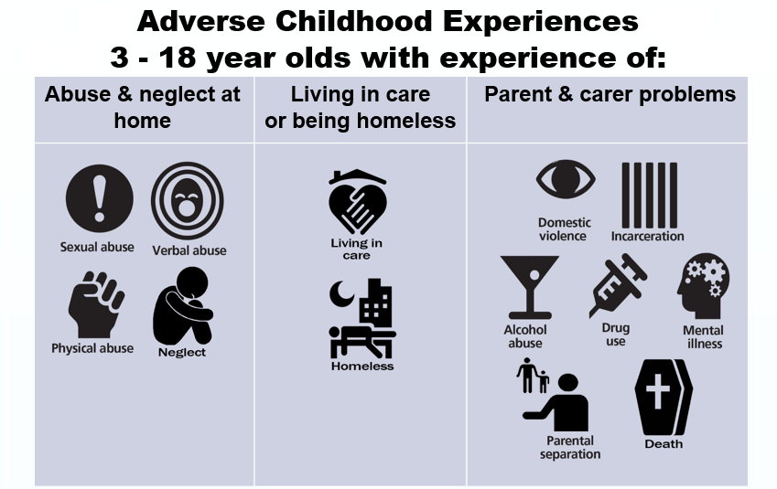
(EPPI Centre, 2018) https://eppi.ioe.ac.uk/cms/Default.aspx?tabid=3681&articleType=ArticleView&articleId=175

Slide 5
Environmental factors
Aspects of the child’s environment that can undermine their sense of safety, stability and bonding, such as, growing up in a household with:
Substance misuse
Mental health problems
Instability due to parental separation or household members being in jail or prison
(CDC, 2019a)

Slide 6
Effect of ACEs
ACEs are linked to chronic health problems, mental illness, and substance misuse in adulthood.
ACEs can also negatively impact education and job opportunities. However, ACEs can be prevented.
(CDC, 2019a)

Slide 7

(Hall, 2018)

Slide 8
The extent of the problem
ACEs are common. About 61% of adults surveyed across 25 states in the USA reported that they had experienced at least one type of ACE, and nearly 1 in 6 reported they had experienced four or more types of ACEs.
Preventing ACEs could potentially reduce many health conditions. For example, up to 1.9 million cases of heart disease and 21 million cases of depression could have been potentially avoided by preventing ACEs.
Some children are at greater risk than others. Women and several racial/ethnic minority groups were at greater risk for having experienced 4 or more types of ACEs.
ACEs are costly. The economic and social costs to families, communities, and society totals hundreds of billions of dollars each year.
(CDC, 2019a)

Slide 9
The extent of the problem in Wales
For details on the prevalence of ACEs in Wales please see the Ashton (2020) presentation.
This also includes information on the increased issues for people with ACE’s as well as information about mental well-being and the impact on the Health service.
file:///C:/Users/ext-kh/Downloads/Kathryn-Ashton-Adverse-Childhood-Experiences-ACEs-in-Wales%20(6).pdf

Slide 10
Impact of ACEs
ACEs can have lasting, negative effects on health, well-being, and opportunity.
These experiences can increase the risks of:
injury
sexually transmitted infections
maternal and child health problems
teen pregnancy
involvement in sex trafficking
a wide range of chronic diseases and are leading causes of death such as cancer, diabetes, heart disease, and suicide.
(CDC, 2019a)

Slide 11
Impact of ACEs
ACEs and associated conditions, such as living in under-resourced or racially segregated neighbourhoods, frequently moving, and experiencing food insecurity, can cause toxic stress (extended or prolonged stress).
Toxic stress from ACEs can change brain development and affect such things as attention, decision-making, learning, and response to stress.
(CDC, 2019a)

Slide 12
Impact of ACEs
Children growing up with toxic stress may have difficulty forming healthy and stable relationships.
They may also have unstable work histories as adults and struggle with finances, jobs, and depression throughout life.
These effects can also be passed on to their own children.
Some children may face further exposure to toxic stress from historical and ongoing traumas due to systemic racism or the impacts of poverty, resulting from limited educational and economic opportunities.
(CDC, 2019a)

Slide 13
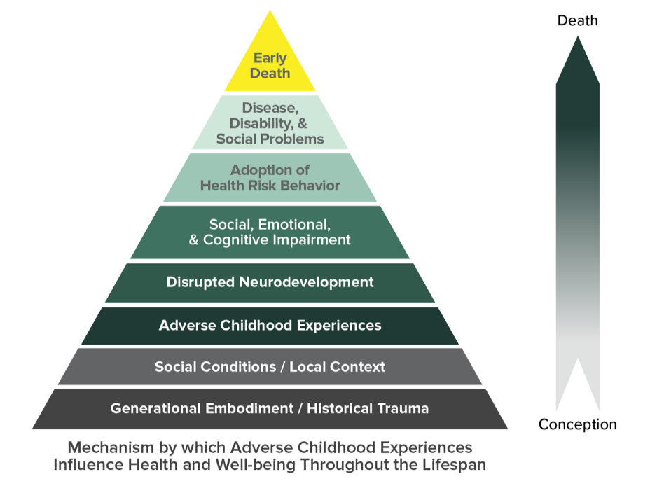
Impact of ACEs
The ACE Pyramid represents the conceptual framework for the ACE Study.
The ACE Study has uncovered how ACEs are strongly related to development of risk factors for disease, and well-being throughout the life course.
(CDC, 2019b)

Slide 14
The Ace Study
The ACE Pyramid comes from the CDC-Kaiser Permanente Adverse Childhood Experiences (ACE) Study.
This is one of the largest investigations of childhood abuse and neglect and household challenges and later-life health and well-being.
The original ACE Study was conducted at Kaiser Permanente from 1995 to 1997 with two waves of data collection.
More information is available from the link below.
https://www.ajpmonline.org/article/S0749-3797(98)00017-8/abstract
(CDC, 2019b)

Slide 15
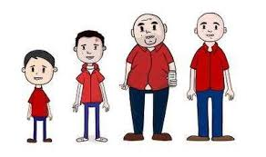
Impact of ACEs
(Youtube, 2017)

Slide 16
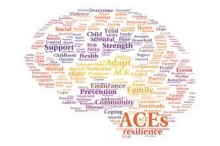
Preventing ACES
What can we do to prevent ACEs or support children living with ACEs?

Slide 17
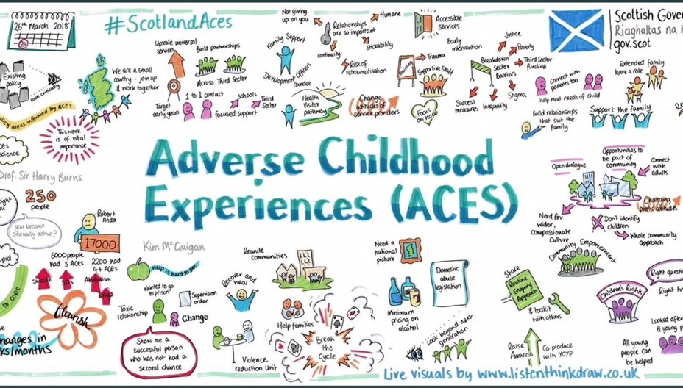
We can prevent Aces (CDC 2019a; YouTube, 2018)

Slide 18
Preventing Aces (CDC, 2019a)
Strategy
Approach
Strengthen economic supports to families
Promote social norms that protect against violence and adversity
Strengthening household financial security
Family-friendly work policies
Public education campaigns
Legislative approaches to reduce corporal punishment
Bystander approaches
Men and boys as allies in prevention

Slide 19
Preventing Aces (CDC, 2019a)
Strategy
Approach
Ensuring a strong start for children
Teach Skills
Connecting youth to caring adults and activities
Early childhood visits
High quality childcare
Pre-school enrichment with family engagement
Social and emotional learning
Safe dating and healthy relationships skill programs
Parenting skills and family relationship approaches
Mentoring programs
After school programs

Slide 20
Preventing Aces (CDC, 2019a)
Strategy
Approach
Intervene to lessen immediate and long-term harms
Enhanced primary care
Victim-centred services
Treatment to lessen the harms of ACEs
Treatment to prevent problem behaviour and future involvement in violence
Family-centred treatment for substance misuse.

Slide 21
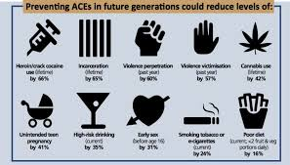
Preventing Aces (Ashton, 2020)

Slide 22
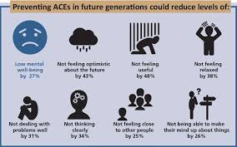
Preventing Aces (Ashton, 2020)

Slide 23
Raising Awareness
Can help:
Change how people think about the causes of ACEs and who can help prevent them.
Shift the focus from individual responsibility to community solutions.
Reduce stigma around seeking help with parenting challenges or for substance misuse, depression or suicidal thoughts.
Promote safe, stable, nurturing, relationships and environments where children live, learn and play.
(CDC, 2019a)

Slide 24
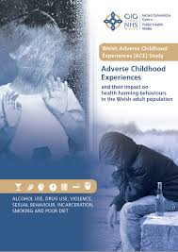
Welsh Adverse experiences study
To find out the impact of ACEs in Wales please look at this report which is available via a link on Moodle.

Slide 25

ACE awareness in Wales
“Wales: awareness of ACEs is strong – but not the confidence to help”
Public Health Wales (PHW) survey has shown that Public sector workers have a good awareness of adverse childhood experiences (ACEs),and can identify opportunities for improvement but only 36% feel confident in preventing ACEs within their role.
Genevieve Riley of PHW said: ‘The survey is very positive news regarding awareness of ACEs in the Welsh public sector. But it has also identified a number of potential areas to focus on to further support the workforce.’
(Community Practitioner, 2020)

Slide 26
“Let us help all children to reach their full potential and create neighbourhoods, communities and a world in which every child can thrive.”
(CDC, 2019a)
We all have a responsibility to do this.

Slide 27
References
Ashton, K. (2020) Adverse Childhood Experiences in Wales. Available at: file:///C:/Users/ext-kh/Downloads/Kathryn-Ashton-Adverse-Childhood-Experiences-ACEs-in-Wales%20(2).pdf
Centers for Disease Control and Prevention (CDC) (2019a) Adverse Childhood Experiences (ACEs). Available at: https://www.cdc.gov/violenceprevention/childabuseandneglect/acestudy/index.html (Accessed 20th February 2020).
Centers for Disease Control and Prevention (CDC) (2019b) About the CDC-Kaiser ACE Study. Available at: https://www.cdc.gov/violenceprevention/childabuseandneglect/acestudy/about.html (Accessed 20th February 2020).
Community Practitioner (2020) News: Wales: awareness of ACEs is strong – but not the confidence to help. Available at: https://www.communitypractitioner.co.uk/news/2020/02/wales-awareness-aces-strong-%E2%80%93-not-confidence-help (Accessed 20th February 2020).

Slide 28
References
EPPI Centre (2018) Involving young people with lived experience of adverse childhood experiences (ACEs) in a systematic review. Available at: https://eppi.ioe.ac.uk/cms/Default.aspx?tabid=3681&articleType=ArticleView&articleId=175 (Accessed 20th February 2020).
Hall, A. (2018) What are Adverse Childhood Experiences (ACEs)?. Available at: https://www.safeguardinginschools.co.uk/what-are-adverse-childhood-experiences-aces/ (Accessed 20th February 2020).
YouTube (2017) Adverse Childhood Experiences (ACEs) Available at: https://www.youtube.com/watch?v=XHgLYI9KZ-A (Accessed 20th February 2020).
YouTube (2018) We can prevent ACEs. Available at: https://www.youtube.com/watch?v=8gm-lNpzU4g (Accessed 20th February 2020).

