Slide 1
The Impact of the Male Gaze Upon Modern Interpretations of Classical Greek Statuary
1800573

Slide 2
The Male Gaze
The basis of the male gaze.
Crafted for males by a male.
The heterosexual matrix.
Objectification of women by creator and audience.
  Othering
  Visual Pleasure
  Projecting their own fantasy
Points of attention
Allegedly a modern conception, but modern scholars have been applying it to aspects of the ancient world.

Slide 3
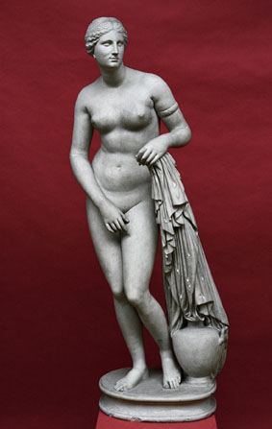
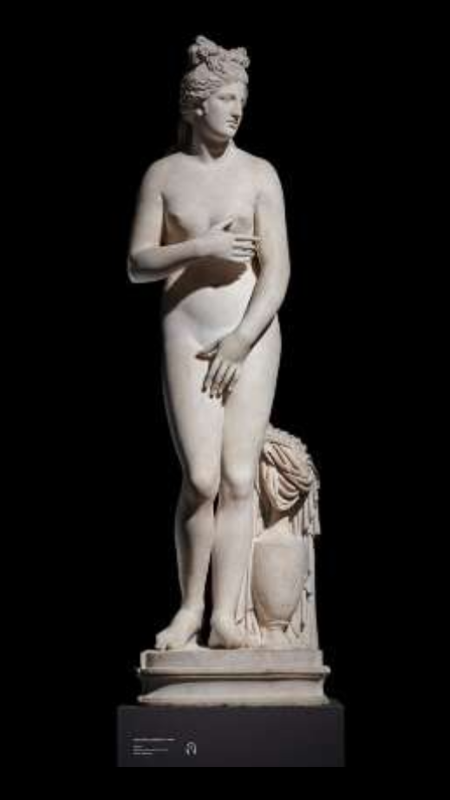
Knidian Aphrodite
Left: Fig.1:
Praxiteles, c.350BCE, Knidian Aphrodite, Roman marble copy of original bronze sculpture, 152cm. Museum of Classical Archaeology Databases. Accessed: 04/11/2020: https://museum.classics.cam.ac.uk/collections/casts/aphrodite-knidos
Often an object of many modern scholars when discussing the male gaze.
Beard and Henderson herald the Knidian Aphrodite as the epitome of a statue tailored for the male gaze.
Depiction
  Focuses through lines, props, and storytelling
  Differences in depicting modesty
  Faux modesty
  “The artist made two statues of the goddess, and offered them both for sale: one of them was represented with drapery, and for this reason was preferred by the people of Cos, who had the choice; the second was offered them at the same price, but, on the grounds of propriety and modesty, they thought fit to choose the other.”
  [Plin. NH. 36.4]
Setting the stage:
  “When she had gazed at it from every angle in its shrine viewable-all-around,
  She cried out, ‘Where did Praxiteles see me naked?’”
  [Anth. Pal. 160]
  The little temple in which it, is placed is open on all sides, so that the beauties of the statue admit of being seen from every point of view; an arrangement which was favoured by the goddess herself, it is generally believed. Indeed, from whatever point it is viewed, its execution is equally worthy of admiration. A certain individual, it is said, became enamoured of this statue, and, concealing himself in the temple during the night, gratified his lustful passion upon it, traces of which are to be seen in a stain left upon the marble.”
  [Plin. NH. 36.4]
The issues with a male audience and literary sources.
Holding classical Athenian values.
  Goddess
  Woman
Right: Fig 2.:
Anon, c.100-150AD, Knidian Aphrodite, Marble statue of Aphrodite at her bath; Greek, possibly Thasian marble. Version of the type known as Capitoline/Dresden. British Museum. Accessed: 04/11/2020: https://www.britishmuseum.org/collection/object/G_1834-0301-1

Slide 4
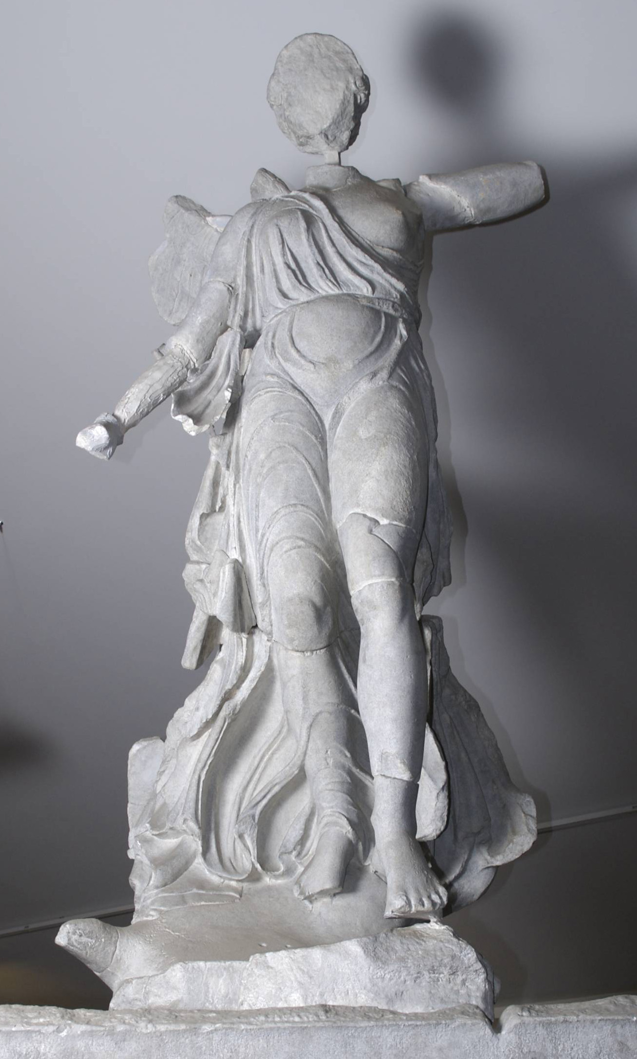
Nike of Paionios
Leading lines to the left breast from the arm and also the framing from the drapery that has exposed her. Lines leading to the genitalia.
Roughly 420BCE – before Knidian Aphrodite.
Partial nudity but leaves little to the imagination.
Haynes – On separating the goddess from the statue.
  Original setting
  Embodiment of victory
Fig 3:
Paionios on Mende, c.420 BCE, Nike -Winged Victory, Original marble piece with several missing segments it was discovered in 1875 at Olympia, Museum of Classical Archeology Databases, Accessed:04/11/2020: https://museum.classics.cam.ac.uk/collections/casts/nike-paionios

Slide 5
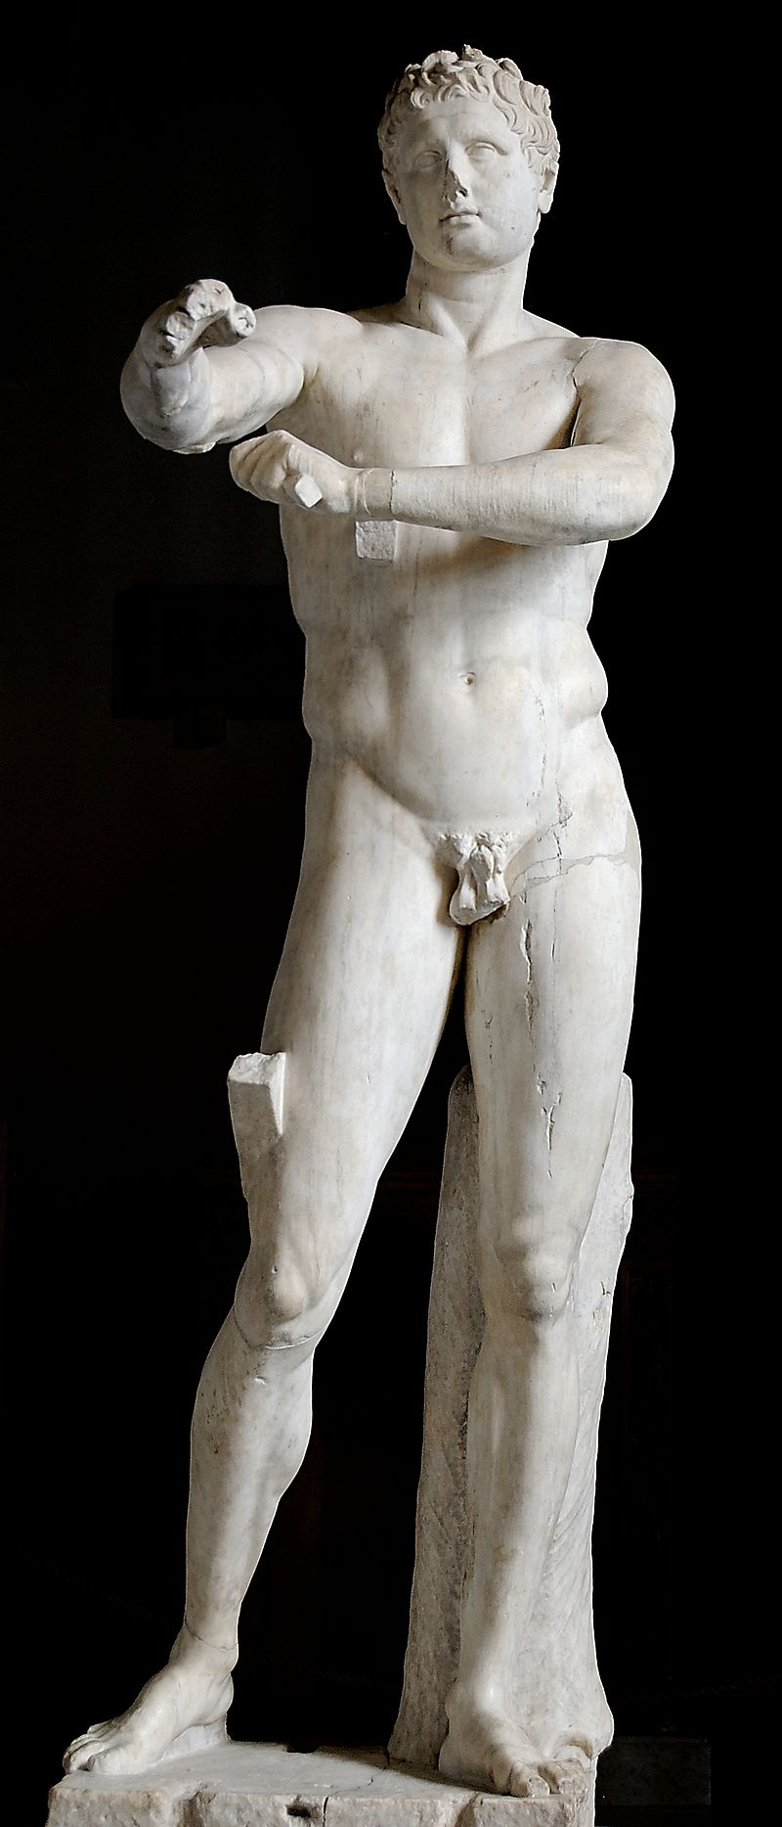
Apoxyomenos
Ideal male build
  Athletic
  Stoic
  Active
Nakedness: “The costume of the male citizen,” [Stewart. 1997. Pg.26].
  Less shocking
  Expected
Fig 4:
Lyssipus, c.330BCE, The Vatican Apoxyomenos, Roman, marble, copy, 2.05 meters tall. Resides in the Museo Pio-Clementino, Vatican City, donated 1849. Accessed 04/11/2020:
https://upload.wikimedia.org/wikipedia/commons/4/4d/Apoxyomenos_Pio-Clementino_Inv1185.jpg

Slide 6
Conclusion
View of the ancient with the understanding of the modern world:
  Application
  Understanding
  Norms
  Concluding
Understanding art:
  Contrapposto
  Composition
  Setting
  Story telling
  Goddesses and their contexts

Slide 7
Bibliography
Beard, M., & Henderson, J., 2001. Classical art from Greece to Rome. Oxford: Oxford University Press.
Haynes, M., 2013. Framing a View of the Unviewable: Architecture, Aphrodite, and Erotic Looking in the Lucianic Erôtes. Helios, 40(1/2). Pp.71–96.
Havelock, C.M., 2007. The Aphrodite of Knidos and her successors: a historical review of the female nude in Greek art. University of Michigan Press.
Lee, M.M., 2015. Other "Ways of Seeing": Female Viewers of the Knidian Aphrodite. Helios, 42(1), pp.103–123.
Lesser, R.H., 2016. Beyond the Male Gaze: The Power of the Knidian Aphrodite in her Narrative Context. Paper presented in the Lambda Classical Caucus panel at the 147th Annual Meeting of the Society for Classical Studies, San Francisco, CA.
Macnab, T., 2009. The male gaze made marble: The Aphrodite of Knidos by the Ancient Greek Praxiteles. The Art Story Foundation.
Sassatelli, R., 2011. Interview with Laura Mulvey. Theory, culture & society, 28(5), pp.123–143.
Stewart, A., 1997. Art, Desire, and the Body in Ancient Greece. Cambridge: Cambridge University Press.
Ancient Sources
Anon, Knidian Aphrodite, c. 100-150AD.
Lyssipus, The Vatican Apoxyomenos, c.330BCE.
Paionios on Mende, Nike – Winged Victory, c.420BCE.
Pliny the Elder, The Natural History, John Bostock (trans.), 1855. London: Taylor and Francis. Perseus Tufts Digital Library:
http://www.perseus.tufts.edu/hopper/text?doc=Perseus:abo:phi,0978,001:36:4
Praxiteles, Knidian Aphrodite, c. 350BCE.

