Slide 1
Problem Solving and Decision Making
LCLM4004
SHUKRI GESEY
Student ID: 2540706
Lecturer: ANITA NAN
Assignment 1: Basil’s Bakery

Slide 2
OVERVIEW
Introduction
Company background
Problem: nature and scope
PESTLE analysis
Cause and effect: Fishbone diagram
Conclusion
References

Slide 3
Introduction
This presentation looks at why Basil’s Bakery sales have fallen.
PESTLE looks at outside factors affecting a business.
A fishbone diagram helps us explore possible causes of a problem.
Method: Kumah et al. (2024); Per Dannemand (2026)

Slide 4

Company background
Basil’s Bakery
• Started in 2015 in Coventry, UK
• An independent bakery
• Sells bread, cakes and pastries
• Uses quality organic ingredients
• Sales fell during COVID-19
Source: Basil’s Bakery assignment case study

Slide 5
Problem: nature and scope
5W2H
What? Sales are around 25% below 2019 levels.
Who? The bakery, its staff and customers.
Where? Coventry, UK.
When? Sales fell in 2020 and stayed low in 2023–2025.
Why? Fewer visitors and changing work habits.
How? Fewer customers and limited ordering options.
How much? About 25% lower than 2019.
Source: Basil’s Bakery assignment case study

Slide 6
PESTLE ANALYSIS: Basil’s Bakery
POLITICAL
• Government business support
• Changes in government policies
ECONOMIC
• Rising ingredient and running costs
• Customers spending less
SOCIAL
• More people working from home
• Fewer people visiting retail parks
Sources: Clark (2025); Basil’s Bakery case study

Slide 7
PESTLE ANALYSIS: Basil’s Bakery
TECHNOLOGICAL
• No simple online ordering system
• Social media could reach more customers
LEGAL
• Food safety rules must be followed
• Employment and business regulations apply
ENVIRONMENTAL
• Poor harvests can raise ingredient costs
• Packaging and food waste need attention
Sources: Nguyen et al. (2024); Basil’s Bakery case study

Slide 8
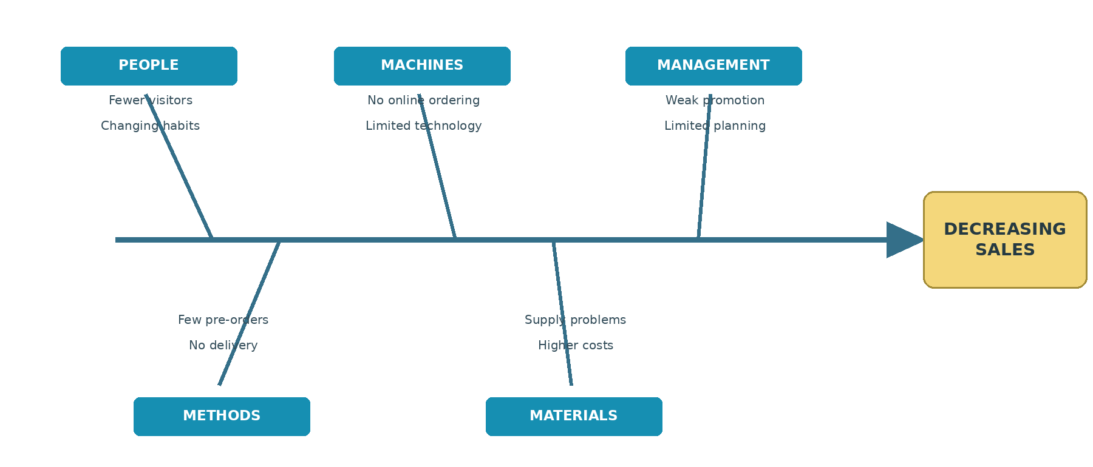
Cause and effect analysis (Fishbone diagram)
Possible causes identified from the case study; diagram drawn for this assignment.
Method: Kumah et al. (2024)

Slide 9
Conclusion
• Basil’s Bakery sales have not fully recovered.
• Fewer visitors, rising costs and limited ordering options may be affecting sales.
• The fishbone diagram shows possible causes.
• The bakery could try simple pre-orders and promote its products online.
Source: Basil’s Bakery case study; Kumah et al. (2024)

Slide 10
References
Chen, S. and Ren, G. (2025). The impact of exogenous shocks on the sustainability of supply chain relationships. Sustainability, 17(7), 2828.
Clark, D. (2025). Inflation rate for the consumer price index in the United Kingdom. Statista. https://www.statista.com/statistics/306648/inflation-rate-consumer-price-index-cpi-united-kingdom-uk/
Kumah, A. et al. (2024). Cause-and-effect (Fishbone) diagram: A tool for generating and organizing quality improvement ideas. Innovations Journals, 7(2), 85–87.
Nguyen, M. Van, Thuc, Le D. and Nguyen, T.T. (2024). PESTEL analysis of corporate social responsibility performance in construction organizations. Engineering Construction & Architectural Management.
Per Dannemand, A. (2026). The PESTEL framework and its variants for analysing the strategic environment. Futures, 184, 103914.
Shuaibu, A.S., Mahmoud, A.S. and Sheltami, T.R. (2025). A review of last-mile delivery optimization. Drones, 9(3), 158.
Basil’s Bakery case study (course assignment material, n.d.).

Slide 11

Questions

