Slide 1
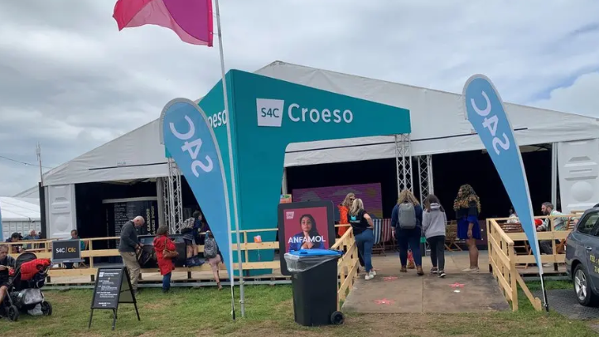
S4C
How has it impacted the role of the Welsh language in education?
Sarah Roberts-Ogleby (2204676)
(BBC News, 2023)

Slide 2
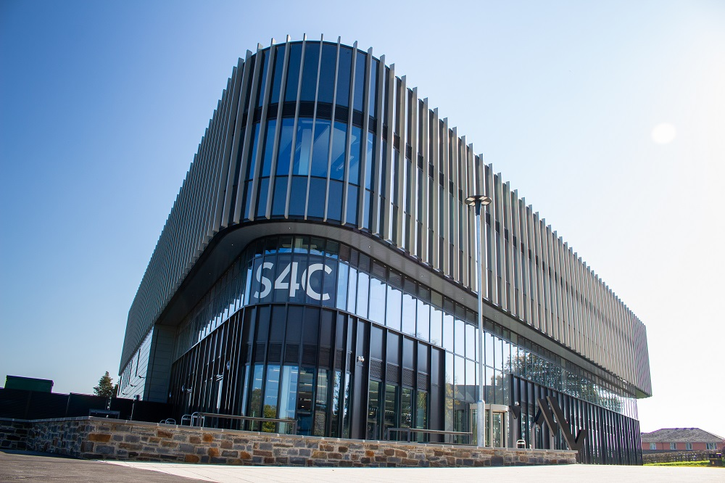

What is S4C?
Welsh Language Television Channel
Language
Culture
Economy
(Jones and Jones, 2017; National Assembly for Wales, 2017; S4C, 2022a; S4C 2024; Tibbetts, 2011)

Slide 3

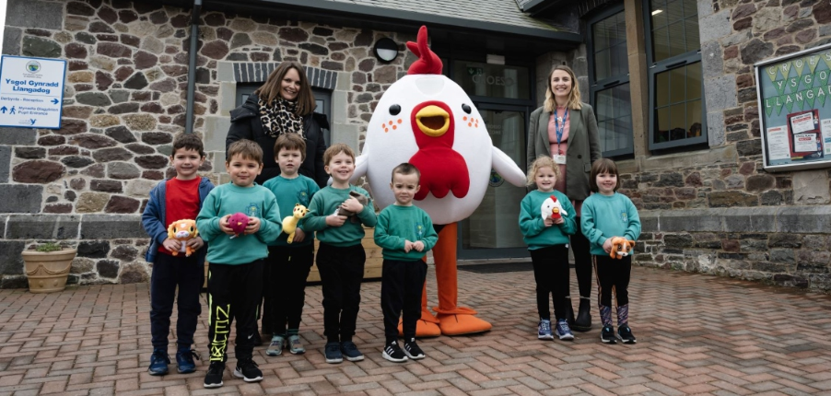
Language Preservation
Accessibilty
Cymraeg 2050
National Curriculum
(Garrett, 2010; LingoDigest, 2024; S4C, 2022b; S4C, 2023; S4C, 2025a; S4C, 2025b; Trudgill, 2000)

Slide 4

Cultural Representation
"S4C’s service ensures choice and diversity of emphasis, and by commissioning content from a wide range of independent production companies, harnesses a breadth of perspectives and visions."
(BBC News, 2023; Jones and Jones, 2017; S4C, 2022c; S4C, 2023; Trudgill, 2000)

Slide 5
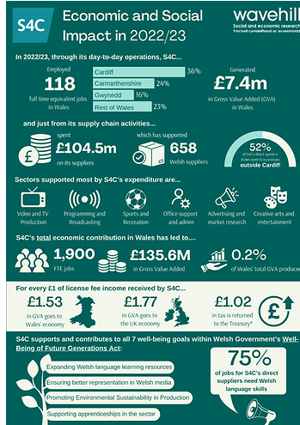

Social Impact
(Maher, 2024; S4C, 2022c)

Slide 6
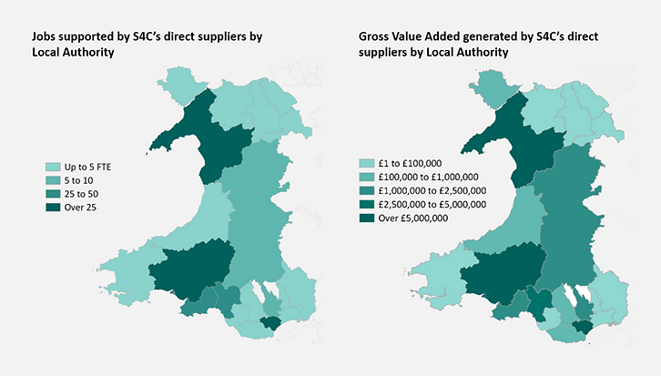
Economic Impact
(Linden, 2024; Maher, 2024, S4C, 2022c)

Slide 7


Educational Content
(Jones and Jones, 2017; Mayer, 2024; Nation.Cymru, 2021; S4C, 2022b; S4C, 2022c; S4C, 2025a)

Slide 8

Problems and Criticisms
"S4C 'won't apologise' for more English on Welsh channel...​"
“S4C does not respond well to constructive criticisms.”
(BBC News, 2023; Jones and Jones, 2017; Laughton, 2004; National Assembly for Wales, 2017)

Slide 9
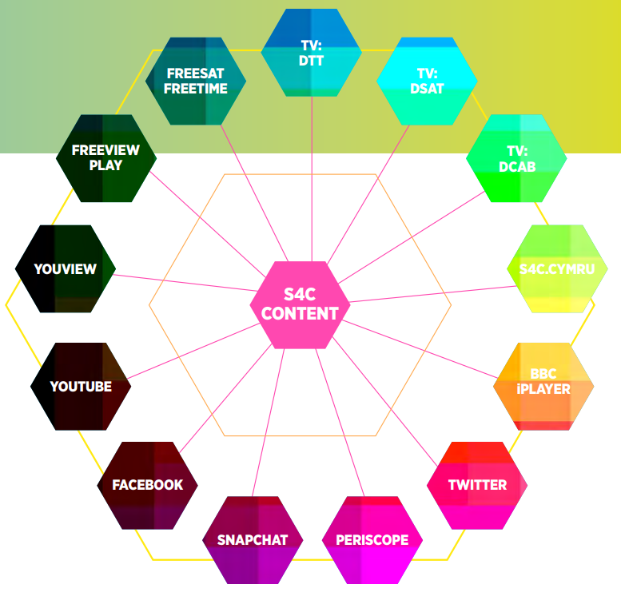
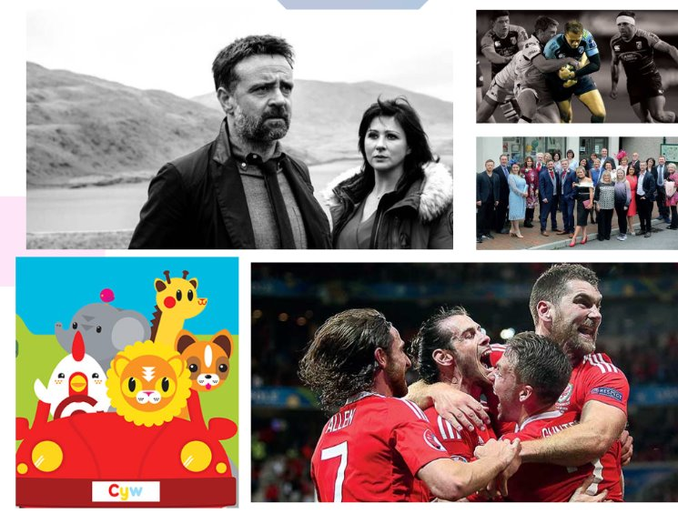
Summary
(BBC News, 2023; Cummins, 1979; Garrett, 2010; Jones and Jones, 2017; Jones, 2024; S4C, 2022b; S4C; 2023; S4C 2025a)

Slide 10
References
BBC News (2023) S4C 'won't apologise' for more English on Welsh channel. Available at: https://www.bbc.co.uk/news/uk-wales-66447811 (Accessed: 7th January 2025).
Garrett, P. (2010) Attitudes to Language Cambridge: Cambridge University Press, pp. 7–177.
Jones, H. and Jones, I. (2017) S4C: PUSHING THE BOUNDARIES. Available at: https://www.s4c.cymru/gwthiorffiniau/pdf/S4C-Review.pdf (Accessed: 7th January 2024).
Jones, M. (2024) The Welsh Government must focus more on language attitudes. Available at: https://nation.cymru/opinion/the-welsh-government-must-focus-more-on-language-attitudes/ (Accessed: 2nd January 2025).
Laughton, R. (2004) S4C: An Independent Review. Available at: https://www.s4c.cymru/abouts4c/authority/pdf/e_adolygiad_laughton.pdf (Accessed: 7th January 2024).
Linden, S. (2024) S4C’s economic and social impact on Wales. Available at: https://www.atvtoday.co.uk/236486-s4c/ (Accessed: 11th January 2025).
Maher, R. (2024) Measuring impact in the creative sector: economic, social and cultural contributions in Wales. Available at: https://www.wavehill.com/single-post/measuring-impact-in-the-creative-sector-economic-social-and-cultural-contributions-in-wales (Accessed: 11th January 2025).
Nation.Cymru (2021) S4C extreme science series features on children’s education website. Available at: https://nation.cymru/news/s4c-extreme-science-series-features-on-childrens-education-website/ (Accessed: 7th January 2025).
National Assembly for Wales (2017) Culture, Welsh Language and Communications Committee Outside the Box The Future of S4C. Available at: https://senedd.wales/media/s2ro4ttb/cr-ld11157-e.pdf (Accessed: 7th January 2025).
S4C (2025a) Dysgu Cymraeg. Available at: https://www.s4c.cymru/en/dysgu-cymraeg/page/56808/where-should-i-start/ (Accessed: 7th January 2025).
S4C (2025b) Introducing S4C. Available at: .https://www.s4c.cymru/en/about-us/introducing-s4c/page/57262/s4c-and-its-viewers/ (Accessed: 7th January 2025).
S4C (2024) 1,900 jobs and £136m generated by S4C. Available at: https://www.s4c.cymru/en/press/post/59942/1900-jobs-and-136m-generated-by-s4c/#:~:text=A%20new%20report%20states%20that,136m%20for%20the%20Welsh%20economy. (Accessed: 9th January 2025).
S4C (2023) A million Welsh speakers: Launching a Memorandum of Understanding between S4C and the Welsh Government. Available at: https://www.s4c.cymru/en/press/post/54395/a-million-welsh-speakers-launching-a-memorandum-of-understanding-between-s4c-and-the-welsh-governmen/ (Accessed: 9th January 2025).
S4C (2022a) Press - S4C announces a creative refresh for its Commissioning team. Available at: https://www.s4c.cymru/en/press/post/52710/s4c-announces-a-creative-refresh-for-its-commissioning-team/ (Accessed: 7th January 2025).
S4C (2022b) S4C and Carmarthenshire County Council launch new Welsh language scheme in schools. Available at: https://www.s4c.cymru/en/press/post/48558/s4c-and-carmarthenshire-county-council-launch-new-welsh-language-scheme-in-schools/ (Accessed: 11th January 2025).
S4C (2022c) S4C’s Contribution to Society and the Economy. Available at: https://adroddiad.s4c.cymru/en/s4cs-contribution-to-society/ (Accessed: 11th January 2025).
Tibbetts, T. (2011) Welsh Icon Set stock illustration. Available at: https://www.istockphoto.com/vector/welsh-icon-set-gm165794667-17920864 (Accessed: 7th January 2025).
Trudgill, P. (2000) Sociolinguistics - An introduction to language and society. Fourth edn. London: Penguin, pp. 119–127.

