Slide 1

Learning in the Digital Era- BMPL4007
Sadie France
s.france@uwtsd.ac.uk
Week 5

Slide 2

Aims for today's session
PDP- Personal Development Plan
How to submit your assignment to TurnItIn
10am-1pm- Draft sessions

Slide 3
Part 5 of the assignment......
2.​ | Produce a Personal Development Plan (PDP) using the template provided, to outline how you intend to address the gaps in your skills which you identified in your reflection, and how these will contribute to your future aspirations. The plan should be in the region of 750 words, and you should reference appropriate sources to support your work. Your plan should demonstrate the application of SMART objectives to the development goals you set.​

Slide 4

Benefits to a PDP
Provides you with clear goals.
Helps you to identify your strengths and weaknesses.
Improves your employability.
Improves your performance.
Increases your motivation.
Helps track your progress.
Improves your sense of purpose.
Enhances your mental wellbeing and reduces stress.

Slide 5
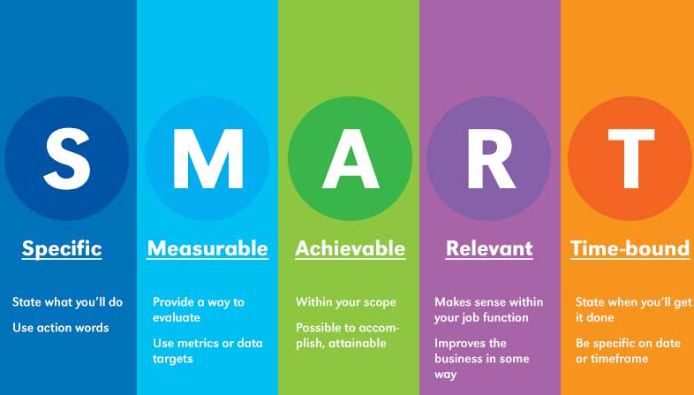

Slide 6
Example of SMART
SMART goal for running a marathon
Specific: I’d like to start training every day to run a marathon.
Measurable: I will use my Apple Watch to track my training progress as my mileage increases.
Attainable: I’ve already run a half-marathon this year, so I have a solid base-fitness level.
Relevant: I value my health and wellness, and this goal will help me sustain that.
Time-bound: The marathon is a year away, so I need to be ready by then.
(Wool, 2022)

Slide 7
Example of SMART
SMART goal for writing a book
Specific: I’d like to write a novel.
Measurable: I want to write at least 2,000 words a day for three months.
Attainable: I’m retired now, so I have more time to dedicate to this project.
Relevant: Reading and writing have always been a passion of mine.
Time-bound: I’ll start writing in the first week of July and finish my first draft by December.
(Wool, 2022)

Slide 8
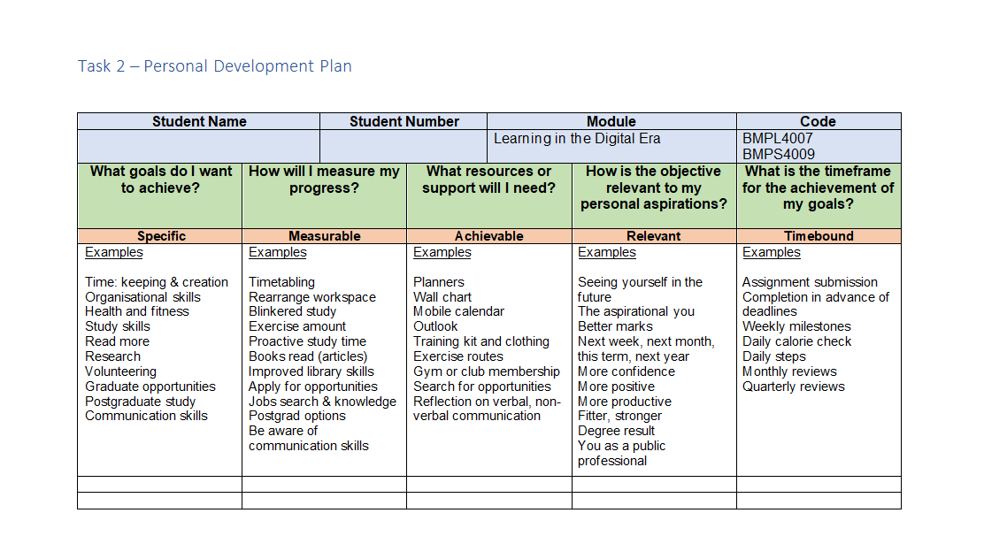
PPD (Personal Development Plan)

Slide 9
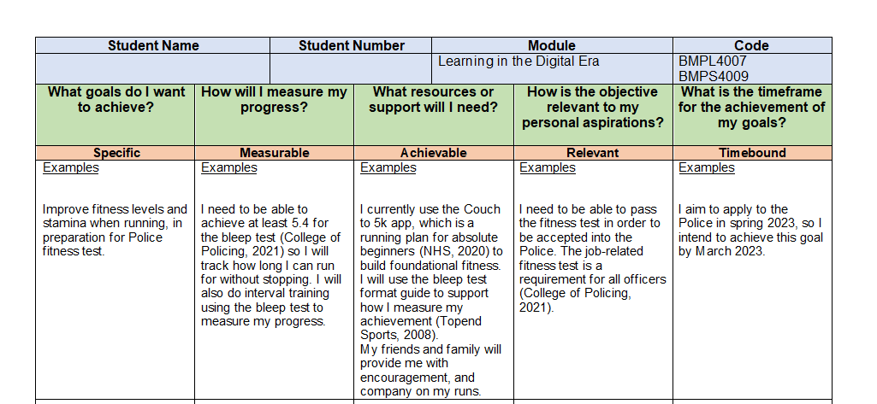

Slide 10

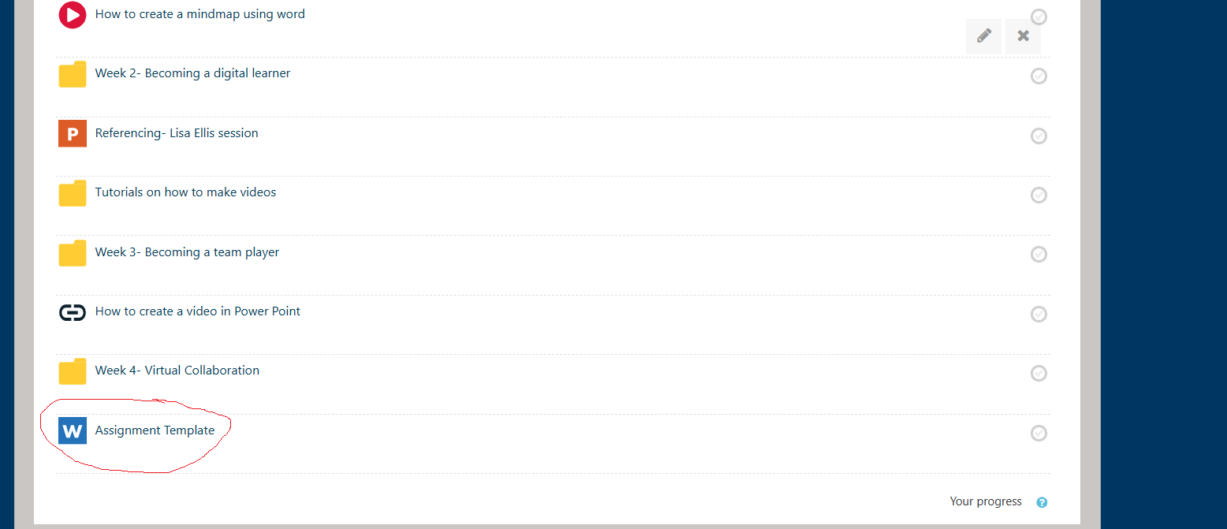
Template
The template for your assignment is on Moodle:-

Slide 11
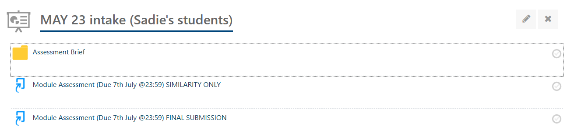
How to submit your assignment to TurnItIn

Slide 12
Please remember....
Your assignment is due on the 7th JULY 2023 :23:59pm
Failure to meet this deadline will result in you being capped at 40% if up to 7 days late
If more than 7 days late, your paper will not be marked and therefore will be graded as 0!!!
Please email me if you have any questions or concerns

Slide 13

Any questions?

