Slide 1
Archaeological Specialist apprenticeship
MA Archaeological Practice
Catch up session 26/7/23

Slide 2
Development of professional practice

Slide 3
KSB
“know the limits of their own understanding, abilities and responsibilities, how to practice within them, and when and how to seek expert assistance” (B2)

Slide 4
CBA Council for British Archaeology
Founded 1944
Umbrella organisation for societies
Expert advice on planning
Direct membership
YAC
Research Reports
Practical Handbooks

Slide 5
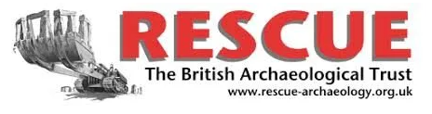
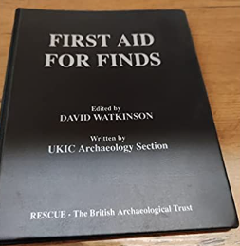
RESCUE
Founded 1971
Campaigning role
Rescue News

Slide 6

CIfA
Founded 1984
Code of conduct
Grades of membership
Entry criteria (Competence)
Standards and Guidance 1992
Disciplinary procedure
Register of Archaeological Organisations
Annual conference
Special Interest Groups / Area Groups
Job Information Service
Opportunities to serve

Slide 7


BAJR
Run by David Connolly and others
Fieldwork focus
BAJR Guides
Forum / Facebook group
Job ads

Slide 8

ALGAO
Curators /HERs
England/ Wales/ Scotland
Non-political
Provides guidance on curatorial practice
Model briefs

Slide 9
Other bodies
AEA Association of Environmental Archaeologists
BABAO British Association for Biological Anthropology and Osteoarchaeology
SGRP Study Group for Roman Pottery
Medieval Pottery Research Group
Nautical Archaeology Society
Period societies

Slide 10
Professional practice in practice
Code of conduct
Explicit methodology documented in advance
In line with current best practice/guidance
Data created and archived
Reported and disseminated
Does not exceed area of competence
“know the limits of their own understanding, abilities and responsibilities, how to practice within them, and when and how to seek expert assistance” (B2)

