Slide 1

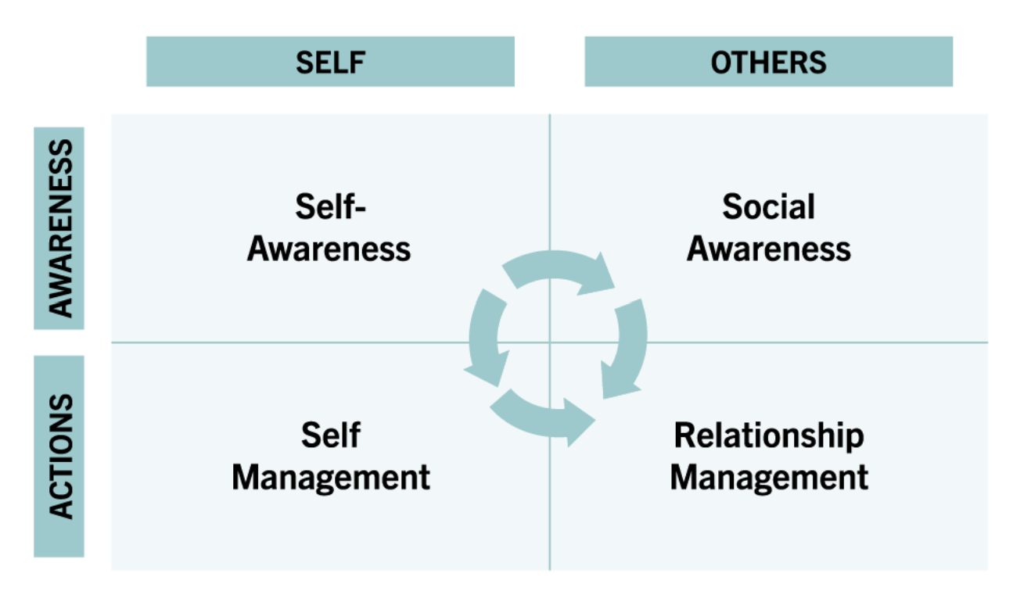
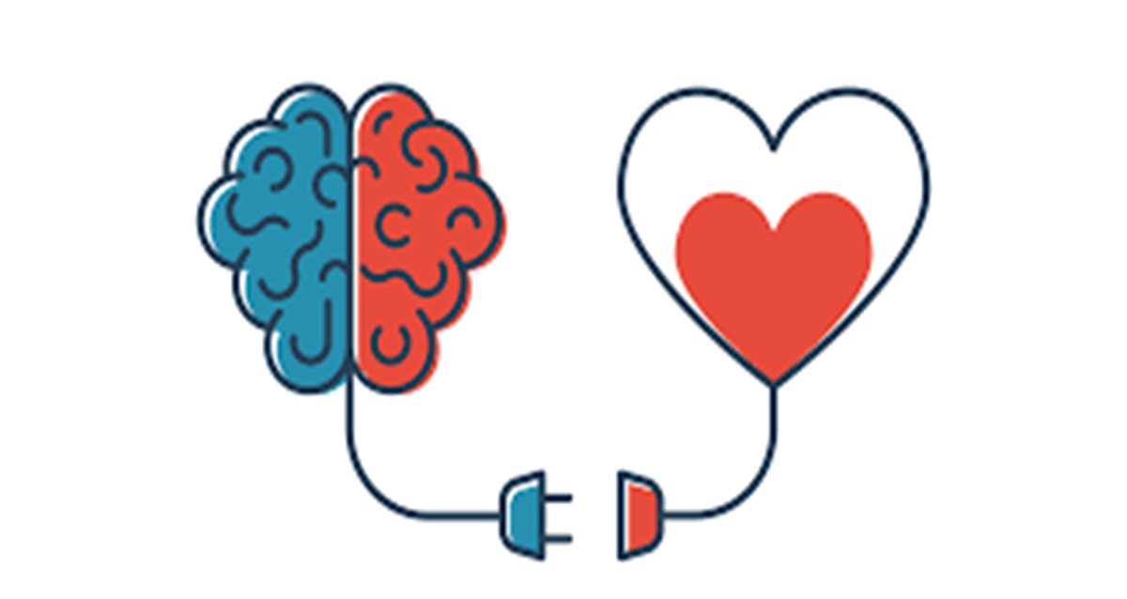
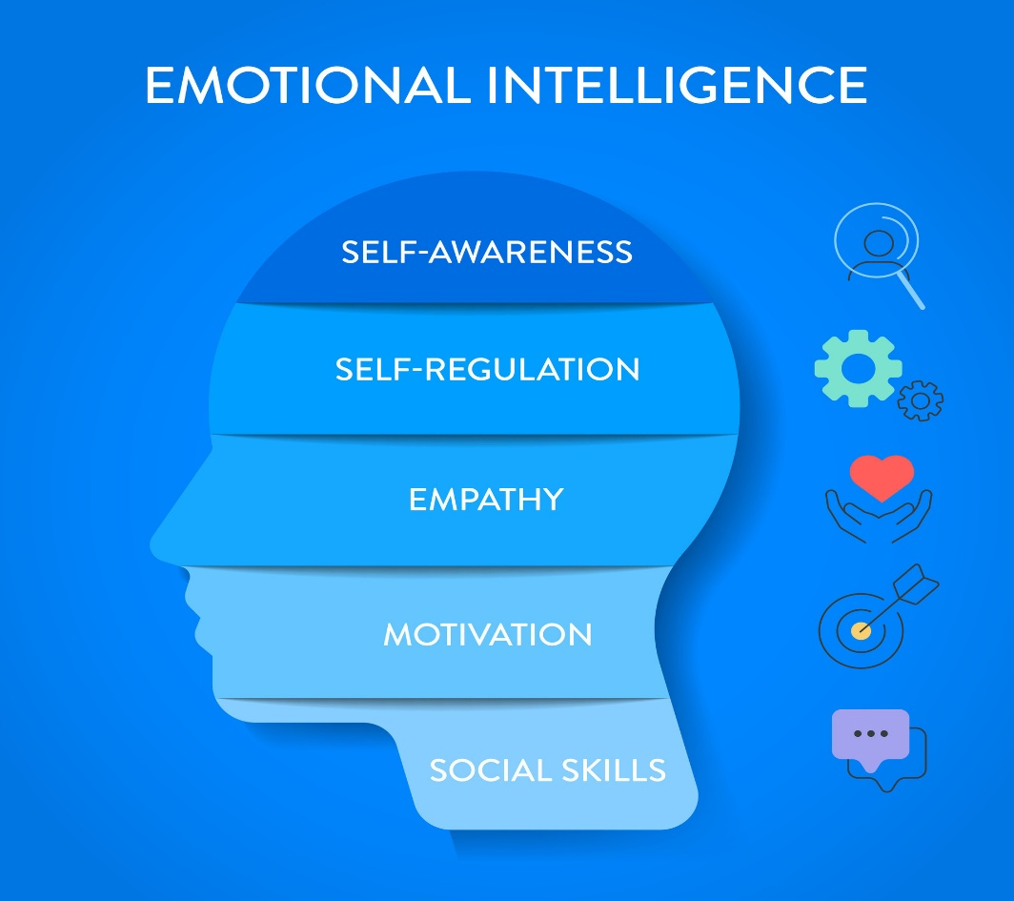
Emotional Intelligence in Action: Cultivating Self-Awareness and Mindfulness for Academic Success
LCLM: Developing Emotional Intelligence Skills
Student Name: Laurentiu Lisman Student Number: 2322353
Methods
Managing Emotions and Mindfulness as a Student
Actions to Manage EI Challenges
"If you are tuned out of your own emotions, you will be poor at reading them in other people."
— Daniel Goleman
Conducted a review of literature on emotional intelligence, including Daniel Goleman’s framework.
Data from high-quality academic sources.
Theory: Daniel Goleman’s Emotional Intelligence Framework (Landry, 2020).
Used reflection to apply theory to practice and identify steps for improving emotional awareness.
As a student, I have faced EI challenges such as stress and overload from academic tasks:
Encourage Empathy: I make an effort to see things from other people’s perspectives and be patient when they share their feelings
Use Support System: Using friends and family members as a support system helps reduce stress.
Coping strategies such as breathing and journaling also help.
Knowing and identifying your emotional patterns: In my experience, I find it easy to manage my emotions when I am tracking my feelings and triggers.
Use Mindful Study Techniques: Emotions play a role in how well we can study. In my experience, breaking down tasks into small parts helps.
Mindfulness meditation: Mindfulness meditation, 15 minutes a day, helps me stay calm and composed..
Developing empathy: I have found that caring for other people’s emotions helps in understanding our emotions better.
Developing Emotional Intelligence
Conclusion
Introduction
Enhance Self-Awareness: Tracking feelings and emotions in different situations can help build control over emotions (Landry, 2020).
Self Management: Being aware of and having control over emotions in all situations is an important part of emotional intelligence (Safarli, 2021).
Social awareness: Interact with others and learn to sense their emotions and react accordingly.
Relationship Management: Learn to manage relationships with others effectively. Improve ability to influence others and manage conflicts. This is an important part of emotional intelligence (Landry, 2020).
Practice Mindfulness: There is a positive relationship between mindfulness and emotional intelligence (Jiménez-Picón et al., 2021).
Understanding our own emotions helps us connect better with others. Emotional intelligence can be improved through awareness and daily practice.. Mindfulness helps manage stress and maintain focus while studying. Developing EI leads to better relationships, motivation, and academic success.
Emotional Intelligence is the concept of understanding other people and their emotions in a social context. It involves controlling and regulating emotions (Maldonado & Márquez, 2023).
Emotional intelligence plays a key role in academic life, influencing how we manage stress, relationships, and performance. In light of Goleman’s Emotional Intelligence Framework, this assignment explores how emotional intelligence can be developed, how mindfulness helps regulate emotions, and why both are essential.
Factors for Academic Success
Emotional awareness helps us manage our emotions and stay focused (Parker et al., 2004).
Motivation and Discipline are important for staying committed to our academic goals.
Effective Communication: We need to build positive interactions with peers and lecturers.
References
Jiménez-Picón, N., Romero-Martín, M., Ponce-Blandón, J.A., Ramirez-Baena, L., Palomo-Lara, J.C. and Gómez-Salgado, J. (2021) ‘The relationship between mindfulness and emotional intelligence as a protective factor for healthcare professionals: Systematic review’, International Journal of Environmental Research and Public Health, 18(10), pp. 1–14. Available at: https://doi.org/10.3390/ijerph18105491.
Landry, L. (2020) ‘Why emotional intelligence is important in leadership’, Harvard Business School Online. Available at: https://online.hbs.edu/blog/post/emotional-intelligence-in-leadership.
Maldonado, I.C. and Márquez, M.-D.B. (2023) ‘Emotional intelligence, leadership, and work teams: A hybrid literature review’, Heliyon, 9(10), pp. 1–19. Available at: https://doi.org/10.1016/j.heliyon.2023.e20356.
Parker, J.D.A., Summerfeldt, L.J., Hogan, M.J. and Majeski, S.A. (2004) ‘Emotional intelligence and academic success: Examining the transition from high school to university’, Personality and Individual Differences, 36(1), pp. 163–172. Available at: https://doi.org/10.1016/s0191-8869(03)00076-x.
Safarli, E. (2021) ‘The importance of emotional intelligence in interpersonal relationships: A study on pilots in the context of Daniel Goleman’s emotional intelligence model’, International Journal of Business and Economic Studies, 3, pp. [insert page numbers if available]. Available at: https://doi.org/10.54821/uiecd.931546.

