Slide 1
Develop martial arts to engage 7–11-year-olds in physical activity
By Sharnelle Saint

Slide 2
Location
By looking at all different schools with different types of sports facilities I have decided to choose Ysgol Bae Baglan.
I have chosen this school as it offers the best sporting facilities within the area, I was looking in which was Neath Port Talbot.
I chose this one as they have a multipurpose sports hall which I would be able to use to carry out my sports development to engage children ages 7- 11.

Slide 3
Research based of martial arts
Based on the school sports survey for Wales martial arts is one of the least popular sports within schools.
From the location I have chosen, a main idea come to mind as this specific school have the facilities and are able to ahold martial arts in the sports hall they have on site. The location I have chosen is Ysgol Bae Baglan.
Looking at the school sport survey I looked at the participation levels and martial arts was one of the lowest sports that is being taken up in the sports community by students.

Slide 4
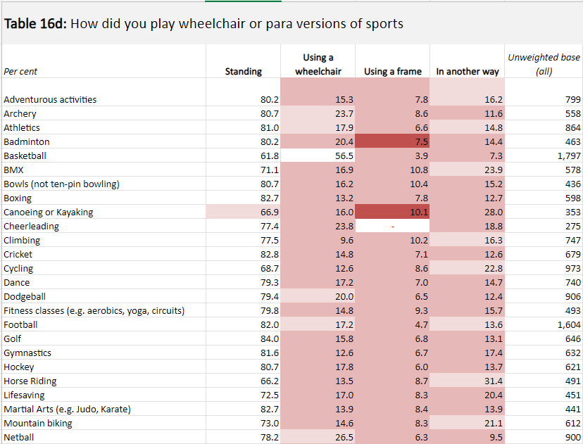
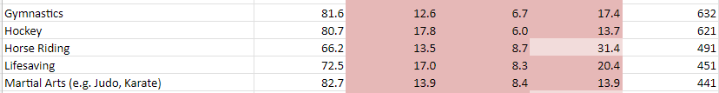
This is the excel spread sheet of the different participations in different sports with different abilities.

Slide 5
Ideas for engaging 7–11-year-olds
To get the children to engage in the activities I will lower the time with each activities so that they do not get bored as quickly.
Between each activity I will make sure that I switch each drill between physical and technical as it will keep the children's attention on what they should be doing instead of them losing focus and distracting others.
I will have the children doing drills that they do not have to line up for otherwise they will get bored of just standing around and I will get them to be moving as much as they can during the session so that they do not get bored sitting around or standing around doing nothing between activities.

Slide 6
Potential funding/partners
I will partner up with martial arts school in Wales, for funding I will be using Be Active Wales Fund to help with my martial arts funding for each session.
By using Be Active Wales Fund the minimum award is
£300 and the maximum award is £50,000. This is the most updated website for the funding last updated 2024 by Sports Wales.
Furthermore, Be Active Wales Funding say in their website they will buy equipment that ables more people to join in sport to help develop this session and make it safer for the children that participate.

Slide 7
Promotion
The way I would promote my sessions to the children would be to make posters and flyers and put them up around the local areas such as: schools, shops, local leisure centers and street posts. By doing this I will get the children's and parents' attention and they will find out all the information on there.
Another suggestion would be to create social media profiles targeting parents and teachers so they can then suggest the sessions to the children, this way they will be able to see more of what the sessions are going to bring for the children and what is in store during the session.

Slide 8
Key recommendations
When the children come to the sessions, they will learn new skills and they will have a good time meeting new people and making new friends, which they may want to proceed to do the sport after they have come to my session and join a club.
These sessions give them opportunities in life and opens their sporting career to help them gain skills and confidence for if they want to join a team after this session.
For my session to be successful I will make sure that the children have fun and enjoy themselves so that they would want to join a club and carry out this sport, as it could help with mental health further down the line if they do struggle with mental health as they get older.

Slide 9
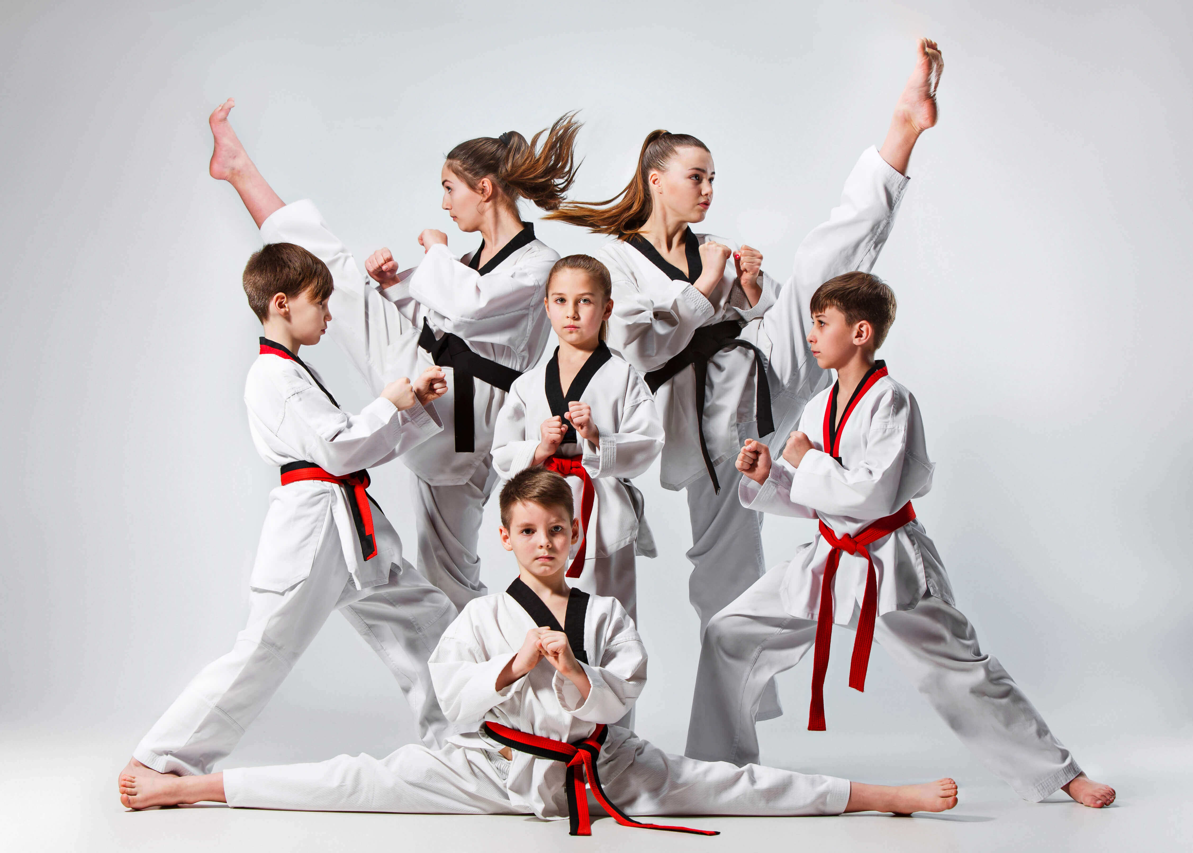
Thank you for listening

