Slide 1

Choosing the right diet for you
By Jon Playsted

Slide 2


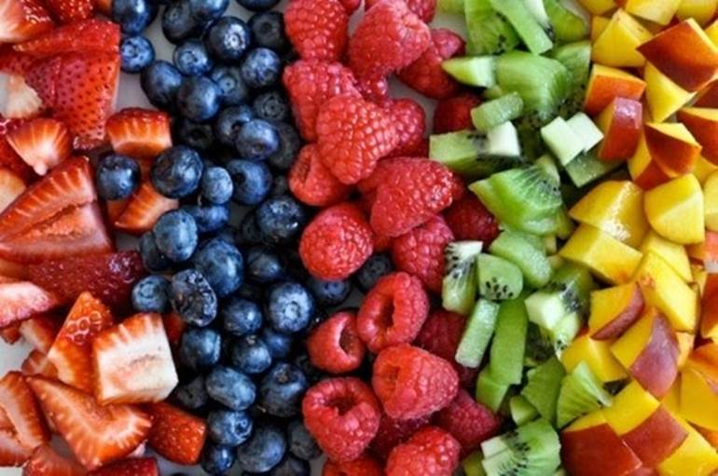


Covid-19 and the Diet Industry

Slide 3
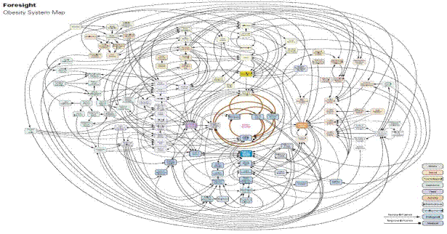
UK government’s obesity map

Slide 4
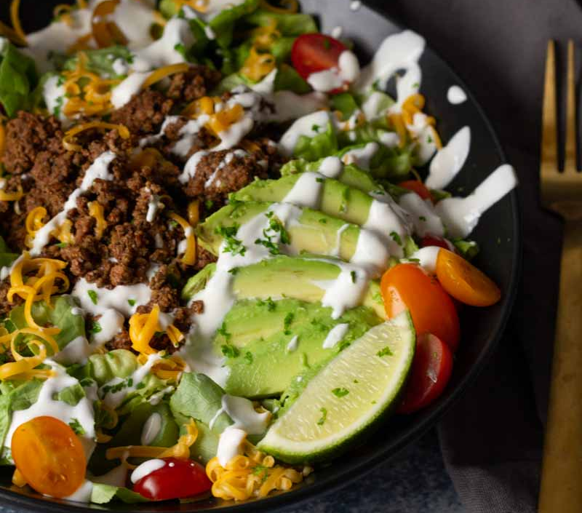
Keto diet

Slide 5
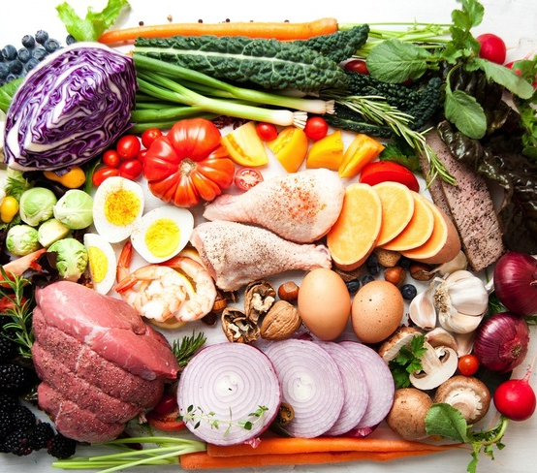
Paleo diet

Slide 6

Intermittent fasting

Slide 7
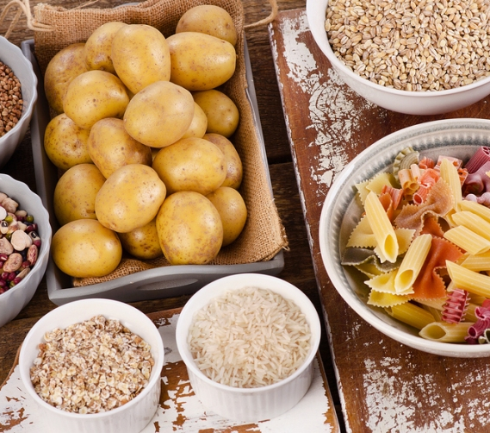
Low-fat diet

Slide 8

Weight Watchers diet

Slide 9
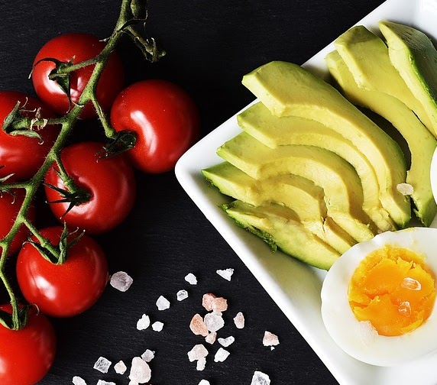
Sugar Free Diet

Slide 10

Whole 30

Slide 11

Warrior diet

Slide 12
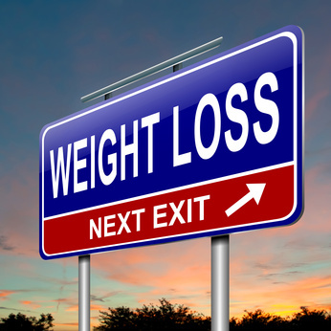
Calorie deficit

Slide 13
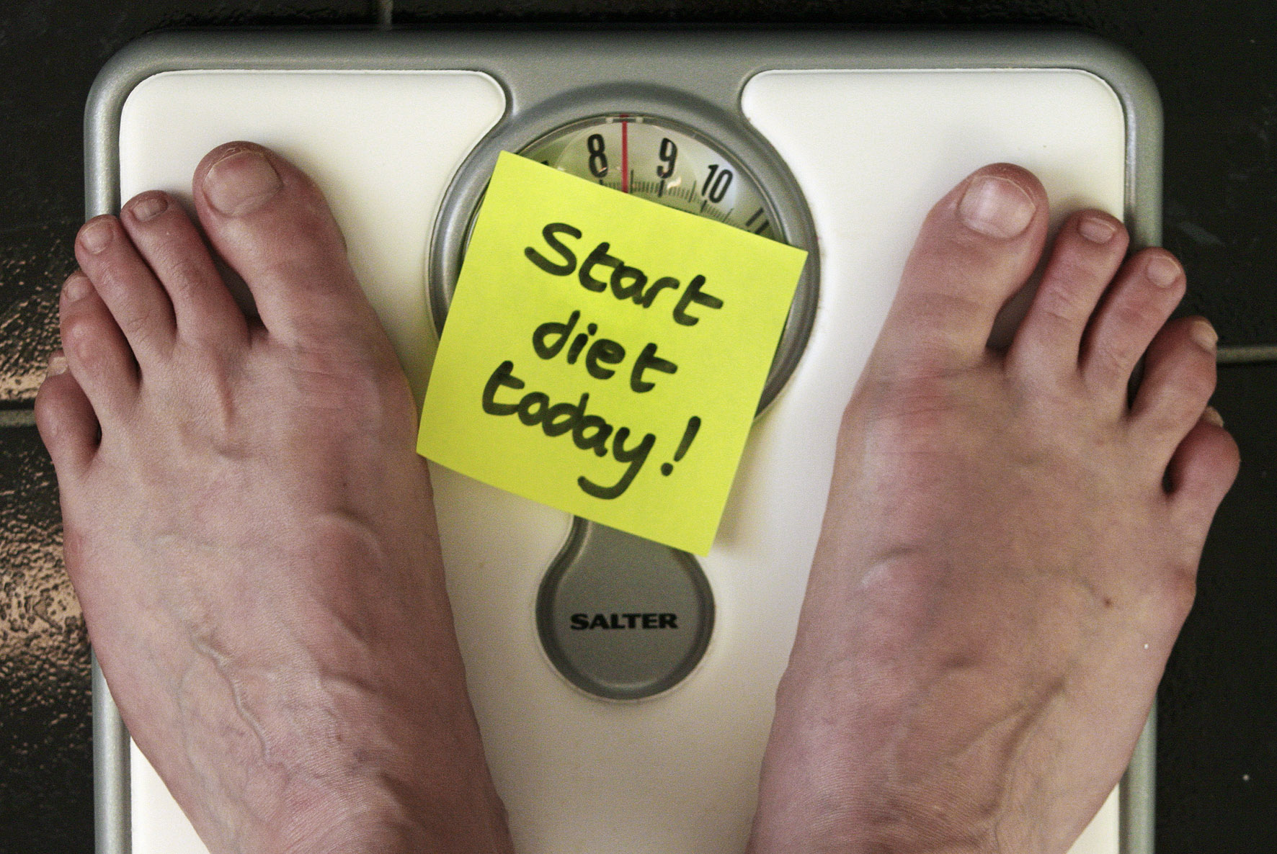



Goals and adherence

Slide 14
conclusion
1. Establish Goals
2. Provide the Tools for Adherence
3. Save Money

Slide 15
Introduction references
Assets.publishing.service.gov.uk. 2022. [online] Available at: <https://assets.publishing.service.gov.uk/government/uploads/system/uploads/attachment_data/file/296290/obesity-map-full-hi-res.pdf> [Accessed 8 January 2022].
Bhf.org.uk. 2022. 4 reasons why you shouldn't follow the latest diet. [online] Available at: <https://www.bhf.org.uk/informationsupport/heart-matters-magazine/news/food-trends-2016/do-not-follow-food-trends> [Accessed 8 January 2022].
Grandviewresearch.com. 2022. Fitness App Market Size, Share & Growth Report, 2021 - 2028. [online] Available at: <https://www.grandviewresearch.com/industry-analysis/fitness-app-market> [Accessed 8 January 2022].
Morris, M.A., Wilkins, E., Timmins, K.A., Bryant, M., Birkin, M. and Griffiths, C., 2018. Can big data solve a big problem? Reporting the obesity data landscape in line with the Foresight obesity system map. International Journal of Obesity, 42(12), pp.1963-1976.
Nutraingredients.com. 2022. Vitamin market set to hit £500m but where are the new users?. [online] Available at: <https://www.nutraingredients.com/Article/2020/10/23/Vitamin-market-set-to-hit-500m-but-where-are-the-new-users> [Accessed 8 January 2022].

Slide 16
Goals references
Cullen, K.W., Baranowski, T.O.M. and Smith, S.P., 2001. Using goal setting as a strategy for dietary behaviour change. Journal of the American Dietetic Association, 101(5), pp.562-566.
Holtzman, B. and Ackerman, K.E., 2021. Recommendations and nutritional considerations for female athletes: health and performance. Sports Medicine, 51(1), pp.43-57.
Koliaki, C., Spinos, T., Spinou, Μ., Brinia, Μ.E., Mitsopoulou, D. and Katsilambros, N., 2018, September. Defining the optimal dietary approach for safe, effective and sustainable weight loss in overweight and obese adults. In Healthcare(Vol. 6, No. 3, p. 73). Multidisciplinary Digital Publishing Institute.
Lancha Jr, A.H., Sforzo, G.A. and Pereira-Lancha, L.O., 2018. Improving nutritional habits with no diet prescription: details of a nutritional coaching process. American journal of lifestyle medicine, 12(2), pp.160-165.
Morton, R.W., McGlory, C. and Phillips, S.M., 2015. Nutritional interventions to augment resistance training-induced skeletal muscle hypertrophy. Frontiers in physiology, 6, p.245.

Slide 17
Adherence references
Das, S.K., Gilhooly, C.H., Golden, J.K., Pittas, A.G., Fuss, P.J., Cheatham, R.A., Tyler, S., Tsay, M., McCrory, M.A., Lichtenstein, A.H. and Dallal, G.E., 2007. Long-term effects of 2 energy-restricted diets differing in glycemic load on dietary adherence, body composition, and metabolism in CALERIE: a 1-y randomized controlled trial. The American journal of clinical nutrition, 85(4), pp.1023-1030.
Lloyd, H.M., Paisley, C.M. and Mela, D.J., 1995. Barriers to the adoption of reduced-fat diets in a UK population. Journal of the American Dietetic Association, 95(3), pp.316-322.

