Slide 1
LME: Lecture-tutorials
Teaching online for Health reasons as mentioned via email.
The Lecture-tutorial will be on the Big-screens.
Attend the Lecture-tutorial on-campus as normal.
Ask questions out loud as normal in class or on the PC/laptop via MS-Teams chat or voice call.
  If you would like me to look at something during the Lecture-tutorial, send me the document/screenshot/snip via Teams chat.
Recommended: Bring headphones (wired 3.5mm jack) to use with the Lab PCs for 1-2-1 chat if needed or just message me.
Any student can have a 1-2-1 chat with me via text/voice on Teams if they are struggling with anything during the Lecture/tutorial.
Frequent F2F support sessions are also be provided on-campus: Next slide.

Slide 2
2026-2027: F2F support sessions on-campus
At the UWTSD Dylan Thomas Centre, SA1 Campus Swansea, SA1 1RR (located just behind Sainsbury’s) on the:
  Wed. 14th October 3.30pm-5pm
  Wed. 11th November 3.30pm-5pm
  Wed. 2nd December 3.30pm-5pm
  Wed. 10th February 3.30pm-5pm
  Wed. 10th March 3.30pm-5pm
  Wed. 21st April 3.30pm-5pm
Support also available online: Teams Link to join: https://teams.microsoft.com/meet/341777065848986?p=tB10bSLpKYRJRNdf39
Other Lecturers also available in other rooms: Moodle: SOAC Ask Anything Wednesdays

Slide 3
Demo & Student Activity:
MS-Teams test
Open MS-Teams
Select: Chat (Left side menu)
Search: James Williams
Type a Message: Say Hi ☺
If you are struggling with an activity, you can message me via chat and request a 1-2-1 voice chat whenever needed.
You can also ask each other and help and support each other.

Slide 4

Module introduction
Leadership, Management and Ethics (ACCA7044)

Slide 5
Introduction
This deck provides a gentle introduction to the module. And will cover:
Module overview
Module learning outcomes
The Assignment
Referencing method & academic writing (Int. students)
Introductory activity

Slide 6
Module: Leadership, Management and Ethics
Module Code | ACCA7044
Title | Leadership, Management and Ethics
Level | 7 (Post-graduate)
Credits | 10 credits. 1 semester. 2hrs pw.
Pre-Requisites | None (No previous knowledge required)

Slide 7
Module overview
As Post graduate students you will have an opportunity to move into a Leadership/Management position, if you want to.
You will be more qualified than other University graduates.
And able to apply for Higher positions with higher salaries.
The purpose of this module is to give you the essential knowledge and understanding required to become an effective & Contemporary 21st Century Leader & Manager.

Slide 8
Module Aim
To develop advanced understanding of leadership, management, and ethics in professional practice.

Slide 9
Module Learning Outcomes
Demonstrate a deep and systematic understanding of leadership, management, and ethics, enabling critical analysis of an Organisation;
Exhibit a commitment to continuing professional development, taking initiative and personal responsibility for growth in leadership, management, and ethics.

Slide 10
Module Assessment: 1 Assignment
Tutor Show:
Assignment location on Moodle
AI Guidance
Assignment tasks
Available to download from Moodle.

Slide 11
IEEE Referencing
The answer to each Assignment question should include supporting citations using the IEEE format
A ‘Reference list’ using the IEEE format should be placed at the end of the report (approx. 15 sources for the assignment, more if needed).
If you have not used the IEEE referencing method before, please refer to the Assignment & University’s handbook located here.
  There is also a supporting IEEE slide-deck on Moodle, you can also research online to discover other useful sources if unsure about how to use the IEEE referencing method.

Slide 12
Academic writing
The Assignment answers should make use of academic writing techniques such as summarising, synthesising & paraphrasing.
These techniques are taught and practiced at undergraduate level. They are summarised on the following slides as a refresher and in case you are not sure about them.
If you are unsure about these, please read the following slides and use the example sources below:
  How to Paraphrase | Step-by-Step Guide & Examples (scribbr.co.uk)
  How to Integrate Sources | Explanation & Examples (scribbr.co.uk)
  Synthesizing Sources | Examples & Synthesis Matrix (scribbr.com)
  AI Writing Tools | Definition, Uses & Implications (scribbr.com)

Slide 13
Bg. Academic Writing & Referencing
An essential academic writing skill is the ability to refer to the work of other authors and to express their opinions and findings in your own words.
Here are the 3 main methods of academic writing:
  Paraphrasing
  Synthesising
  Summarising
Each method is described on the following slide.

Slide 14
Bg. Academic Writing
Paraphrase: Paraphrasing is writing the ideas of another person in your own words. You do need to change the words and the structure but the meaning remains the same. It is writing the same information/idea in your own words while using references to refer to the original source of information to support your argument.
Synthesis: It is the skill of combining several sources and ideas into one text paragraph and citing the information from several sources to support and idea or compare ideas.
Summarise: is to make the text shorter, while citing the original source of information. A summary is a brief description of an idea, theory or text.
For further information please click-here.

Slide 15
Bg. Academic Writing: Direct quotes
You can also use “Direct quotes” i.e. placing the exact words of others in quotation marks “like so”.
Direct quotes should be used sporadically and not frequently in your assessments.
EXAMPLE: Cybersecurity is becoming increasingly important as organisations store more sensitive information. According to Jones, “cybersecurity is essential for protecting computer systems, networks and data from unauthorised access and attack” [1, p. 42]. This highlights the importance of implementing appropriate security measures to protect their systems and data.
IEEE Reference List:
[1] A. Jones, Introduction to Cybersecurity. London, U.K.: Tech Publishing, 2025.

Slide 16
Bg. Plagiarism
Referencing is acknowledging where you acquired the information, ideas, opinions, stats, images, code etc. from, and referencing them in your assignments.
Plagiarism is presenting the words, ideas, views, images, code etc.. of others as your own. This is ‘academic misconduct’ and students are penalised for this. It can even cost you your degree/HE course.
Plagiarism is taking someone else's work and passing it off as your own.
Penalties: The penalty depends on the severity of the plagiarism/academic misconduct. A 1st offence particularly would likely be a formal warning and an assessment penalty or 0 & resit. Further offences are treated more harshly and can include being expelled from the course or form the University.
Bg. Further information: * University Misconduct policy, * Library Infoskill Moodle Unit courses, * SU Referencing and misconduct

Slide 17
Bg. Third-person tense
Most of your University assessments will ask and expect you to write reports and complete assessments in 3rd person tense.
Use 3rd person tense when answering the LME Assignment tasks.
Third-person tense is important in Academic & Professional reports because:
Objectivity and professionalism: Writing in 3rd person tense removes personal bias and creates a neutral tone, which is essential for presenting research and technical information credibly.
Clarity and focus: Using third person emphasises the subject matter rather than the author, making the report content more focused on the research, facts and findings.

Slide 18
Location: Learning resources
Tutor Show:
Location of ‘Learning & Teaching resources’ on Moodle.
Available to download from Moodle.

Slide 19
Study Time allocation
Study time for the module includes:
Activity type | Hours | Percentage
Scheduled learning | 24 | 24%
Independent learning | 76 | 76%
Placement learning | 0 | 0%
TOTAL | 100 | 100%
There will be some time in the Lecture/tutorials for you to work on Activities related to the Assignment. But you will need to schedule additional private time to work independently to complete the assignment tasks.

Slide 20
Activity: Module document
Use a word processor of your choice such as MS Word to:
Create a new folder and document for this module to save notes and activity answers as we progress through Lecture-tutorial activities related to each assignment task in sequence.
Title the folder and document appropriately, something like: LME or LeadManEthics.

Slide 21
10min break

Slide 22
Activity: Historical Leadership
Can you think of a Historical Leader who inspired others with good values?
  * If needed: Research to consider some examples & choose one you like.
When asked share your answer? 1/2 students

Slide 23
Activity: Contemporary Leadership
Can you think of/find a Contemporary Tech Leader who inspires others and has good values? Perhaps a Leader/CEO of a Games/Animation/Tech Company.
  * If needed: Research to consider some examples & choose one you like.
When asked share your answer? 1/2 students

Slide 24
Activity: Leadership, Management & Ethics
Research and document a definition for ‘Leadership, Management & Ethics’?
When asked share your answer? 1/2 students

Slide 25
Activity: Tech industry & LME
Research and document an answer?
What Leadership & Management styles are used at Apple, Microsoft, Google & Amazon?
When asked share your answer? 1/2 students

Slide 26
Activity: Animation industry & LME
Research and document an answer?
What Leadership & Management styles are used at Animation companies such as Pixar, Walt Disney, DreamWorks Animation & Leading Anime Studios?
When asked share your answer? 1/2 students

Slide 27
5min Group Activity: Leadership
In pairs, discuss and document:
What qualities make a good and effective Leader/manager?
When asked share your answer.
Notes:
How to use breakout rooms in Microsoft Teams - YouTube

Slide 28
Register & Questions?
Any questions?
Register.
Thanks to D.
End.

Slide 29
The End

Slide 30
Archive

Slide 31
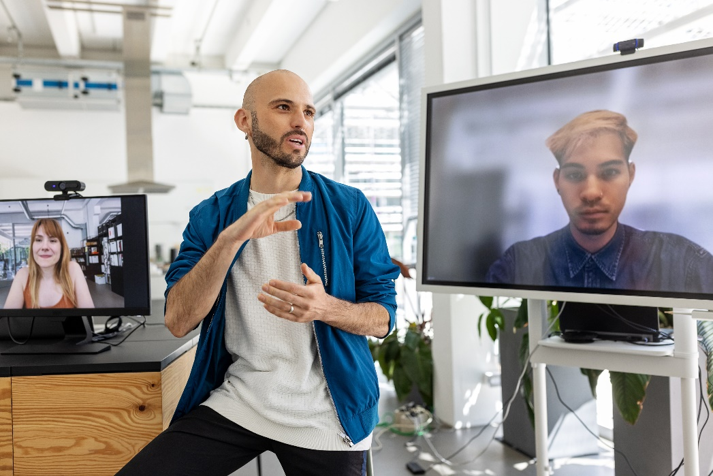


LME: Online Lecture-tutorials
Attend the Lecture-tutorial online: at home, on-campus or other quiet area.
A laptop or PC is required.
The Lecture-tutorial is available via the MS-Teams link in the module on Moodle.
During the Q&A & Activity sections, ask questions in class or on the PC via MS-Teams voice or chat.
If you want me to look at something you can send me an image/screenshot via Teams chat or via dm.
Available online for this module only.

Slide 32

5min Group Activity: Leadership
MS-Teams: Breakout rooms. 2 students per room. Msg when 1min left.
In pairs, discuss and document:
What qualities make a good and effective Leader/manager of people?
When asked share your answer (unmute to share).
Notes:
How to use breakout rooms in Microsoft Teams - YouTube

