Slide 1
Care of the Older Person In Context

Slide 2
AI - Care of the Older person
Modern medicine and increasing longevity have conspired to boost the need for social care, whether in the home or in institutions.
“There’s a pressing requirement for robots in the social care of the elderly, partly because we have fewer people of working age,”
Tony Belpaeme, Professor in Intelligent and Autonomous Control Systems
Plymouth University.

Slide 3
Traditionally among the poorest paid of the workforce, carers are an ever more scarce resource.
Policy makers have begun to cast their eyes towards robots as a possible source of compliant and cheaper help.

Slide 4
Robots already in production, are principally geared to monitor the elderly and infirm, or provide companionship while, as yet, performing only the most straightforward of physical tasks.

Slide 5
Helping older adults to stay meaningfully engaged is critical for their health and wellbeing.
Companionship?

Slide 6
“Of course it would be better to have companionship from people…”
For all sorts of reasons this can’t always be achieved.
“Studies have shown that people don’t mind having robots in the house to talk to. Ask the elderly subjects who take part in these studies if they’d like to have the robot left in the house for a bit longer, and the answer is nearly always yes.”
Tony Belpaeme, Professor in Intelligent and Autonomous Control Systems
Plymouth University.

Slide 7
Consider our relationship with nonhuman entities of a different type: animals. The ancient bonds between us have changed: hunting, transport, protection and other such necessities have slipped to a secondary role.
The predominant function of domestic animals in advanced industrial societies is companionship.

Slide 8
When medical researchers started to take an interest in the health effects of pet ownership, they began to find all sorts of beneficial consequences, physical as well as mental.
These include reductions in distress, anxiety, loneliness and depression, as well as a predictable increase in exercise.
Pets seem to reduce cardiovascular risk factors.

Slide 9
Financing longevity will require new models, new tools and new norms.
New opportunities for later life employment, new models for planning and financing care and better ways to prevent scams and fraud are needed.

Slide 10
The pleasures of animals as companions – and the real distress that may follow their loss or death – are self-evident.
Research in Japan has revealed a biological and evolutionary basis to the relationship Japanese scientists measured the blood levels of oxytocin in dogs and their owners, had them gaze at one another for an extended period, then repeated the measurements.

Slide 11
Oxytocin - the hormone associated with building a bond between mothers and their babies.
What the Japanese researchers found was that periods of mutual eye contact raised the oxytocin levels in both parties. In short, they uncovered the physiological basis of loving your dog.

Slide 12
Whether on account of chemistry or for other reasons, there is evidence that the majority of pet owners see their animals as part of the family.
“This doesn’t mean they regard them as humans,”
Close links with animals are often in addition to rather than instead of relationships with family and friends.
Professor Nickie Charles, University of Warwick

Slide 13
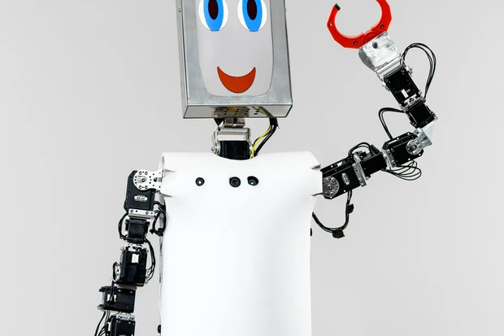
CHARLY (Companion Humanoid Autonomous Robot for Living with You) was designed by the Adaptive Systems Research Group at the University of Hertfordshire. It’s been used for human–robot interaction user studies, which involved the robot playing a version of rock-paper-scissors with passers-by.

Slide 14
The suggestion that non-living things, including robots, might be able to evoke human responses that are quantitatively and even qualitatively comparable to our feelings about animals is contentious.
Yet the evidence of common experience suggests that this is the case, even if we might not admit it or feel uncomfortable if we do.

Slide 15
Who hasn’t shouted at a failing machine?

Slide 16
Think back to the mid-1990s and the advent of small egg-shaped electronic devices with a screen and a few buttons. They were called Tamagotchis. Bandai, the original Japanese manufacturer, described a Tamagotchi as
“an interactive virtual pet that will evolve differently depending on how well you take care of it. Play games with it, feed it food and cure it when it is sick and it will develop into a good companion.”

Slide 17
Conversely, if you neglected your Tamagotchi, it died. For a time, millions of children and even adults became willing slaves to the demands of these computerised pets.

