Slide 1
Problem Solving and Decision Making
Student Name | Farhana Musharrath Tahura
Student ID | 2109147
Module Code | BMSW4002
Assignment Section | Task 1
Lecturer | Buddhi Pathak

Slide 2

Scope and Impact of Absenteeism
What is absenteeism?
Who does it affect?
What is the impact of absenteeism?

Slide 3
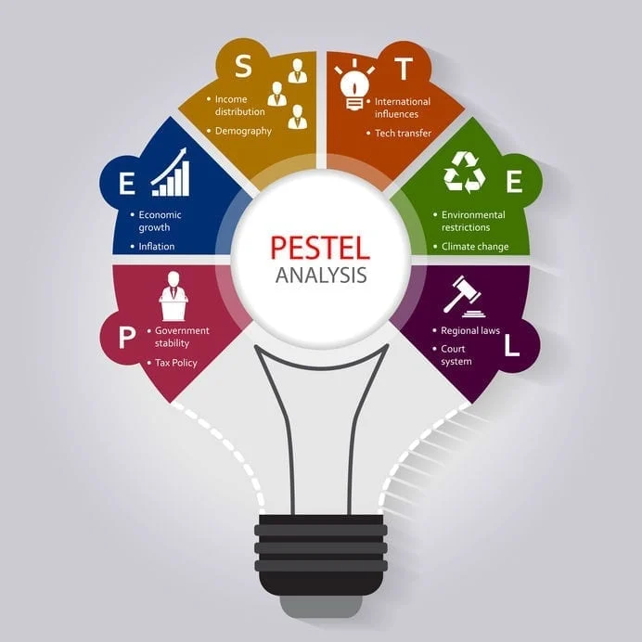
PESTEL ANALYSIS
What is PESTEL Analysis?
Who created it?
When can it be used?
(Cayenne Consulting, 2021)

Slide 4
PESTEL Analysis for Absenteeism
Political | Employee pay freeze
Economic | Shortage in workers even before the pandemic
Sociological | NHS workers are demoralised, overworked and underpaid.
Technological
Environmental
Legal | 10 days isolation if they encounter someone with COVID

Slide 5
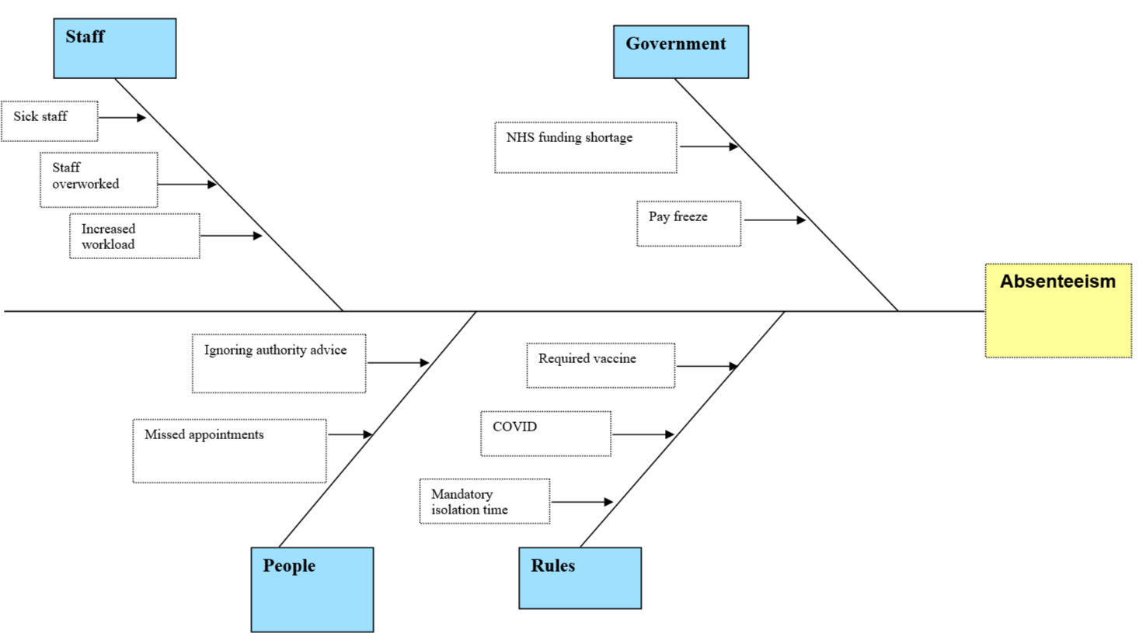
Fishbone/Ishikawa Diagram

Slide 6
Solutions to Absenteeism
Increased pay for NHS staff
Hire more people
Improve workplace environment

Slide 7
PMI – Increased Pay for NHS Staff
Plus + | Minus - | Interesting
Motivated staff (+4) | Increased pay for the NHS (-2) | Less money for other needs (-1)
Happy workers (+4)
Productivity increases (+5)
Score = 13 | Score = -2 | Score = -1 | Total = 10

Slide 8
PMI – Hire More People
Plus + | Minus - | Interesting
Reduced workload for current staff (+5) | More costs (-3)
More jobs available for people (+3) | More people to train (-2)
Reduced waiting times for patients (+4) | Time consuming (-1)
Score = 12 | Score = -6 | Score = 0 | Total = 6

Slide 9
PMI – Improve Workplace Environment
Plus + | Minus - | Interesting
Minimise bullying (+5) |  | Staff who participate in these actions can get fired (+1)
Minimise harassment (+5) |  | If they get fired there may not be enough workers for the responsibilities (-1)
Better for mental health (+5)
Score = 15 | Score = 0 | Score = 0 | Total = 15

Slide 10
References
Cayenne Consulting (2021) Put Your PESTEL to the Mettle. Available at: https://www.caycon.com/blog/put-your-pestel-to-the-mettle (Accessed: 12 March 2022)
Mitrefinch (2017) 9 UNDERLYING CAUSES OF EMPLOYEE ABSENTEEISM IN THE WORKPLACE. Available at: https://mitrefinch.com/blog/9-underlying-causes-employee-absenteeism-workplace/ (Accessed: 12 March 2022)
NHS (2019) Missed GP appointments costing NHS millions. Available at: https://www.england.nhs.uk/2019/01/missed-gp-appointments-costing-nhs-millions/ (Accessed: 19 February 2022)
NHS Confederation (2022) Staff shortages and exhausted workforce present greatest challenge to NHS. Available at: https://www.nhsconfed.org/news/staff-shortages-and-exhausted-workforce-present-greatest-challenge-nhs (Accessed: 25 February 2022)
Office for National Statistics (2018) Living longer - how our population is changing and why it matters. Available at: https://backup.ons.gov.uk/wp-content/uploads/sites/3/2018/08/Living-longer-how-our-population-is-changing-and-why-it-matters.pdf (Accessed: 19 February 2022)
Royal Nursing College (2021) Pandemic takes toll on nursing staff as new analysis shows NHS loses almost a fifth more days to sickness than before COVID-19. Available at: https://www.rcn.org.uk/news-and-events/press-releases/pandemic-takes-toll-on-nursing-staff-as-new-analysis-shows-nhs-loses-fifth-more-days-to-sickness (Accessed: 26 February 2022)

Slide 11
References
The Guardian (2021) Nurses’ pay in England to fall 7% in a decade even after government offer. Available at: https://www.theguardian.com/society/2021/jul/25/nurses-pay-in-england-to-fall-7-in-a-decade-even-after-government-offer (Accessed: 25 February 2022)
The Health Foundation (2019) Six ways to close the workforce gap. Available at: https://www.health.org.uk/news-and-comment/blogs/six-ways-to-close-the-workforce-gap (Accessed: 26 February 2022)
UNISON (2014) UNISON survey shows NHS staff are overworked and underpaid. Available at: https://www.unison.org.uk/news/article/2014/11/unison-survey-shows-nhs-staff-are-overworked-and-underpaid/ (Accessed: 25 February 2022)
Unison (2022) No fresh ideas to deal with growing NHS staffing crisis, says UNISON. Available at: https://www.unison.org.uk/news/press-release/2022/02/no-fresh-ideas-to-deal-with-growing-nhs-staffing-crisis-says-unison/ (Accessed: 26 February 2022)

