Slide 1

What Factors Affect Participation in Different Age Groups With Rugby Teams
Brychan Wyn Thomas
BMSS6007
2306610

Slide 2
Information
Mixed methods research study
Male rugby players across Welsh rugby level
Focus on motivation, barriers and participation

Slide 3
Introduction
Why is physical activity important?
Why rugby?
Physical demands
Competition
Social connection
Team situations
Overall a good sport to research motivations and participation.

Slide 4
Aim of the study
Research Aim
To investigate what factors influence participation in rugby players across different age groups
Participants
42 male rugby players
Welsh rugby levels – semi-professional, university rugby, Amateur rugby

Slide 5
Methodology
Mixed method approach
EMI-2 Questionnaire with 5 open ended questions
Analysis
Descriptive statistics
One-way ANOVA
Independent t-tests
Thematic analysis

Slide 6
Quantitative data
Highest scores: Affiliation, revitalisation, strength and endurance and enjoyment
Lowest scores: Health and pressures, competition and weight management
Findings
Intrinsic and social motivations and factors are greater than extrinsic motivation

Slide 7
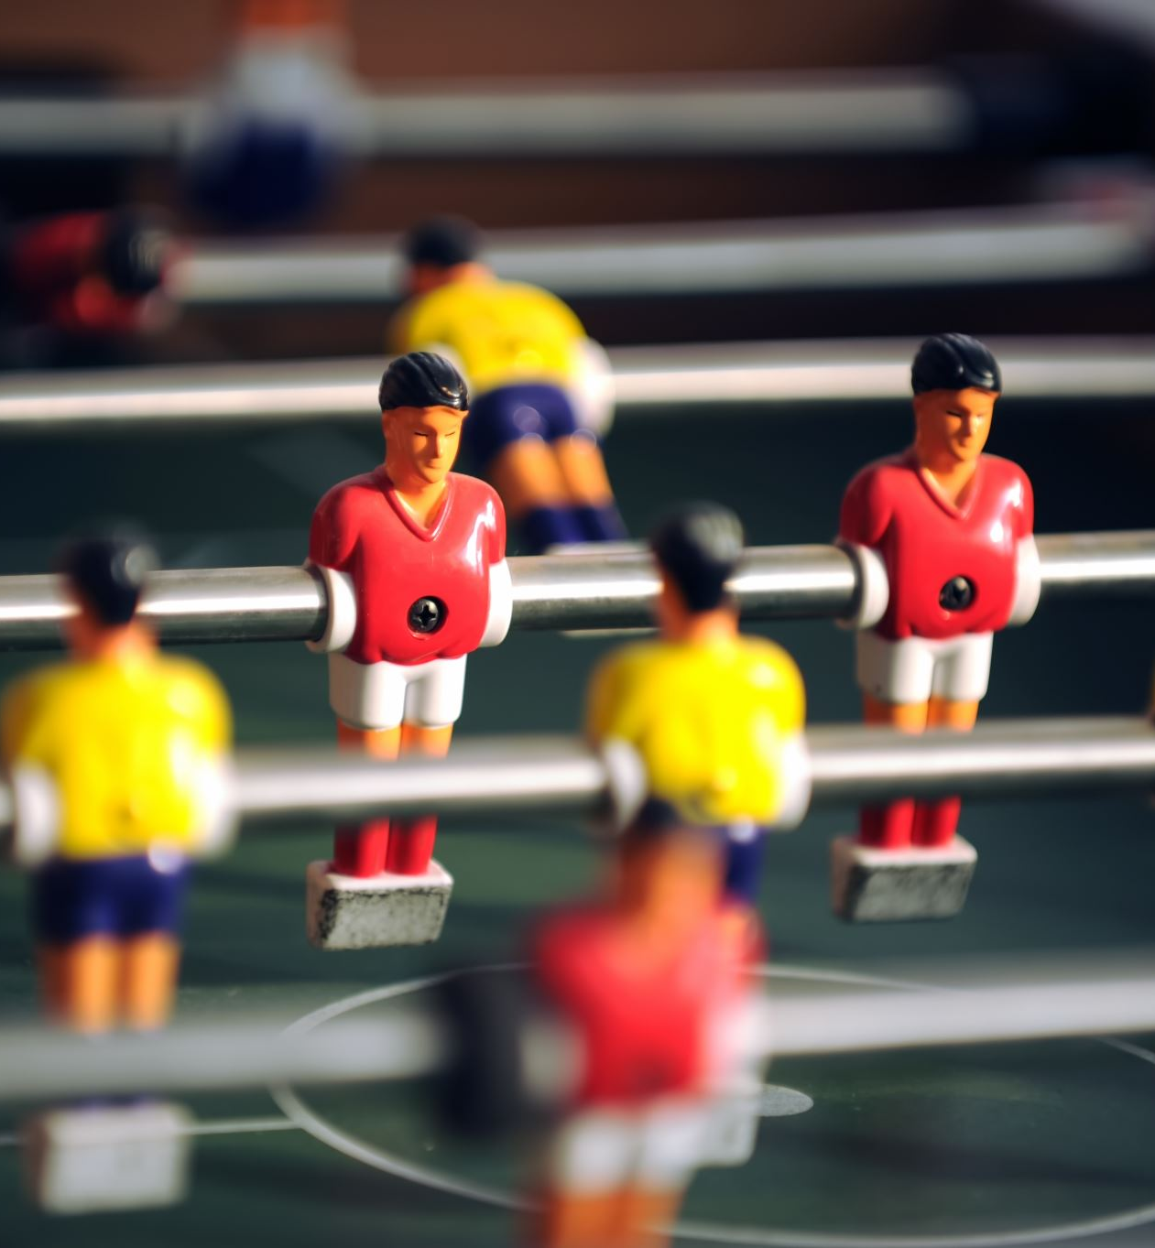
Differences in age groups
ANOVA results
No significant difference between age groups
Findings suggest:
Rugby players are motivated by similar factors regardless of age
T-Test results
Small-differences in age groups such as younger players valuing social recognition but overall similar motivating factors

Slide 8
Qualitative Findings
Motivating factors: Enjoyment, Teamwork, playing with friends and social connection
Barriers: Injuries, work commitments, family responsibilities and time constraints
Findings : Intrinsic motivation and social engagment are key factors in continued particpation in rugby and physical activity

Slide 9
Discussion and implications
Key points of discussion
Supports self-determination theory:
Autonomy
Competence
Relatedness
Implications for rugby teams
Make sessions enjoyable
Promote team cohesion
Support player wellbeing
Used flexible training schedules
Focus on injury prevention

Slide 10
Conclusion
Intrinsic motivation is the main factor in participation in rugby
Social connection is important across all ages
Barriers such as injury and time limit participation
Rugby teams environment may create consistent motiavtion across age groups
Creating a supportive and enjoyable enviroment in rugby is essential in continued partciaption across a persons life time.

Slide 11
Any Questions?

Slide 12
Reference List
Braun, V. and Clarke, V. (2006) ‘Using thematic analysis in psychology’, Qualitative Research in Psychology, 3(2), pp. 77–101.
Brunet, J. and Sabiston, C.M. (2011) ‘Exploring motivation for physical activity across the lifespan’, Psychology of Sport and Exercise, 12(2), pp. 99–105.
Deci, E.L. (2012) Self-determination theory. Rochester: University of Rochester Press.
Gardner, B. (2013) ‘Habit as automaticity, not frequency’, Health Psychology Review, 9(3), pp. 277–295.
Gavin, J., Keough, M., Abravanel, M., Moudrakovski, T. and Mcbrearty, M. (2014) ‘Motivations for participation in physical activity across the lifespan’, International Journal of Wellbeing, 4(1), pp. 46–61.
Kahanavita Liyanage Don, S. (2021) ‘Team cohesion and participation in rugby union’, International Journal of Sports Science, 11(2), pp. 55–63.
Kim, Y. and Cho, D. (2022) ‘Validity and reliability of the Exercise Motivations Inventory-2’, Journal of Exercise Rehabilitation, 18(1), pp. 14–21.
Kruger, P.E. and Smit, A. (2012) ‘Physical demands of rugby union’, South African Journal for Research in Sport, 34(2), pp. 63–79.
Malina, M.A. (2011) ‘Mixed methods research in behavioural studies’, Qualitative Research in Accounting & Management, 8(1), pp. 59–73.
Miller, Y.D., Brown, W.J. and Tudor-Locke, C. (2016) ‘Physical activity and chronic disease prevention’, Public Health Reports, 131(2), pp. 211–218.
Pacewicz, C.E., Smith, A.L. and Raedeke, T.D. (2020) ‘Group cohesion and motivation in team sport’, Psychology of Sport and Exercise, 47, pp. 1–9.
Pope, J.P. and Wilson, P.M. (2012) ‘Understanding motivational processes in university rugby players’, Journal of Sport Behavior, 35(4), pp. 405–423.
Ryan, R.M. and La Guardia, J.G. (2000) ‘What is being optimized? Self-determination theory and basic psychological needs’, Psychological Inquiry, 11(4), pp. 268–272.
Shields, M. (2008) ‘Overweight and obesity among children and youth’, Health Reports, 19(3), pp. 27–42.
Warburton, D.E.R. (2003) ‘Health benefits of physical activity’, Canadian Medical Association Journal, 174(6), pp. 801–809.
White, P. (1982) ‘Barriers to participation in physical activity’, Sports Sociology Review, 15(2), pp. 127–134.

