Slide 1

Page 01
Analyzing the Digital World
Digital Forensics
Presenter: Shrey MukeshKumar Patel
Date: December 18th, 2025
Classification: CONFIDENTIAL / LEGAL PRIVILEGE

Slide 2
Page 02
OVERVIEW OF THE DIGITAL FORENSICS
About Digital Forensics
Digital forensics also aims to determine what, who, when, and how things occurred by examining data stored on digital devices and systems, without altering evidential integrity.
Key Objectives
  Conserve evidence without tampering with it.
  Reconstruct incident or crime-related events.
  Defensible findings support legal proceedings.
  Assign blame to users, systems, or attackers.
CYBER SECURITY

Slide 3
Page 02
About Digital Forensics
THE CURRENT STATE OF THE DIGITAL FORENSICS LANDSCAPE
  Evolution: Digital Forensics has shifted from basic data recovery to complex, cross-platform investigations.
  2025 Standards: Tools: Tools are now expected to be automated and interoperable to manage petabyte breach of data.
  Single Pane of Glass: The new suites (Magnet One, Exterro) combine mobile, cloud, and computer forensics into a single interface.
CYBER SECURITY

Slide 4
Page 02
About Digital Forensics
CONVERGENCE WITH CYBERSECURITY
  DFIR Model: Forensics and Cybersecurity have merged into a unified operational model.
  Instant Feedback: Forensic findings (malware hashes/IPs) are immediately fed into security tools (firewalls/EDR).
  Proactive Hunting: Moving from post-mortem analysis to real-time threat hunting using RAM and logs.
CYBER SECURITY

Slide 5
Page 03
Key Tool Categories & 2025 Capabilities
Category | Leading Tools | Key 2025 Feature
Disk & Data | FTK Imager, Tableau | Live Imaging: Capturing RAM/volatile data without system termination.
Mobile | Cellebrite UFED, Magnet AXIOM | Full File System (FFS): Extracting deep app data (Signal/WhatsApp databases).
Network | Wireshark, Zeek | Encrypted Traffic Analysis: Metadata fingerprinting TLS 1.3 traffic.
Memory | Volatility 3, Rekall | Rootkit Detection: Identifying malware hiding in raw RAM dumps.

Slide 6
Page 02
About Digital Forensics
EMERGING TRENDS
CHALLENGES
  Cloud & Containers: Infrastructure Serverless API logs (AWS CloudTrail) are analyzed rather than disks.
  AI-Based Investigations: Millions of images and audio can have their backslog reduced with the help of ML.
  Drone & IoT: Corroboration of physical alibis: with the help of smart devices (thermostats, drones).
  Zero Trust Architecture: It is based on identity logs instead of capture of network packets because of encryption.
  Going Dark: End-to-End Encryption (Telegram/Signal) prevents access to content without keys.
  Deepfakes: Fake audio/video alibis that criminals create with the help of Generative AI.

Slide 7
Page 04
EXECUTIVE SUMMARY
CYBER SECURITY
  Incident: Unusual access to the QT-AI-2025 Neuro-AI technology.
  Categories: Insider Threat / Corporate Espionage.
  Purpose: Research the conspiracy to sell proprietary IP to competitor "NexGen Circuits"
EXECUTIVE SUMMARY
Case Study: Quantum Tech IP Theft
  Investigator: Shrey MukeshKumar Patel.
  Date: Dec 18th, 2025.
  Primary Findings: Confirmed conspiracy involving an insider, a broker, and a buyer for a price of $5 million.

Slide 8
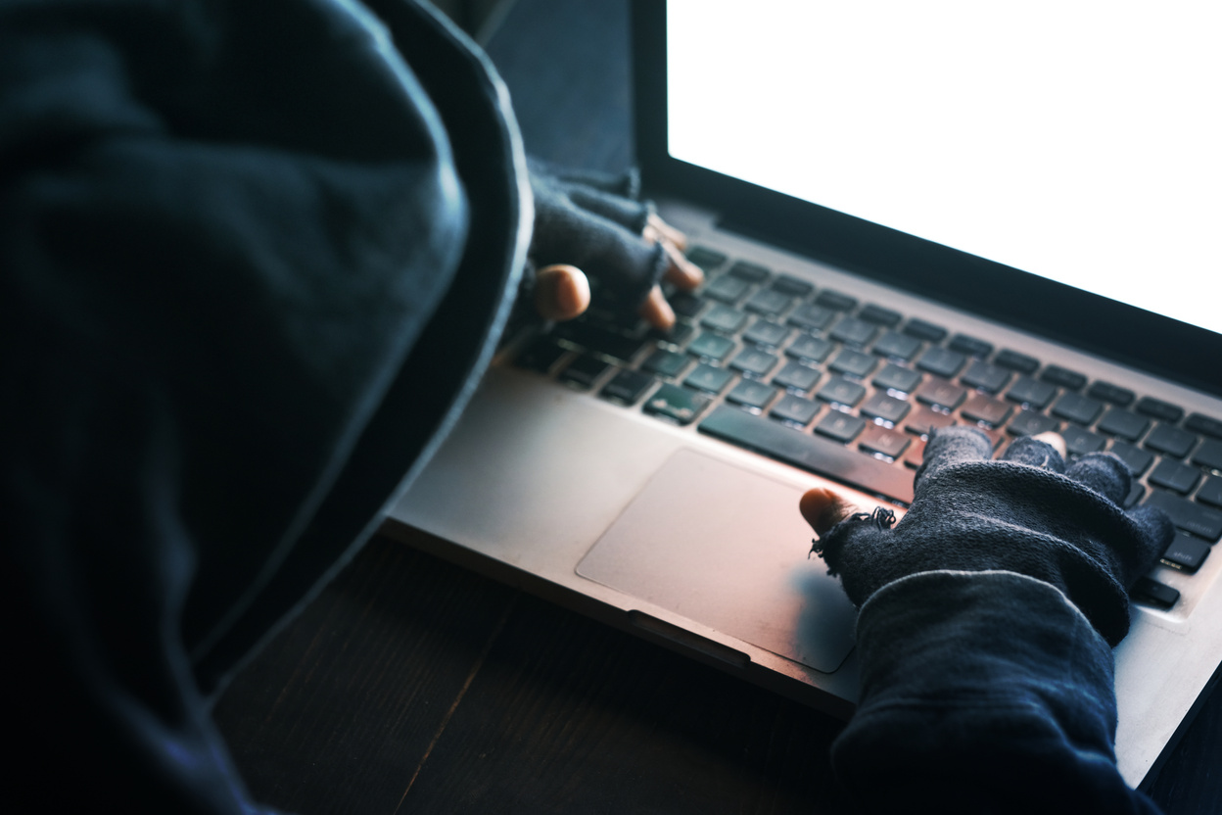
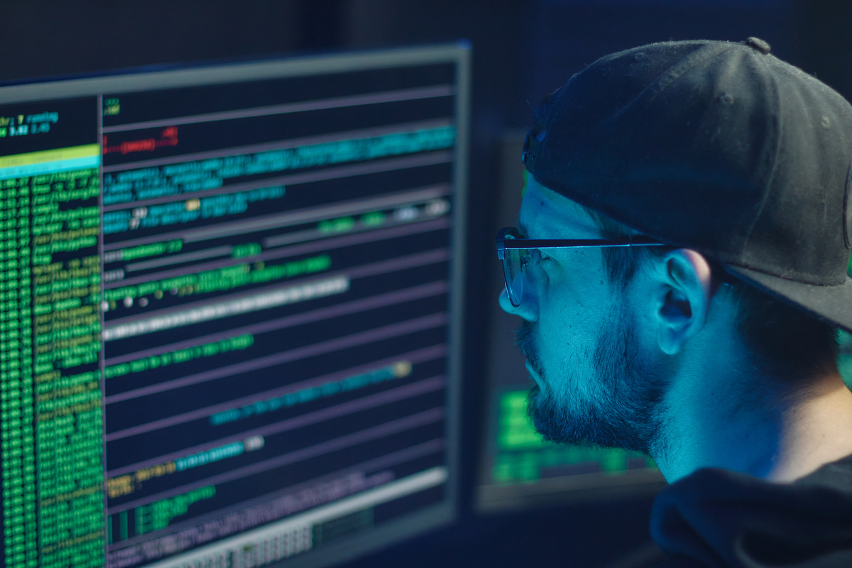
Page 05
ACQUISITION METHODOLOGY (ACPO COMPLIANCE)
  Network Isolation: If the device is in Faraday bag/Airplane mode, then it cannot be wiped remotely.
  Forensic Imaging: Cellebrite UFED used to extract and write-blockers to USBs used.
  Integrity: To prevent tampering, the values of SHA-256 hash are obtained instantly in order to generate a digital fingerprint.
"Chain of Custody":
  Confiscation: Bagging and tagging (Faraday bags).
  Storage: Locker of evidence (Access Logged).
  Analysis: Image removed by Investigator Shrey M. Patel on Dec 12, 2025.
Evidence Inventory & Preservation

Slide 9
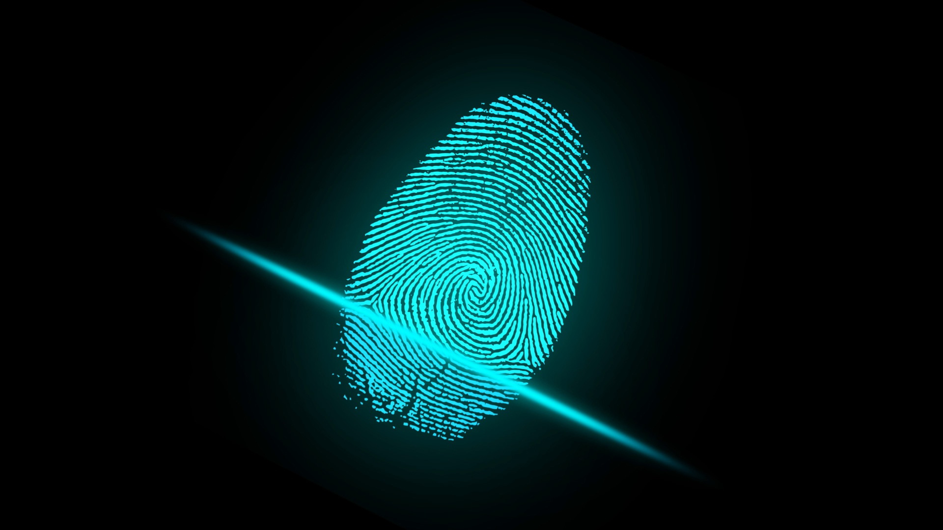
Key Exhibits
Tools Used | Owner (Attributed) | Exhibit ID | Description | Make/Model
Cellebrite UFED | Emma | EV-01 | Smartphone | Huawei P Smart (POT-LX1)
Cellebrite UFED | Joe Marsh | EV-02 | Smartphone | Ulefone Note 14
Page 06

Slide 10
Key Exhibits
Tools Used | Owner (Attributed) | Exhibit ID | Description | Make/Model
Cellebrite UFED | Norman (alias Kate Oleary) | EV-03 | Smartphone | Samsung Galaxy A13
Cellebrite UFED | Unidentified | EV-04 | Smartphone | Nokia C2
Page 07

Slide 11
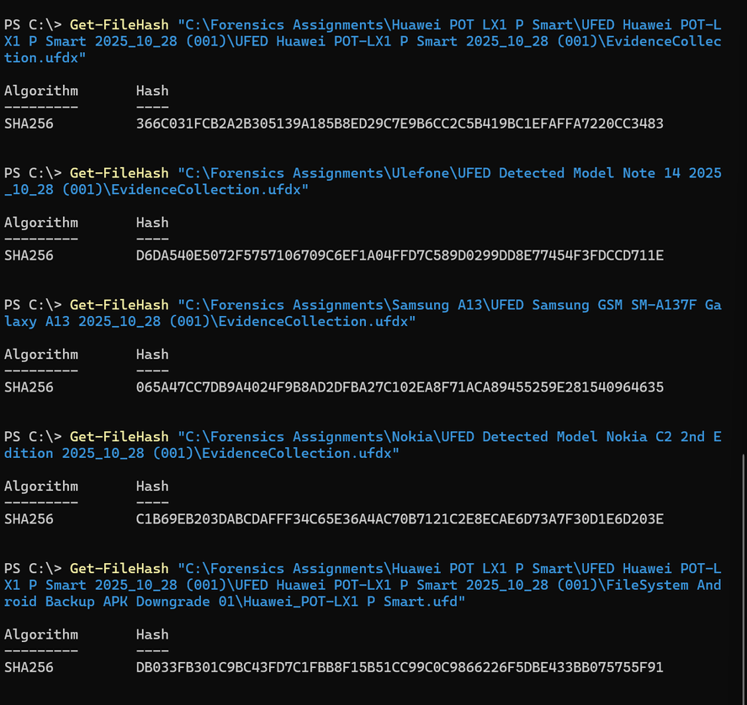
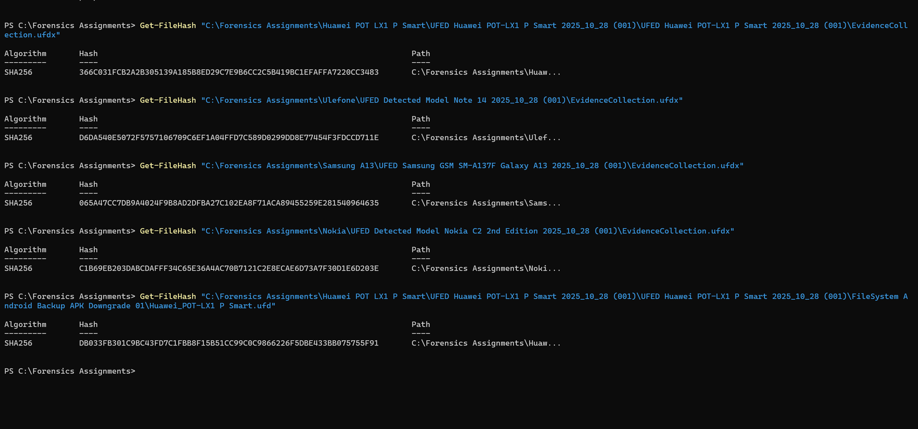
Hash Verification Proof
Page 8
Before Forensics Analysis
After Forensics Analysis

Slide 12
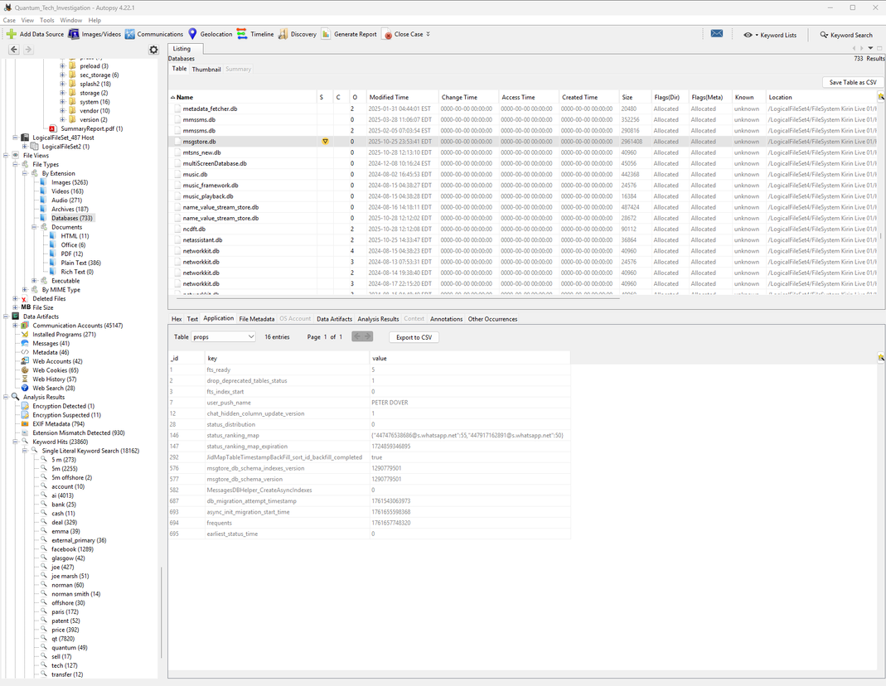
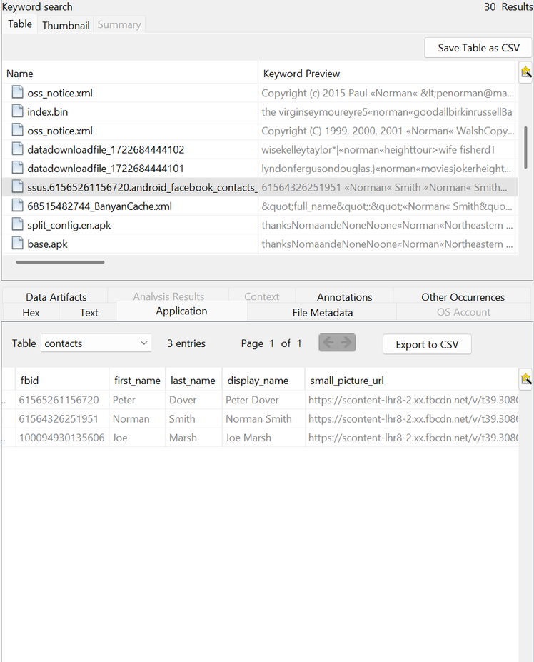
Suspect 1 - Emma (The Insider)
  Immediacy: Senior Engineer / Insider Threat.
  Digital Alias: Only changed the WhatsApp display name to hide identity: to Peter Dover.
  Relationships: Intimate acquaintance with "Joe Marsh".
Page 09

Slide 13
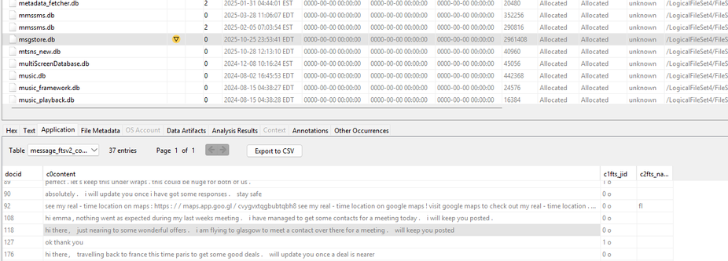
Page 10
  Position: mediator of logistics and negotiations.
  Device: Ulefone Note 14 (EV-02).
  Action: Visited lots of cities as well as towns, including Glasgow, Paris, and Manchester, to sell the stolen technology.
  Negotiation: Achieved the price of the 5M deal.
Suspect 2 - Joe Marsh (The Broker)

Slide 14
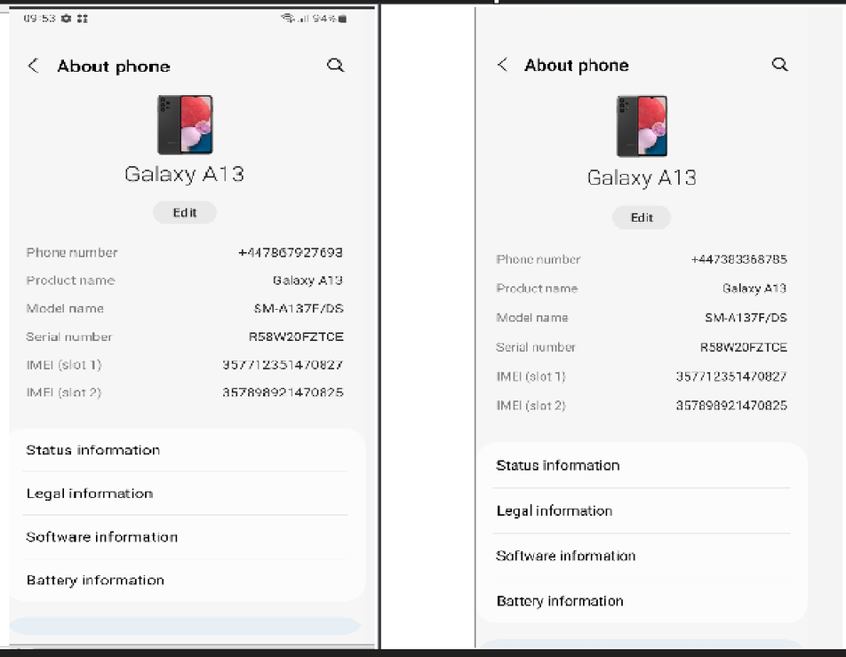
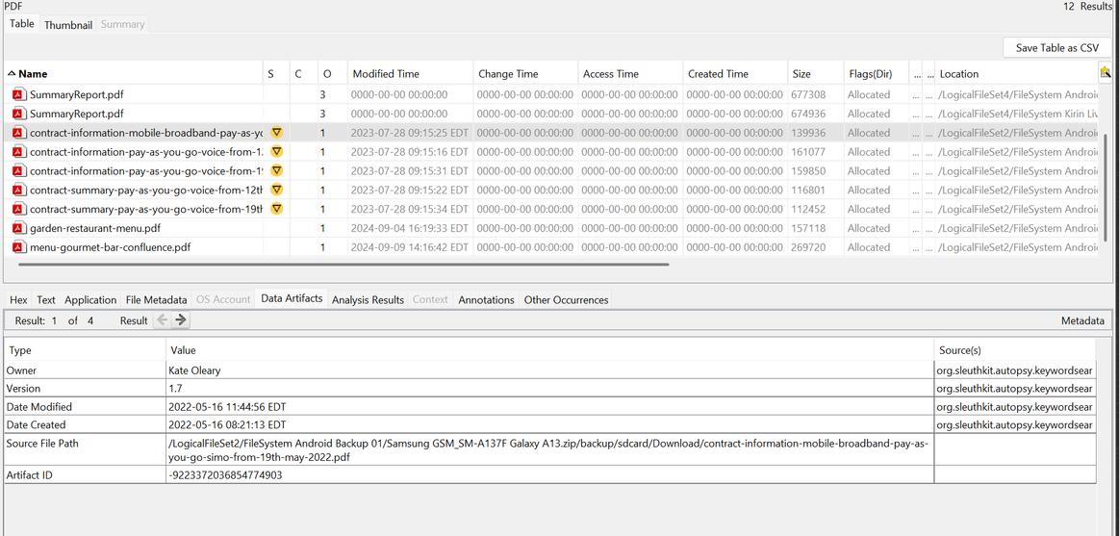
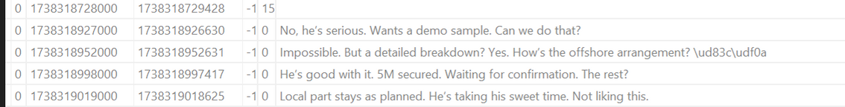
  Role: Buyer / Financier.
  Identity Obfuscation: Proxy device used under the name of a fake account, Kate Oleary (EV-03).
  Attribution: The user who was actively on the device was Norman Smith, as seen on Facebook artifacts on the device.
  Anti-Forensics: In 2025 (Oct), performed a SIM swap to avoid connection to past call history.
  Intent: Docs packaged the requested data in chunks so as to bypass filters.
Suspect 3 - Norman Smith (The Buyer)
Page 11

Slide 15
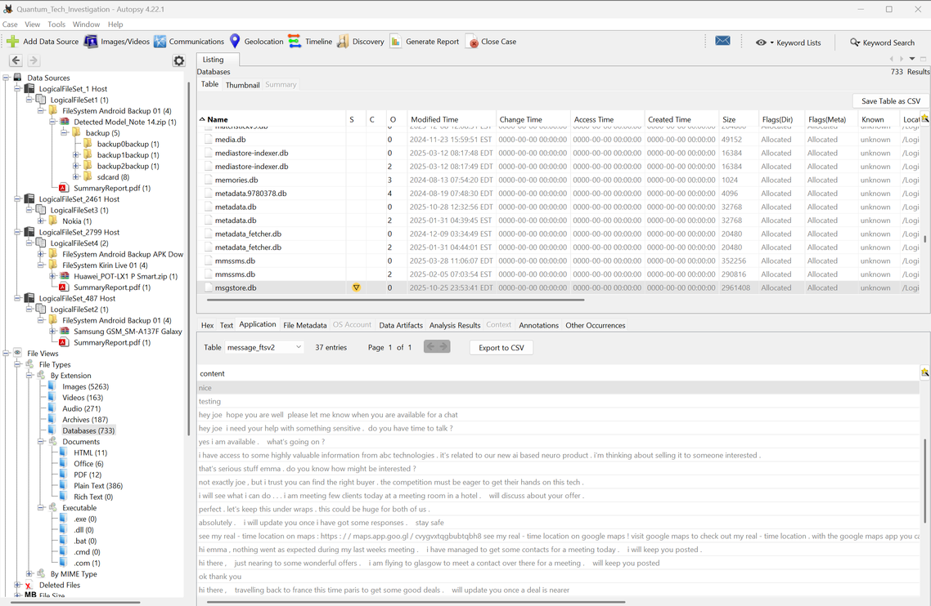
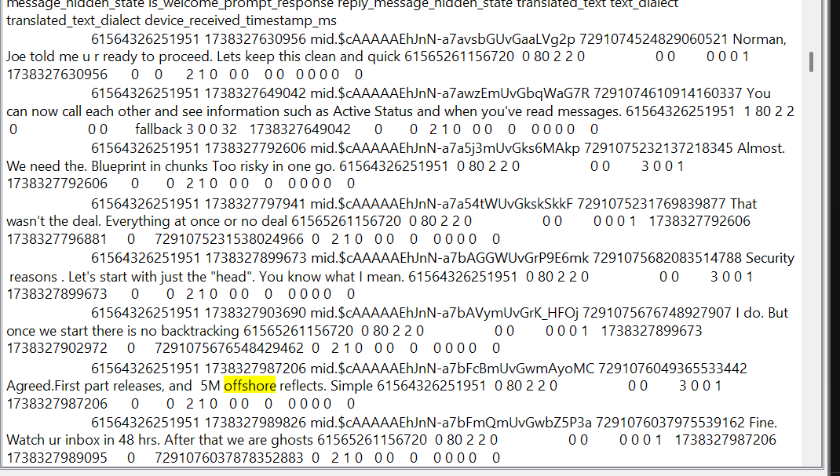
The Conspiracy Timeline
Page 12
  Inception (Aug 21, 2024): Emma sends a message to Joe: I have access to some very valuable information... I'm thinking about selling it."
  The Deal (Oct 16, 2024): Price accepted at 5 Million ("5M")- mode of payment Offshore arrangement.
  Direct Negotiation (Friday, January 31, 2025): Emma and Norman successfully do away with the mediator (Joe) later on in the timeline.
  Norman: "first releases, and 5M overseas reads.

Slide 16
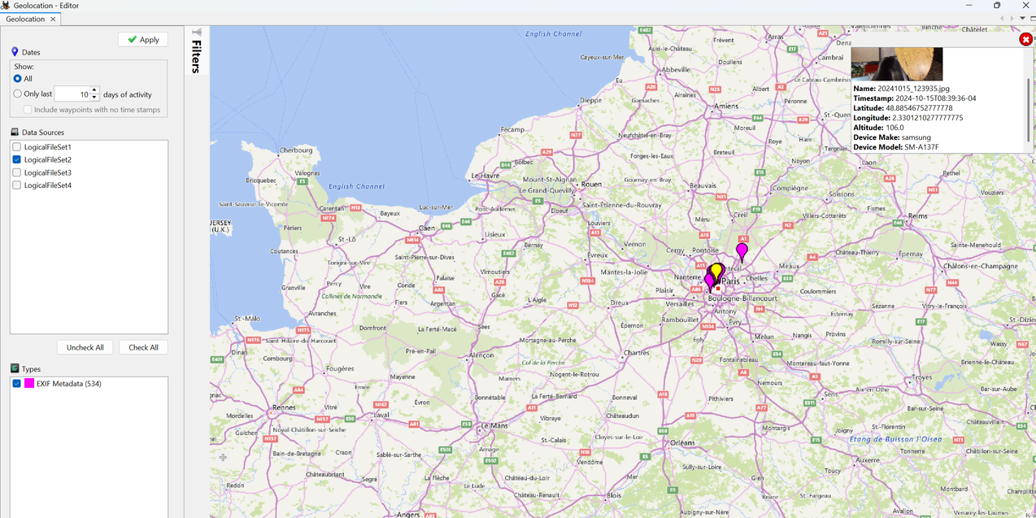
Page 13
Corroborating Evidence (Geolocation)
  Claim: Joe claimed to be traveling to Paris on October 14.
  Evidence: GPS metadata from the Buyer's phone (Samsung A13) placed it at 48.8647° N, 2.3490° E (Paris) on October 16.
  Conclusion: The convergence of the Broker and Buyer in Paris confirms that a physical meeting took place.

Slide 17
Page 14
Anti-Forensic Behavior
Techniques Used by Suspects
  SIM Swapping: The Buyer swapped the SIM number (+44...93 to +44...85) without changing the hardware (IMEI) to conceal old information.
  Alter-Egos: Aliases of Peter Dover and Kate Oleary to conceal their real identities.

Slide 18
Page 15
Recommendations
Legal Actions
  Criminal Charges: Prepare criminal charges against all three suspects of Conspiracy to Commit Fraud, Computer Misuse, and IP Theft.
  Asset Forfeiture: Freeze the assets of Kate Oleary/Norman Smith; subpoena offshore wire transfers on the 5M payment.
  Corporate Remediation
  Now: Suspend Emma and her aliases.
  DLP Enforcement: Implement Endpoint Detection and Response (EDR) in order to signal big file transfers.

Slide 19
Page 16
Conclusion
  Summary: The probe was able to recreate a conspiracy to steal the QT-AI-2025 patent.
  Attribution: Anti-forensic attempts were defeated, and Emma (Source), Joe (Broker), and Norman (Buyer) were identified.
  Result: Evidence is well maintained in accordance with the ACPO guidelines and is sufficient to stand trial.

Slide 20
Page 17
Thank You

