Slide 1
SWOT Analysis for Professional Development in Health and Social Care
Student Name: Mariyam Rubah
Student ID: 2321256
Module Code: LCHS4009
Lecturer Name: Olufemi Oluranti
Notes:
Hello everyone, today I will speak about my SWOT analysis and how it can help me grow in my career in the UK health and social care field. I will think about my strengths, weaknesses, opportunities, and threats to decide my future job. In addition, I will see how to turn my weaknesses and threats into Strenghts and Opportunities.

Slide 2
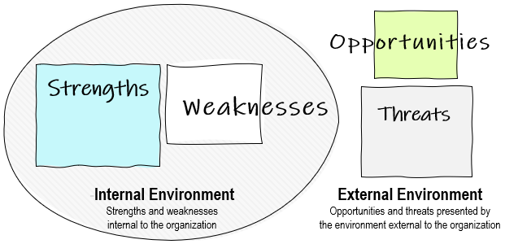
Introduction to SWOT Analysis
A SWOT analysis is a framework used to help plan for the future. It looks at an organization's or individual’s internal strengths and weaknesses, as well as the external opportunities and threats (Tuncay, 2015). This helps in setting goals and making decisions.
Benefits of SWOT Analysis
Helps people be more aware of themselves: Aids individuals in understanding what they are good at and what they need to improve to grow in their careers.
Aids in career planning: By spotting opportunities and challenges in the health and social care field, it helps in setting clear goals and making good choices.

Slide 3

My Strength and weaknesses
Strengths:
Dedicated and hardworking, with a positive attitude towards work.
Excellent interpersonal and communication skills.
Attentive to need of others and understand their feelings sympathetically.
Skilled in administrative jobs and use of digital tools.
Reflection skills, organisational skills
Weaknesses:
Sometimes too emotional during difficult times.
Limited practical experience in formal healthcare settings.
Careful when making decisions and sometimes hard on oneself

Slide 4

My Opportunities and Threats
Opportunities:
I am studying at UWTSD and will graduate in 2026.
The need for care workers in the UK is increasing as 100,000 care worker vacancies in the UK according to Health & Fitness report (Morgan, 2025).
Getting into CPD programs, training, and job placements.
Connecting with others through volunteer work and helping out in the community.
Threats:
Strong competition for jobs in the Health and Social Care Sector.
Stressful work environment due to the nature of care industry
Hazards of fatigue and burnout in health and care sector jobs
Financing and employment policy get changes in health and care sector

Slide 5
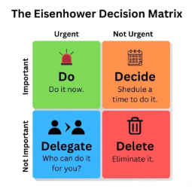
Using Strengths to Reduce Threats and Overcome Weaknesses
Seek help and guidance by using my good communication skills from industry experts and mentors.
I will use my strength of reflection skills to manage my feelings.
Helping out by volunteering or working part-time as a caregiver is a great way to gain more experience (Ruiz-Fernández et al., 2023)
To handle work stress and deadlines better, my organizational skills will be harnessed.
Build my strength by taking classes on emotional understanding and continuing professional development.
Notes:
The Eisenhower Decision matrix is very effective time management techniques in which an individual can make decisions by setting priorities like what is urgent and important must do, not urgent but important decide, not important but urgent delegate to someone else and neither urgent nor important shouldn’t do.

Slide 6
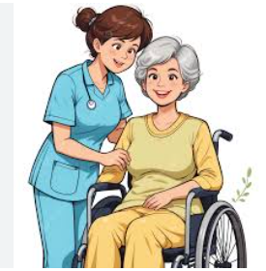
Using Opportunities with Strengths
During placements, I will use what I have learned in class in and apply in real-life care situations.
I will meet with caregivers and teachers to help me in finding better career opportunities.
I will improve my communications skills to get job easier.
To improve my job efficiency, I will take CPD and safety training courses.
Long-term goal: I will start as a care assistant and work my way up to a management or senior care role.

Slide 7
References
Kennedy, D. R., and Porter, A. L. (2022) ‘The Illusion of Urgency’, American journal of pharmaceutical education, 86(7), 8914.
Morgan, M. (2025) Health and Social Care Industry Demand: Is It Still a Good Career in 2025? Available at: https://uk.hfonline.org/health-and-social-care-industry-demand-is-it-still-a-good-career-in-2025/ (Accessed: 05 Oct 2025).
Ruiz-Fernández, M. D., Gámez-Vargas, I., Ventura-Miranda, M. I., et al. (2023) ‘Learning Experiences of Future Healthcare Support Workers Enrolled in a Dual Mode Vocational Training Programme’, Healthcare (Basel, Switzerland), 11(19), 2678.
Tuncay, M. (2015) ’SWOT Analysis in Strategıc Management and a Sample Applicatıon in Public’, Published in: International Research Journal of York University, Vol. 2, No. 3 (June 2015): pp. 276-301.

