Slide 1
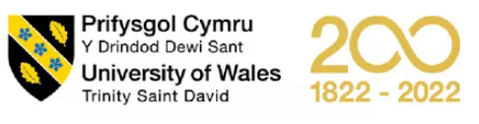
MBA- Marketing management
Presentation by
Nazish Tariq
Student number 2239912

Slide 2
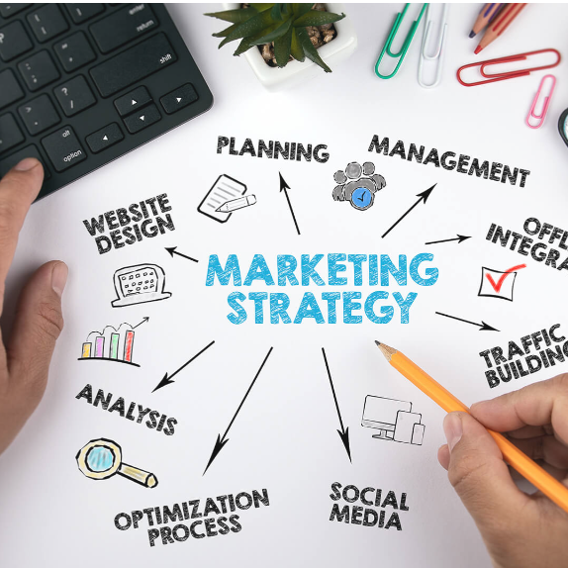
Table of contents
Hilton Market Strategy
Introduction
Factors for market failure
Market strategy after pandemic
Hilton competitive strategy
CSR and green marketing
Recommendations to Improve Competitive advantage.

Slide 3
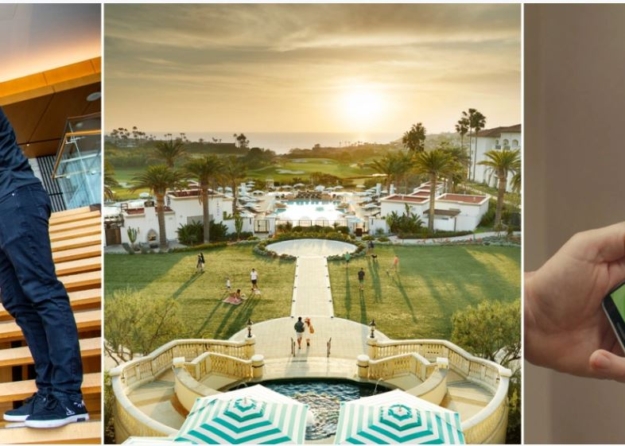
Introduction
Hilton Market Strategy
Hilton
The Hilton Hotel is a well-known chain of hotels worldwide. Its goal is to cater to both business and leisure travellers, with numerous locations in city centres, near airports, convention centres, and popular tourist spots across the globe.
The global spread of COVID-19 has had a significant impact on various sectors of the economy worldwide, including the hotel industry. In-depth analysis using SWOT, PESTEL, and financial assessments has identified certain challenges faced by the Hilton group. Nevertheless, effective measures have been implemented to combat the pandemic and address these issues.
Following a strong set of financial results for 2022, Hilton Worldwide anticipates increasing the global growth rates of its hotel portfolio.
https://www.hilton.com/en/corporate/

Slide 4
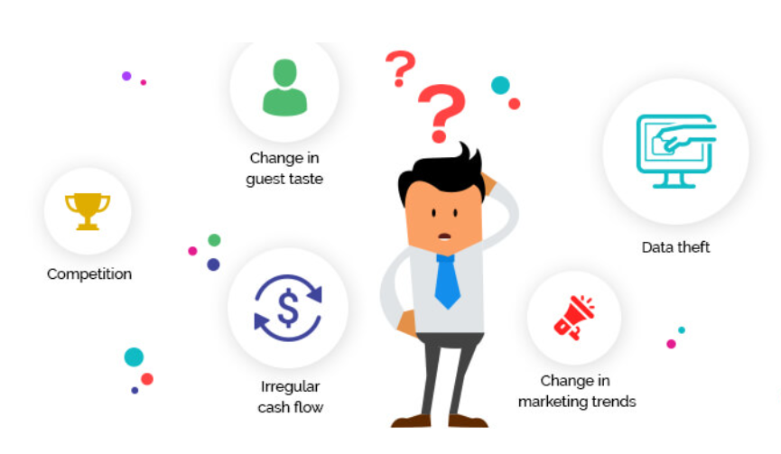
Factors for Market Failure
Hilton Market Strategy
The five major elements include
Competition
Information
Mobility of resources
Externalities
Technological Innovations
Jiang, Y. and Wen, J., 2020. Effects of COVID-19 on hotel marketing and Management

Slide 5
Factors for Market Failure
Hilton Market Strategy
1. Competition
There are four different categories of competitors, according to Kotler and Armstrong (2009):
rivals for the brand
competitive industries
competing parties
Competitive generic
Kotler, P. and Armstrong, G. (2009). Principles of marketing. Pearson.
To maintain market share and customer loyalty, Hilton places great importance on these factors.
2. Information
The need to make quicker, more precise decisions on behalf of the buyer is addressed by marketing information and research. These tools put marketers in intimate proximity to their target market, allowing them to better grasp who they are, what they want, and what their rivals are doing.
Not having access to relevant information in a timely manner can result in the failure of both the market and strategy.
3. Mobility of resources
The mobility of resources is to use locked-up resources for useful applications. Mobilising a resource means creating and organising various sources that will be immediately available for use, as well as meeting the collective objective.
In the hotel industry, staying on the lookout for new resources and locations is crucial for gaining a competitive edge and achieving success in the market.
Jiang, Y. and Wen, J., 2020. Effects of COVID-19 on hotel marketing and Management

Slide 6
Factors for Market failure
Hilton Market Strategy
4. Externalities
Decisions of individuals or businesses in matters like procurement, production, and investments often affect people who have no direct involvement in the transaction. In some cases, such incidental effects may be negligible. But if they get too large, it could pose a problem.
In the Hotel industry, this factor holds significant weight as it has the potential to result in business closure and negative social and environmental impacts.
5. Technological Innovations
Technology is an important source of competitive advantage for hotels (Law & Jogaratnam, 2005).
Innovation in technology refers to the introduction of new or improved products or processes that have significantly different technological features than their predecessors. These innovations are implemented through the introduction of new products (product innovations) or the application of new processes (process innovations) that have been brought to the market.
In today's rapidly growing markets and globalized world, it is crucial for the hotel industry to continuously innovate and embrace new technologies. This has become even more apparent since the pandemic, as Hilton has invested in technology to ensure the safety and satisfaction of their customers.
Jiang, Y. and Wen, J., 2020. Effects of COVID-19 on hotel marketing and Management

Slide 7
Market strategy- continued
Hilton Market Strategy
Hilton Clean Stay
We have enhanced meeting and event experiences and raised the bar for event cleanliness and customer service. This has resulted in a greater market share for us.
Maximum Flexibility
Modified cancellation policies and took a number of steps to provide even more flexibility for Hilton Honors members including status and Points extensions.
Contactless Arrival
Hilton continues to offer contactless options for guests through their Hilton Honors app, allowing guests to customize their stay by selecting their preferred room, completing digital check-ins and check-outs, and using their mobile devices as digital keys. The Hilton Digital Key has been successfully used by guests to access over 100 million doors worldwide.
https://www.hilton.com/en/corporate

Slide 8
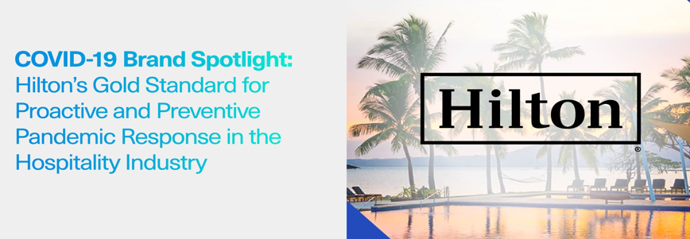
Market strategy adopted after the pandemic
Hilton Market Strategy
Innovation
Hilton has achieved an unprecedented feat by adding a million rooms in just one year. Additionally, they have responded to the pandemic by introducing innovative solutions for guests and contributing positively to communities.
https://www.hilton.com/en/corporate

Slide 9
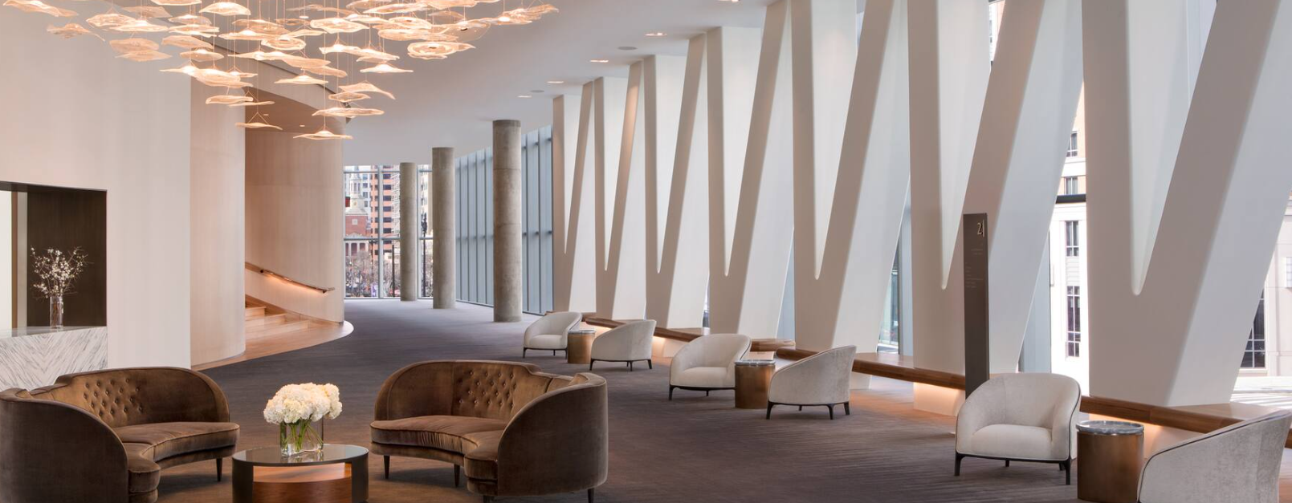
Market strategy-continued
Hilton Market Strategy
Hilton Event Ready
In the current climate, event planners and attendees demand exceptionally high levels of cleanliness. To meet this expectation, Hilton EventReady with Clean Stay offers meticulously crafted solutions and innovative environments that ensure safe and comfortable gatherings.
Hotel Expansions
Hilton added 355 new hotels in 2022, or about one every day, for a total of 58,200 rooms, and had net unit growth of 48,300 rooms, or 4.7% of the portfolio.
Kusuma, K.D., Armoni, N.L.E., Astawa, I.K., Virginiya, P.T. and Chaerunnisah, I.U., 2023. Implementation of Digital Marketing in Increasing Room Occupancy Rate at Hilton.

Slide 10

HILTON COMPETITIVE strategy
Hilton Market Strategy
The combination of cutting-edge technology, superior solutions, and innovation that work together to boost sales and minimize expenses without compromising quality is what gives Hilton its competitive edge. In a way that gives them an unassailable competitive advantage, these services enable customers to gain access to the most recent tools, technology, cutting-edge methodologies, and industry leaders.
Hilton’s Approach to the Market
The Hilton hotels provide distinct benefits by tailoring their services and pricing structures to suit the individual characteristics of each property, such as its size, target market, and level of complexity.
This approach ensures that they have the appropriate level of involvement in decision-making and retain control over revenue performance, based on your specific requirements.
www.hilton.com/en/corporate/development/hilton-performance-advantage/

Slide 11

Competitive Strategy- continued
Hilton Market Strategy
Global online services
Hilton specialize in creating high-performance brand websites that not only increase revenue but also foster customer loyalty.
Creating Mobile applications to reach the customer easily and effectively by the touch of a button.
Their demand generation strategy involves integrating various methods such as search engines, social media platforms, online advertisements, and mobile marketing.
The global eCommerce team which provides complete support for the success of owners and operators.
Hilton reservations and customer care
The HRCC manages reservations for all properties under the Hilton brand
The HRCC spans all major continents and languages globally
The HRCC team consistently provides a top-selling and customer service-focused organisation
www.hilton.com/en/corporate/development/hilton-performance-advantage/

Slide 12
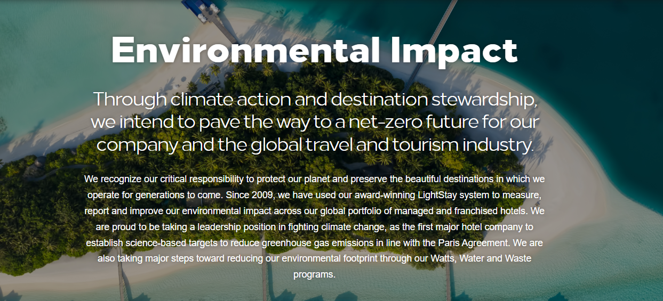
CSR Green Marketing
Hilton Market Strategy
Why CSR is important
Incorporating CSR into a company's practices improves how the brand is perceived, draws in potential investors and talented employees, and has a positive financial impact. It also boosts employee involvement and customer loyalty.
https://esg.hilton.com/environment/
Hilton’s mission is to create a positive social impact by prioritizing Diversity, Equity & Inclusion as well as protecting human rights. We are dedicated to taking immediate and meaningful action toward these goals.
https://esg.hilton.com/wp-content/uploads/sites/4/2023/04/Hilton-2022-Environmental-Social-and-Governance-Report.pdf

Slide 13
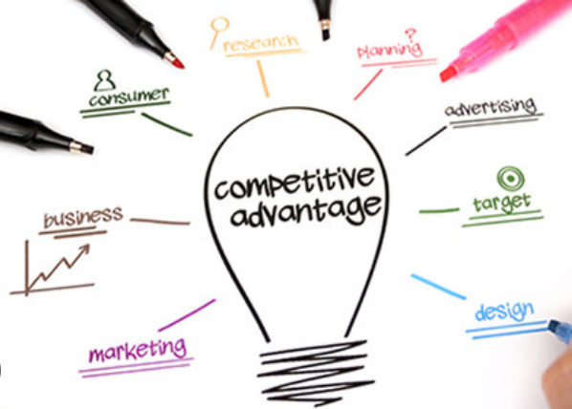
Recommendations to Improve Competitive Advantage.
Hilton Market Strategy
Invest in Artificial intelligence
Invest in Green projects
Low carbon Emissions
Increase Brand awareness
Invest in new projects in Under developing countries.
Diversify the portfolio
Customer awareness
Invest in community for better environment
Hang, Y., Sarfraz, M., Khalid, R., Ozturk, I. and Tariq, J., 2022

Slide 14
References
Hilton Market Strategy
Chathoth, P. K. (2007). The impact of information technology on hotel operations, service management and transaction costs: A conceptual framework for full-service hotel firms. International Journal of Hospitality Management, 26(2), 395-408. https://doi.org/10.1016/j.ijhm.2006.03.004
Law & Jogaratnam, (2005); Melián-González & Bulchand-Gidumal, 2017; Tseng, Kuo, & Chou, 2008
Jiang, Y. and Wen, J., 2020. Effects of COVID-19 on hotel marketing and management: a perspective article. International journal of contemporary hospitality management, 32(8), pp.2563-2573.
Shin, H., Perdue, R. R., & Kang, J. (2019). Front desk technology innovation in hotels: A managerial perspective. Tourism Management, 74, 310-318. https://doi.org/10.1016/j.tourman.2019.04.004
Kotler, P., 2011. Philip Kotler's contributions to marketing theory and practice. In Review of Marketing Research: Special Issue–Marketing Legends (pp. 87-120). Emerald Group Publishing Limited.
https://www.imf.org/external/pubs/ft/fandd/2010/12/basics.htm
https://esg.hilton.com/wp-content/uploads/sites/4/2023/04/Hilton-2022-Environmental-Social-and-Governance-Report.pdf
https://hospitalitytech.com/hiltons-first-us-marketing-campaign-covid-19-focuses-making-memories
https://research-methodology.net/hilton-marketing-communication-mix/#google_vignette
https://scholar.google.co.uk/scholar?q=why+social+and+corporate+responsibility+important+for+marketing&hl=en&as_sdt=0&as_vis=1&oi=scholart
https://stories.hilton.com/releases/hilton-named-most-valuable-hotel-brand-by-brand-finance-for-sixth-consecutive-year
https://stories.hilton.com/releases/hilton-successfully-navigates-year-like-no-other
https://tophotel.news/hilton-looks-to-exceed-2022s-almost-a-hotel-per-day-expansion-rate/#:~:text=Hilton%20Worldwide%20is%20expecting%20to,representing%204.7%25%20of%20the%20portfolio.
https://www.hilton.com/en/corporate/development/hilton-performance-advantage/
https://www.hilton.com/en/hotels/durgigi-garden-inn-umhlanga-arch/
https://www.hilton.com/en/hotels/wmtmtgi-hilton-garden-inn-guizhou-maotai-town/
https://www.hiltonhonors.com/en_US/hh2-aug-2020/promo-expired/
https://www.statista.com/statistics/379046/worldwide-retail-e-commerce-sales/
https://www.studysmarter.co.uk/explanations/microeconomics/market-efficiency/positive-externalities/
Hang, Y., Sarfraz, M., Khalid, R., Ozturk, I. and Tariq, J., 2022. Does corporate social responsibility and green product innovation boost organizational performance? a moderated mediation model of competitive advantage and green trust. Economic research-Ekonomska istraživanja, 35(1), pp.5379-5399.

