Slide 1

Leadership and Management Theory and Practice
LCBB6022
Student name & ID : Nedret Metodiev 2317961
Lecturer name:Dr Faizu Edu
Component 1: Practical - Individual Presentation
Submission:24.03.2026

Slide 2
1. Introduction
Leaders today operate in environments defined by diversity, complexity, and constant change. Edith Heard’s reflection on empathy and multicultural awareness highlights a crucial truth: effective leadership depends on understanding people as much as understanding strategy.
This presentation explores how emotional intelligence (EI) and cultural intelligence (CQ) shape leadership effectiveness, especially in global and collaborative settings.

Slide 3
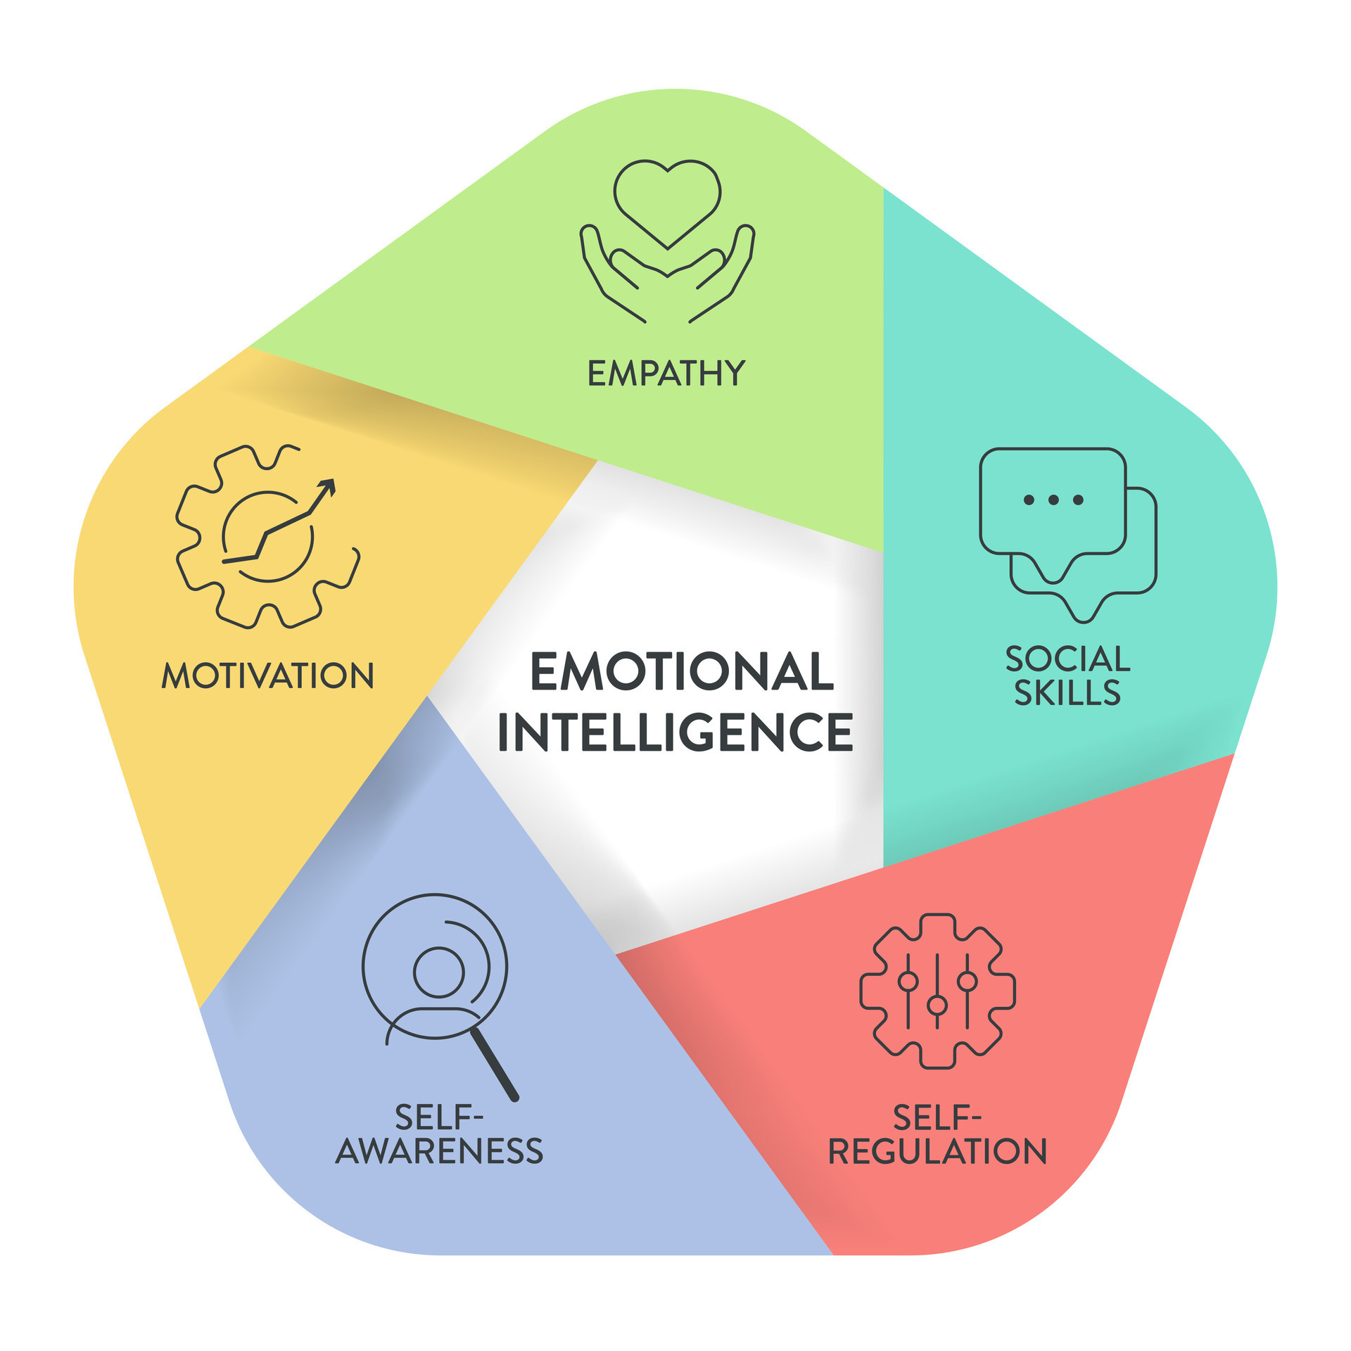
2. Emotional Intelligence: A Foundation for Human-Centred Leadership
What EI Means
Emotional intelligence is the capacity to recognise, interpret, and manage emotions — both your own and those of others. Leaders with strong EI create stability, build trust, and navigate interpersonal challenges with maturity.
Goleman’s EI Framework
Self-awareness – understanding your emotional patterns
Self-management – regulating impulses and reactions
Social awareness – perceiving others’ emotions accurately
Relationship management – guiding interactions constructively
Emotional intelligence EI or emotional quotient EQ, framework diagram ...
www.vecteezy.com

Slide 4
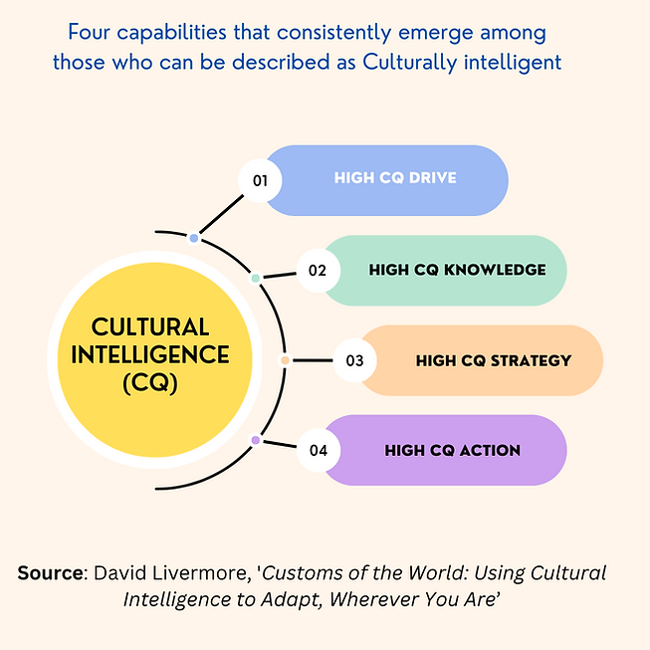
3. Cultural Intelligence: Navigating Differences with Skill
What CQ Means
Cultural intelligence refers to the ability to work effectively across cultural boundaries. It goes beyond awareness — it involves adapting behaviour, communication, and expectations in multicultural contexts.
Earley & Ang’s CQ Model
Cognitive CQ – understanding cultural norms and systems
Motivational CQ – willingness to engage with cultural differences
Behavioural CQ – adjusting actions to suit cultural expectations
Metacognitive CQ – reflecting on cultural interactions
Cultural Intelligence | ExecGlobalCoaching
www.executiveglobalcoaching.com

Slide 5
4. How EI and CQ Strengthen Leadership Together
When EI and CQ intersect, leaders gain a powerful toolkit:
EI helps leaders understand people.
CQ helps leaders understand people in different cultural contexts.
Together, they enable leaders to:
Communicate with sensitivity
Build inclusive team cultures
Reduce conflict and misunderstanding
Foster collaboration across borders
This combination mirrors Edith Heard’s emphasis on listening, empathy, and navigating multicultural environments.

Slide 6
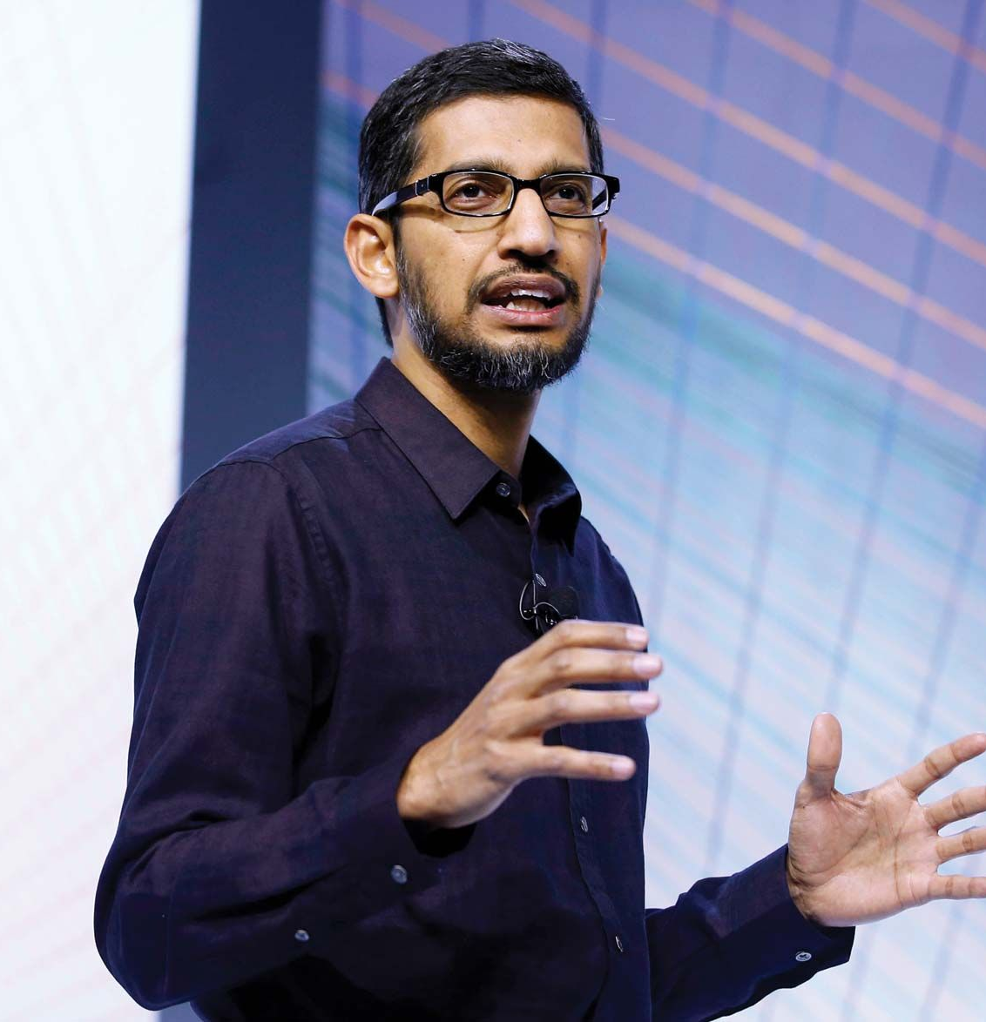
5. Business Examples Demonstrating EI & CQ
1. Google – Sundar Pichai’s Calm, Empathetic Leadership
Why it’s a strong EI example: Sundar Pichai is widely recognised for his calm, emotionally intelligent leadership style. He is known for listening deeply, encouraging open dialogue, and creating psychological safety — a core value at Google. His approach helped stabilise the company during periods of rapid growth and internal tension.
CQ connection: Pichai’s global background (born in India, leading a multinational workforce) enables him to navigate cultural differences with ease. His leadership style resonates across diverse teams and regions.
Sundar Pichai | Biography, Google, & Facts | Britannica
www.britannica.com

Slide 7
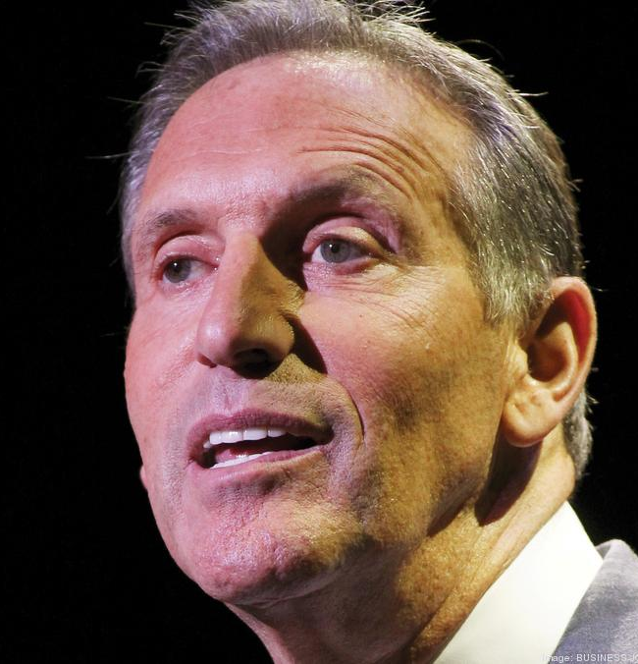
2. Starbucks – Howard Schultz and the Culture of Belonging
Why it’s a strong EI example: Howard Schultz built Starbucks around the idea of treating employees (“partners”) with dignity and respect. His emotionally intelligent approach emphasised empathy, active listening, and community-building.
CQ connection: As Starbucks expanded globally, Schultz championed cultural sensitivity in store design, product offerings, and employee training. This helped Starbucks adapt to local customs while maintaining a consistent brand identity.
Former Starbucks CEO Howard Schultz buys Surf Club Four Seasons condo ...
www.bizjournals.com

Slide 8

3. Toyota – Cross-Cultural Collaboration in the Toyota Production System
Why it’s a strong EI example: Toyota’s leadership culture emphasises humility, continuous improvement (kaizen), and respect for people. Leaders are trained to listen to frontline workers, value their insights, and respond constructively — all core EI behaviours.
CQ connection: When Toyota expanded into the US and Europe, leaders had to adapt Japanese management principles to different cultural contexts. Their success in blending cultures demonstrates high CQ and sensitivity to local working styles.
Toyota Production System: Revolutionizing Manufacturing
enginestories.com

Slide 9
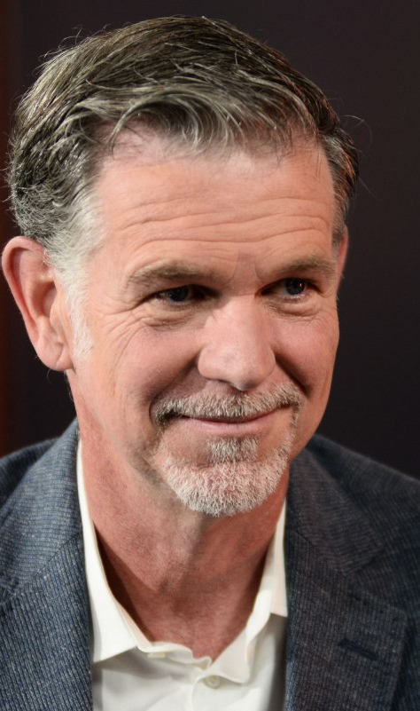
4. Netflix – Reed Hastings and Radical Transparency
Why it’s a strong EI example: Netflix’s culture of “freedom and responsibility” requires leaders to give honest feedback while maintaining trust. Reed Hastings’ emotionally intelligent approach encourages open communication and accountability without fear.
CQ connection: As Netflix expanded into over 190 countries, leaders had to adapt their communication style to different cultural norms. The company invested heavily in understanding local storytelling traditions, consumer behaviours, and workplace expectations — a clear demonstration of CQ in action.
Netflix co-founder Reed Hastings joins Anthropic's board | TechCrunch
techcrunch.com

Slide 10

6. Critical Evaluation: Why These Skills Matter
Strengths
Enhance communication and reduce conflict
Improve team cohesion and psychological safety
Support ethical and inclusive decision-making
Enable leaders to adapt to global markets
Limitations
EI and CQ can be difficult to measure reliably
High EI doesn’t guarantee moral behaviour
CQ can be used superficially without genuine respect
Both require continuous learning, not one-time training

Slide 11

7. Conclusion
Emotional and cultural intelligence are not optional extras — they are essential capabilities for leaders navigating today’s interconnected world. Edith Heard’s emphasis on empathy and multicultural awareness reflects a broader leadership truth: understanding people is the cornerstone of influence.
Leaders who cultivate EI and CQ are better equipped to inspire, collaborate, and guide diverse teams toward shared success.

Slide 12
8.References
Ang, S. and Van Dyne, L. (2008) ‘Conceptualization of cultural intelligence: Definition, distinctiveness, and nomological network’, in Ang, S. and Van Dyne, L. (eds.) Handbook of Cultural Intelligence. New York: M.E. Sharpe, pp. 3–15.
Earley, P.C. and Ang, S. (2003) Cultural Intelligence: Individual Interactions Across Cultures. Stanford, CA: Stanford University Press.
Financial Times (2022) ‘Interview with Edith Heard’, Financial Times, 27 February.
Goleman, D. (1995) Emotional Intelligence: Why It Can Matter More Than IQ. New York: Bantam Books.
Goleman, D. (1998) ‘What makes a leader?’, Harvard Business Review, 76(6), pp. 93–102.
Google (2023) Diversity, equity and inclusion report. Google. Available at: https://www.google.com (Accessed: 23 March 2026).
Hastings, R. and Meyer, E. (2020) No Rules Rules: Netflix and the Culture of Reinvention. London: Penguin.
Livermore, D. (2015) Leading with Cultural Intelligence: The Real Secret to Success. 2nd edn. New York: AMACOM.
Netflix (2023) Netflix culture: Freedom and responsibility. Netflix. Available at: https://www.netflix.com (Accessed:23 March 2026).
Schultz, H. and Gordon, J. (2011) Onward: How Starbucks Fought for Its Life Without Losing Its Soul. New York: Rodale.
Starbucks (2023) Global social impact report. Starbucks. Available at: https://www.starbucks.com (Accessed:23 March 2026).
Toyota (2022) Toyota Production System: Respect for people and continuous improvement. Toyota Motor Corporation. Available at: https://www.toyota-global.com (Accessed:23 March 2026).
Yukl, G. (2013) Leadership in Organizations. 8th edn. Harlow: Pearson.

Slide 13
Thank you!

