Slide 1
A Study of Novice Programmer Performance and Programming Pedagogy

Slide 2
“The Rainfall Problem” (1980s)
“Write a program that repeatedly reads in positive integers, until it reads the integer 99999. After seeing 99999, it should print out the average”
Could only be solved by 14% of the novice student programmers
30% of the most advanced students failed to solve it.
This result has been repeated in numerous studies

Slide 3
Why am I interested in programming pedagogy
The McCracken working group (2001)
  Students performed poorly → average student score being 21%.
  Majority of students failed to gain even the most rudimentary skills required to get a program ready to run.
  Results were independent of the country and the education system
Notes:
The McCracken working group assessed the programming ability of a large number of first year computer science students across four universities

Slide 4
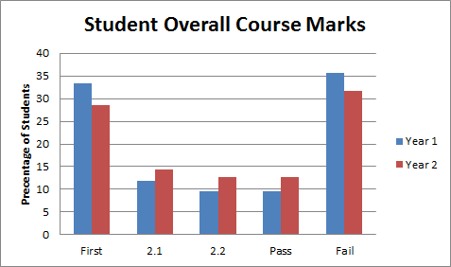
Class polarization effect
Bimodal Distribution
How do we address this?

Slide 5
Silver Bullet?
There is no “silver bullet”
How could I improve my teaching?

Slide 6
Questions this raises
Is success or failure predictable?
  If so can those individuals identified as being at risk of failure be given additional assistance?
Are there any common behaviour patterns or factors associated with success of failure?
Is it possible that students may benefit from a different teaching approach?
  What is it?

Slide 7
Action Research
Involves developing a researchers practice by allowing them to:
  Document their actions and beliefs.
  Evaluate their decisions and actions.
  Take action to improve their practice
  Determine if their practice has improved
PRACTICE = TEACHING

Slide 8
Action Research
“No one else does your practice, so no one else can claim they know it with the authority of your own experience. This is your original claim to knowledge. ....you will be judged on the quality of the action you took, whether you tried to enable others to learn for themselves. You will not be judged, however, on whether you succeeded.”
(McNiff, 2009)

Slide 9
Five Stages of the Action Research Cycle
Identify primary problems
Communicate what was learnt
Iterate N Times

Slide 10
Where do we start?
There has been significant research in a wide range of related research topics including :
Pedagogy (General e.g. constructivism)
Programming pedagogy
Cognitive psychology → Software comprehension
Programming languages and techniques
Approaches to programming e.g. procedural vs OOPs
General programming difficulties

Slide 11
Grounded Theory
A systematic method applied over a number of stages
Relates theory to the reality of the phenomena under consideration → “grounds” it !!
Will discuss in more detail at the end of the presentation

Slide 12
Abstraction
Abstraction emerged as the primary concept
Closely related to:
“plan/text structure” knowledge
problem solving
To learn abstraction the student needs to be able to solve fairly large programming problems
To program the student needs to be able to learn to create abstract solutions

Slide 13
Abstraction
The importance of abstraction in programming is well known:
“We all know that the only mental tool by means of which a very finite piece of reasoning can cover a myriad of cases is called “abstraction”; as a result the effective exploitation of his powers of abstraction must be regarded as one of the most vital activities of a competent programmer.”
(Dijkstra, 1972)

Slide 14
How do we create abstractions
We need to consider:
Cognitive psychology → how human memory works
  Short Term Memory (STM) → a subset of working memory
  Small amounts of information decays quickly
  “The Magical Number Seven, Plus or Minus Two: Some Limits on Our Capacity for Processing Information” (Miller, 1956)
  Working Memory (WM)
  A mental scratch space for performing complex tasks
  Long Term Memory (LTM)
  Memories stored over long durations associated with “mental models”
Software Comprehension → how we build mental models of software

Slide 15
Memory Chunking
How do we remember long numbers or words?
We chunk them e.g. splitting numbers into groups of 3
For the same reason:
CONTRAPOSTABLE
is much easier to remember than
ECTPANRSLBOTPO
Out short-term and long-term memory uses this type of chunking process

Slide 16
Program and Situation Models (Pennington, 1987)
Situation Model: our understanding of the:
  problem domain (background or domain specific knowledge)
  the functions, goals and purpose of the program
Program Model: our knowledge of programming
  Text structure knowledge: how the code is written
  Plan structure knowledge: how the code maps to the problem

Slide 17
Pennington’s Program Model (1987)
A “plan” is a schema or abstract “chunk” of knowledge
A program is a set of plans
Text Structure Knowledge:
Structured programming units or prime programs
Plan Structure Knowledge:
Intermediate concepts e.g. searching, sorting, etc.
Algorithms and Data Structures
Software Constructs

Slide 18
Von Mayrhauser (1995): Slot Types and Fillers
Plans (or frames) consist of two parts:
  slots: abstractions that can be applied to multiple problems
  Contain slot fillers
  slot fillers: “value” developed to solve a particular problem
type variablename;
Plan
int
count
SLOT
int count;
SLOT FILLERS
(Rist, 2004)

Slide 19
Reading Vs Writing Code
Reading:
Develop program model and then situation model (Bottom Up)
  How does the code work
  How does it relate to the problem being solved
Novice Programmer: read code line by line
Expert Programmer: follow flow of control of executing code
Writing:
Focus changes from code flow of control to data flow and comprehension of code function (Top Down)
Pennington (1987)

Slide 20
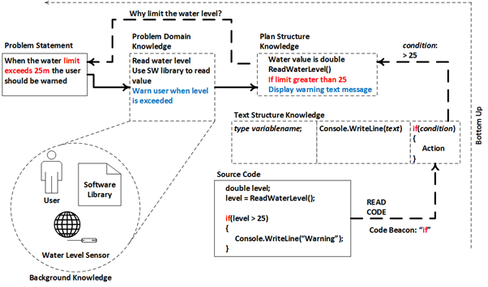
How we read code
Cross Referencing (Bottom Up)
Problem Domain Knowledge
Problem Statement
Plan Structure Knowledge
Text Structure Knowledge
Source Code
Code Beacon
“if”

Slide 21
Modifying Code
The situation model is matched with the program model and used to build high-order plans in the program model
Constant cross-referencing between program and situation model required (abstract thinking)
  Implies an increased mental load
Plan knowledge bridges the gap between the problem and program domain
  Plays an important role in the cross-referencing strategy
  Better plan/text structure knowledge reduces mental load
Pennington (1987)

Slide 22
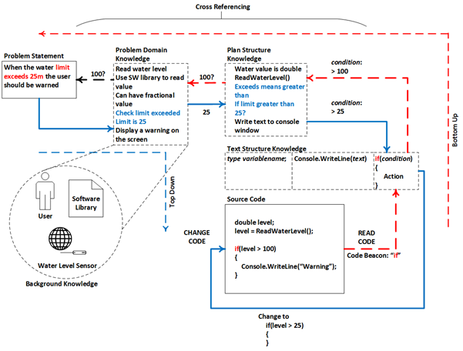
How we modify code
Cross Referencing (Bottom Up)
Problem Domain Knowledge
Plan Structure Knowledge
Problem Statement
Text Structure Knowledge
Top Down
Source Code

Slide 23
Reducing Cognitive Load
Teach both the reading and the writing of code
Cross referencing is vital
  assumes some prior knowledge of the problem domain
  (expertise → domain specific knowledge)
  cognitive load is reduced by better recall of programming patterns
  expertise is gained through experience i.e. practice
  adopt a teaching approach to reinforce the memory of patterns through targeted practice

Slide 24
Why is Working Memory Important
Controls our attention
→ allows us to spot the unusual
Enables us to concentrate
→ people with low memory are more easily distracted
It is related to fluid intelligence (gF)
→ gF is related to problem solving
Is working memory related to programming ability?

Slide 25
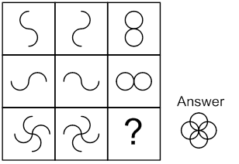
Example

Slide 26
Results
Correlation between Raven Matrices test scores and student results
Not normally distributed
Non-parametric Cramer V test :
Moderate association demonstrated
Linear regression analysis: coefficient of determination (R²) 0.9794

Slide 27
Results
Ravens
Code
Ravens
Code
Code
Ravens
BELOW AVERAGE
AVERAGE (50-60%)
ABOVE AVERAGE

Slide 28
Results
The results demonstrate :
A potential relationship between working memory and programming ability
Problem solving difficulties (related to poor WM)
Offer an explanation for the bimodal distribution of results often seen in programming
Initial code testing can predict which students will need further support ← targeted help
  sign-test : Z score=-0.093 and probability(p) value=0.926 no statistical change in student assignment results against original code test results

Slide 29
Action Research
Worksheets
Pattern Based Learning (ACI)
  Problem Solving for Programming
Structured Problem Solving

Slide 30
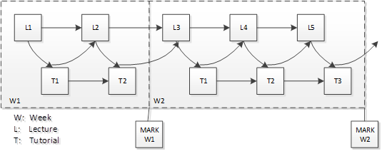
Teaching through Worksheets
The original approach to teaching was to use a series of worksheets
Structured content ← similar to chapters in a book
Exercises provided at the end of sections ← collocation
Multiple hand in dates ← to promote regular practice

Slide 31
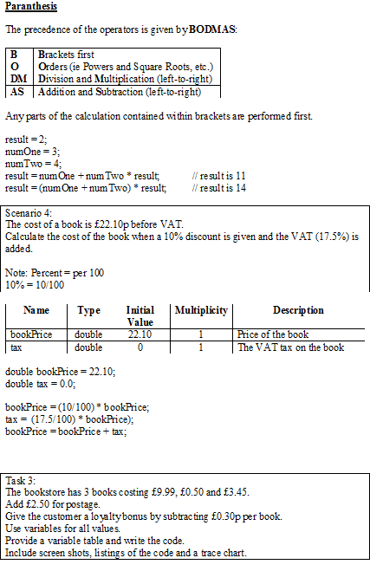
Worksheet Structure
Theory
Example(s)
Exercises(s)

Slide 32
Worksheet Content
Variable identification tables
Requirements analysis
Flow Charts
Coding exercises
Name | Type | Initial Value | Multiplicity | Description
totalCost | double | 0 | 1 | The total cost of the products in the shopping basket
A shop wants a program that allows the assistant to enter the price of 2 products and calculates the total cost. When the cost is more than £30 the cost of the lowest product is deducted from the total. Finally the total cost should be displayed.
Identify the variables.
Draw the flow chart and write the code.

Slide 33
Flow Charts
Only useful if you already know the solution
If you can draw a flow chart you can already code the solution
Raises the same difficulties that occur in coding
Intermediate Stage
(Codeable Solution)
c
Flow Charts
(Program Logic)
Problem Solving
c
c
c
Code

Slide 34
Behavioural Analysis – Frequent Pattern Tree
Results were:
Analysed per worksheet
Analysed in relation to final grades → across all worksheets
Conclusions:
Metrics were not a good predictor of student performance
No strong patterns could be identified
Problem solving was again found to be the best indicator of poorer performance
  Confirmed similar findings from other research studies

Slide 35
Analogous Transfer of Knowledge
The process of learning an abstract principle through analogy
Using multiple concrete examples to learn the same abstract principle
Problem solving expertise is recognised as the ability to:
  Ignore irrelevant surface dissimilarity (natural language)
  Recognise structural similarity in problems i.e. identify the abstract solution
Question: To what extent does natural language procedure (concrete surface features) distract novice programmers?

Slide 36
Range Selection Problem
“A game requires a player to collect a number of coins and pays a bonus of 150 points when more than 100 are collected and a bonus of 500 points when more than 400 coins are collected. The player can only be awarded one bonus.”
Developed and used operator range diagrams (no code required)
30 students
15 students were influenced by the natural language procedure
In a later exercise this rose to 23 students

Slide 37
Training
Teach students to look out for this by providing a number of “misleading” exercises
Train them to spot inconsistencies in their logic
These can be minor → postcode and telephone number
Make a list of names of quantities and categorise (integers, Booleans, etc.)
To avoid misunderstandings initial exercises should be very terse

Slide 38
Expertise
Experts
Domain specific knowledge to apply to a problem
Better more complete mental models
Novices
Lack problem solving skills
Working memory plays a potential role
Have difficulty interpreting natural language problems

Slide 39
Abstract Construction Instruction (ACI)
Based on memory chunking
Plans, slots and fillers become taught abstract patterns
Teach fillers to create concrete patterns
Name patterns
Focus on pattern recall
  Provide exercises specifically targeted at reinforcing recall of pattern → practice, practice, practice
Surprise tests!!
Variable Declaration Pattern
type variablename;
type
  int
  double
  string
  bool
Slots
Filler

Slide 40
Analogous Transfer of Knowledge
Teach the abstract principle
Teach multiple concrete examples using the principle
Better than….
Teach multiple concrete examples
Allow the student to derive the abstract principle themselves
type variablename;
int count;
double price;
int count;
double price;
type variablename;
Hmm, got it !!
Gick, 1983

Slide 41
Exercises: Reinforce Recall of Patterns
type name;
name = “fred”;
type number1;
number22 = 22;
The exercises can be quite cryptic and terse
type partName;
partName = value;
type postCode;
postCode = value;
Identify the variable:
We wish to find the discount price when a product is on sale with 5.3% off the normal price

Slide 42
Reduce Surface Dissimilarities
ACI APPROACH
If(number1 > 10)
{
if(number2 > 4)
{
}
}
If(number > 10)
{
}
if(condition)
{
}
Branch Pattern
Exercise:
Enter price
Display “Price is greater than £302.20p”
Exercise:
A shop wants a program that allows the assistant to enter the price of 2 products and calculates the total cost. When the cost is more than £30 the cost of the lowest product is deducted from the total. Finally the total cost should be displayed.
Identify the variables.
if(price > 302.20)
{
}
total = price1 + price2
If(total > 30)
{
if(price1 < price2)
total = total – price1;
else
total = total – price1;
}
if(condition1)
{
if(condition2)
{
}
}
Nested Branch Pattern
Reduced Distractors
Reduced Cognitive Load

Slide 43
Examples: Minor Progressive Steps
Procedure Pattern
void ProcedureName()
Procedure with Arguments Pattern
void ProcedureName(arguments)
Function Pattern
type FunctionName()
Function with Arguments Pattern
type FunctionName(arguments)

Slide 44
Example: Introduction to OOP
Class Declaration Pattern
class ClassName
{
//Attributes
//Constructors
//Properties
//Methods
}
Exercises
Class Attribute Pattern
User
user’s name
user’s password
Customer
customer’s name
customer’s age
first line of
customer’s address
class ClassName
{
//Attributes
type _attributeName;
}

Slide 45
Notional Machine
Don’t avoid teaching the notional machine
Three properties of a variable
  Unique identifier
  Value
  Memory address
Arrays
Pointers
Offset
int x = 2;
int *y = &x;
Array address + 0
0
Value1
Array address + 1
1
Value2
Array address + 2
2
Value3
y contains the memory address of x

Slide 46
Functions as Solutions
resulttype ProblemName ( information to solve problem )
Calculate area of the shape
Solve two problems
Area of circle
Area of square
Reuse solutions
2 x circles
2 x rectangles

Slide 47
Problem Solving Techniques
Instill good programming problem solving techniques e.g.
  Divide and conquer
  Low hanging fruit
  Generalise solutions, etc.
Obtaining complete solution is not necessary
Tackle big problems → focus on identifying small solvable problems
Code must be tested

Slide 48
Example: Black Jack (Divide and Conquer)
How do we represent the cards?
  Point value and suit
How to we shuffle the cards? ← random numbers
How do we deal a card?
How do we prevent the same card being dealt twice?
What do we mean by player turn order?
What is the players hand?
etc.

Slide 49



Simplify Big Problems: How do we shuffle cards?
How do we represent a single card?
  One value → a number 1
How about two cards?
  An array → two numbers 1..2
  Generalise: any number of cards (e.g. 52) 1..52
How do we shuffle two cards?
  Swap two values → swap values in the array
Generalise: Swap two cards in any size array
How do we randomly swap cards?
  Random number → array index?
Generalise solution N pairs of cards in any size array
ORDER FROM EASIEST TO HARDEST

Slide 50
Low Hanging Fruit
void SwapTwoCards(int cards[], int cardPosition1, int cardPosition2)
{
int tmp = cards[cardPosition1];
cards[cardPosition1] = cards[cardPosition2];
cards[cardPosition2] = tmp;
}
void ShuffleCards(int cards[], int deckSize, int maxShuffle)
{
for (int shuffleNo = 0; shuffleNo < maxShuffle; shuffleNo++)
{
int cardPosition1 = GetRandomNumber(deckSize);
int cardPosition2 = GetRandomNumber(deckSize);
SwapTwoCards(cards, cardPosition1, cardPosition2);
}
}

Slide 51
Build a Solution
int main(int argc, char **argv)
{
time_t t;
int cards[12];
int deckSize = 12;
srand(time(&t));
CreateDeckOfCards(cards, deckSize);
ShuffleCards(cards, deckSize, 10000);
return 0;
}
Tell a story

Slide 52
Methodology
Obtained through in-class observation, interview, survey and test
Two groups compared (4 students each)
  ACI group
  Non–ACI (different lecturer and module)
During initial testing
  ACI group showed slightly better recall
  ACI group demonstrated poorer problem solving ability
After problem solving instruction problem solving results for both groups were comparable

Slide 53
Results
ACI provides a much gentler introduction → rote learning??
Allowed closer examination of student difficulties
  Difficulty rises as even simple patterns become more dependant on each other
  e.g. the Array Counting Loop pattern

Slide 54
Results
Students in both groups were much more confident following problem solving instruction
Students perception: difficultly was converting solution to code
Actual problem: they had no codeable solution
Find a number in a list of 20 numbers
Intermediate Step
Implies array
for(i = 0; i < 20; i++)
{
if(numbers[i] > biggest)
biggest = number1
}
c
Incorrect
Conceptual leap
c
if(number1 > number2)
biggest = number1
int numbers[20]

Slide 55
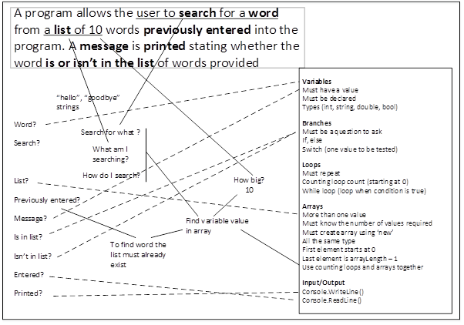
Mapping between Student’s Knowledge Domain and the Problem Space
Inert Knowledge: Poor mapping between “what they knew” about coding and the “things they didn’t understand” in the problem space
Explicitly teach this

Slide 56
Structured Problem based Learning
Solving larger problems → similar to commercial problems
A constructivist approach using Scaffolded learning
Provide a coding framework
Build framework in stages to enable problem discovery

Slide 57
Results
Building the framework was challenging
  Components had to be manageable sizes
  Led to the construction of a usable framework for solving larger problems e.g. MVC
  Designed to provide a suitable challenge for each lecture
  Well documented → student had to understand problem
  Time consuming
Correct scaffolding requires fading → fading was insufficient
Results obtained through survey
  Students found and solved their own problems
  Results were mixed → some students preferred the approach

Slide 58
Grounded Action Research
Worksheets
Pattern Based Learning
  Problem Solving for Programming
Structured Problem Solving

Slide 59
Future Work
Refine Abstract Code Instruction (ACI)
  Pattern naming in particular
Develop a better scaffolding framework for teaching problem solving → how should the fading work?
Mix ACI with a “provided” solutions approach → aka Pattern Oriented Instruction (POI)
Interleaved practice
Simultaneous exposure to multiple problem types

Slide 60
An adapted version of Grounded Theory
A systematic method applied over a number of stages
Relates theory to the reality of the phenomena under consideration → “grounds” it !!
Data is first collected
No starting hypothesis
No starting concepts or ideas
Researchers should avoid pre-conceived ideas
The theory should generate itself

Slide 61
Straussion approach: Variation of Grounded Theory
Research can start with a “research question”
  You can start by producing a literature review (which was required)
  Literature review integrates into the research → becomes primary research
  Literature review evolves as research progresses
    Focus changes as theory develops

Slide 62
Grounded Theory Data
What constitutes data for grounded research?
Create memos (short notes)
Qualitative data
  Research papers (the secondary research)
  Interviews
  Surveys
Quantitive data
  Statistical data
Your own research results are data that feed back into the anaylsis

Slide 63
Incidents, Categories and Properties
An occurrence of a concept (or “Code”) is known as “Incident”
  Given a name
Constant Comparison Method
→ determines frequency of “incidents” of a concept
A “category” or high level concept is defined by multiple incidents which can be assigned a common meaning
The concepts become “properties” of the category
Each property may be dimensionalised e.g. good, average, poor performance

Slide 64
Open Coding Stage
Coding is the process of identifying codes, properties, dimensions and categories
Key activities are:
Producing memos (field notes)
Identifying and naming concepts (codes)
Constant comparison of incidents across various sources

Slide 65
Constant Comparison Method
“maintain theoretical sensitivity through constant comparison”
Constantly comparing:
  incidents to incidents
  incidents to concepts
  concept to concept
Found the difference between concepts and categories became more blurred during this process

Slide 66
Axial Coding Stage
Looking for relationships (connections) between categories and sub-categories

Slide 67
Selective Coding Stage
Identify a single core category
Core Category:
It should be related to all other categories
It should be able to explain any variation and contradictory evidence
It should be a simple descriptive narrative about the central phenomenon of study
Variation of Grounded Theory (less strict):
May produce two or three “main” related categories

Slide 68
The Open Coding Process
Memo:
More complex concepts may also be stored in semantic memory as large structures in what are known as schema. A schema is a well integrated chunk of knowledge about the world, events, people or actions [8] and includes scripts and frames
Reseach Papers
Interpretation and rephrasing
Reseach Papers
Reseach Papers
Node
(code)
NVIVO
Memo Database

Slide 69
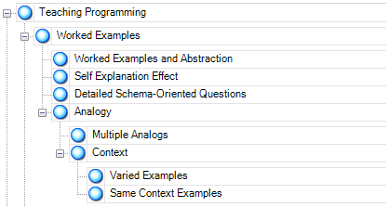
The Open Coding Process
Rearrange and rename nodes to form categories
  Sub-categories
  Main-categories
Identify properties associated with the nodes
Primarily Boolean properties

Slide 70
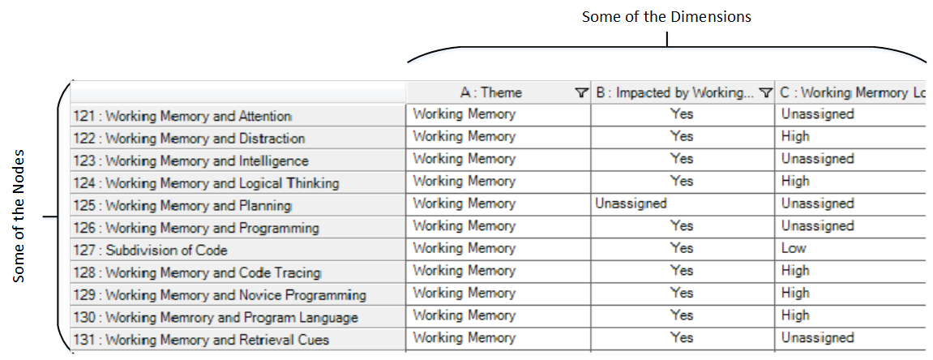
The Open Coding Process
NVivo Database
Some of the Properties
Dimension Value

Slide 71
Open Coding Results
The Open Coding results produced :
Low volume of data
Highly multivariate data (many properties identified)
“Sparse” data ← “the curse of dimensionality”
  Low support counts spread across the nodes (there weren’t 100,000s of research papers to analyse)

Slide 72
The Axial Coding Process
Couldn’t use statistical analysis
  Data mining techniques didn’t work
Had to use a visualisation approach
  The objective was to determine the variables that limited programming ability

Slide 73
A New Approach Required
Use a weighted graph approach to visualise grounded theory data (similar to semantic network)
Define a dimension as a name value pair
  “Impacted by Problem Solving = YES”
Dimensions become unique nodes in the graph
Each value in the Nvivo database is mapped to a dimension
  Edges added when dimensions occur together (in database row)
  Support count of existing edges is incremented
Edges are not directional (can be interpreted in either direction)
Edges can be culled by altering a support threshold
  Nodes without edges are culled
  Reveals more or less detail as required (drill down the graph)

Slide 74
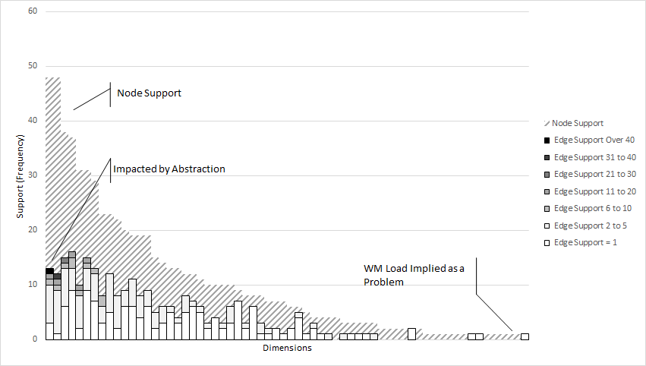
A New Approach Required
Edges with higher support are associated with nodes of higher support (most common themes)

Slide 75
The Edge Weighted Graphs
Allowed the main concepts and their relationships to be identified
Indicated area where the research could be focused
Allowed a coherent picture to be formed from a wide range of research areas
Gave a strong framework around which the final literature review could be structured
Enabled both axial and selective coding ← the relationships between concepts could be visualised more clearly

Slide 76
Any Questions?

Slide 77
Problem Solving: Finding largest value in 3 numbers
Broken Solution
Good Solution
if(number1 > number2)
{ }
else if(number1 > number3)
{}
else if(number2 > number1)
{}
etc.
if(number1 > number2
&& number1 > number3)
{ max = number1 }
else if(number2 > number1
&& number2 > number3)
{ max = number2 }
else { max = number3 }
Best Solution
max = number1
if(number2 > max)
{ max = number2 }
if(number3 > max)
{ max = number 3 }
What is the best solution?
This is a subjective decision

Slide 78
One message per slide
Steer focus -- Contrast and size
Avoid using Sentences when speaking at the same time – put in presentation aid
Dark background
Six objects per slide

Slide 79
Grounded Theory Analysis
Aaaaa
Bbbb
Cccc
Dddd
Eeee
Ffff
Gggg
Hhhhhh

