Slide 1
BMSK6001 Emergent Leadership Skills for the Workplace
Evening Session 4

Slide 2

Agenda
Leadership
Leadership that gets results…
Six styles of leadership
Climate
Styles as drivers of climate

Slide 3
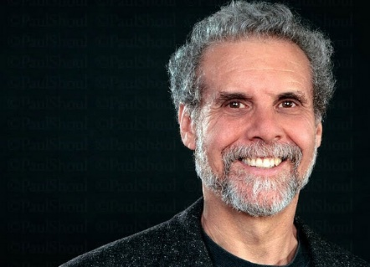
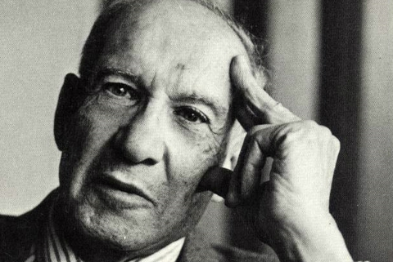
Leadership?
‘Effective Leadership is not about making speeches or being liked; leadership is defined by results not attributes.’ Peter Drucker
In McGrath, J. and Bates, B. (2017). The little book of big management theories. 2nd edn. Harlow UK; Pearson Education Limited p.48
And ‘Great Leadership works through the emotions.’
Goleman, D. (2013). Primal leadership: unleashing the power of emotional intelligence. Boston, USA; Harvard Business School Publishing p.3

Slide 4

Leadership that gets results…
Emotional Intelligence: A Primer
Self-awareness
  Emotional self-awareness
  Accurate self-assessment
  Self-confidence
Self-Management
  Self-control
  Trustworthiness
  Conscientiousness
  Adaptability
  Achievement orientation
  Initiative
Social Awareness
  Empathy
  Organisational awareness
  Service orientation
Social Skill
  Visionary leadership
  Influence
  Developing others
  Communication
  Change catalyst
  Conflict management
  Building bonds
  Teamwork and collaboration

Slide 5
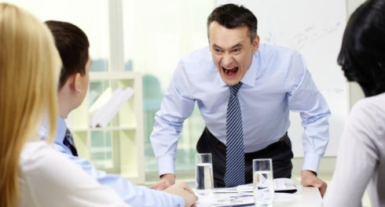
Six Styles of Leadership
: Demand immediate compliance
: Mobilise people towards a vision
: Create emotional bonds and harmony
: Build consensus through participation
: Expect excellence and self-direction
: Develop people for the future
Coercive
Authoritative
Affiliative
Democratic
Pacesetting
Coaching

Slide 6

Daniel Goleman – Climate
(factors that influence an organisation’s ‘working environment’
Flexibility – the freedom to innovate
Responsibility – to the organisation
Standards – that people set
Rewards – accuracy of feedback and ‘aptness’
Clarity – about Mission and Values
Commitment – to a common purpose

Slide 7
Styles as Drivers of Climate
 | Coercive | Authoritative | Affiliative | Democratic | Pacesetting | Coaching
Flexibility | -.28 | .32 | .27 | .28 | -.07 | .17
Responsibility | -.37 | .21 | .16 | .23 | .04 | .08
Standards | .02 | .38 | .31 | .22 | -.27 | .39
Rewards | -.18 | .54 | .48 | .42 | -.29 | .43
Clarity | -.11 | .44 | .37 | .35 | -.28 | .38
Commitment | -.13 | .35 | .34 | .26 | -.20 | .27
Overall impact on climate | -.26 | .54 | .46 | .43 | -.25 | .42
Notes:
Goleman’s research investigated how each leadership style affected the six drivers of climate, or working atmosphere. The figures show the correlation between each leadership style and each aspect of climate. So, for instance, if we look at the climate of flexibility, we wee that the coercive style has a -.28 correlation while the democratic style has a .28 correlation, equally strong but in the opposite direction.
According to the data, the authoritative leadership style has the most positive effect on climate, but three others – affiliative, democratic and coaching – follow close behind.
That said, the research indicates that no style should be relied upon exclusively, and all have at least short-term uses.

Slide 8
The Six Styles at a glance
 | Coercive | Authoritative
The leader’s modus operandi | Demands immediate compliance | Mobilises people toward a vision
The style in a phrase | “Do what I tell you” | “Come with me”
Underlying emotional intelligence competencies | Drive to achieve, initiative, self-control | Self-confidence, empathy, change catalyst
When the style works best | In a crisis, to kick-start a turnaround, or with problem employees | When changes require a new vision, or when a clear direction is needed
Overall impact on climate | Negative | Most strongly positive

Slide 9
The Six Styles at a glance (cont.)
 | Affiliative | Democratic
The leader’s modus operandi | Creates harmony and builds emotional bonds | Forges consensus through participation
The style in a phrase | “People come first” | “What do you think?”
Underlying emotional intelligence competencies | Empathy, building relationships, communication | Collaboration, team leadership, communication
When the style works best | To heal rifts in a team or to motivate people during stressful circumstances | To build buy-in or consensus, or to get input from valuable employees
Overall impact on climate | Positive | Positive

Slide 10
The Six Styles at a glance (cont.)
 | Pacesetting | Coaching
The leader’s modus operandi | Sets high standards for performance | Develops people for the future
The style in a phrase | “Do as I do, now.” | “Try this?”
Underlying emotional intelligence competencies | Conscientious, drive to achieve, initiative | Developing others, empathy, self-awareness
When the style works best | To get quick results from a highly motivated and competent team | To help an employee improve performance or develop long-term strengths
Overall impact on climate | Negative | Positive

Slide 11
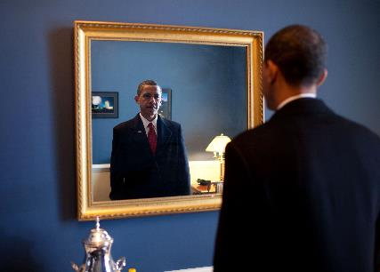
Some more thoughts…
What is Empowerment?
What is Delegation?
What is Direction?
What is Motivation?
How capable are YOU?

Slide 12
Define Motivation?
"Motivation is defined as the power that triggers action that follows" (Cheng, & Cheng, 2012).
"Motivation is generally understood to denote the strength of a person's desire to attain a goal" (Schmidt, Palminteri, Lafargue, & Pessiglione, 2010).
"Motivation is what causes behaviour" (Fejes, 2008).
Motivation is “‘…. the willingness of an individual to exert high levels of effort to achieve organisational goals, putting the needs of the team (or organisation) before satisfaction of their own personal needs’ (KW Hamilton, 2010)

Slide 13
Motivation is …..
‘…. the willingness of an individual to exert high levels of effort to achieve organisational goals, putting the needs of the team (or organisation) before satisfaction of their own personal needs’
(KW Hamilton, 2010)
‘Motivation is the art of getting people to do what you want them to do because they want to do it.’
(Dwight D. Eisenhower)
Notes:
Eisenhower’s definition sets out a challenge to any potential leader, namely, how to get people to follow you and to carry out your wishes. His assertion suggests that effective leadership is based upon the leader having a positive impact upon the people he is trying to lead. Adrian Gilpin of the Institute of Human Development underlines and reinforces the importance of this in his definition of leadership, stating that leadership is:
‘… the impact you have on yourself and the impact you have on people around you’
These definitions indicate that leadership is as much about the individual leader as it is about his or her training. In other words, while there are things that you can learn that will assist you as a leader, leadership is concerned more with our ability to influence and persuade our colleagues to follow our direction. Thus, effective leadership can depend very much on the personal qualities, characteristics and behaviours of the leader.

Slide 14
Characteristics of a High Performance Team
Skilled people;
Trained people;
A clear vision for the future;
A goals-oriented approach;
Clear roles and responsibilities;
People with complementary skills;
Effective communication;
Committed people;
Loyal people;
Honest people;
Team members who put needs of others before their own;
Concern for others;
People who are flexible;
People who want to learn and to develop;
People who are confident;
Trust;
Accountability;
Appropriate challenge and a desire to improve things;
High morale;
Motivated people;
A shared or common pride in the team;
Effective leadership based on empowering team members.
Notes:
Post the Recession in 2008, the world of work has changed noticeably. The language of many organisations (public and voluntary sectors) and companies (private sector) is focused on the need, respectively, to ‘do more for less’ or to ‘add value’. While this might appear to represent a shift in thinking, at the root of this is a desire to maximise performance. Where once high performance was considered a laudable aspiration, it has become an imperative for many organisations and companies.
Typical characteristics might include some or all of the following:
Skilled people;
Trained people;
A clear vision for the future;
A goals-oriented approach;
Clear roles and responsibilities;
People with complementary skills;
Effective communication;
Committed people;
Loyal people;
Honest people;
People who put the Team needs before their own;
People who are concerned for others;
People who are flexible;
People who want to learn and to develop;
People who are confident;
Trust;
Accountability;
Appropriate challenge and a desire to improve things;
High morale;
Motivated people;
A shared or common pride in the team; and,
Effective leadership based on empowering team members.

Slide 15
Performance – A coaches view…
Performance = Potential - Interference
Gallwey, W.T. (2015) The Inner Game Of Tennis. London: Pan Publishers
Notes:
So, is a significant part of the ‘interference’ a demotivating environment?

Slide 16
For the next session
You are the new CEO of a medium sized company, which is underperforming. Morale seems low. What would you do to create a motivating environment – at both a senior level and throughout your organisation?
Write approximately 500 words on your findings
Justify your proposed actions with appropriate academic and practical evidence
Fully reference the evidence you provide

Slide 17
Reference
Goleman D. (2000) ‘Leadership That Gets Results’. Harvard Business Review. 78(2):pp78-90.Available at https://search.ebscohost.com/login.aspx?direct=true&db=bth&AN=2839618&site=ehost-live. [Accessed April 12, 2020.]
Gallwey, W.T. (2015) The Inner Game Of Tennis. London: Pan Publishers

Slide 18
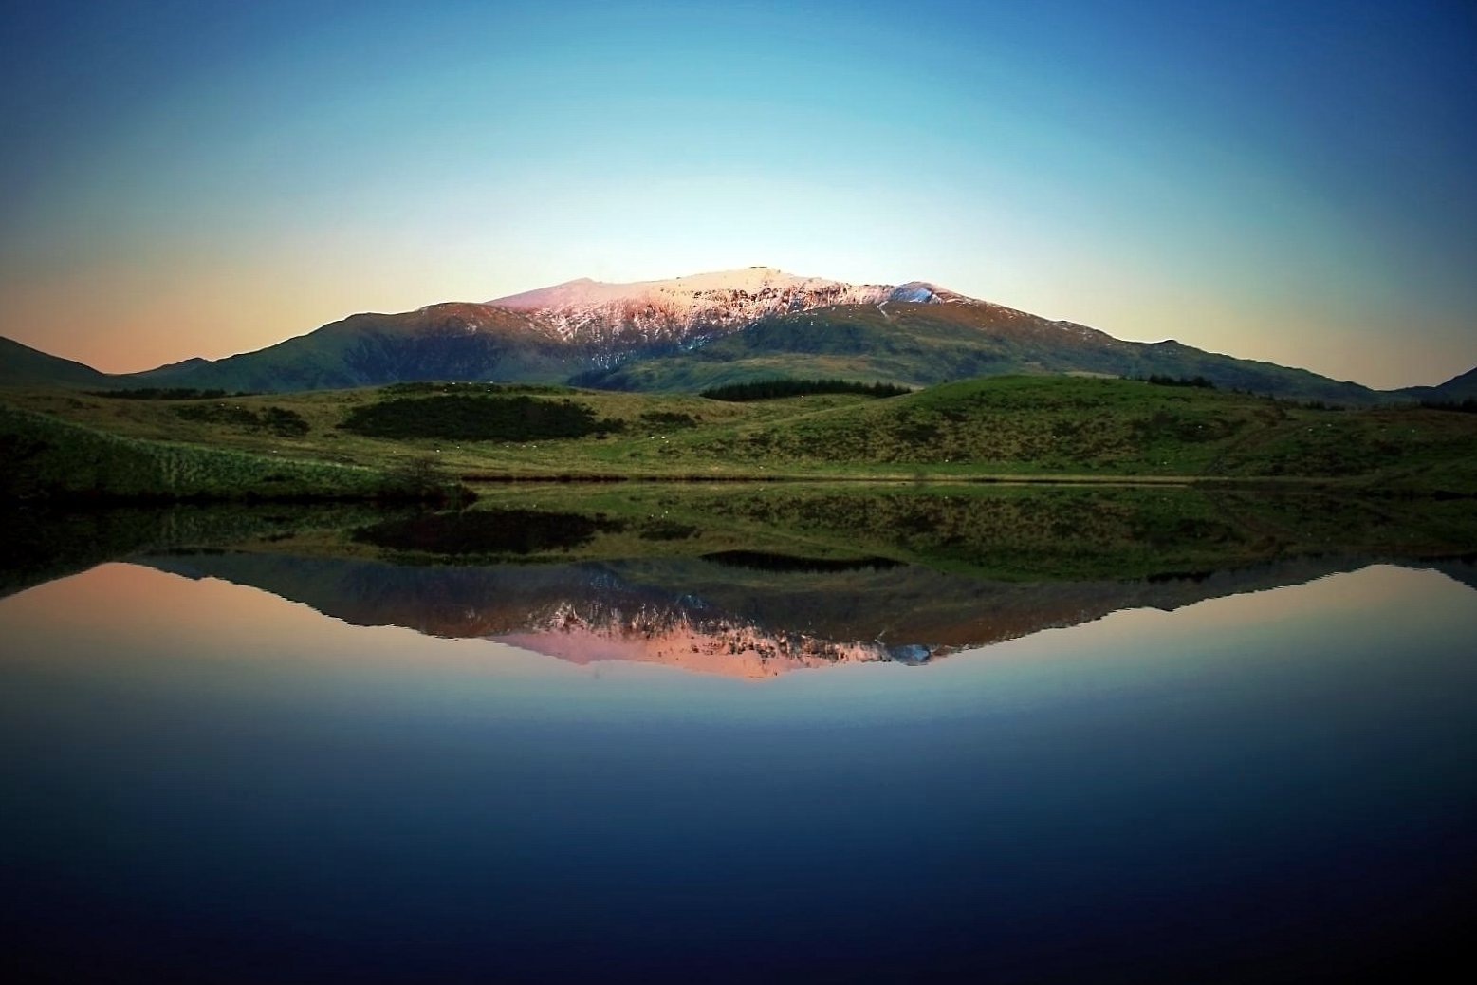
Summary
Take 5 minutes to reflect upon the session – what have you learnt?
Any key areas you want to research further?
What can help you with your assignment?
What can help you in your career?

