Slide 1
What are the challenges and opportunities for students in the Digital Era
Presented by Samantha Kilvington
Student 2508581

Slide 2
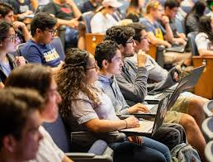


Overview
In my report, I focused equally on both the challenges and opportunities that students face and looked at the ways they can adapt and improve their knowledge.
My main key finding is that if we manage our time and prioritise by keeping up with the relevant platforms, ask for help and get relevant training, then we can successfully use these tools to our advantage.

Slide 3
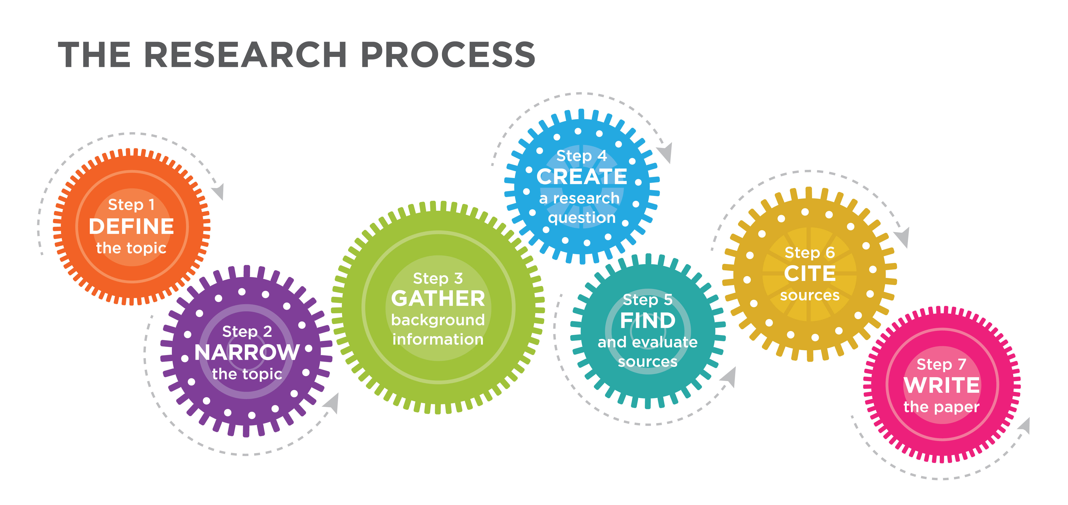
Research
I found my sources by reading articles, reports and using the internet, such as Google and Wikipedia to find my information.
I found that choosing a credible source was hard because there were so many I agreed with and wanted to include but the one I chose in the end I thought was the most credible and I related to the most.
The research did change my perspective, but in a positive way. I guess the more I read through these articles and opinions, my opinion changed too. I think that it is easier than I thought to learn and access the digital learning platforms; it’s just knowing where to find them.

Slide 4

Planning and writing
Planning and writing
How did you plan your report?
I planned my report by using a template to follow, and I dedicated time to each section so I could research and plan each section.
What strategies helped you with structuring or referencing?
The strategies I used were to plan and dedicate time to each section so that I was fully prepared and made notes, and choose my sources and references correctly.
What part of the writing process was the most difficult?
I found the referencing quite hard as I didn’t understand this at first, but the more I researched it and looked at the Harvard referencing on Moodle, it helped me.

Slide 5
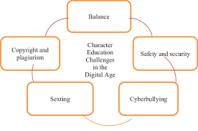
Challenges
I found the biggest challenge to be my confidence in completing this and finding all the right information.
I overcame these challenges by doing enough research so that what I was writing felt solid and made sense to me and whoever would be reading it.
I also completed about 10 different versions and sent these to my Tutor to give me feedback.

Slide 6

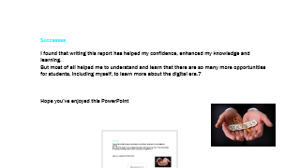
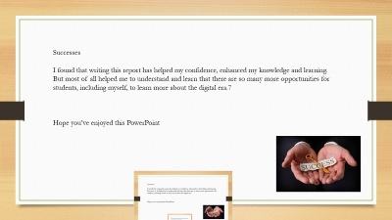
Successes
I found that writing this report has helped my confidence, enhanced my knowledge and skills in the digital world and how I will implement these into my daily life and work.
But most of all helped me to understand and learn that there are so many more opportunities for students, including myself, to learn more about the digital era.
Hope you’ve enjoyed this PowerPoint

