Slide 1
Changemakers: Building your Personal Brand for Sustainable Employment
Laura James
Laura.james@uwtsd.ac.uk

Slide 2
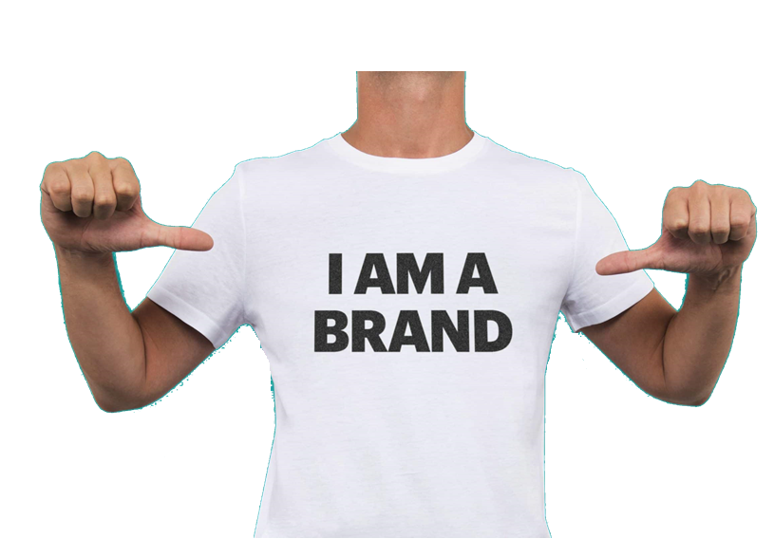
Qualifications
Employment

Slide 3

Welcome To The Module:
We are all BRANDS.
We have our own intellectual balance sheets and brand names, we have to invest in ourselves and market ourselves.

Slide 4
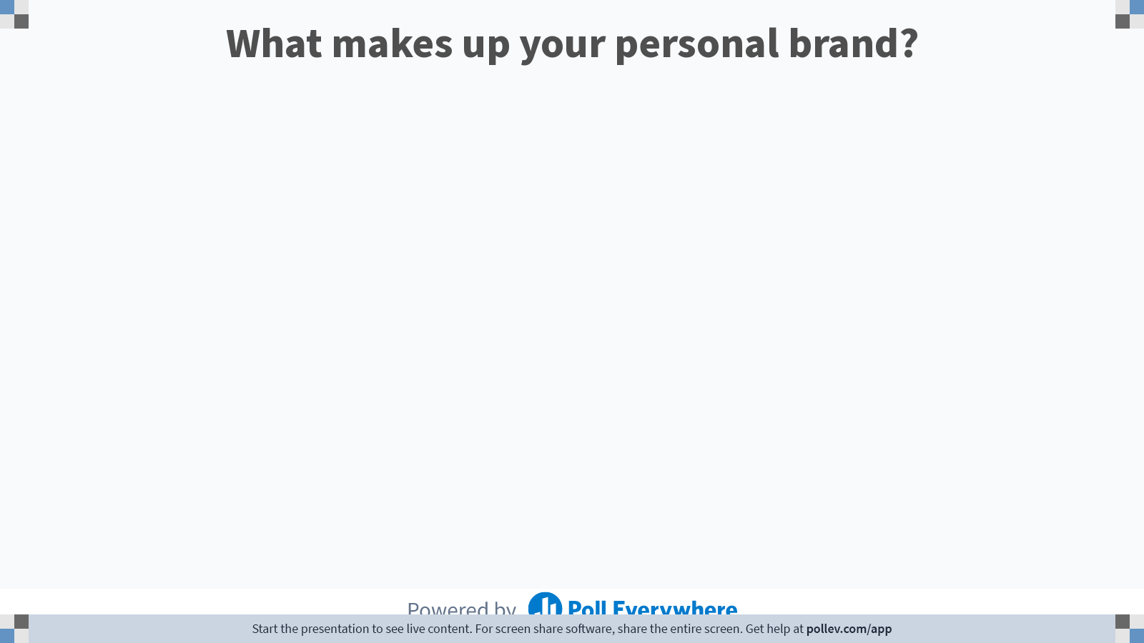
Notes:
Poll Title: Do not modify the notes in this section to avoid tampering with the Poll Everywhere activity.
More info at polleverywhere.com/support
What makes up your personal brand?
https://www.polleverywhere.com/free_text_polls/4anTmqdxwKl2IlLK9riPa

Slide 5
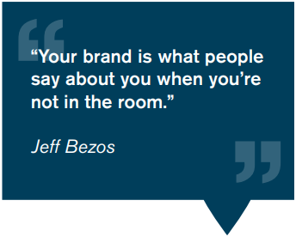

The primary AIM of this module is to support the development of the skills and competencies necessary for career resilience and professional development for the future work context.

Slide 6


Slide 7
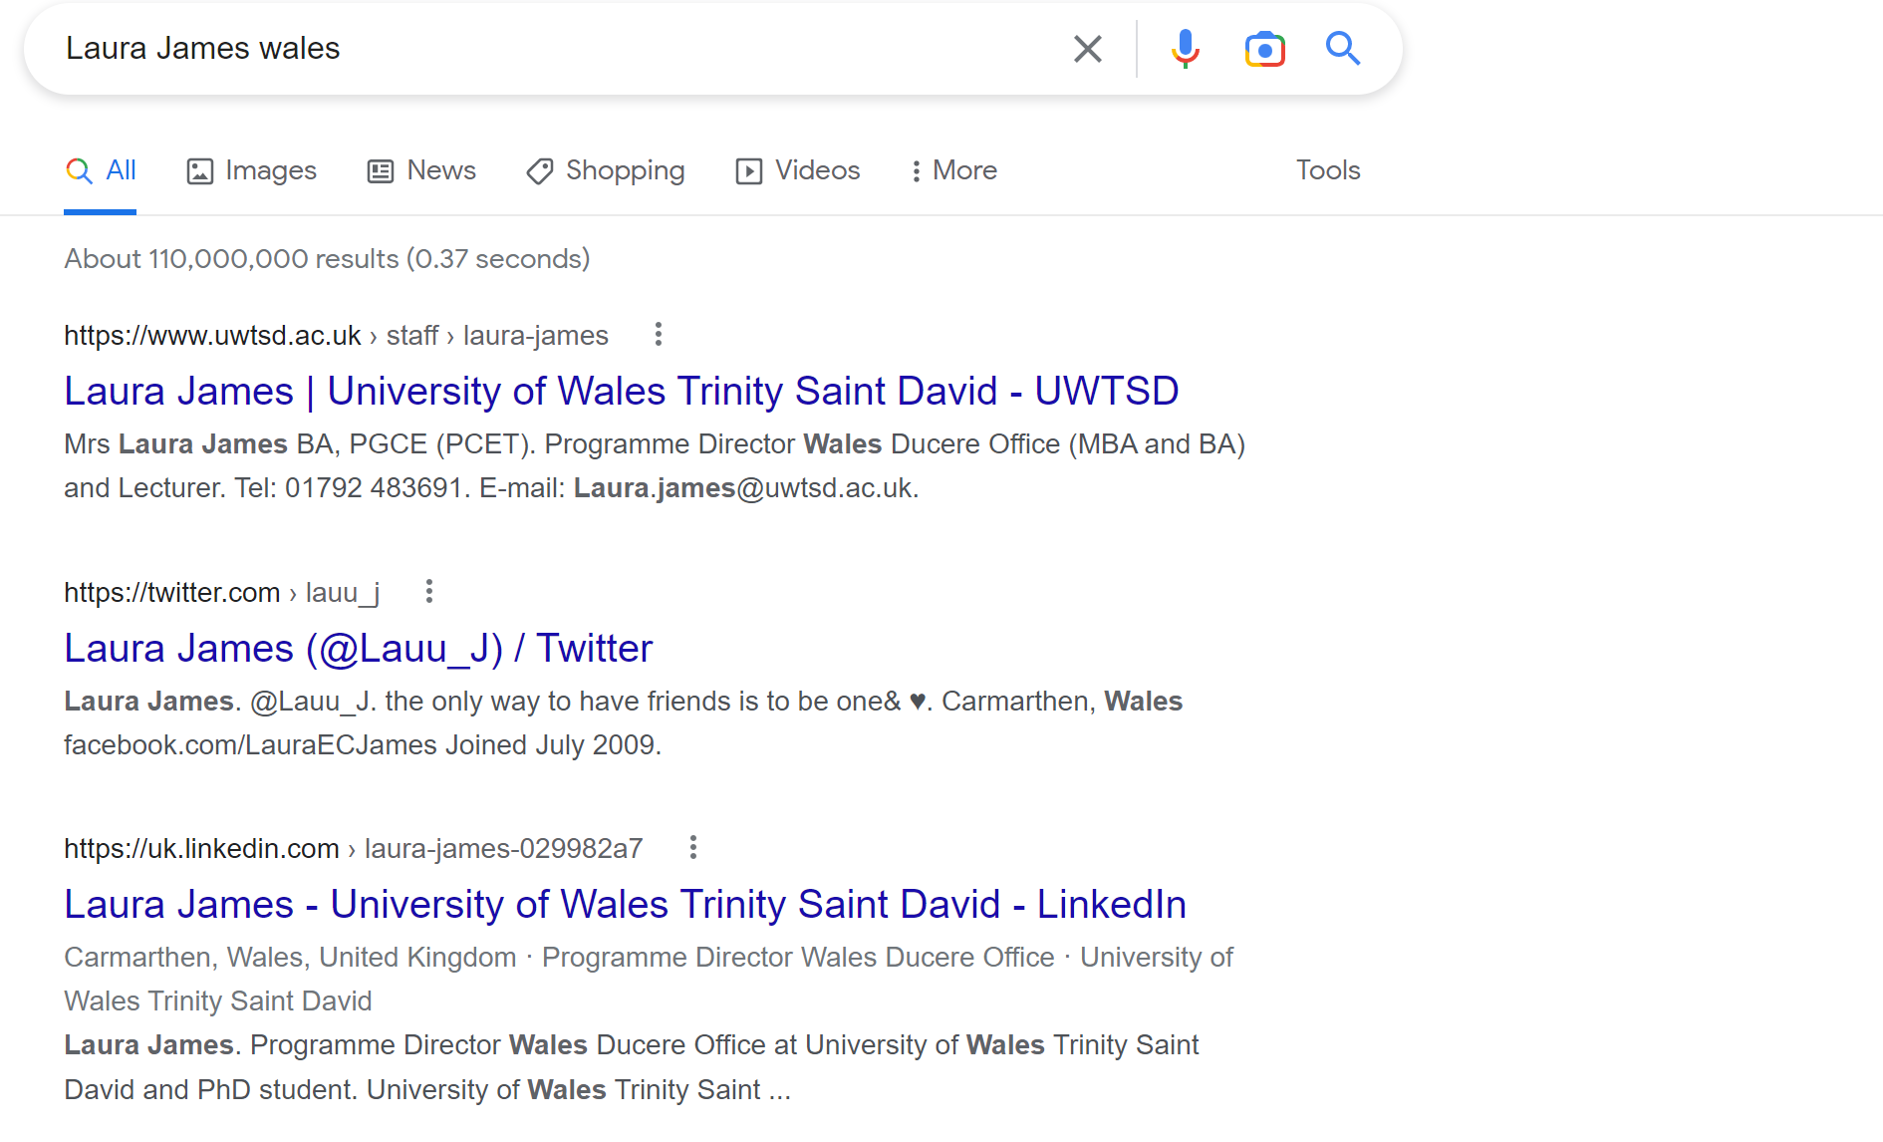
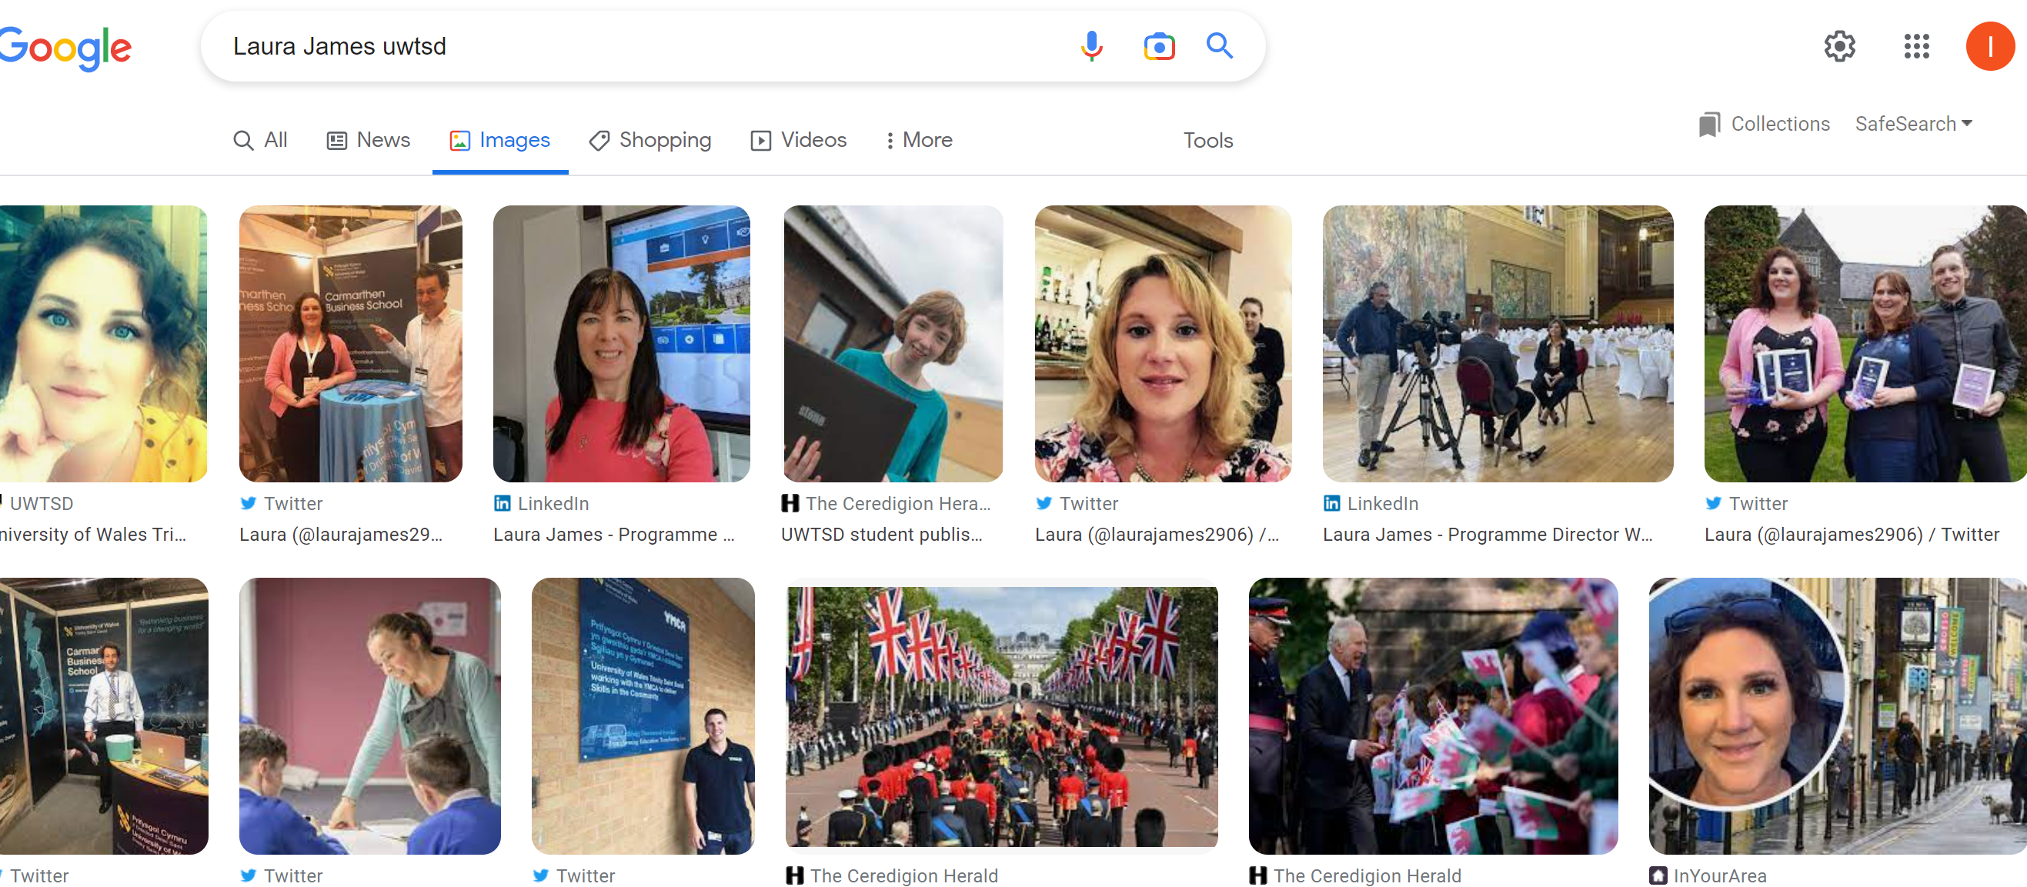

Slide 8

Personal Brand
Whether you know it or not, you have a personal brand.
Whether you have a date or a job interview, chances are someone is going to Google you to learn more about who you are and these results are the first impression they will have of you.
  Is it a good one?
  Is the information you are sharing across social media sites consistent?
  Do you want to allow your online reputation to take on a life of its own or control the narrative?

Slide 9

Why Is This Important?
According to a 2018 CareerBuilder survey, 70% of employers use social media to screen candidates during the hiring process, and 43% of employers use social media to check on current employees.
Another reason personal branding is valuable is that the gig economy is not going away anytime soon.
The average person switches jobs every 2 to 3 years and freelance and contract work continues to grow in popularity.

Slide 10

An Employers Perspective – The Future of Work
Notes:
https://www.youtube.com/watch?v=ysO9XzgSJ_w&feature=emb_title

Slide 11
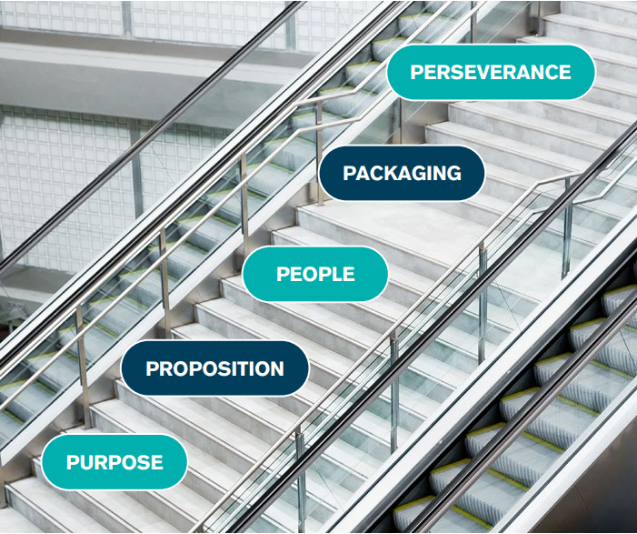
5P’s to Personal Branding
As a result, YOU need to be able to clearly communicate who you are and what you do to stand out to prospective clients and employers.
If you aren’t effectively managing your personal brand, then you run the risk of losing out.

Slide 12
Module Structure
The module consist of 4 Units and is designed to support the development of your personal brand using the 5P’s as a framework.
Unit 1
Brand You (Purpose and Proposition)
Unit 2
It’s a Small World (People)
Unit 3
Opportunity Knocks (Packaging)
Unit 4
The Pursuit of Happiness (Perseverance)

Slide 13
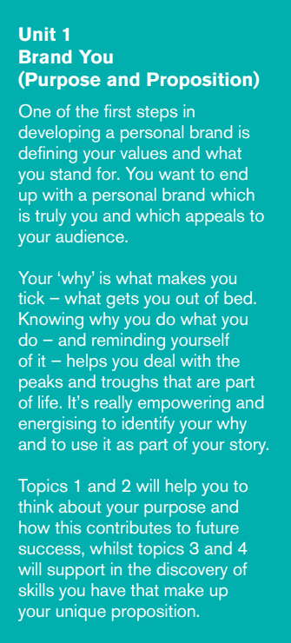
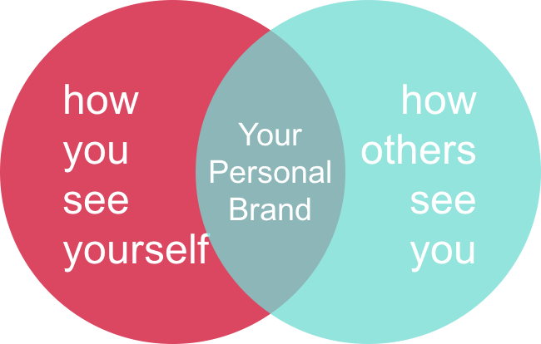
Unit 1 - Brand You (Purpose and Proposition)
Topic 1:
Ambition is Critical
Topic 2:
What Drives You?
Topic 3:
Boundaryless Careers
Topic 4:
Boundaryless Skills

Slide 14
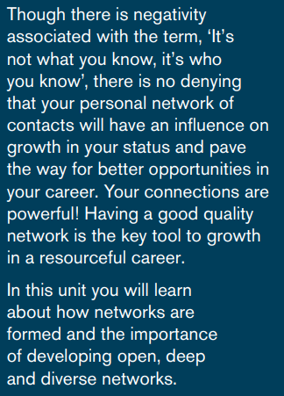

Unit 2-It’s a Small World (People)
Topic 1:
No one is an island
Topic 2:
Variety is the spice of life
Topic 3:
Network Society
Topic 4:
Making Connections

Slide 15
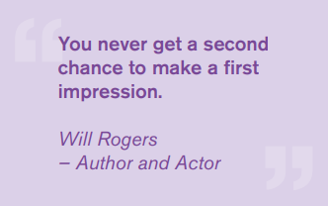
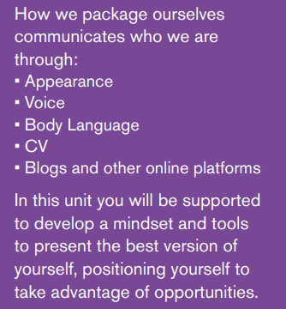

Unit 3 - Opportunity Knocks (Packaging)
Topic 1:
Creating Your Own Luck
Topic 2:
Identifying Opportunities
Topic 3:
Open Doors
Topic 4:
Me.com

Slide 16
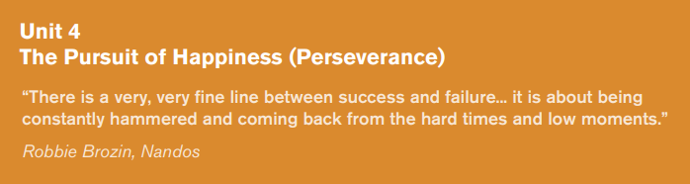

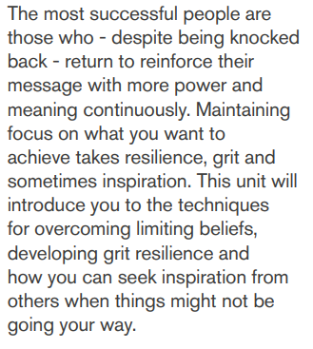
Topic 1:
Creating Your Own Luck
Topic 2:
Identifying Opportunities
Topic 3:
Open Doors
Topic 4:
Me.com

Slide 17


Slide 18
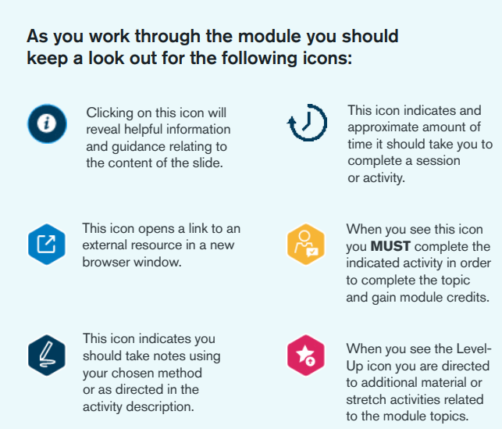
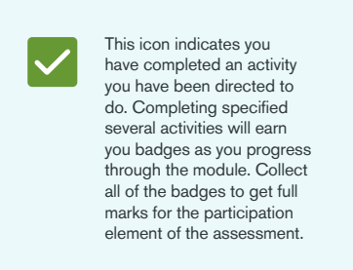



Navigating The Module

Slide 19
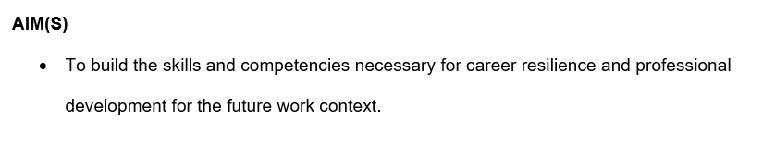
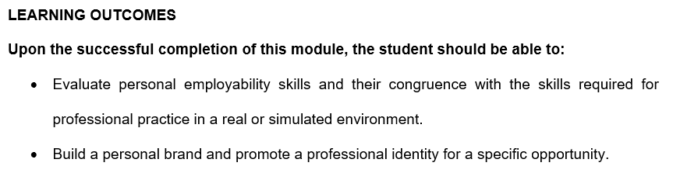
Aim & Learning Outcomes

Slide 20
Next week
Assessments
Career Goals and ambition
Motivation- What drives you
Boundaryless Career
Skills

Slide 21


