Slide 1
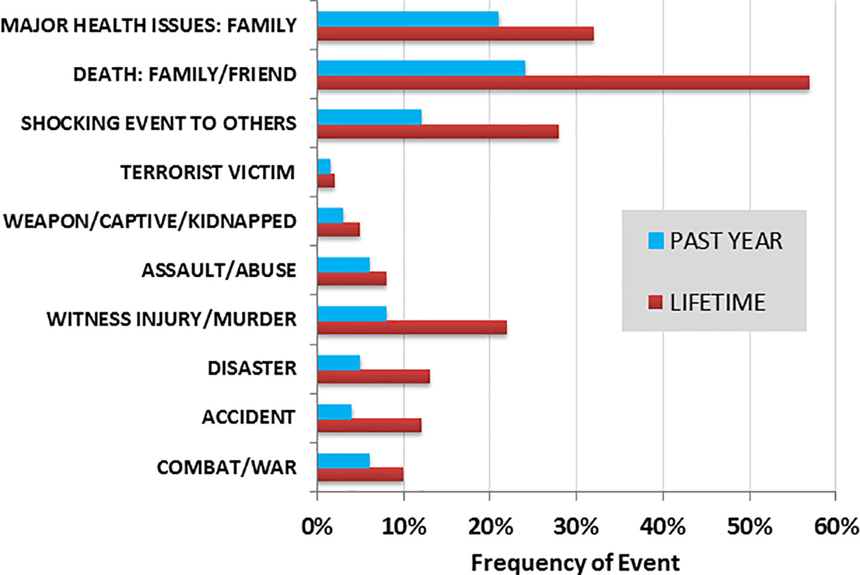
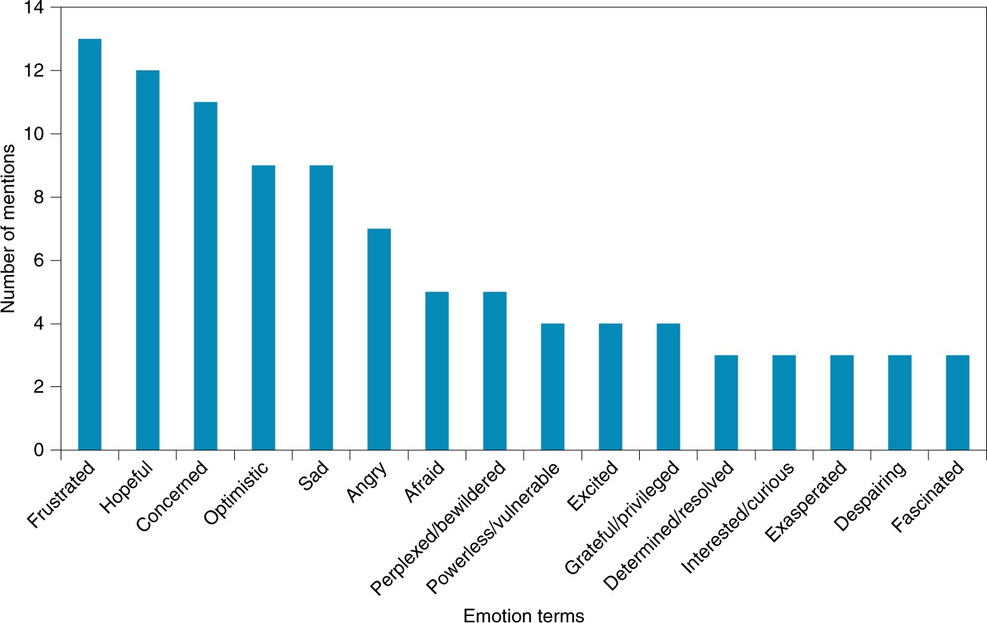
The Important of resilience/ wellbeing and mental health
Introduction
Analysis
Results Image
Results
The mental health problem and the resilience/ wellbeing is a very common problems and as we know all of us have mental health issues and the important think you should know Is hard to accept or to talk about it, but at the same time you can have help/support for any kind of mental health issues.
There are several possible reasons of mental health issues. Although some people may be more severely impact by specific things than others, it’s possible that many people are affected by a complex combination of elements.
Life seems more difficult when our mental health is poor. We may frequently experience sadness, tears, exhaustion, and hopelessness. We may be living in an intolerable situation or be constantly.
Objectives
Methods
Results Image
Summary and conclusions
You will never feel insufficient if you work harder to keep yourself occupied, have a hobby, and make an effort to interact with others.
In England, throughout any given week: Anxiety and depression combined: 8 out of 100
Six out of 100 people have generalised anxiety disorder (GAD).
Depression: 3 out of 100 persons
PTSD (post-traumatic stress disorder): 4 out of 100 persons.
1 in 100 people suffer from obsessive- compulsive disorder (OCD).
Less than 1 in 100 people suffer with panic disorder.
In recent years, there has been a general increase in the number of persons reporting menta; health issues.
The percentage of men and women with common mental health issues increased by 20% between 1993 and 2014.
In any given week the proportion of people experiencing serious mental health symptoms increased from 7% in 1993 to over 9% in 2014.
There has been an increase in the number of young women reporting common mental health issues,

