Slide 1
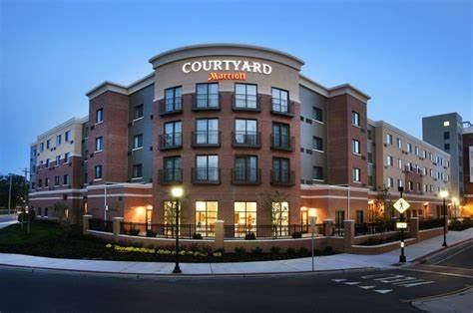
IMPORTANCE OF QUALITY SERVICE IN THE HOSPITALITY INDUSTRY
Student name:Constantin Bogdan Rusu
Student ID:2014305
Module:Hospitality and Guest Service (BMIH4003)
Lecturer: Muhamad Cassamo
COURTYARD BY MARRIOT

Slide 2
Table of Contents
S/No | Topic | Slide
1. | Title and student’s name | 1
2. | Table of content | 2
3. | Name of the Hotel in the study | 3
4. | Introduction of the hotel | 4
5. | Brand consumers | 5
6. | Nature, scope and role of guest services | 6
7. | Importance of quality services to guests | 7
8. | Importance of hospitality in the industry | 8
9. | How hotels meet guest expectations | 9
10. | How hotels exceed guest expectations | 10
11. | Summary | 11
12. | References | 13

Slide 3
Sheraton Tel Aviv
Hotel
Courtyard by Marriot
Notes:
This presentation will use Sheratton Tel Aviv Hotel as a case study to achieve its objective of examining the importance of quality services in the hospitality industry.

Slide 4
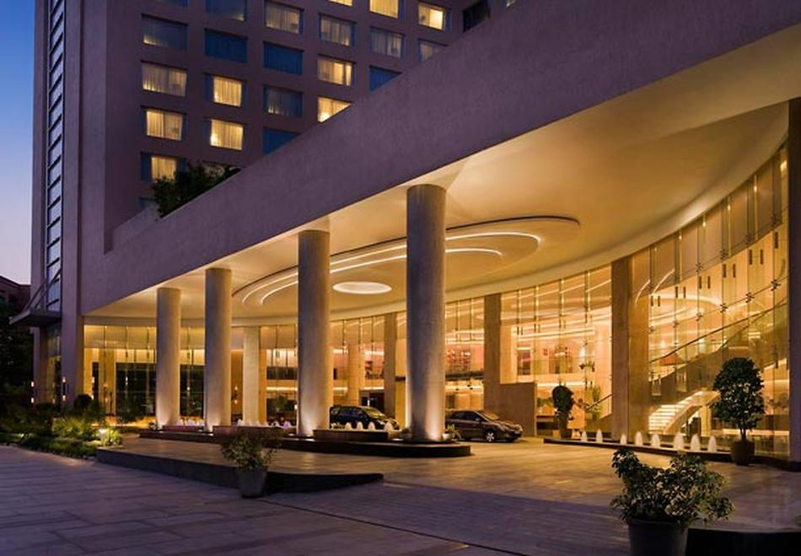
About Courtyard by Marriot
Introduction
Owned by Marriott International.
Courtyard by Marriot is Marriott’s mid-priced brand.
Its clientele is primarily business travelers, but it also accommodates vacationing families and guests.
Notes:
Introduction
Marriott International owns several hotels. Among them is the hotel chain Courtyard by Marriott. Courtyard by Marriot is Marriott’s mid-priced brand. Its clientele is primarily business travelers, but it also accommodates vacationing families and guests. The amenities offered in the rooms range from state-of-art room services, couches and delicious meals. Also offered are free internet and fitness facilities (Dhir and Dhir,2019).

Slide 5





Main brand consumers
BUSINESS AND EVENT ATTENDING CUSTOMERS
LEISURE GUESTS
VISITING FAMILIES
WELNESS TRAVELERS
Notes:
Main brand consumers
Understanding the personas of your targeted clients is essential for creating a marketing campaign that will appeal to them and enhance hotel revenue. A brief biography of the typical customer that frequents your establishment is known as a guest persona(Dhir and Dhir,2019)
The many categories of guests are discussed in this presentation, focusing on the Courtyard by Marriot. Besides that, there will be a look into the best ways to market in the hospitality industry, as demonstrated by Courtyard by Marriot. (Schmitt., 2010)
Business and Event Attending Guests: These are visitors who only stay at the hotel for business purposes. This could be a group of people who go to business gatherings but may not be drawn to the entertainment. They will be intrigued by the excellent services offered for the convention facilities, nevertheless. (Keung.,2000)
Leisure Guests: These are guests who may need same services as the business travelers, and amenities they can make use of during their stay as they unwind from their daily routines.
Visiting Families: Families consist of parents who wish to spend quality time together by venturing out with their kids.
Wellness Travelers: These are the people who travel to improve their own well-being and health. These vacationers are likely interested in taking some time to relax, cleanse their bodies, and cultivate healthier habits while they are away from home.

Slide 6
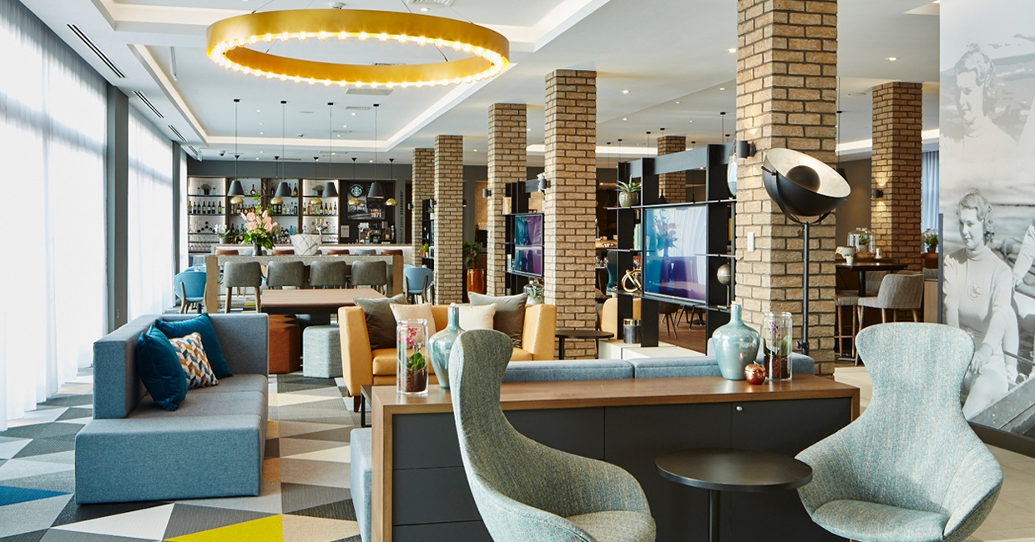
NATURE, SCOPE & ROLE OF GUEST SERVICES
1. State-of-the art Guest Rooms
2. Meetings and Business Centre
3. Fitness Amenities
4. Fast free internet
Notes:
NATURE, SCOPE&ROLE OF GUEST SERVICES
State-of-the art Guest Rooms
They have guest rooms that provides enough space to work, relax, reflect and be your best self(Dhir and Dhir,2019).
Meetings and Business Centre
Their Business Center has exactly what the guests who come for those purposes need to be productive. The conference facilities are modern and makes it convenient for conducting any form of conferencing(Dhir and Dhir,2019).
Fitness Amenities
They have modern 24-hour fitness facilities, with a gym and swimming pool to give the guests an opportunity to start their day with a workout or take a quick dip in the pool (Dhir and Dhir,2019).
Fast free internet
The hotel provides guests with fast and free Wi-Fi, accessible in all the casual spaces to meet or work.

Slide 7

IMPORTANCE OF QUALITY SERVICES TO GUESTS
Customer loyalty
Positive evaluations
Profitability
Employee satisfaction
Notes:
IMPORTANCE OF QUALITY SERVICES TO GUESTS
- It has a direct bearing on customer loyalty (Schmitt, 2010)
- Customers who receive high-quality service are more likely to return to the institution, promote it to others, and offer positive evaluations.
- It has an indirect bearing on profitability (Meyer, 2006)
- Increased output and employee satisfaction are the results, and the company gains a good reputation in the community.

Slide 8

Large image
IMPORTANCE OF HOSPITALITY INDUSTRY
Offers a rewarding job opportunity.
Impacts on the quality of clients’ lives.
Promotes Local Cuisines
Promotes Tourism
Notes:
IMPORTANCE OF HOSPITALITY INDUSTRY
Offers a rewarding job opportunity.
A hospitality facility is a social environment to work in. Unlike other jobs, it is a pleasant and rewarding to the employees (Schmitt, 2010)
Impacts on the quality of clients’ lives.
Provision of wellness facilities impacts on the lives of guests directly, improving their lifestyle.
Promotes Local Cuisines
Some hotels are known for certain meals that are traditionally of a particular country (Suryanarayanan et al., 2021)
Promotes Tourism
Hotels can be tourist destinations, where cultural heritage are kept, or shared.

Slide 9

HOW HOTELS MEET GUESTS’ EXPECTATIONS
Online and Website Advertisements
Creating a cultural connection to the facilities
Extra free services
Notes:
HOW HOTELS MEET GUESTS’ EXPECTATIONS
Online and Website Advertisements
Hotels use their websites and online advertisement to showcase their facilities (Mike and Diekmann, 2017)
Creating a cultural connection to the facilities
Hotels in many countries act as a medium of cultural heritage (Hue et al., 2022).
Extra free services
This is the aspect of providing extra services like sightseeing, free drinks in the guest rooms, Netflix etc. (Hue et al., 2022).

Slide 10





HOW HOTELS EXCEED GUEST EXPECTATIONS
Discounts
Special room services
Check-in and check-out times
Additional guests
Notes:
HOW HOTELS EXCEED GUEST EXPECTATIONS
Offering discounts for longer staying guests, or organizations that bring large numbers of clients. (Schmitt, 2010)
Special room services like drinks and Netflix, or free room service (Meesala and Paul, 2018)
Favorable check-in and check-out times(Keung, 2000)
Provision of additional guests at no extra cost for guest who would want to have a companion. with them(Meyer, 2006).

Slide 11

CONCLUSION
The competitive hospitality business is one that needs innovation and creativity to make it appealing. The creativity is large service-based, and the quality of facilities. Courtyard by Marriot as a case study in this presentation has proved that splendor sells in this industry and class is founded in the nature, scope and quality of the services.
Notes:
The competitive hospitality business is one that needs innovation and creativity to make it appealing. The creativity is large service-based, and the quality of facilities. Courtyard by Marriot as a case study in this presentation has proved that splendor sells in this industry and class is founded in the nature, scope and quality of the services.

Slide 12
References
Courtyard experience (2022) Courtyard by Marriott. Available at: https://courtyard.marriott.com/ (Accessed: January 31, 2023). Smith, M.K. and Diekmann, A., 2017. Tourism and wellbeing. Annals of tourism research, 66, pp.1-13.
Courtyard experience (2022) Courtyard by Marriott. Available at: https://courtyard.marriott.com/ (Accessed: January 31, 2023)
Dhir, S. and Dhir, S., 2019. Marriott Hotels. Cases in Strategic Management: A Flexibility Perspective, pp.147-162.Hotels & Resorts: Book Your Hotel directly with Marriott Bonvoy (no date) ram-test5.ose-dev39-vxbyr.cloud.marriott.com. Available at: https://www.marriott.com/default.mi (Accessed: January 29, 2023).
Hue, N. T. K., Loc, N. T., & Hong, N. T., 2022. Applying Social Media in the Hotel Sector: Satisfaction with the Facebook Pages of Hotels and Intention of Future Visit. Intellectual Economics, 1(16).
Keung, S.W.C., 2000. Tourists’ perceptions of hotel frontline employees’ questionable job-related behaviour. Tourism Management, 21(2), pp.121-134.
Meesala, A. and Paul, J., 2018. Service quality, consumer satisfaction and loyalty in hospitals: Thinking for the future. Journal of Retailing and Consumer Services, 40, pp.261-269.
Meyer, D., 2006. Setting the table: The transforming power of hospitality in business. Harper Collins.
Schmitt, B.H., 2010. Customer experience management: A revolutionary approach to connecting with your customers.
Smith, M. and Puczkó, L., 2008. Health and wellness tourism. Routledge.
Suryanarayanan, S., Srinivasan, S. R., Lin, W., Wang, L., & Sabharwal, J. K., 2021. Managing customer expectations: a study of two four-star hotels in Malaysia and Singapore. Service Excellence in Tourism and Hospitality: Insights from Asia, 41-53.

Slide 13





Thank You
Name
xyz
Email
Class

