Slide 1


Exploratory Data Analysis – Presentation
Data Mining & Visualisation (ACCA7015)
Student Name: Iftekhar Rashid (2215602)
Lecturer’s Name: Nouh Elmitwally

Slide 2
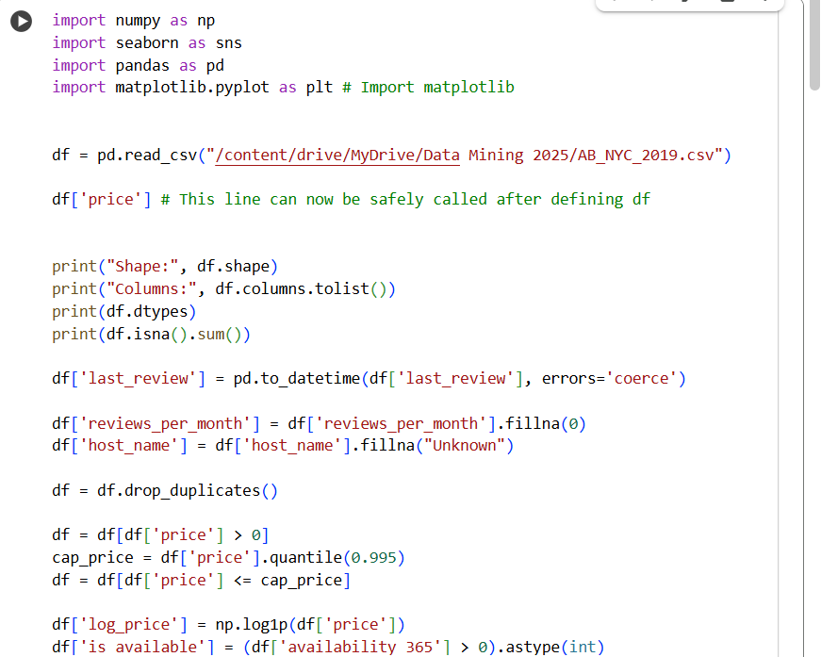
Dataset Preprocessing Step
Insight
This code was used to clean the dataset by fixing missing values, dates, duplicates, and extreme prices.
Why it Matters:
  Cleaning makes the dataset accurate, removes errors and unusual values, and ensures reliable results.
Data Preparation and Cleaning

Slide 3

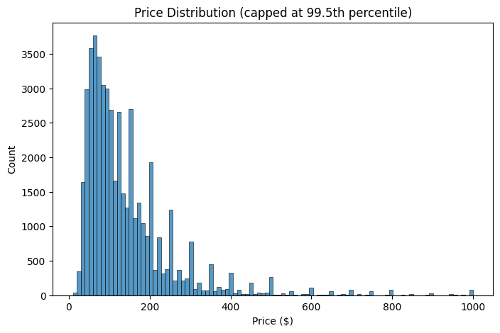

Geographic Distribution of Listings
Insight
Most of the listings are found mostly in Manhattan and Brooklyn, showing that these are the main areas where demand is highest (Ding et al., 2023).
Why it Matters:
This pattern shows the areas with the most competition and points to neighbourhoods that don’t have enough options, which could be good places for growth.

Slide 4
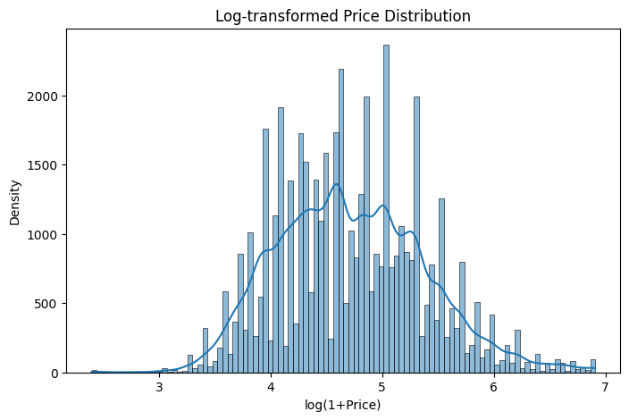
Price vs Number of Reviews
Insights
Cheaper listings usually get more reviews, which shows that lower prices can lead to more bookings (Dolnicar et al., 2023).
Variety
Prices should be set carefully — if they’re too high, fewer people book and you get fewer reviews.

Slide 5

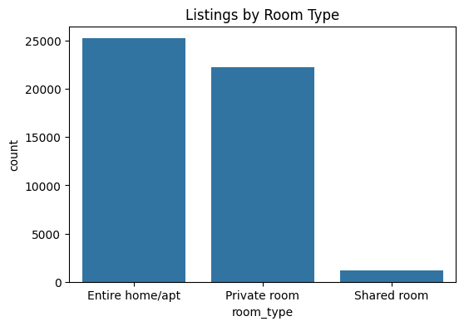

Price Distribution by Room Type
insight
Why it Matters:
Homes or apartments that are rented out as a whole usually cost more than just renting a private room or a shared room (Leoni & Nilsson, 2021).
Hosts should set prices based on the type of room; premium for full units vs modest pricing for private/shared rooms.

Slide 6
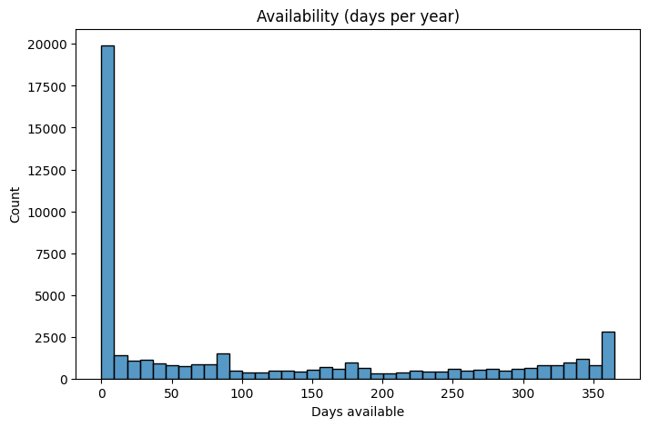
Median Price by Neighbourhood Group
Insight
Manhattan has the highest average nightly prices for listings, while the Bronx and Queens have much lower average prices (Subhash Reddy et al., 2024).
Why it matters
Location is a main factor that decides prices. Hosts outside Manhattan
often set lower prices to attract guests.

Slide 7
Listing Availability (Days per Year)
Many hosts either keep their listing up all year or don’t list at all, showing different hosting styles (Foroughifar & Mehta, 2024).
Insight
Knowing who rents full-time and who rents sometimes helps the platform improve its features and ads.
Why it matters?

Slide 8
Listings by Room Type
Insight
Most Airbnb listings are whole homes/apartments or private rooms, while shared rooms are very few (Ding et al., 2023).
Why it matters?
Shared rooms may only attract a small group of guests or less busy areas.

Slide 9
Log-Transformed Price Distribution
Why it matters?
Insight
Using a log scale makes it easier to model and understand the average without being affected by extreme values.
Log transformation makes the data look more balanced and reduces the effect of very large or very small numbers (Kirkos et al., 2021).

Slide 10
Price Distribution (Capped at 99.5th Percentile)
Why it matters?
Insight
Using a log scale makes it easier to find and understand the average because very large or unusual numbers don’t distort the results.
After removing extreme cases, most prices fall between $50 and $300, which makes the patterns easier to see (Leoni & Nilsson, 2021).

Slide 11

Executive Summary of Findings
Manhattan is
most expensive (~$150 median) while Bronx and Queens are cheaper (Subhash
Reddy et al., 2024).
Entire homes/apartments cost more than private or shared rooms (Leoni & Nilsson, 2021).
Cheaper listings attract more reviews, showing strong demand for affordability (Dolnicar et al., 2023).
Two types of hosts: full-time (365 days) vs casual (0 days) (Foroughifar & Mehta, 2024).
Data quality issues like extreme prices and unrealistic minimum nights must be cleaned for reliable insights (Kirkos et al., 2021).

Slide 12

Recommendations for Airbnb and Hosts
Remove unrealistic listings (like $10,000 a night or 1000-night minimum stays) to build trust (Kirkos et al., 2021).
Keep prices affordable to attract more bookings and reviews that match demand (Dolnicar et al., 2023).
Help less popular areas like the Bronx and Staten Island attract more guests (Ding et al., 2023).
Give different support to full-time hosts and casual hosts with the right tools and guidance (Foroughifar & Mehta, 2024).

Slide 13
THANK YOU

Slide 14
Refrences
Ding, A., Zhang, L., Zhang, D. and Lu, Z., 2023. The Impact of Airbnb on Housing Prices: Evidence from the United States. Sustainability, 15(12), p.9478. Available at: https://pmc.ncbi.nlm.nih.gov/articles/PMC10361235/ [Accessed 7 October 2025].
Dolnicar, S., Yanamandram, V. and Sharma, R., 2023. Airbnb research: Past, present and future. Annals of Tourism Research, 98, p.103546. Available at: https://pmc.ncbi.nlm.nih.gov/articles/PMC10361235/ [Accessed 11 October 2025].
Leoni, G. and Nilsson, A., 2021. Enhancing the Airbnb Experience: Dynamic Pricing Strategy. International Journal of Hospitality Management, 92, p.102730. Available at: https://www.researchgate.net/publication/391971454_Enhancing_the_Airbnb_Experience_Dynamic_Pricing_Strategy [Accessed 6 October 2025].
Subhash Reddy, S., Raj, S. and Prasad, G., 2024. An Exploratory Study of Airbnb Listings in New York City. arXiv preprint arXiv:2407.01555. Available at: https://arxiv.org/abs/2407.01555 [Accessed 10 October 2025].
Foroughifar, H. and Mehta, N., 2024. Understanding Hosting Strategies on Airbnb: Evidence from Platform Data. Berkeley Haas SICS Working Paper. Available at: https://sics.haas.berkeley.edu/pdf_2024/fm.pdf [Accessed 5 October 2025].
Kirkos, E., Manolopoulos, Y. and Vlachopoulou, M., 2021. Airbnb listings’ performance determinants and predictive models. Tourism Economics, 27(6), pp.1260-1280. Available at: https://www.researchgate.net/publication/350616868_Airbnb_listings%27_performance_determinants_and_predictive_models [Accessed 12 October 2025].

