Slide 1
Fundamentals of Electrical
and Electronic Systems
(ACDA4018)
Lecture - 2

Slide 2
Content
Ohm’s Law
Example

Slide 3
Learning Outcome
The student upon completion of the lecture will be able to:
Define Ohm’s law.
List the advantages of Ohm’s law

Slide 4
Ohm’s law
Ohm’s law was stated by George Simon Ohm.
Ohm’s Law Provides the relation between Voltage, Current and Resistance
Lecture 2 / Fundamentals of Electrical and Electronic Systems

Slide 5
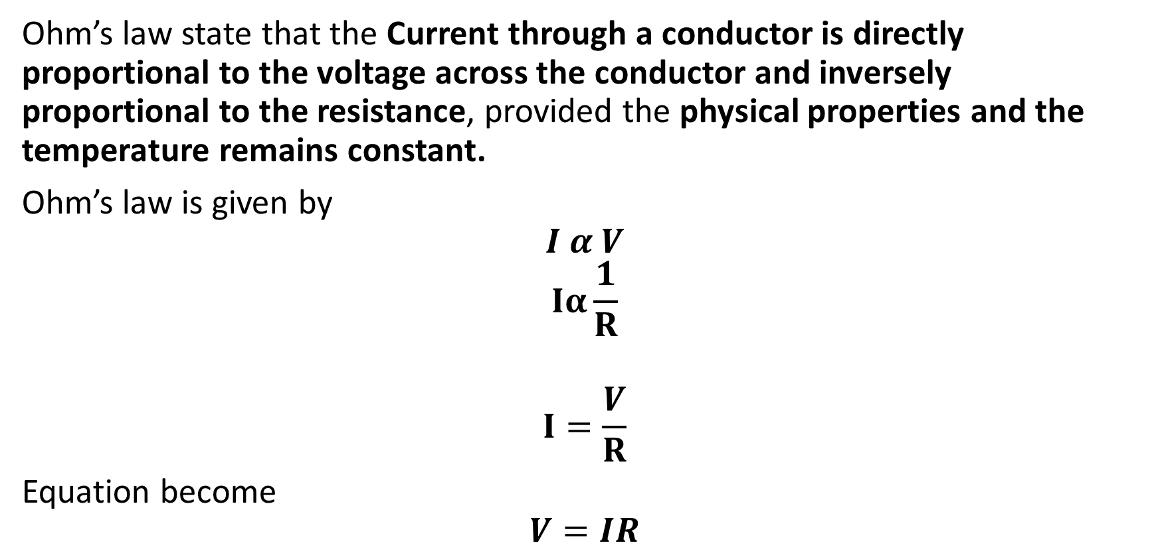
What is Ohm’s Law?
Ohm’s law state that the Current through a conductor is directly proportional to the voltage across the conductor and inversely proportional to the resistance, provided the physical properties and the temperature remains constant.
Ohm’s law is given by
$$I α V$$
$$Iα\frac{1}{R}$$
$$I=\frac{V}{R}$$
Equation become
$$V=IR$$

Slide 6
What is Ohm’s Law?
Where,
V – Voltage across the conductor
I – Current across the conductor
R – Resistance across the conductor

Slide 7
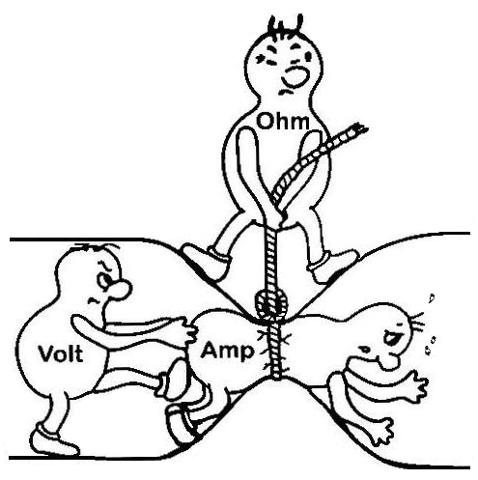
Ohm’s law

Slide 8
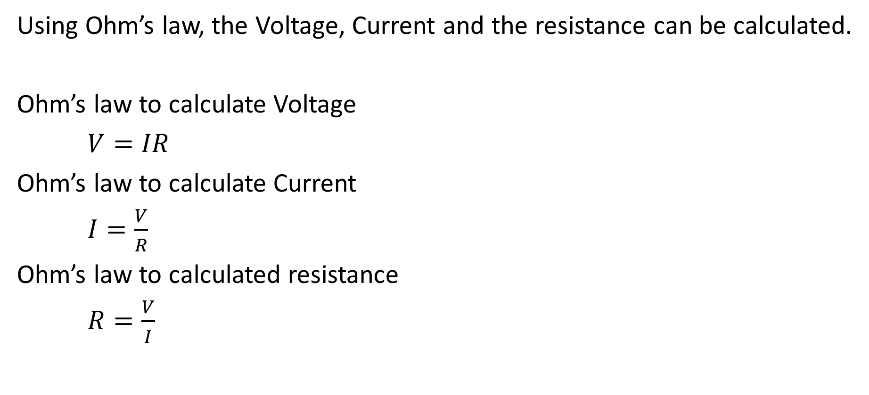
Ohm’s Law
Using Ohm’s law, the Voltage, Current and the resistance can be calculated.
Ohm’s law to calculate Voltage
$V=IR$
Ohm’s law to calculate Current
$I=\frac{V}{R}$
Ohm’s law to calculated resistance
$R=\frac{V}{I}$

Slide 9
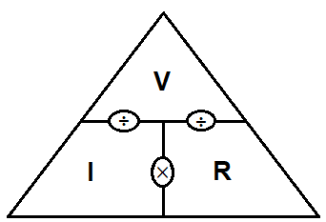
Ohm’s Law Triangle

Slide 10
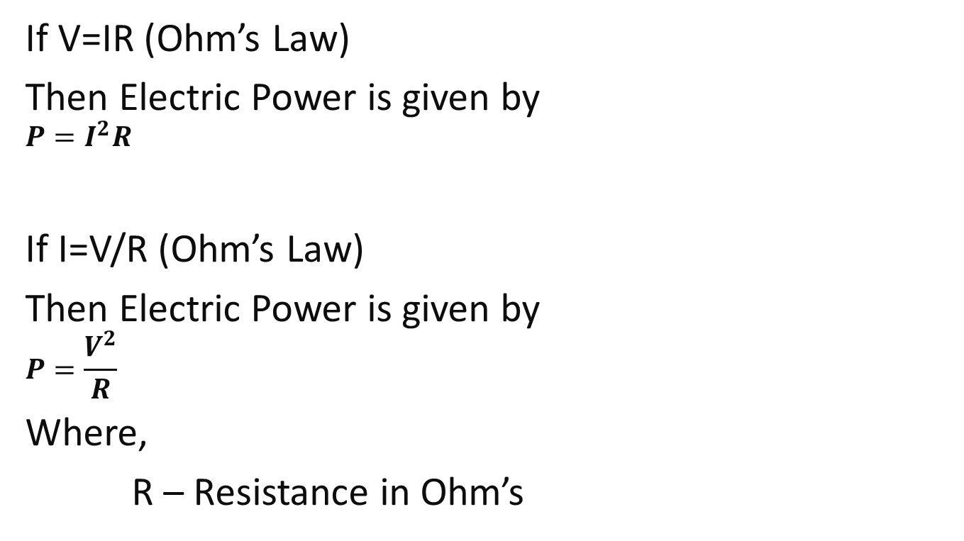
Electric Power
If V=IR (Ohm’s Law)
Then Electric Power is given by
$$P=I^{2}R$$
If I=V/R (Ohm’s Law)
Then Electric Power is given by
$$P=\frac{V^{2}}{R}$$
Where,
R – Resistance in Ohm’s

Slide 11
Advantages of Ohm’s law
Ohm’s law can be used to calculate Voltage, current and Resistance in a circuit.

Slide 12
Limitations of Ohm’s law
It cannot be applied accurately in a circuit, in which the temperature keeps changing.
This law cannot be applied to unilateral networks.
(Circuit having elements like diode, transistors, etc.)
It is also not applicable in non – linear elements.
(Non-linear elements are those in which the current is not directly proportional to the applied voltage)

Slide 13
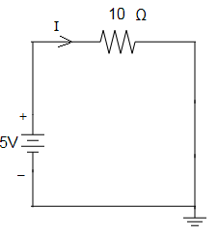
Exercise 1
Calculate the current flowing through the resistor in the following circuit diagram

Slide 14
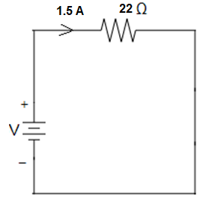
Exercise 2
Calculate the Voltage across the resistor

Slide 15
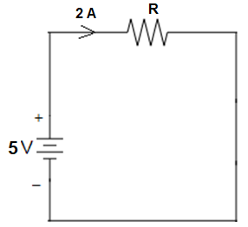
Exercise 3
Calculate the resistance across the resistor

Slide 16
Exercise 4
Calculate the resistance in a circuit, if the current across the circuit is 2mA and the potential difference is 200V.
Solution:

Slide 17
Exercise 5
Calculate the potential difference across a circuit, if the current across the circuit is 5A and the resistance is 5KΩ.
Solution:

Slide 18
Exercise 6
A 15V battery is connected to a resistor having a resistance of 10Ω. Calculate the current and power across the resistor.
Solution:

Slide 19
Exercise 7
Calculate the Power of an aircon , if the voltage supplied is 440V and the resistance offered is 200Ω.
Solution:

Slide 20
Exercise 8
What capacitance is needed to store 3C of charge at a voltage of 120 V.
Solution:

Slide 21
Thank You

