Slide 1
INTERNATIONAL
HOTEL
MANAGEMENT
Marketing Essentials
BMIH4005

Slide 2

The partner to learning for this module through Teams is Moodle
Your module Moodle Page will include the teaching material that will be delivered by your lecturer
You will also find essential information to support you through the module.

Slide 3
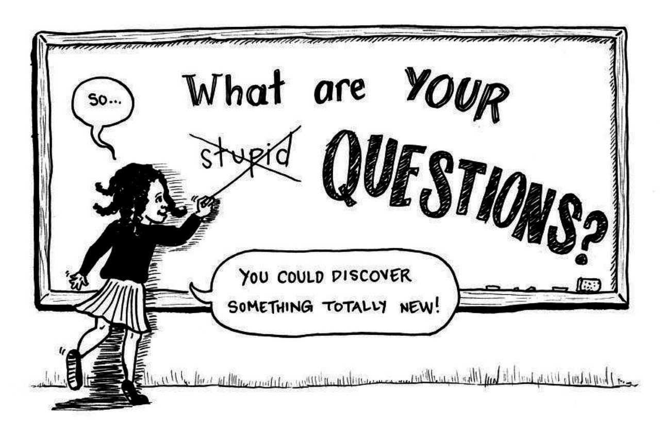
Support

Slide 4
Module structure

Slide 5

Module Handbook
This is an important document as it provides information about the module, assessment writing guidelines, resources and further information.
Go to your Marketing Essentials Moodle Page, click on the Module Information Tab and scroll down to the Handbook and download
Let’s look at this now….
https://moodle.uwtsd.ac.uk/pluginfile.php/848285/mod_resource/content/0/BMET4003D%20ME%20Autumn%202023PDF.pdf

Slide 6
Do you have any questions
About
Your
Assessments?

Slide 7
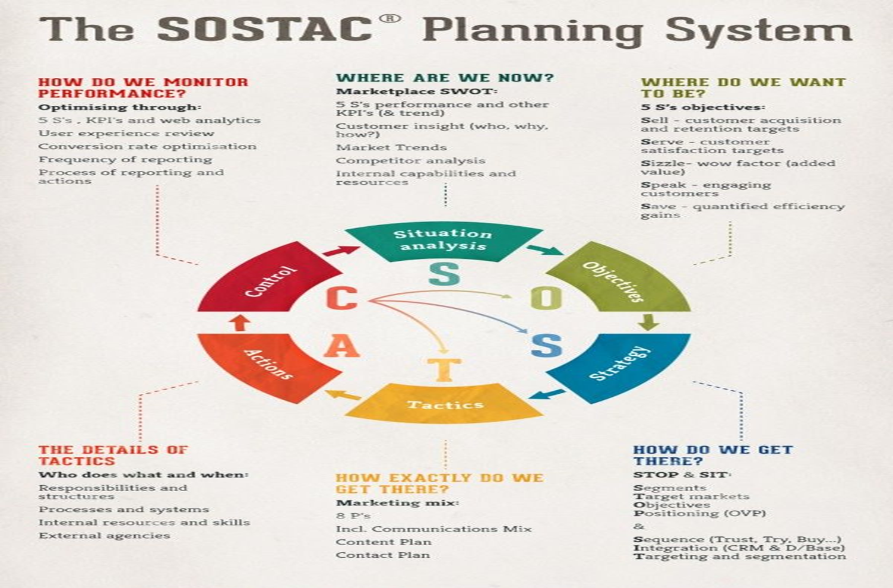
The SOSTAC Planning System
Many approaches to developing a marketing communications plan
No common approach but essential elements every plan must have
SOSTAC is an aide-memoire to help ensure focus on the key elements
SOSTAC can also be used to develop corporate plans, marketing plans, direct mail plans...even personal plans

Slide 8
Modern media society
The German sociologist Richard Münch states that in a world that is driven by communications, no one can deny the need for gaining public attention: ‘Whoever misses that goal is to be forgotten and doomed’
(Münch, 1992).
Some years ago, quite a lot of marketers and communications managers still thought that economic success is almost directly related to the number of advertisements placed and the quantity of information provided – the more, the better.

Slide 9
Modern media society (Continued)
As the market has shifted from a seller’s market to a buyer’s market, their marketing communications efforts became even pushier.
A constant and enormous augmentation, acceleration and collection of public communications were to be seen as well as a loss of the perceived trustworthiness advertisements (Münch, 1992), creating a credibility gap and thus a negative reaction from consumers
(Kroeber-Riel et al., 2009).

Slide 10
Modern media society (Continued)
In 2010 this led to a rethinking in the conduct of corporate communications
(Nessmann in Lettner, 2010).
Instead of seeking ‘shrill’ short-term attention and using ‘chintzy’ sales tricks, integrated marketing communications (including public relations) are now about lasting communications, presenting not only the features of a service or product and its usefulness for the customer, but the corporate values, too.

Slide 11
What do you think Marketing is ?
Notes:
Use some words and summaries in the chat box to describe this for me

Slide 12
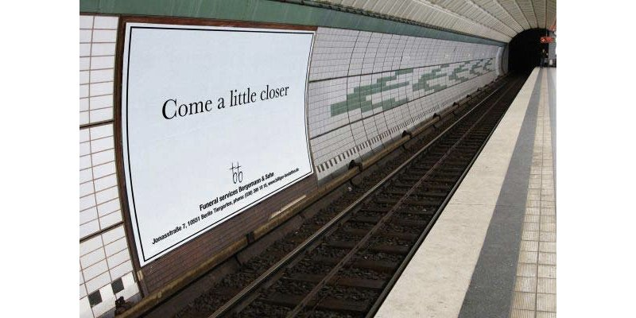
Marketing is too important to be left to the marketing department.
(Packard,1972)
"Marketing is not the art of finding clever ways to dispose of what you make; it is the art of creating genuine customer value". (Kotler, 1967)
Jung Von Matt/Spree -Berlin advertising agency Bergemann & Sohn in Germany. 2006."

Slide 13
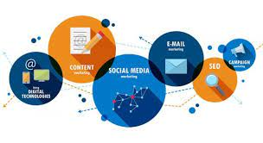
Marketing
Some may think of marketing as selling and advertising only. But successful marketing is much more.
Marketing is an entrepreneurial mindset; it focuses on the analysis, planning, implementation and controlling of all internal and external corporate activities which are suitable for improving corporate performance in terms of improving the customer’s benefit and hence improving the market-related business objectives (Bruhn, 2010).

Slide 14
Five step marketing process
Understand the market place and the customer needs
Design customer-driven marketing strategies
Construct integrated marketing programmes that deliver superior value
Build profitable customer relationships
Capture value from the customers
(Kotler and Armstrong, 2010)

Slide 15
Some thoughts on marketing?
“What is marketing? Simply put marketing is managing profitable customer relationships. The aim of marketing is to create value for customers and capture value from customers in return” (Kotler 2013)
“During the last decade, the international marketing field has developed enormously, and the marketing function has now taken the central position in most companies….The Globalisation of the marketplace is now a reality”
(Ghauri 2014)
“Whether we recognise it or not, we are all involved, willingly or unwillingly, passively or actively, in marketing. We encounter marketing practices every day when we are exposed to advertising and product displays, evaluate brands, make buying decisions, shop and consume”
(Bowie et al 2017)

Slide 16
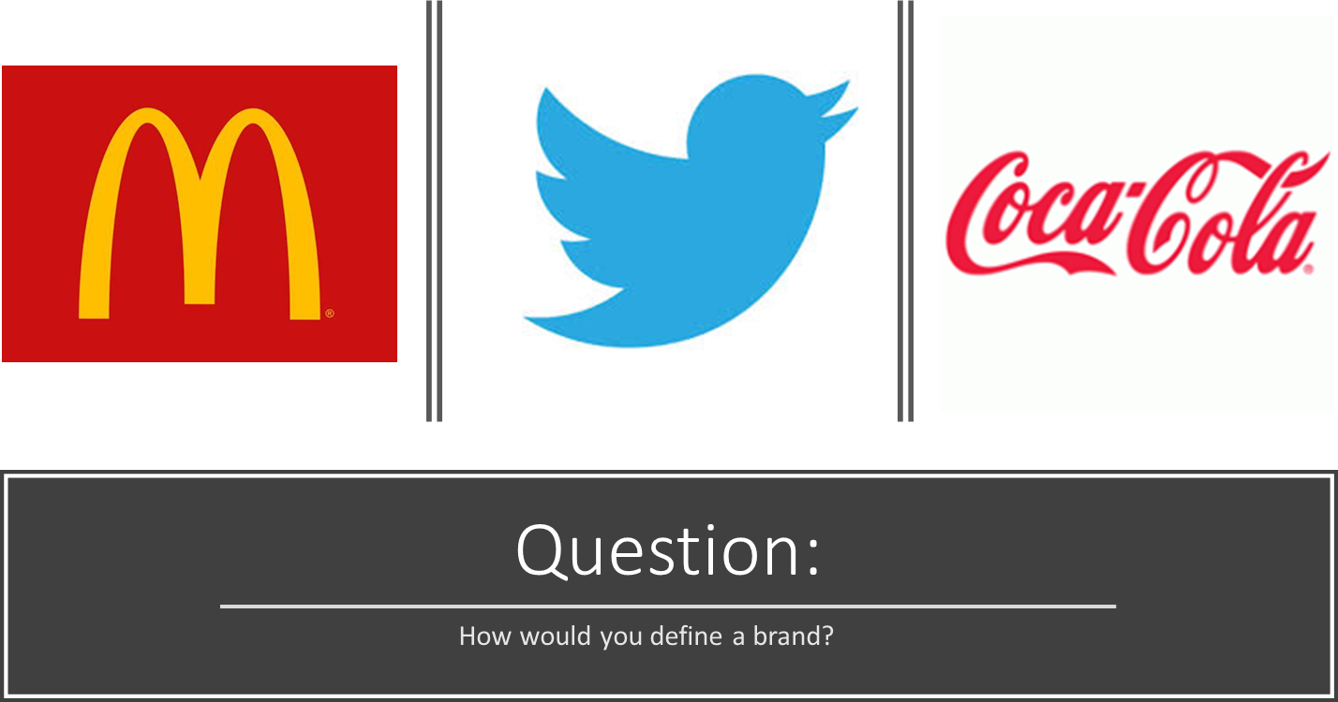
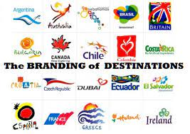

Slide 17

Branding (Continued)
Branding is one of the most powerful tools in the marketing arsenal (Holt, 2003).
The term branding is misleading, as it indicates etymologically that a brand can be established easily, like a cow can be branded.
Quite the opposite is true: ‘A brand is created in a consumer’s mind’ (Moilanen and Rainisto, 2009).
‘The aim of branding is to find a brand idea that will run through all the places and situations where consumers, employees, suppliers and investors experience the brand’ (Kotler et al., 2011).

Slide 18
Branding (Continued)
Brand management is a long-term process that not only includes the value proposition of the product, but the customers’ mindsets as well.
Image and identity are of utmost importance, especially when dealing with complex products or services like events or destinations:
‘the methods of creating and maintaining a brand, and the methods of utilising the opportunities created by a strong brand differ significantly between places and companies’
(Moilanen and Rainisto, 2009).

Slide 19
Destination branding and competitive identity
A destination may be a nation, a region, a city or village or even just a part of a town, or a single hotel complex that is perceived and chosen by the customer.
For tourism destinations, it refers to the definition of destination by Buhalis who defines a destination as a ‘geographical region which is understood by its visitors as a unique entity, with a political and legislative work for tourism marketing and planning’.

Slide 20
Destination branding and competitive identity (Continued)
‘In order to be successfully promoted in the targeted markets, a destination must be favourably differentiated from its competition, or positively positioned, in the minds of the consumers’ (Echtner and Ritchie, 2003).
This became even harder as the competitive tourism industry reached a high level of standardisation with product parity, substitutability and competition.
The destination’s ‘reputation or brand play a hugely significant role in determining just how successful they are in this competition’ (Morgan, Pritchard and Pride, 2011).

Slide 21
Destination branding and competitive identity (Continued)
Academics have argued whether a destination can ever be a brand – according to Morgan et al. (2011) in a strict marketing sense they cannot.
This is why some prefer the terms ‘place reputation management’ and ‘competitive identity’.
This has to do with the very special circumstances a destination marketer has to face.

Slide 22
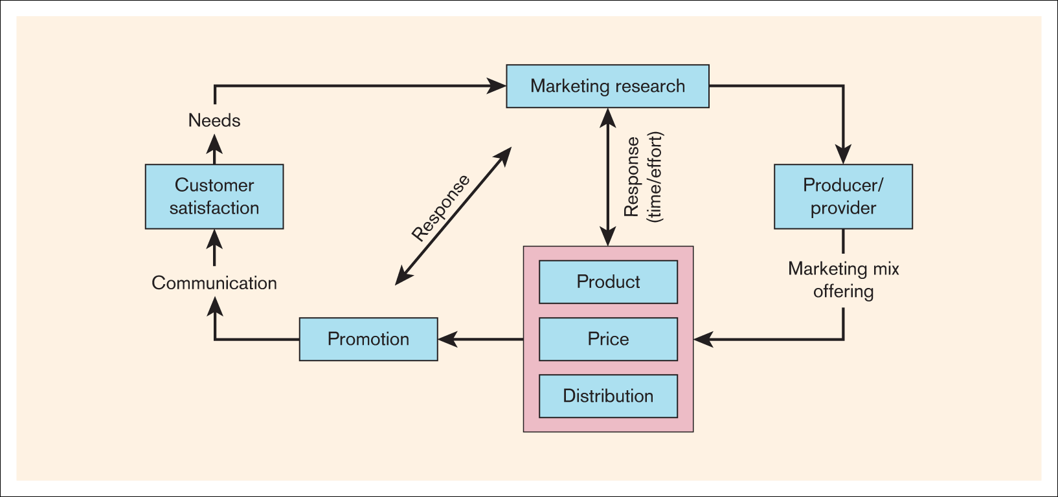
The marketing system

Slide 23
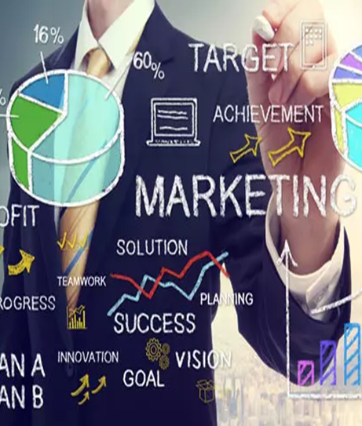
You all have made different choices, for different reasons, and there are people behind that brand that have been influencing your decision.
Write down what brands appeal to you
How do you like them to engage with you? Celebrities/emails/TV/social media etc
How do marketers know how you like to be contacted

Slide 24
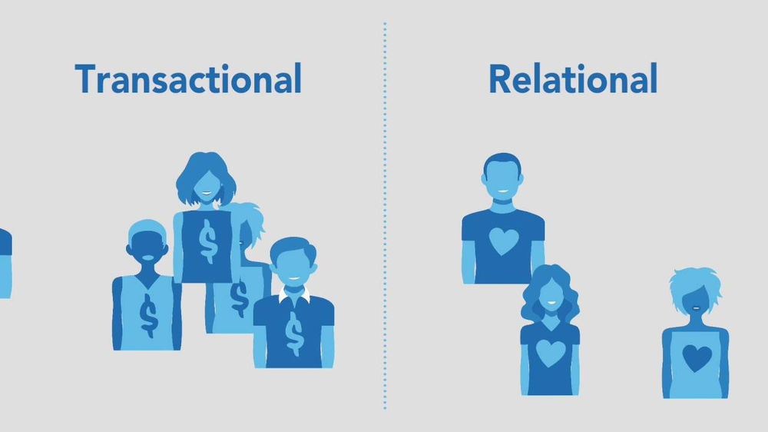
Transactional or Rational?
Some believe that marketing is primarily a business philosophy that puts the customer first. From this perspective the primary goal of any hospitality business is to create and retain satisfied customers
An alternative perspective proposes that marketing is a management practice, that aims to manipulate customer demand “marketing’s central purpose is demand management” (Kotler,1999)

Slide 25
Transactional vs relationship marketing
from a one-off sale to establishing long term relationships-
Transactional marketing is associated with hospitality businesses that serve transient or temporary markets for example,
Relationship marketing associated with businesses who establish long term relationships, and these could be returning customers or business to business

Slide 26
Institutional definitions of marketing
“Marketing is the activity, set of institutions, and processes for creating, communicating, delivering, and exchanging offerings that have value for customers, clients, partners and society at large”. (AMA)
“Marketing is the management process responsible for identifying, anticipating and satisfying customer requirements profitably” (CIM)
Notes:
Two important professional bodies for marketers are the American Marketing Association (AMA) and the UK based Chartered Institute of Marketing (CIM), here are their definitions of marketing…

Slide 27

AMA stresses the importance of value creation, customer's experience value when they use or consume a product or service…known as VALUE- IN- USE, therefore a hotel room would have no value until a customer uses it.
CIM stresses the importance of satisfying customers requirements.
If we integrate the two, we can say that every customers broad requirement is to experience value.
The Difference within the definitions…

Slide 28
References
Bowie, D. (2017) Hospitality marketing. 3rd ed. London: Routledge.
Brassington, F. and Pettitt, S. (2006) Principles of marketing. 4th ed. Harlow: Financial Times Prentice Hall.
Ghauri, P. and Cateora, P. (2014) International marketing. 4th ed. London: McGraw Hall.
Kotler, P. and Armstrong, G. (2013) Principles of marketing. 6th ed. London: Pearson.
Jenkins, M. and McDonald, M. (2022) Market Segmentation; Organizational archetypes and Research Agendas, European Journal of Marketing, 31(1).
Piercy, N. and Morgan, N. (1993) Strategic and operational market segmentation: a managerial analysis, Journal of Strategic Marketing, 1(2).
Database Search (uwtsd.ac.uk)
Cite Them Right - Home (uwtsd.ac.uk)

