Slide 1
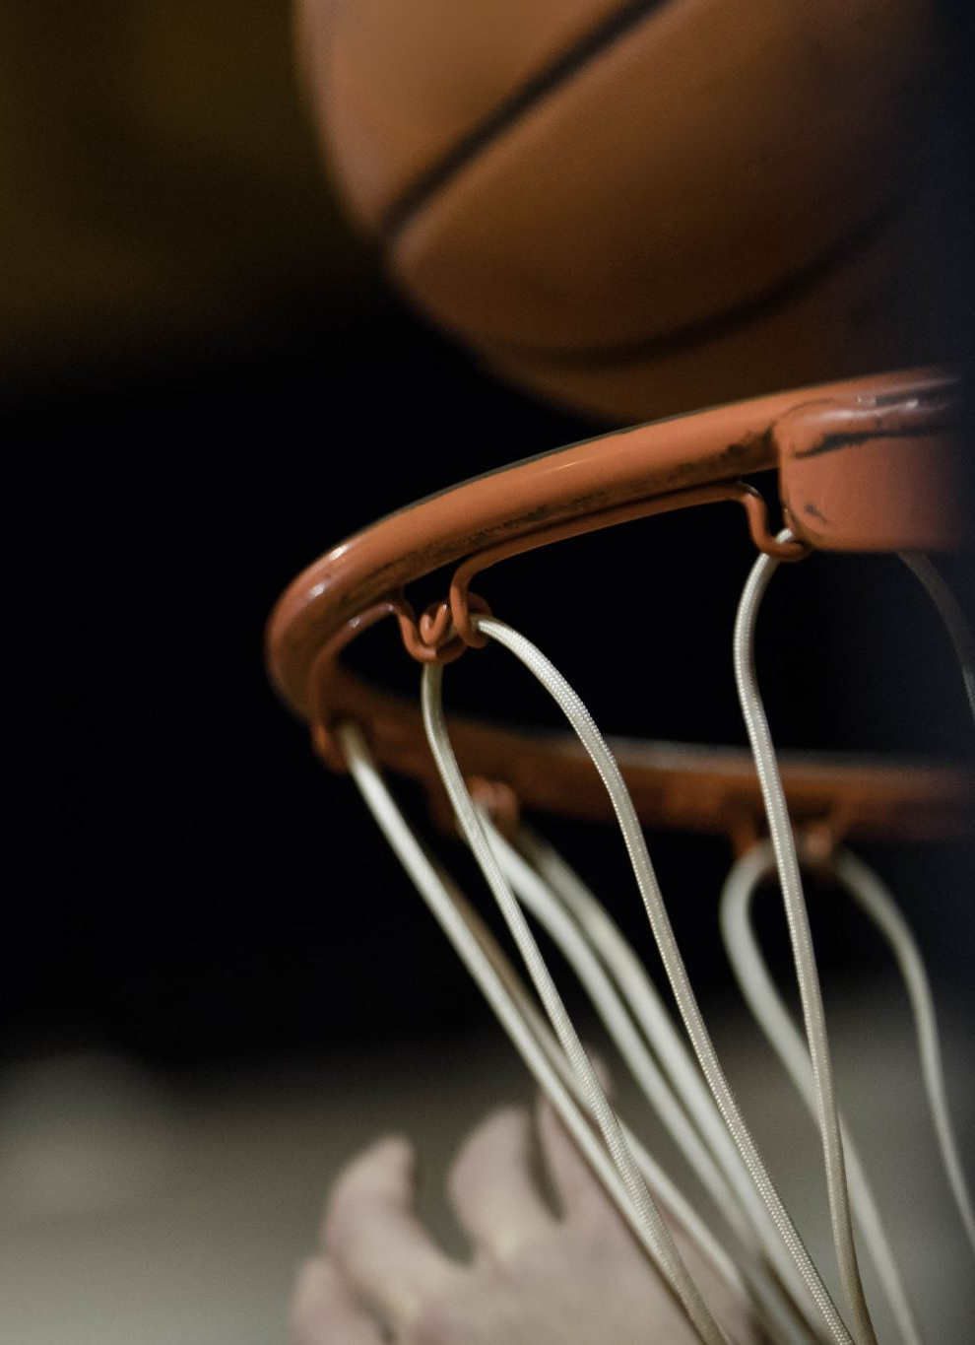
Sport and Athlete Sponsorship

Slide 2
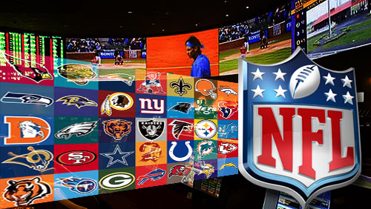
Last week
An overview into college sport and the NCAA
A basic understanding of the transition process between college sport and major leagues
The financial implications of the NCAA
A debate involving student athletes wages.

Slide 3
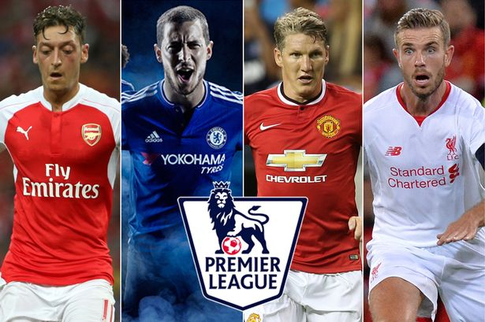
Today’s lecture
Sport sponsorship within USA and UK leagues.
Sport sponsorship within Olympics
Shirt sponsorship
Athlete Sponsorship/endorsement
Athletes case studies

Slide 4
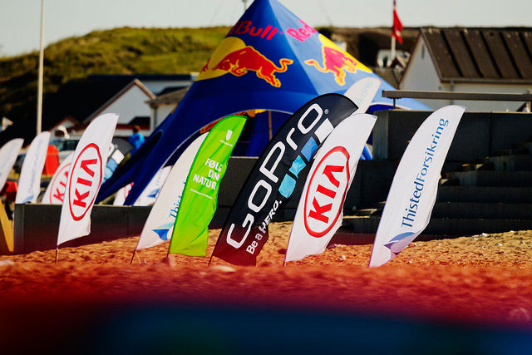
Sport Sponsorship
Tripartite Relationship
  Sponsor
  Sponsee
  Stakeholders
Direct
Indirect

Slide 6
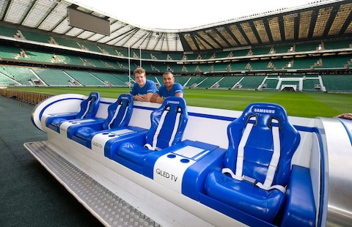
Activation Investment
With the purpose of deepening the impact of sponsorship with the sponsorship target.
Samsung and WRU
Managed to provide 180 fans the opportunity to watch the game.
Firstly incorporated in 2014 in Australia
Used in London Sevens.
https://www.youtube.com/watch?v=lFBaoDPY5Z8

Slide 7
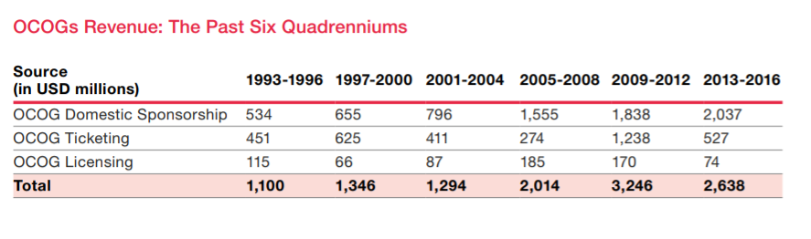
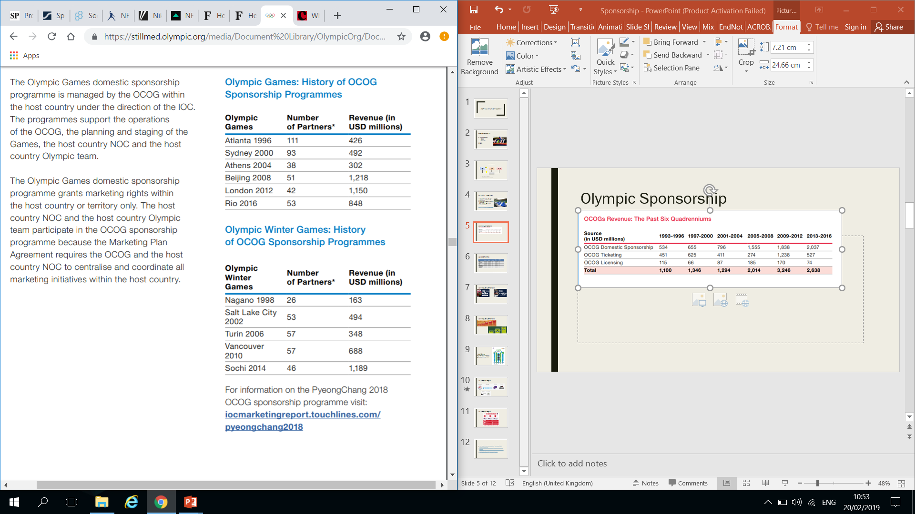
Olympic Sponsorship

Slide 8
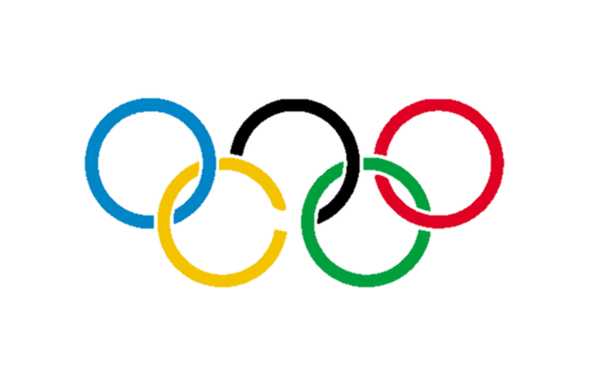
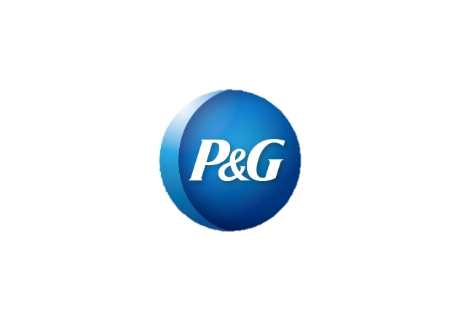


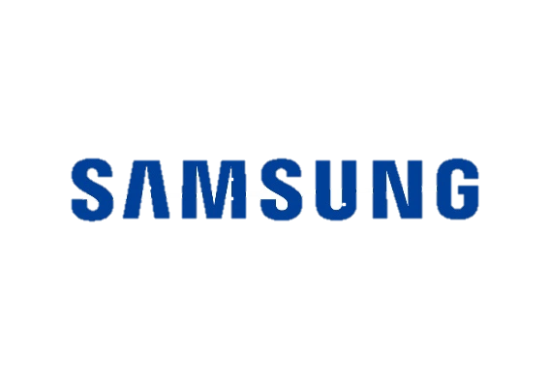

Olympic Sponsors

Slide 9
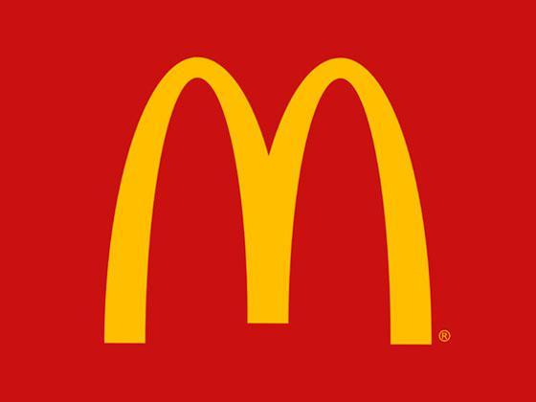

McDonald’s Olympic deal
2017 McDonald’s stopped sponsorship Olympics after 41 years.
Reported $100 million sponsorship for every Olympics.
McDonald’s has been trying to hold down costs as it invests in improving food quality, restaurant service and online ordering to woo back U.S. diners.
One week later IOC signed Intel
as an official sponsor until 2024
Notes:
https://www.olympic.org/news/ioc-and-intel-announce-worldwide-top-partnership-through-to-2024
https://www.telegraph.co.uk/olympics/2017/06/16/mcdonalds-ends-40-year-sponsorship-olympics/
https://www.reuters.com/article/us-olympics-mcdonalds-idUSKBN1971HB

Slide 10
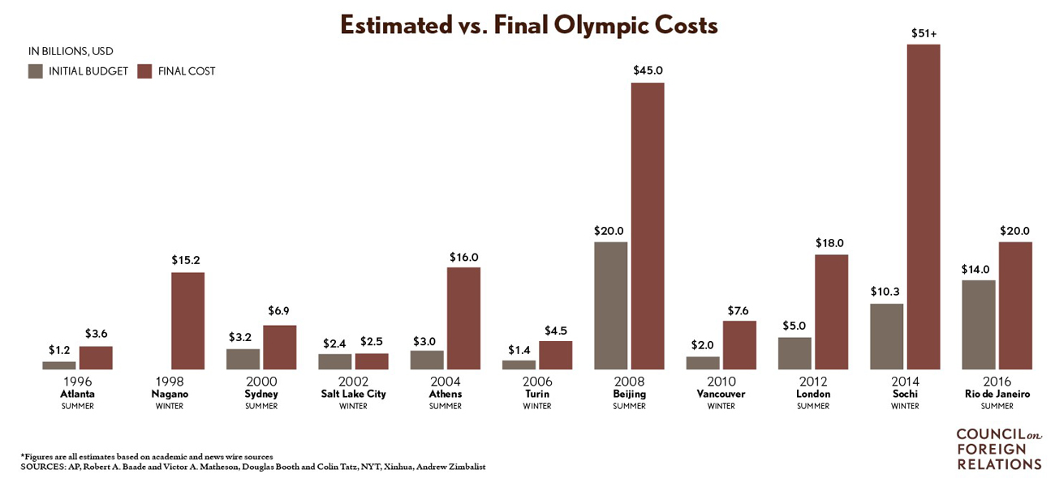

Tokyo 2020 Olympics
Tokyo sponsorship deals near $3 billion (47 sponsors)
Bid budget (2013) = ¥829 billion (US$7.3 billion)
Current budget (2019) = ¥1.35 trillion (£9.4 billion/$12 billion/€10.6 billion)
Lewis (2018) argues that the budget does not reflect the true cost of the event and puts the spend at around $25 billion.
80% of the $25 billion is taxpayer money.
The rest ($5.3 billion) is divided:
  $1.7 billion from the IOC
  Rest from sponsors, merchandising and ticket sales.
Notes:
https://uk.reuters.com/article/uk-olympics-2018-tokyo/extraordinary-tokyo-sponsorship-deals-near-3-billion-ioc-idUKKBN1FR09Q
https://www.voanews.com/a/tokyo-olympics-costs-hit-almost-25-billion--may-go-higher/4607072.html
https://www.straitstimes.com/sport/olympics-tokyo-2020-games-heading-towards-massive-cost-overrun
https://www.weforum.org/agenda/2016/07/the-cost-to-cities-of-hosting-the-olympics-since-1964/

Slide 11
USA Sponsorship
What sponsors want & where dollars will go in 2018 – IEG

Slide 12
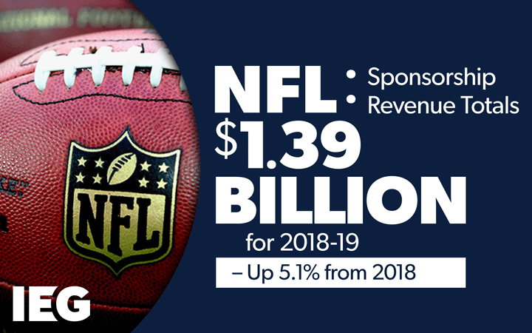
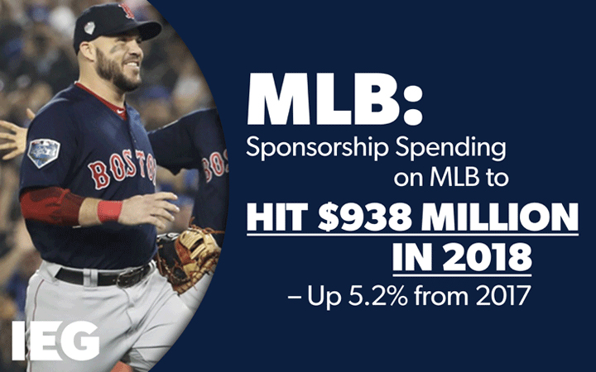
USA leagues Sponsorship
Notes:
http://www.sponsorship.com/Report/2017/10/16/Sponsorship-Spending-On-North-American-Soccer-To-G.aspx

Slide 13
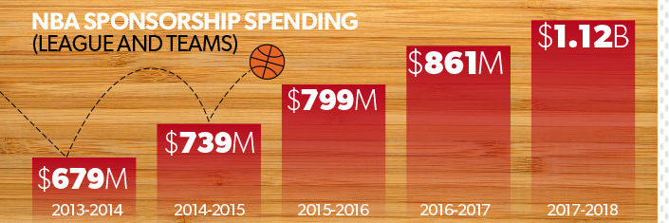
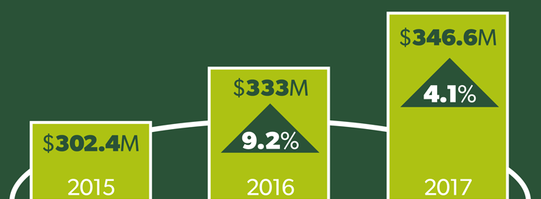
USA leagues Sponsorship

Slide 14
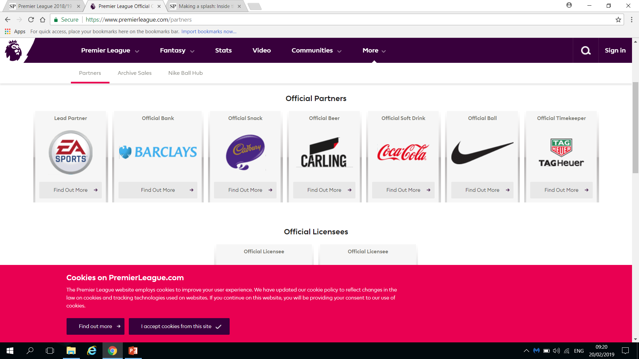
UK Premier League

Slide 15
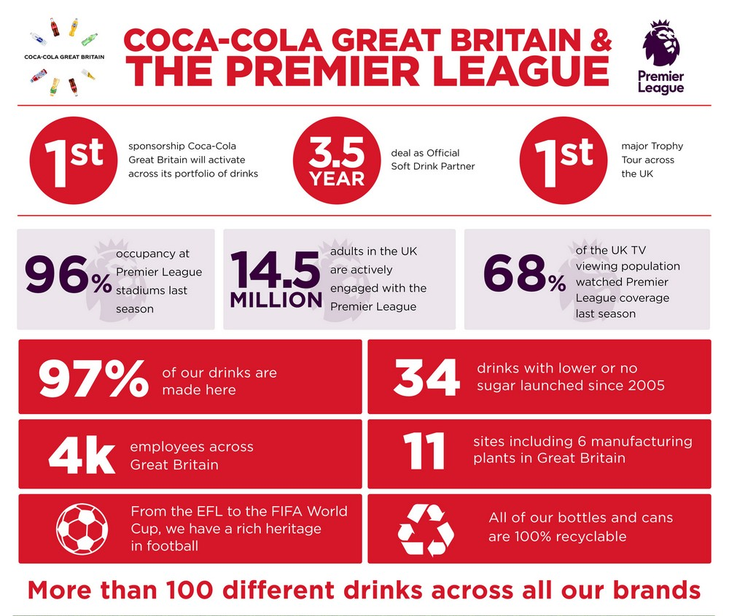
UK Premier League

Slide 16
2 x breakout rooms
Research
Research – What sports have gained more sponsorship in the UK over the past 4-5 years? Select 1 sport and present back some facts
Think about
Think about sports that are up and coming, ones that you have seen grow / more coverage on TV
Present
Present your information on a max of 3 slides- informal, use pictures / stats to present your findings

Slide 17
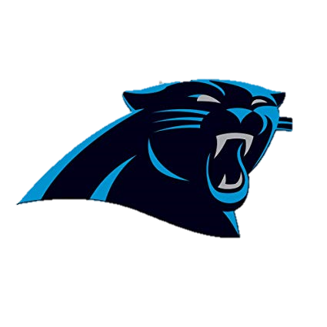
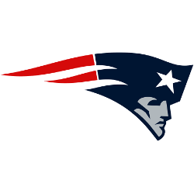

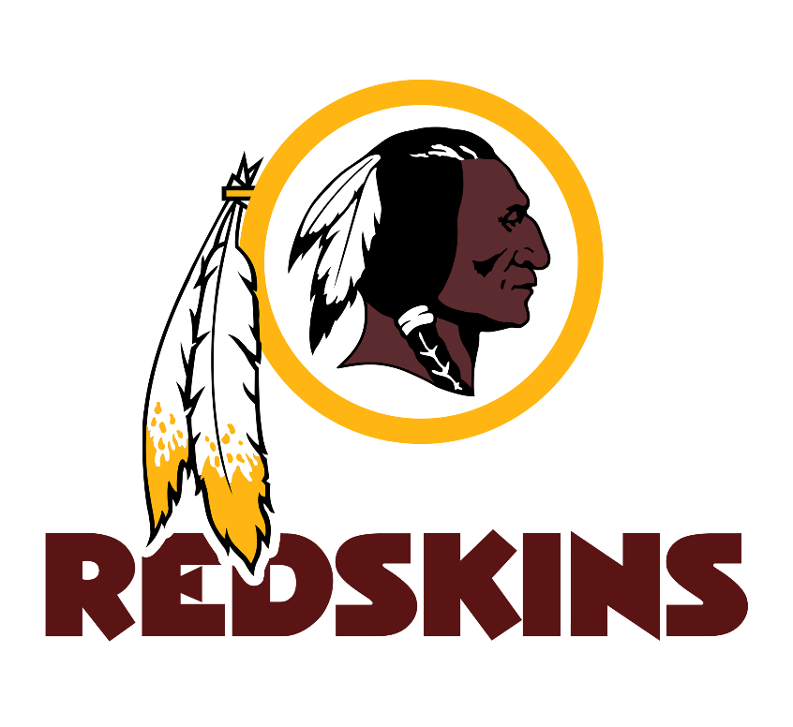

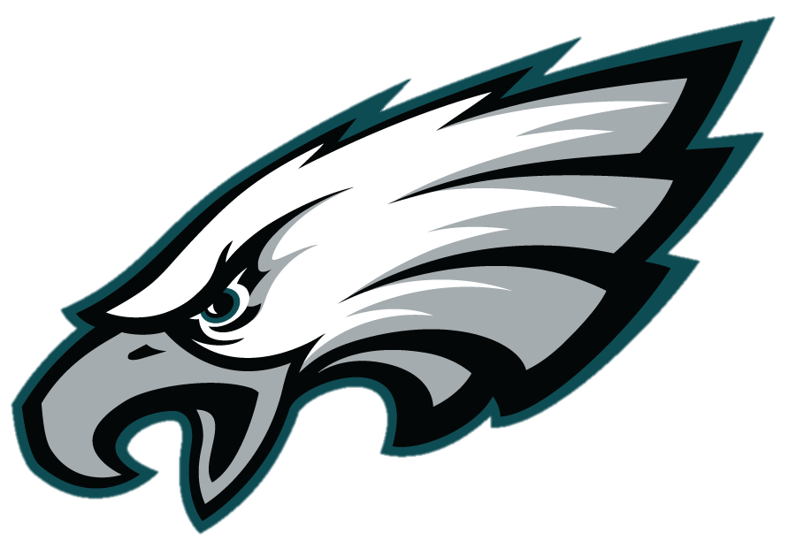
Shirt Sponsorship
Who is the kit supplier of these NFL teams?

Slide 18
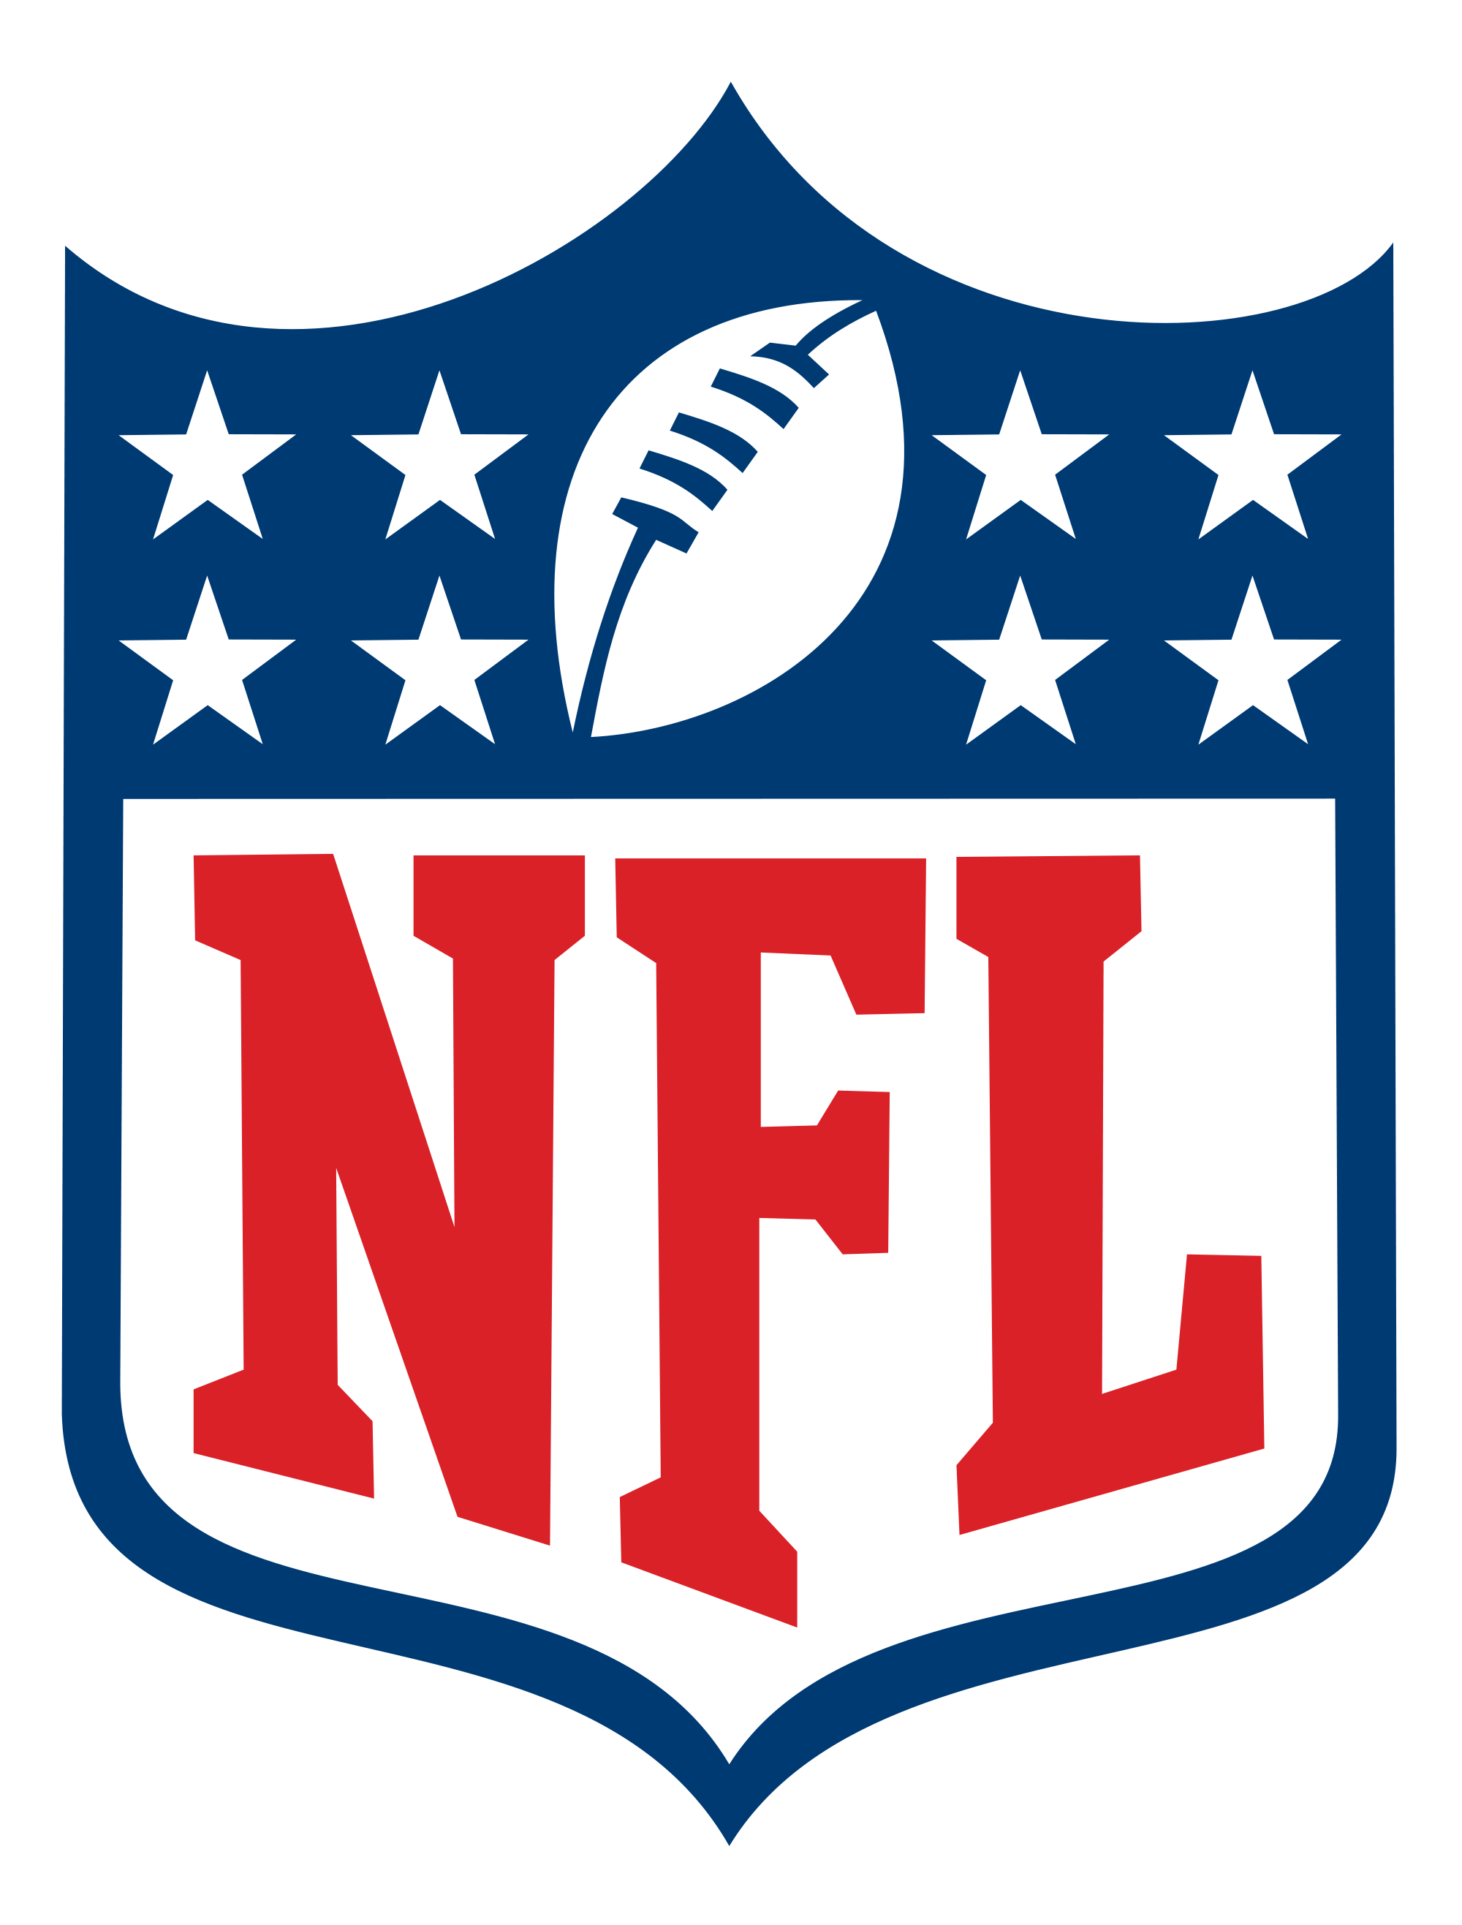
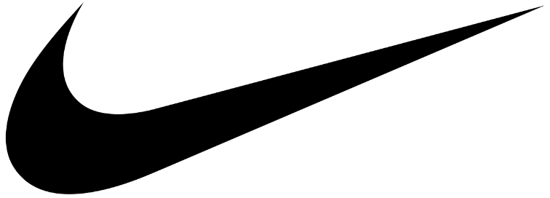
NFL and Nike sign 8-year contract for uniforms
The new deal will star once the current one finishes in 2020 and will run until 2028.
Sponsors all 32 teams with game day uniforms.
Financial details of the NFL deal have not been released but the deal with the NBA (8 years) was worth $1billion.

Slide 19
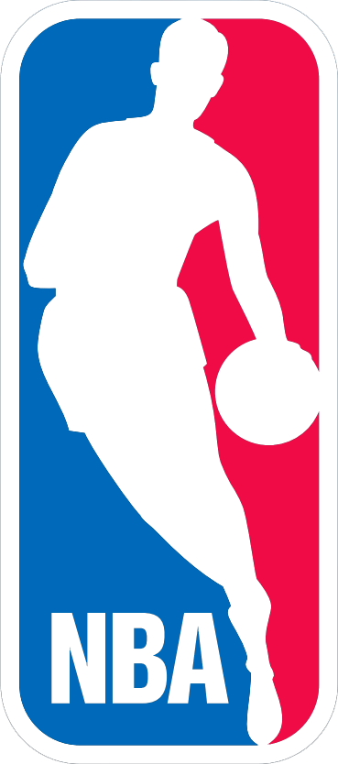
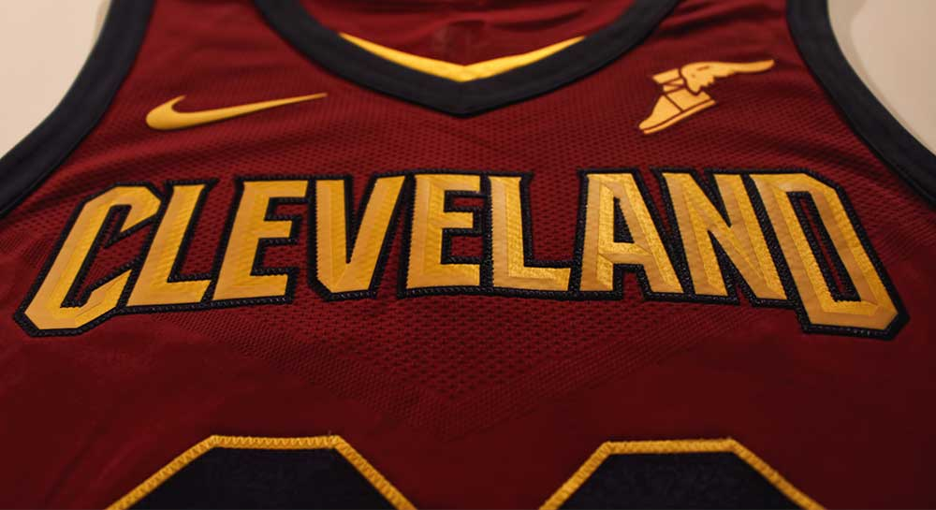
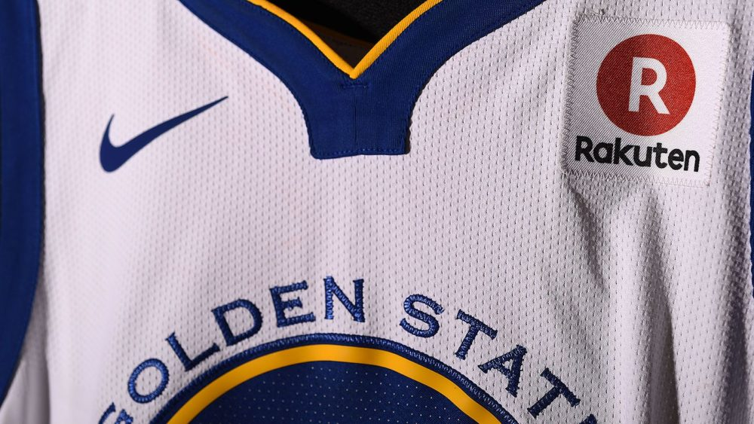
NBA jersey sponsoring
Eight year contract signed in 2015 for $1 billion, more than triple of what Adidas paid.
Nike’s logo will appear in the game jerseys for the first time in NBA history.
However, there are 14 teams in the NBA that for the first time ever have signed jersey sponsors.

Slide 20
Team | Sponsor | How Much (per year)
Atlanta Hawks | Sharecare | $2.5m-$10m
Boston Celtics | General Electric | $7m
Brooklyn Nets | Infor | $8m
Cleveland Cavaliers | Goodyear | Over $10m
Denver Nuggets | Western Union Bank | $5m - $10m
Detroit Pistons | Flagstar Bank | $5m- $10m
Golden State Warriors | Rakuten | $20m
Milwaukee Bucks | Harley – Davidson | $2.5m
Minnesota Timberwolves | Fitbit | $3m - $8m
Orland Magic | Disney | $5m - $10m
Philadelphia 76ERS | Stubhub | $5m
Sacramento Kings | Blue Diamond Almonds | $5m
Toronto Raptors | Sun Life | Ove $5m
Utah Jazz | Qualtrics | $4m

Slide 21
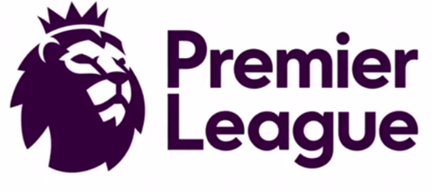
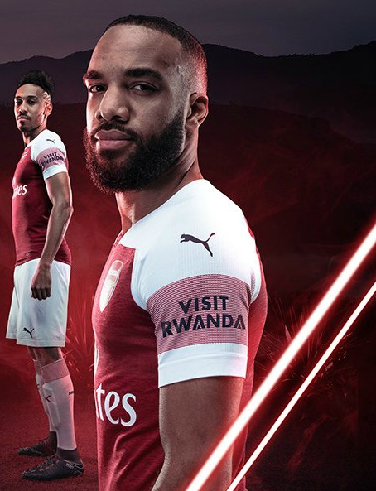
Premier League Shirt Sponsorship
Premier League Clubs will rake in a collective £344.5 million in shirt sponsorship deals.
8 teams advertising betting and gambling companies
More clubs are jumping at the opportunity to sign a sleeve sponsor.
Notes:
http://www.sportspromedia.com/analysis/premier-league-preview-2018-19-sponsors-kit-deals-every-club

Slide 22
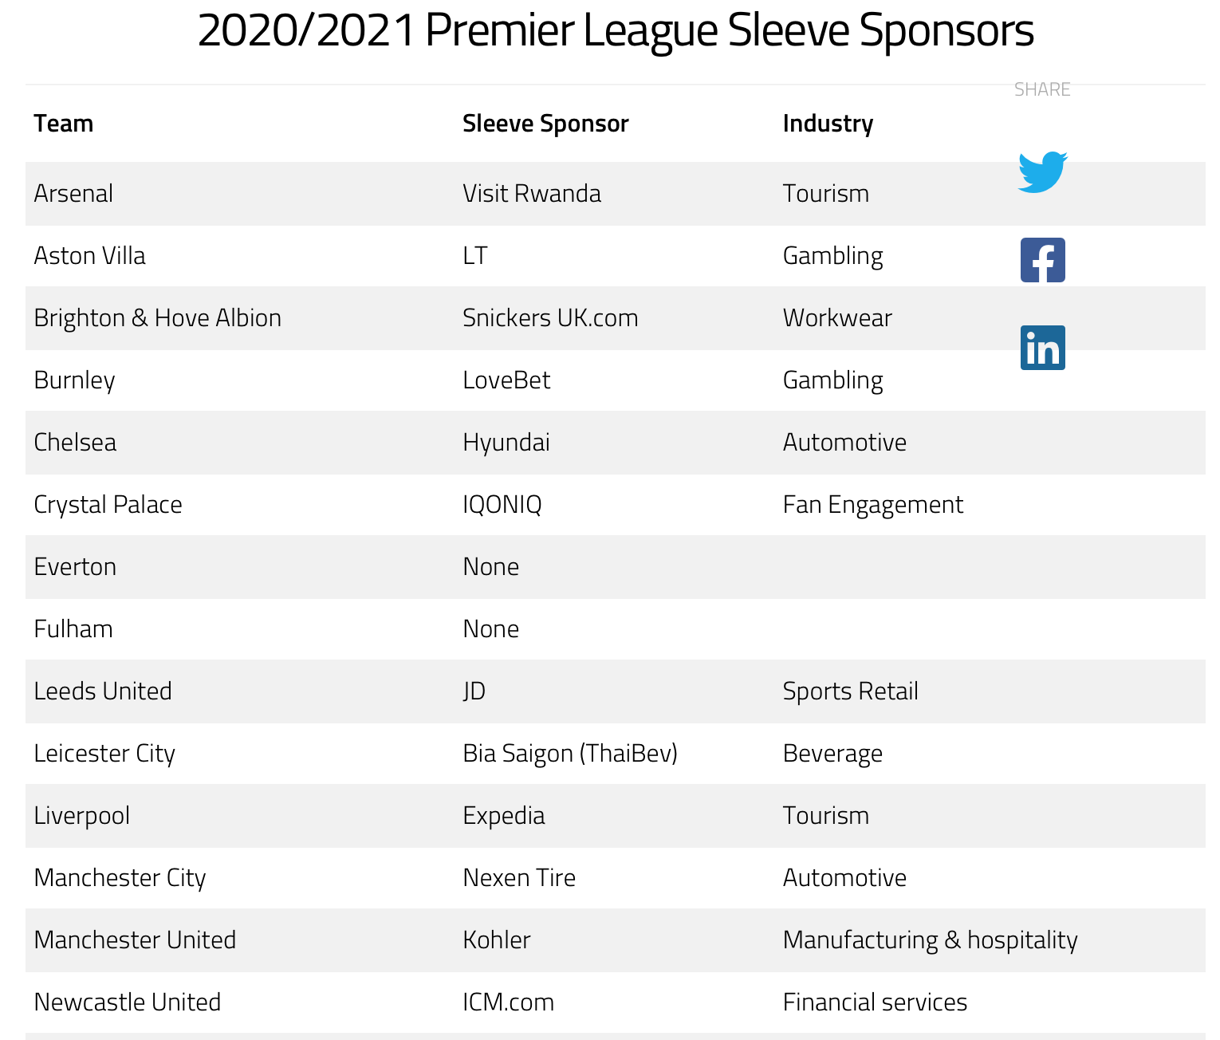
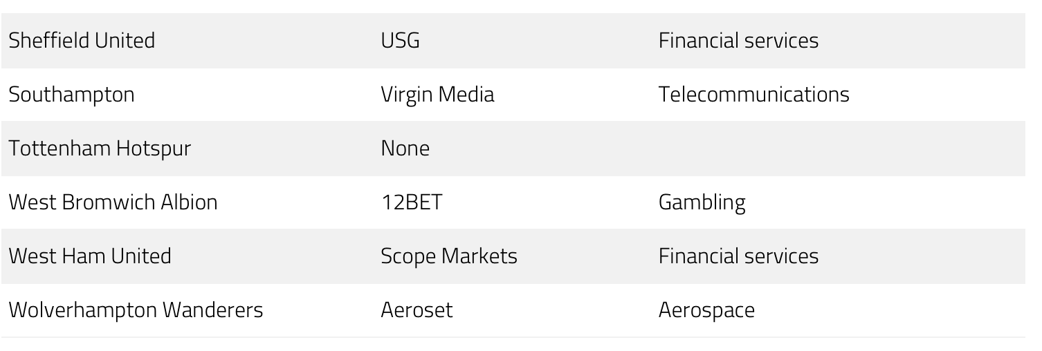
Sleeve Sponsors

Slide 23
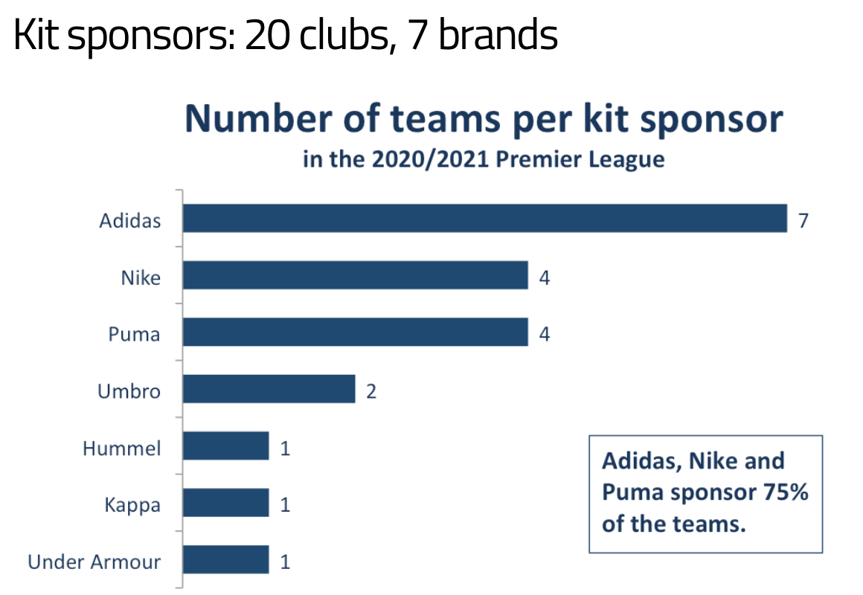
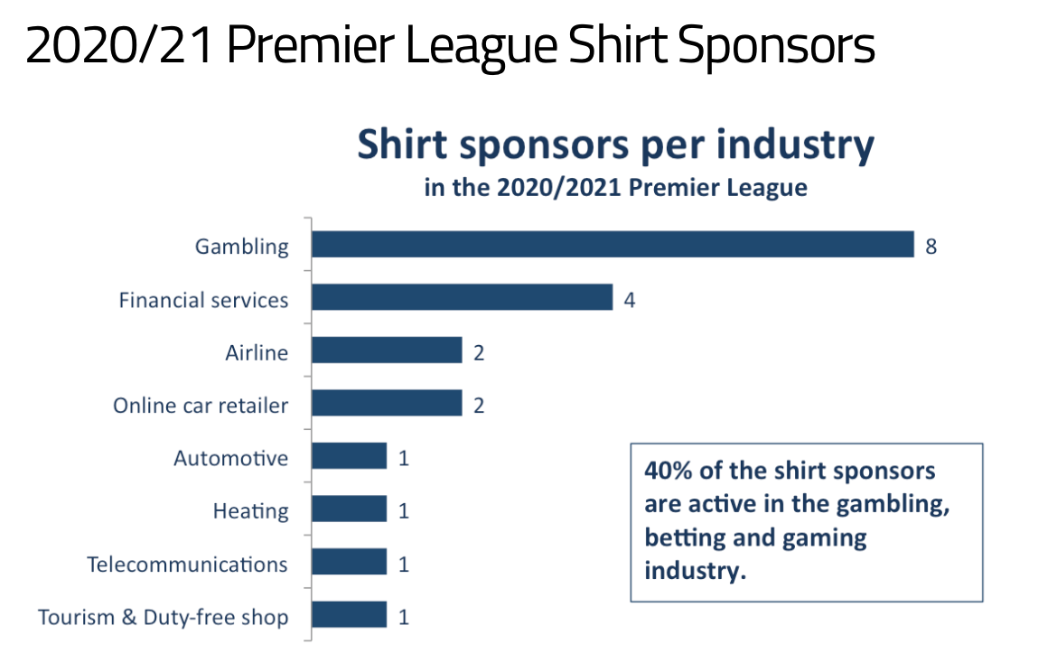

Slide 24
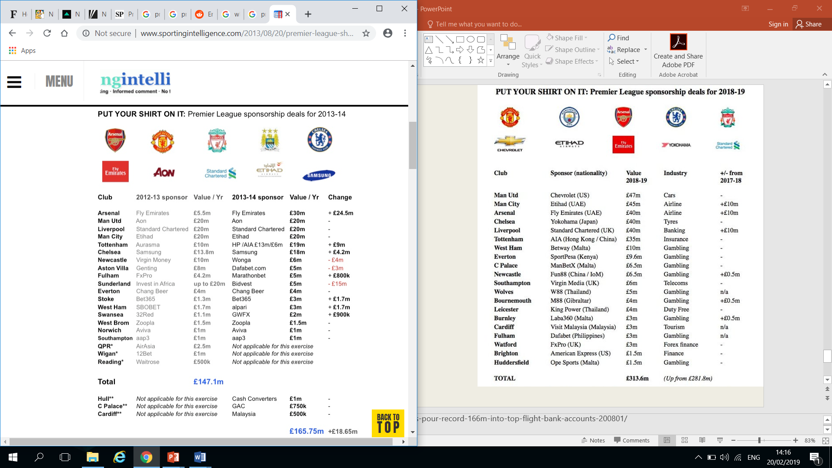
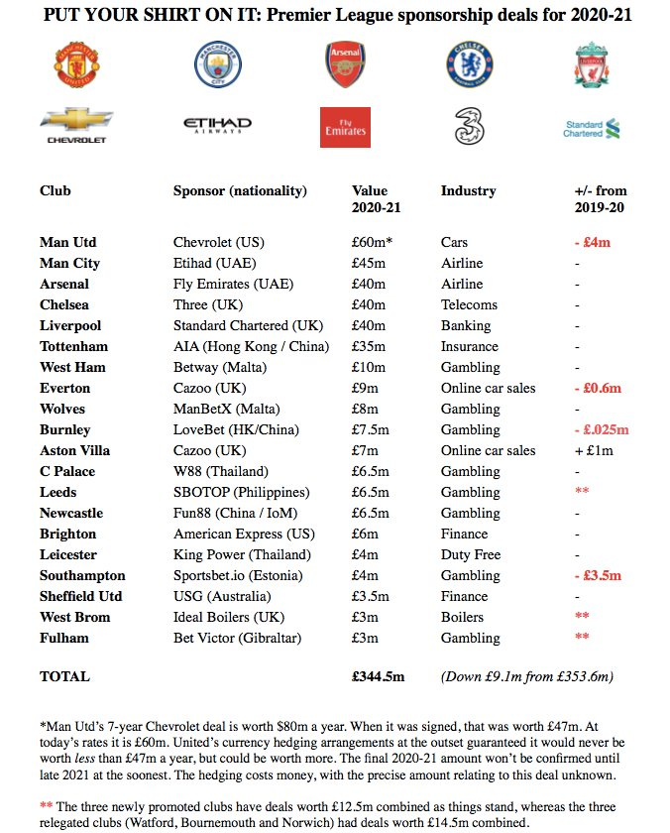
Notes:
http://www.sportingintelligence.com/2013/08/20/premier-league-shirt-sponsors-pour-record-166m-into-top-flight-bank-accounts-200801/

Slide 25
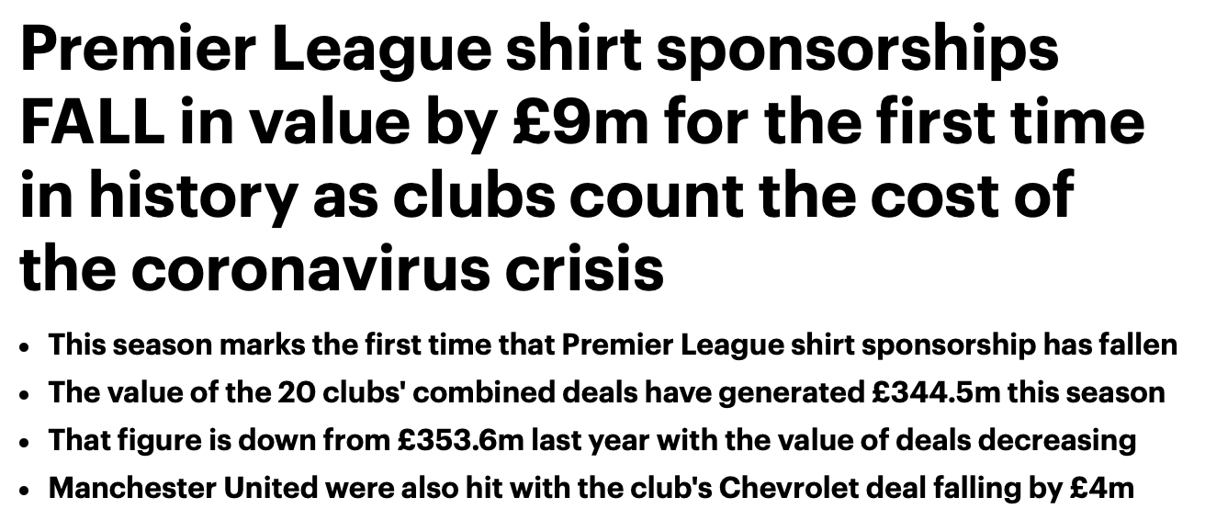

Slide 26


Slide 27
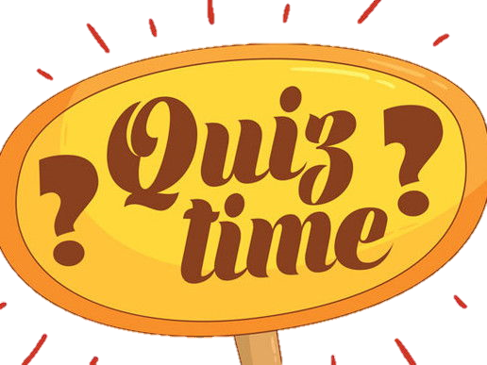

Slide 28

Presentations
Look at Sports sponsorship and Athlete sponsorship
Investigate an athlete and discover how much sponsorship money they receive.
Pick from the list below or just choose any athlete at random.
Create 2 PowerPoint slides to present at the start of next session.
  Michael Jordan
  Cristiano Ronaldo
  Messi
  Serena Williams
  Leigh Halfpenny

