Slide 1
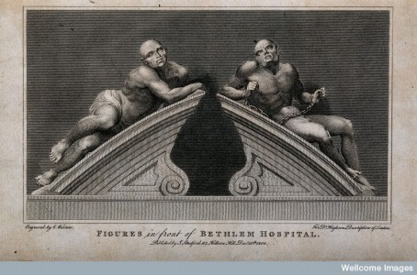
Madhouses and Mad Doctors
Part I
The changing response to madness
Notes:
Madhouses and Mad Doctors
The changing reaction to madness

Slide 2
Aims
To explore the changing response to madness into the 17th century and beyond
To understand the European face of madhouses
To become familiar with Bethlem Hospital, Moorhouse.

Slide 3
Changes in the 17th Century
From around the 17th century, the response to incapacity and poverty was starting to change.
Why might this be?
Northern Europe, including the United Provinces (Holland), Britain there is a move towards confinement
Notes:
The revival of trade, the expansion of towns and the spread of market relations seem to have prompted a more secular and sceptical attitude towards the poor, especially the idle and vagabond

Slide 4
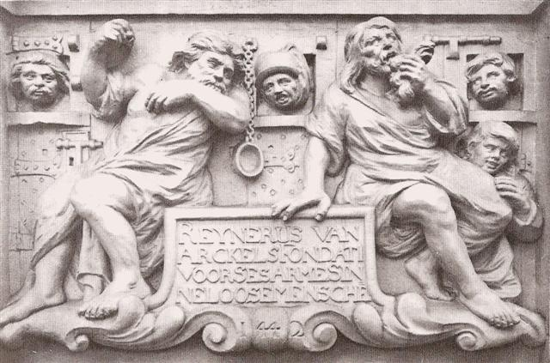
Dutch Madhouses: Dolhuizen
Started in the 15th century
Were original small houses
But expanded as communities sought to expel violent and hostile madmen.
Idle and social non-conformers were seen as a threat and a danger to a calm and ordered society.
Notes:
A relief panael depicting inmates of the ‘Hertogenbosch lunatic asylum, carved by Peter Van Coeverden (1686). Three mad faces peer out through openings to their cells, while two other madmen and a young boy grimace and posture in front of us.

Slide 5
Misfits of society
Before long and across Europe, beggars, prostitutes and other misfits of society were finding themselves incarcerated.
Anyone that might be a danger to a stable society would find themselves locked away.
In theory, the idle, the degenerates of society would now have to work!

Slide 6
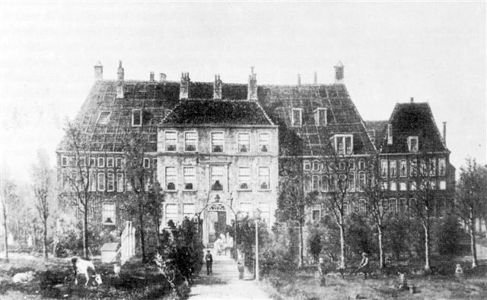
Undesirables
Everything outside the ‘normal’ was soon considered ‘insane’ This included: epileptics, those who demonstrated anti-social behaviours, dementia, rioters, addicts etc.
Dutch Madhouse: Reinier Van Arkel had a capacity for 45 patients by the 18th century.
This was a progressive centre for a time, they inmates /patients were not incarcerated initially, but they were observed. The charge for admittance would depend on the patient’s ability to pay.
Notes:
However, for some of these houses, efforts were made to not incarcerate some of the mad people, after all, how can you get the sick and crazed to work and be disciplined.
So, in Netherlands at least, efforts were made to put the insane into houses of their own: Dolhuizes

Slide 7
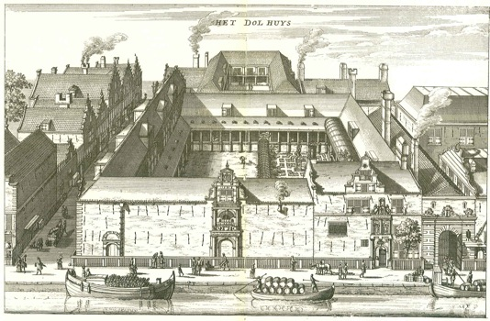
Notes:
Amsterdam Dolhuis:
Lottery
Door 't mildt inleggen der goeder burgeren wys bedacht / Is dit huys met dees lotery A˚ 1592 in beter staet gebracht" (By means of the gentle input of the good and wise citizens, this house was brought into a better state through this lottery A˚ 1592). The institution had been established in 1562 with three thousand guilders left to the city by Hendrick Pouwelsz van Gisp (ca. 1495-1561), whose (presumed) portrait also belonged to the institution's inventory (fig. 3). Gisp decided to bequeath the sum after his pregnant wife was attacked by an insane woman.10 Once she delivered ahealthy child, he kept his vow and designated part of his money to the building of a madhouse after his death. The original structure soon proved too small, and on April 9, 1591, the city council approved the organization of a public lottery, the proceeds of which would be used for the extension of the Dolhuis.11 A print produced for the occasion contains the rules of the lottery as well as an overview of the prizes that could be won—an impressive amount of silver tableware combined with money—as well as an artist's impression of what the expanded building would look like (fig. 4).12 Lots priced at six pence each were sold for one year, then the drawing commenced on August 14, 1592. Despite what the inscription on the painting's frame would have us believe, the planned expansion of the Dolhuis was not completed until 1617 (fig. 5).

Slide 8
Madness and England
The Poor Relief Act 1601
  Able-bodied paupers would now be consigned to workhouses, however parishes would also be obliged to look after lunatics.
  Bethlem (1676) – Built from the ashes, following the Great Fire of London in 1666.
  Moorfields, on the edge of the city of London. Designed by Robert Hooke, rival of Isaac Newton and friend of Christopher Wren.
Notes:
Able-bodied paupers consigned to workhouses, but

Slide 9
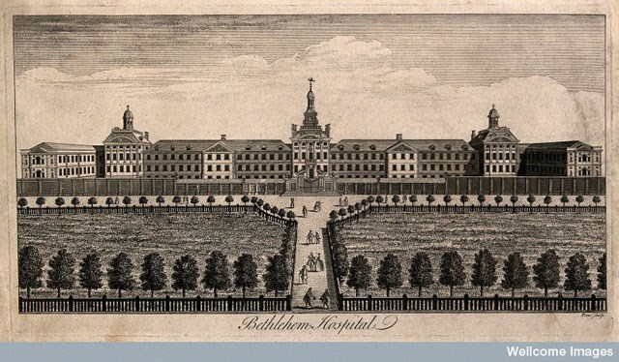
Notes:
This building looked like nothing in history. It had stone gates that opened onto landscaped lawns, it had Corinthian columns, it was a spectacular gesture of reinvention, not only of London, but also of Madness itself.
Bethlem had stood for s long as the only public institution for the mad, that its gloomy, draughty cells had become synonymous with the misery of the condition.
The new building was the envy of the city. In the words of Bethlehems Beuaty, Londons Charity, and the Cities Glory (1676)
The first of many poetic effusions published after its opening, it ‘makes one Half-Madd to be a Lodger there’

Slide 10
Bethlem
However the face that Bethlem presented to the world was no more than a façade.
Building had no foundations
Erected on waste ground and six inches below ground its brick gave way to rubble.
‘The outside is a perfect mockery to the inside’ Thomas Brown (1699) making one wonder ‘whether the persons that ordered the building of it, or those that inhabit it, were the maddest’
Notes:
The symbolism was impossible to ignore, the façade of care concealing the black hole of neglect. It was a cruel but accurate reflection of the mixed motives that had led to Bethlem’s reinvention.
These houses reflected a new intolerance for civil disorder. People wished for the mad to be treated humanely, but at the same time they believed that the less contact they had with others the better.
The madhouse stood in clear contrast the system that emerged under the French monarchy
The mad were confined alongisde, beggars, criminals, prostitutes and vagabonds. In Paris the new prisons included the Bicetre and the Salpetriere, which would eventally become the city’s two great asylums for men and women, respectively. Their purpose was simply to remove beggars and other public nuisnaces from the streets, which they did in numbers that eventually rose to around six thousand. A letter from the king was enough to confine anyone for life without right of appeal.

Slide 11
France
Bicetre and Salpetriere – two large asylums for men and women respectively.
Any degenerates of society would be imprisoned. The idea was simply to remove society’s misfits from the streets
Eventually the inmates within these two asylums would rise to as many as 6,000
A letter from the king was enough to imprison anyone for life, without right of appeal.
Notes:
The madhouse stood in clear contrast the system that emerged under the French monarchy
The mad were confined alongisde, beggars, criminals, prostitutes and vagabonds. In Paris the new prisons included the Bicetre and the Salpetriere, which would eventally become the city’s two great asylums for men and women, respectively. Their purpose was simply to remove beggars and other public nuisnaces from the streets, which they did in numbers that eventually rose to around six thousand. A letter from the king was enough to confine anyone for life without right of appeal.

Slide 12
The Salpetriere – Parisian Hospital
The Salpetriere is the largest hospital in Paris and possibly in Europe: This hospital is both a house for women and a prison. It received pregnant women and girls, wet nurses and their nurslings; male children from the age of seven or eight months to four and five years of age; young girls of all ages; aged married men and women; raving lunatics, imbeciles, epileptics, paralytics, blind persons, cripples, people suffering from ringworm, incurables of all sorts, children afflicted with scrofula, and so on and so forth.
Jacques Tenon, French surgeon (1669-1760)
1788
Notes:
Beggars, prostitutes, protestants, epileptics, orphans, homosexuals, magicians, idiots, sent there by families, husbands, neighbours

Slide 13
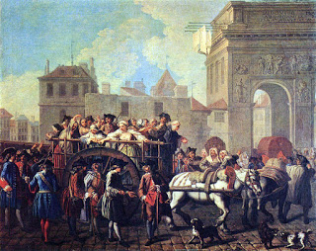
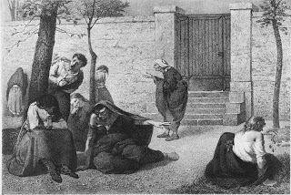
Notes:
On Sundays, prostitutes were rounded up and carted off to La Salpetriere

Slide 14
Treatment of the Insane - Hospitals
Usually it would be the families that look after the insane, lunatics
Often this might be chained up in attics, put outside, into out buildings
If families could not be found, the insane would be locked up in jail, or poor-house, alongside notorious or seedy, untrustworthy members of society.
For the better off, relatives might be placed in religious institutions, sometimes with a warrant bearing the king’s signature
Marquis de Sade (1740-1814)
Notes:
Letters de cachet closed off all access to the courts or grounds of appeal, and Sade’s repeated sexual escapades had prompted his mother-in-law, Madame de Montreuil, to obtain the warrant.

Slide 15
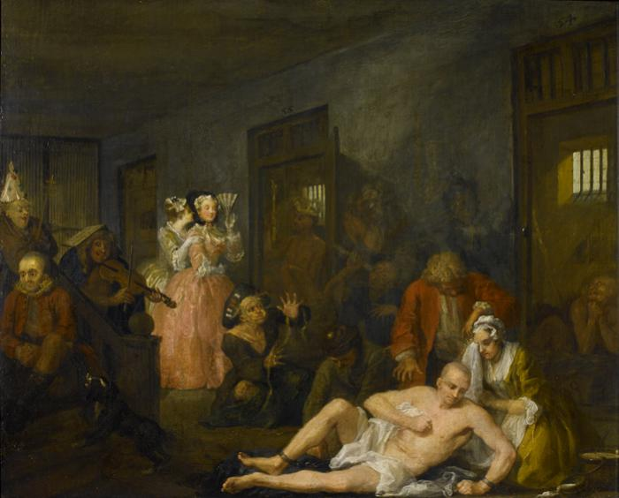
Representations of Madness - England
Rake’s Progress: William Hogarth
http://www.soane.org/collections-research/key-stories/rakes-progress
Notes:
http://www.soane.org/collections-research/key-stories/rakes-progress
Tom has descended into madness. He is now in Bethlem Hospital or ‘Bedlam’, as it was known.
The inmates around him – a tailor, a musician, an astronomer and an archbishop – are suffering various delusions. One man thinks he is a king, but is naked, carrying a straw crown and sceptre.
Bedlam is open to the public (as indeed it really was), and two fashionable ladies are sightseeing – for them, it’s an amusing day out, observing the poor suffering lunatics

Slide 16
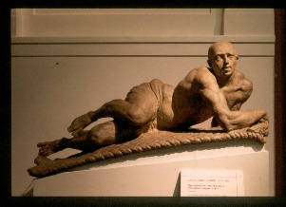
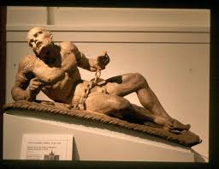
Raving and Melancholy Madness (1676)
Caius Gabriel Cibber
These two figures would be seen crowning the main gates of Bethlem and would remain a landmark in London for generations.
Notes:
The contrast between them illustrated a classical ideal of madness and its physical roots: on the left the torpor caused by black bile, and on the right the frenzy produced by excess blood.

Slide 17
Bethlem - Bedlam
Despite the magnificence of the exterior, the interior consisted of two galleries, one for women and one for men.
These two images of Madness represented the types of people that would be confined to Bethlem: those who were a danger to society, violent and aggressive and those who wanted to withdraw and be alone.
They also represented those that society wanted to lock away: Those that were too violent to be seen and those that were too mopish to do any good!

Slide 18
Trade in Lunacy
The older Bethlem had been the sole institution that looked after the insane, they had the monopoly of care.
Now however, it was competing with fashionable and rival funders. It became vogue to sponsor the building of these institutions.
So whereas before the mad would be looked after by families or live homeless on the streets, the middle class would now have somewhere to incarcerate their relatives, those that were too difficult to support at home.

Slide 19
Trade in Lunacy
Private madhouses would often share cleaners, nurses and medical staff.
They offered the care and support that families would not be able to offer themselves.
The new hospitals accepted fee-paying patients, who soon made up around one third of the inmates within a hospital.

