Slide 1
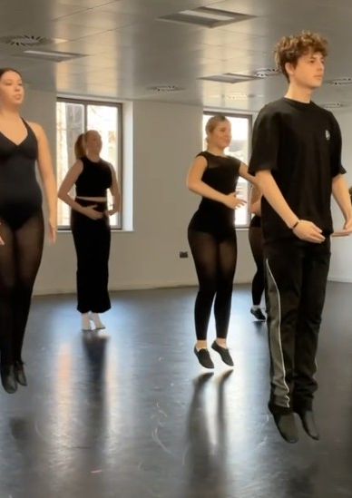
Fitness well-being and its importance in DANCE
Dance Training 1
(ADPB4004)
Fitness and Training
By: Callum, Dee, Emily & Kailyn

Slide 2
What is Fitness?
Physical Fitness
'The ability to carry out a daily task with stamina and alertness, without undue fatigue, and with ample energy to enjoy leisure-time pursuits and meet unforeseen emergencies' (Blair and Jacobs, n.d.)

Slide 3
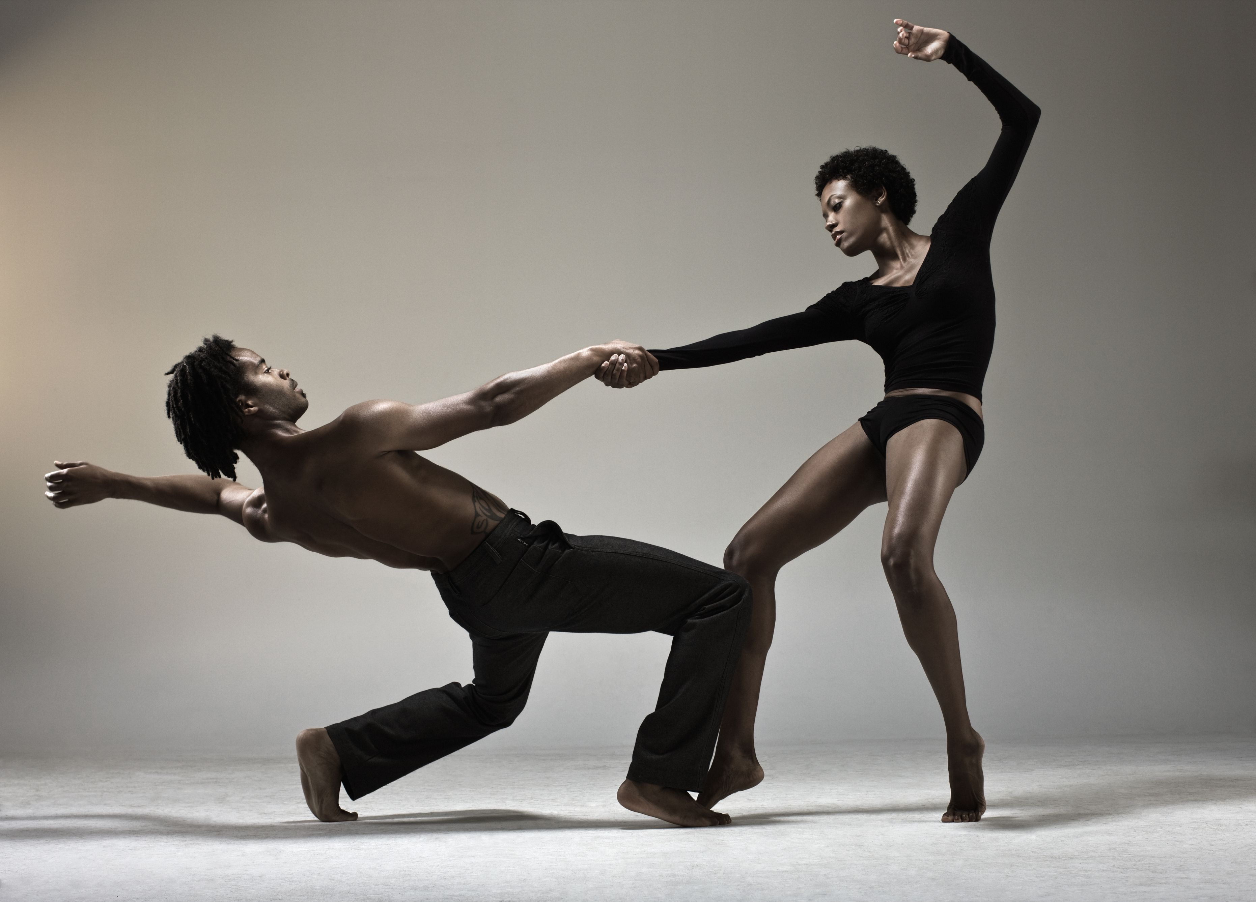
Importance of fitness through dance
''Ensure that the dancers are less prone to injuries, can enhance their performance, and push their physical abilities.'' - Danielle Hernandez, 2019
( Image from Movedancewear.com, 2025)

Slide 4
HEALTH-RELATED FITNESS
Cardiorespiratory Endurance
Body Composition
Muscular Strength
Muscular Endurance
Flexibility

Slide 5
SKILL-RELATED
Agility
Coordination
Balance
Power
Reaction time
Speed

Slide 6
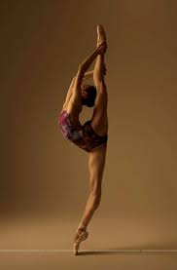
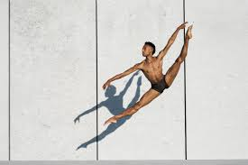
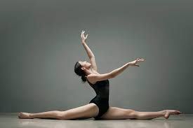
Flexibility importance in dance
What is flexibility?
Flexibility is a range of motions through the joints.
Flexibility has two types of components which are static and dynamic.
What affects flexibility?
Being active
Age and gender
Muscle
The Most important aspect to flexibility?
STRETCHING!
Ballistic
Static
dynamic
Flexibility through dance
Improve posture
Injury prevention
Balance and stability
Better performance

Slide 7
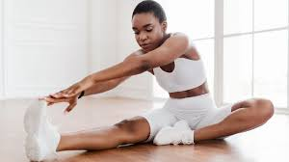
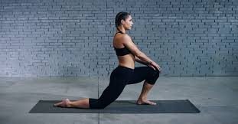
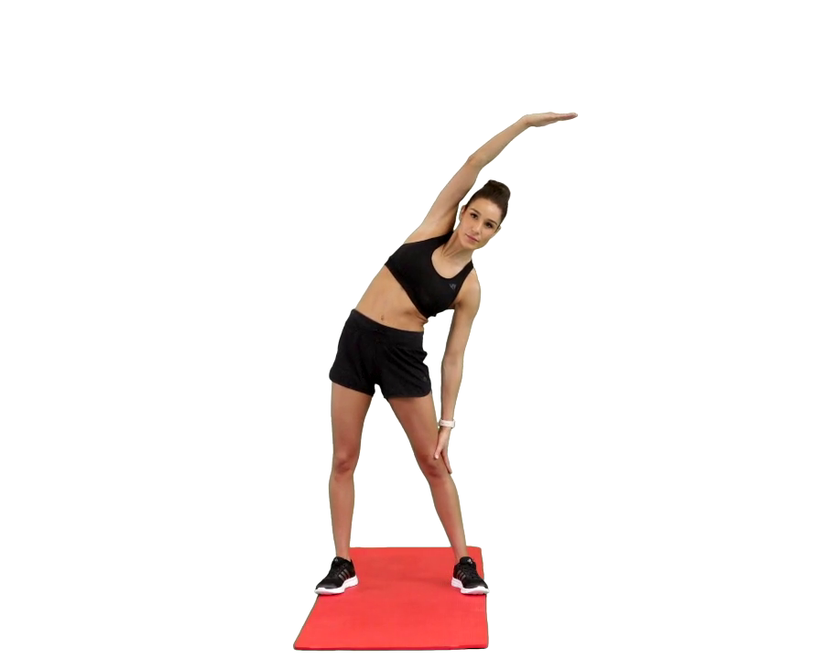
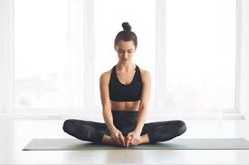
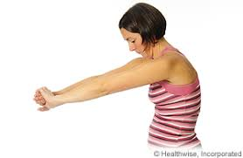
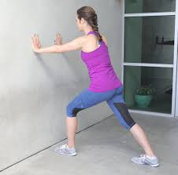
Stretches to improve flexibility for dancers?
  Hamstring stretch Hip flexor stretch Side stretch
  Butterfly stretch Upper back Calf stretch

Slide 8



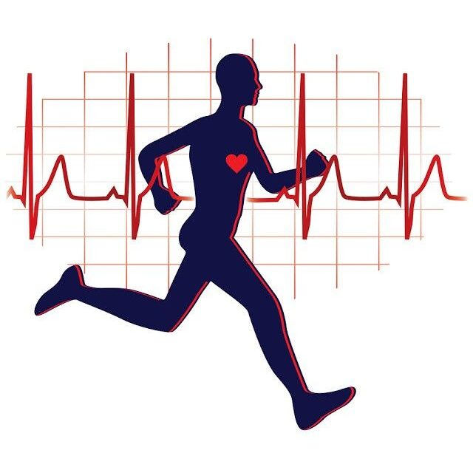





Cardiovascular importance in dance
Slide by Callum Jones
Image from (adventurefitness.club, 2021)
How can I improve my Cardiovascular Fitness?
Cardiovascular fitness (or CV fitness) refers to the efficiency of our heart, lungs and blood vessels, and their ability to transfer oxygen to our muscles as we exercise. CV is carried out as we perform actions that gradually increase our heart rate or beats-per-minute (BPM). Your overall fitness depends on the relationship between your cardiovascular system, respiratory system, and skeletal system. (Waehner, 2024).
There are a variety of CV training types, these include:
CONTINUOUS TRAINING – Executing a constant exercise at an average-intensity for a suggested 20-60 minutes.
INTERVAL TRAINING – Carrying out exercises that alternate in intensity.
FAARTLEK – The Swedish term for 'speed play'. This training type involves an unstructured process of running whilst varying your speed.
CV is a crucial process for every individual's body, especially for those who undergo dynamic activities throughout their week, such as athletes or dancers. CV contributes towards a person's physical endurance and recovery. Additionally, the process minimizes the likelihood of injury and overall increases stamina, extended the amount of exercise your body can endure before getting fatigued.
It should be noted that each training type can be tailored towards a specific individual and can focus on a specific factor of CV. For example, interval training can particularly be helpful to dancers, as it echoes the challenges of dance as an art form. This can include the need to vary your pace and/or energy in a routine.
How can I measure my Cardiovascular Fitness?
It is important to measure our CV so that we can look for patterns and keep track of our improvements. Cardiovascular fitness and activity monitor agents measure the physical activity of an individual and record the physiological response to that activity. Agents include treadmills, exercise bikes, heart rate monitors, bike computers, pedometers, and overall activity/lifestyle monitors. Although there is great variety in the forms of these agents, there is significant commonality and overlap in the measurements they make. (IEEE, 2013, p. 5).
It is imperative that our CV fitness becomes a part of our daily life/routine. There are multiple ways to integrate CV activities into our lives, some of which are simpler than you think. These can include taking walks, choosing the stairs over an elevator, engaging in active sports, or perhaps taking the time to attend weekly classes that surround the use of cardio, like a dance or Zumba class.

Slide 9
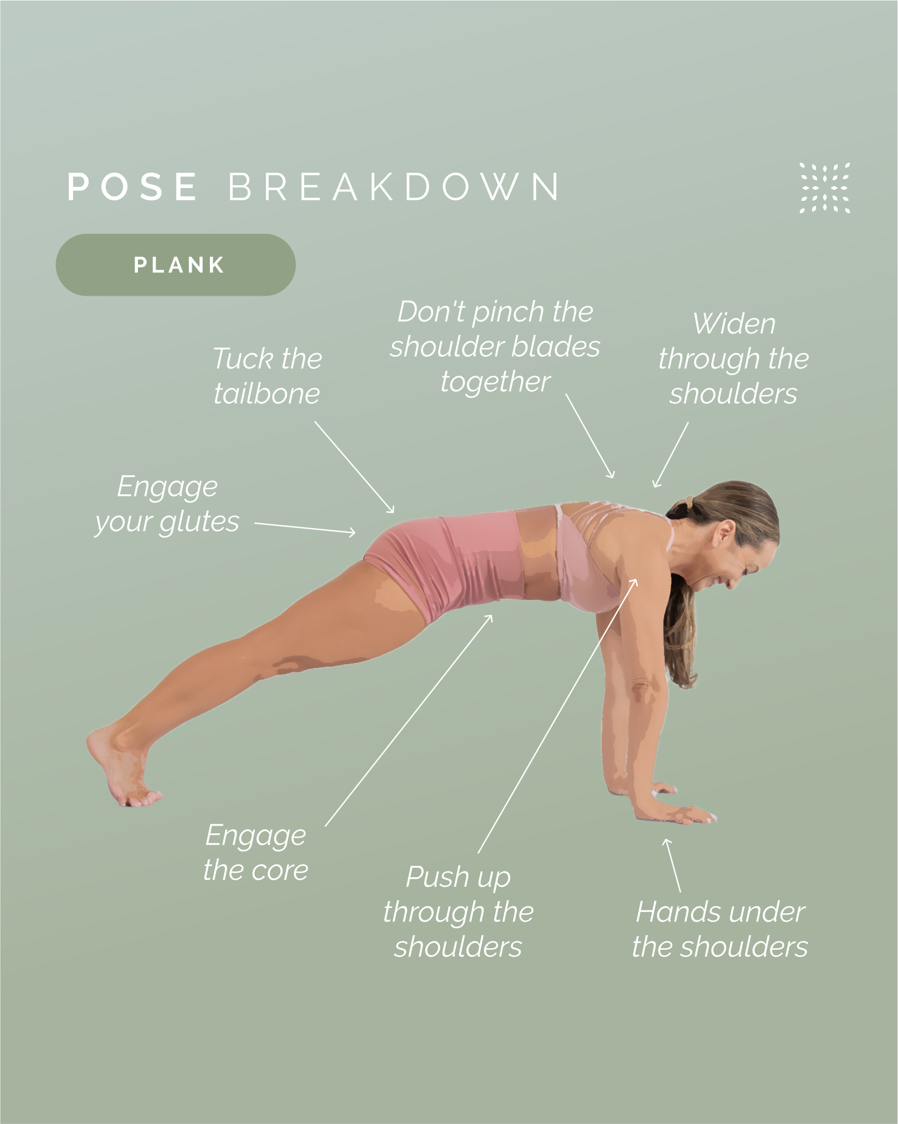
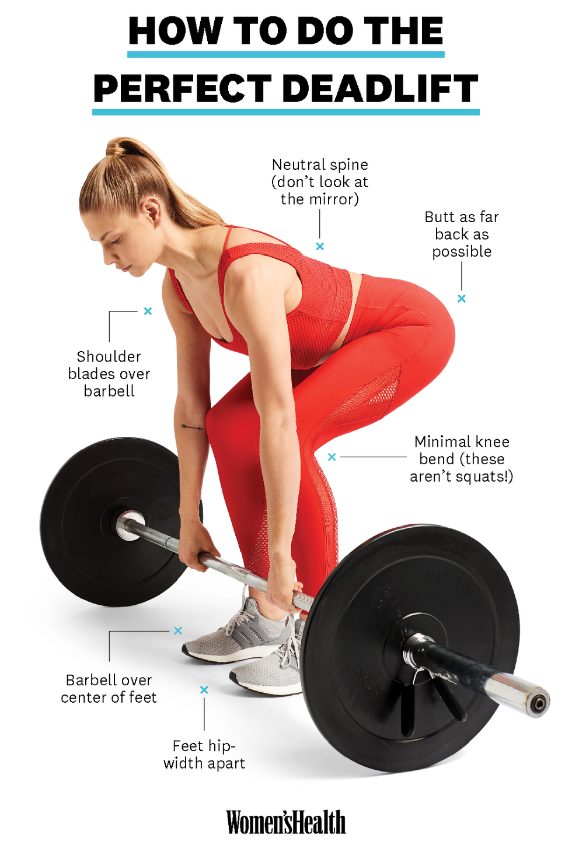
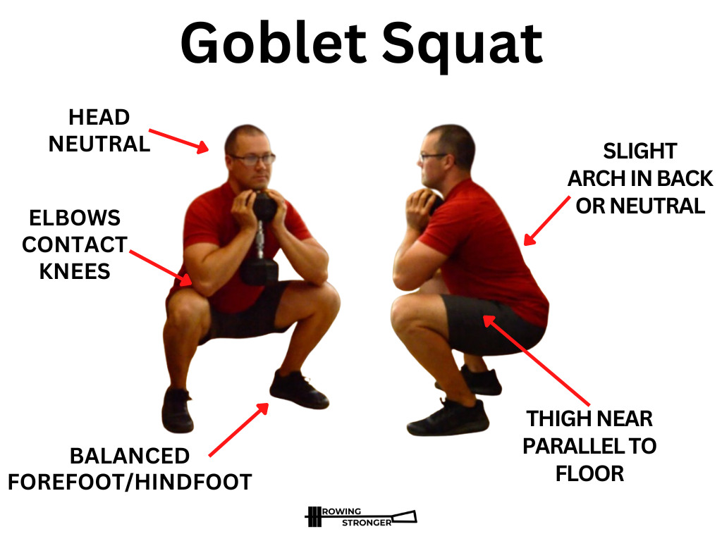
muscular fitness, what is it?
Muscular Fitness has 3 main components.
Muscle Endurance, the ability of a muscle or group of muscles to sustain repeated contractions or maintain static contraction over a prolonged period without fatigue.
EXAMPLE:
A great way to work on your endurance is a Plank, and sustain the position, holding it for intervals, there is isometric contractions in your core when you hold that contracted muscle for a long period.
Muscular Strength, is how much maximal force you can exert from a single or multiple group of muscles.
EXAMPLE:
A very common one is weight training, for example, deadlifts, which primarily focuses on a controlled movement working on the force and exerting it in reps.
Muscular Power, is the ability of a muscle or group of muscles to generate force rapidly, combining both speed and strength to produce explosive movements.
EXAMPLE:
Weight training is good for this too, using lower weights but having higher reps and do these with a high velocity. This will engage the use of your Power over your strength.
https://omstars.com/blog/pose-tutorials/the-benefits-of-plank-pose-and-how-to-do-it-safely-and-effectively/
https://www.womenshealthmag.com/fitness/a26679436/how-to-deadlift/
Emily
move-of-the-month-goblet-squat

Slide 10






Why is muscular fitness important to dance?
Strength/Power - 'In dance, you are required to jump, catch partners, move down onto the floor and up out of the floor at fast speeds, and perform other explosive movements. These movements require a level of muscular strength and power.' (Wilmerding and Krasnow, 2017)
Endurance – 'Dance routines often last for extended periods. Muscular endurance allows dancers to maintain energy and perform consistently without losing technique or precision.' (Blaine, 2025)
Injury Prevention – Having stronger muscles helps support and stabilize our joints and also absorbs impact, not only that but it helps improve alignment and all of these factors can lower the risk of an injury occurring.
Balance and Control - 'Muscular fitness enhances core strength, which is vital for balance, posture, and fluid movement. This is crucial for complex footwork, turns and maintaining poses,' (Blaine, 2025) also In ballet, tap and jazz, a lot of it focuses on balancing on one leg and/or balancing on the ball of the foot.
Flexibility and Range of Motion – 'Whilst flexibility is crucial for dance, it works best in tandem with strong muscles. Strength ensures that movements like splits, extensions and backbends are executed safely and with control' (Blaine, 2025)
Aesthetic Execution – 'Muscular Fitness helps improve precision, allowing dancers to execute movements, with clarity, grace and power enhancing the overall performance.' (Blaine, 2025)

Slide 11
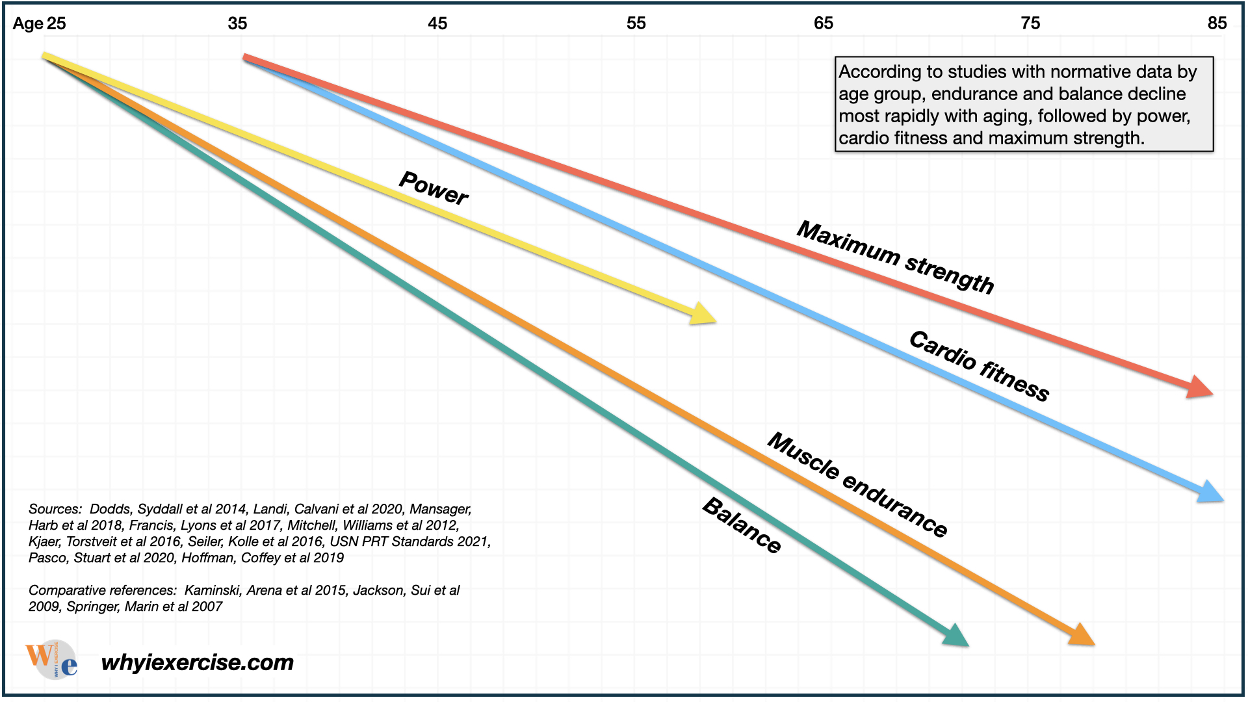
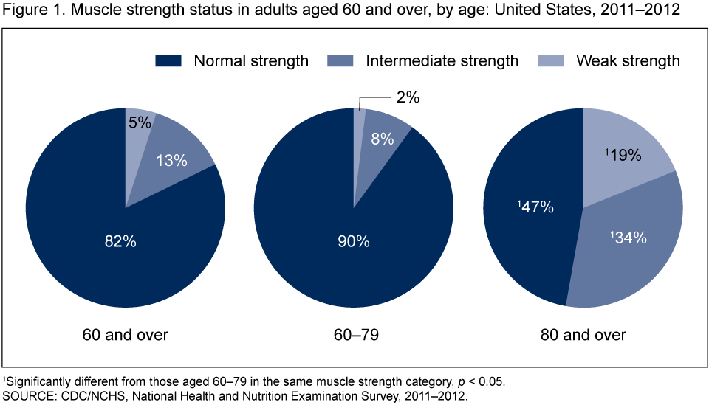
FUN FACT:
Muscular Strength can help with chronic injuries for example, fibromyalgia, arthritis or chronic back pain.
Prevalence of Reduced Muscle Strength in Older U.S. Adults: United States, 2011–2012 CDC
'Muscular strength enhances overall health and boosts athletic activity.
A strong body allows you to perform movements and activities that require power without getting tired.
Muscular strength helps you maintain a healthy body weight by burning calories and enhancing your body composition, which is the ratio between fat and muscle.
Building strength may also boost mood and energy levels while promoting healthy sleep patterns. This may boost confidence, provide a sense of accomplishment, and allow you to add more difficult or strenuous activities to your fitness routine.
Developing muscular strengths helps to build strong, healthier muscles and bones. This helps to develop good posture and relieve back pain.
You’ll have more stability, balance, and flexibility, making injuries and falls less likely.' (Cronkleton, 2019)
The best type of training for Muscular Fitness would be Resistance Training, if you would like to look at how to create yourself or another athlete a Resistance Training regimen and Analysis, CLICK HERE for more.
Emily

Slide 12
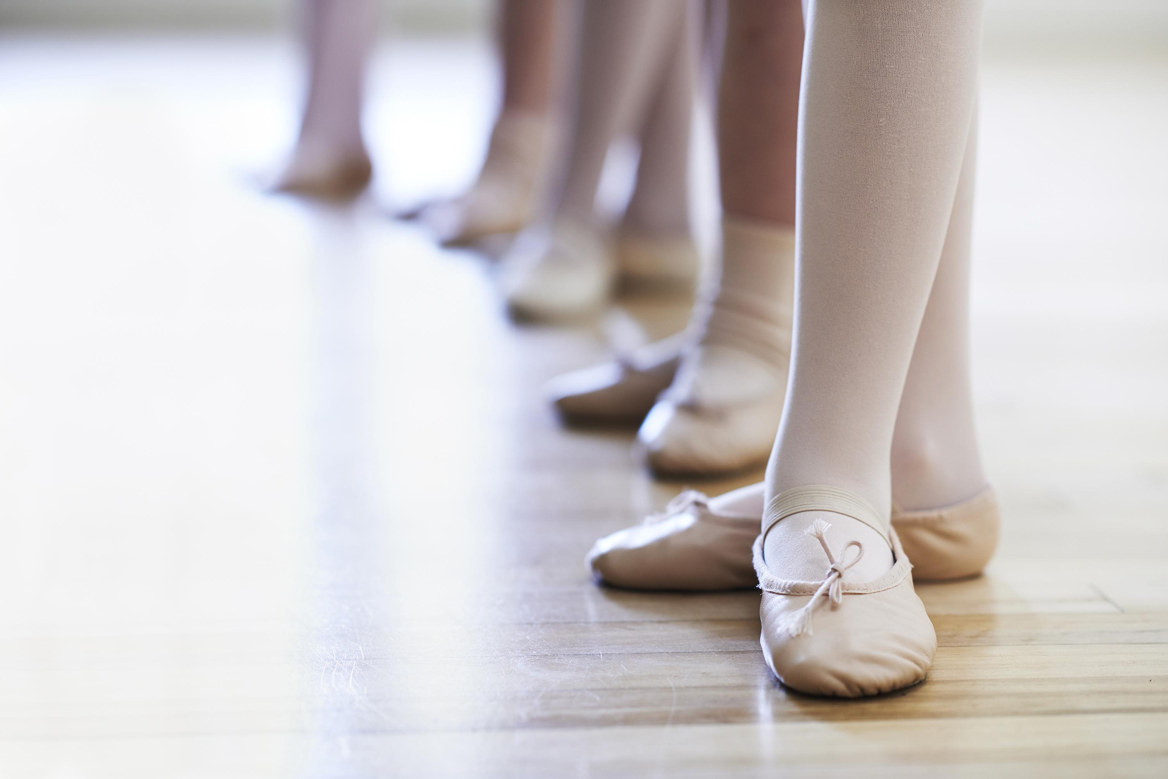
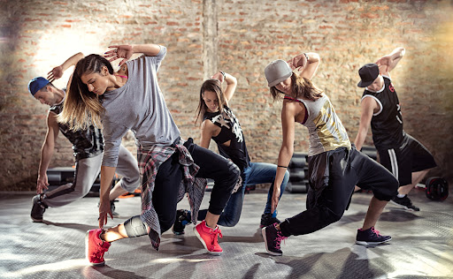
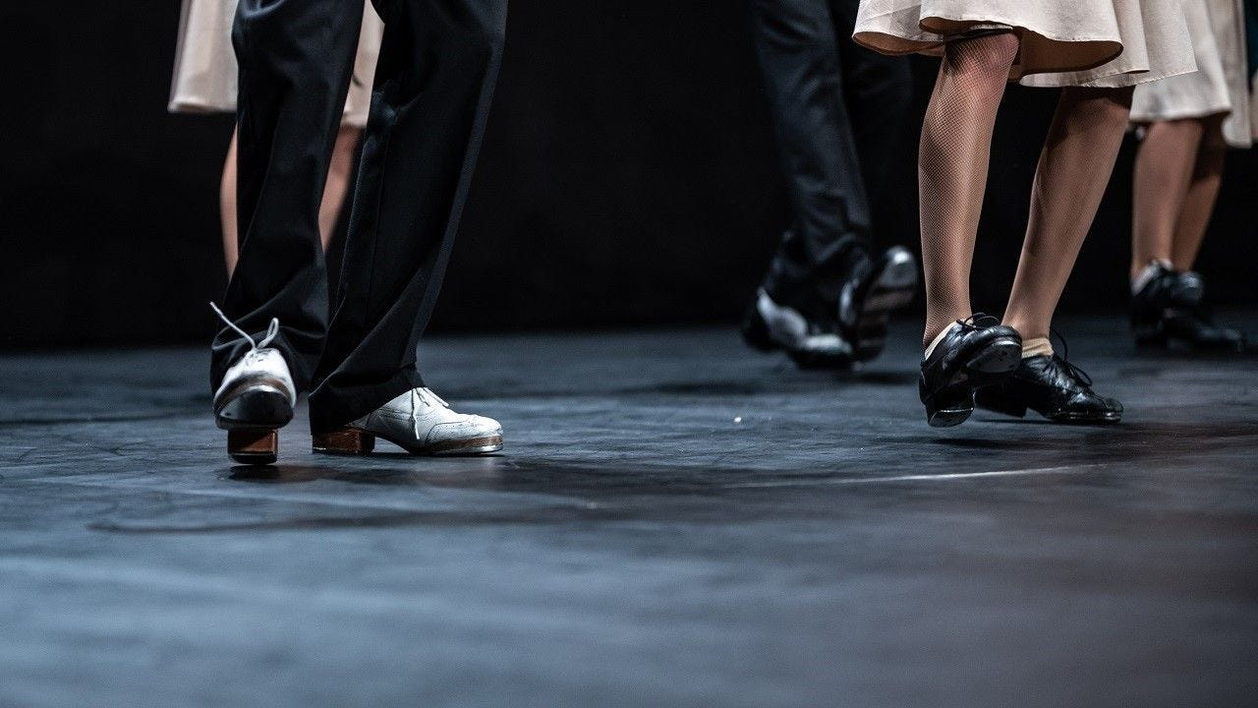
Jazz, tap and ballet
Callum
Jazz
Balance and ankle strength
Co-ordination
Flexibility and core strength
Tap
Co-ordination
Cardiovascular endurance in my legs and calves.
Posture
Ballet
Flexibility
Balance and core strength on releve'
Fluidity paired with extension and muscular strength
Kai
Jazz
Strength
Tap
Agility
Speed
Ballet
Coordination, bending and stretching of legs
Core Strength
Emily
Jazz
Strength in Legs and the extension of my legs
Stamina and overall Cardiovascular health
Overall flexibility
Tap
Co-ordination
Muscular Endurance specifically in the group of muscles on my calves.
Ballet
Strength in my core
Endurance, surrounding tendons/Joints in my Feet
Dee
Jazz
stamina
hip flexibility
Tap
Stretching my calves before class
leg placement
Co- ordination
Ballet
Turn out hips
balance

Slide 13
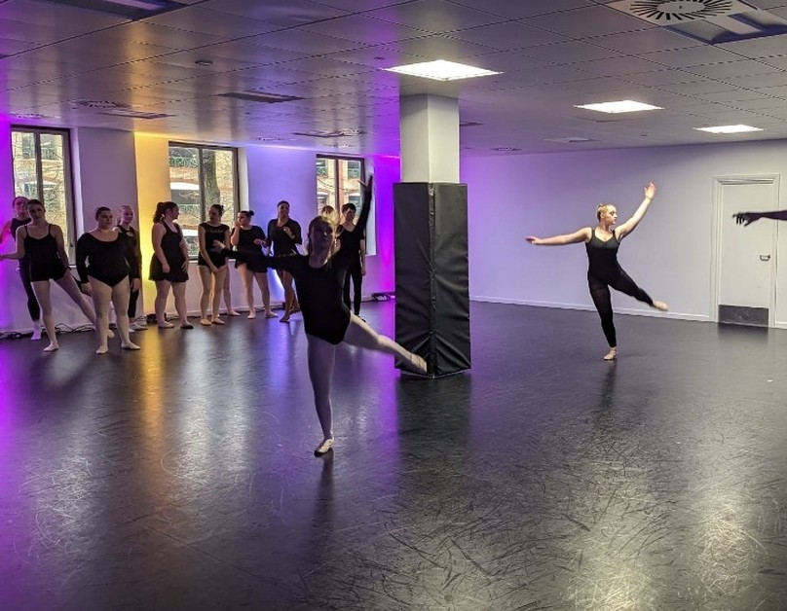
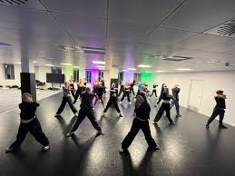
conclusion
Flexibility
Flexibility is crucial for dancers to enhance their performances, dance more expressively, be technical with dance movements, prevent injury and posture.
Cardiovascular Fitness
Cardiovascular is imperative for each individuals body. It allows us to transport oxygen around our body safely and efficiently. Training our cardiovascular fitness allows us to maintain a steady exercise rate without becoming fatigued. It also has many other beneficial advantages such as the improvement of ones mental agility and health and allowing us to regulate our body temperature.
Muscular Fitness
Muscular Fitness is a key importance when training for sports overall, but it is crucial in Dance to attain correct movements, to endure routines and to use power for movements that need explosive moves. It is imperative for us as dancers to train this further.
Overall

Slide 14
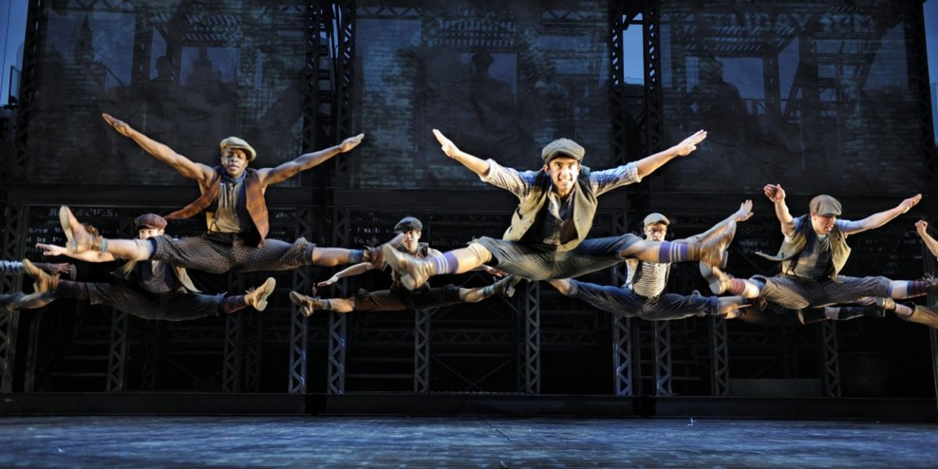
“Physical fitness is not only one of the most important keys to a healthy body, it is the basis of dynamic and creative intellectual activity.” – John F. Kennedy

Slide 15
BIBLIOGRAPHY
Kai
p-themes (2019). 7 Compelling Reasons Why You Need Dancer’s Fitness. [online] Beyond the Barre. Available at: https://beyondthebarreusa.com/blogs/fitness-nutrition/7-compelling-reasons-why-you-need-dancer-fitness.
‌admin (2014). Dance is a Sport: Chelsea Simone Interview - Dance Informa Magazine. [online] Dance Informa Magazine. Available at: https://www.danceinforma.com/2014/10/08/chelsea-simone-interview/ [Accessed 15 Feb. 2025].
Caspersen CJ, Powell KE, Christenson GM. Physical activity, exercise, and physical fitness: definitions and distinctions for health-related research. Public health reports. 1985 Mar;100(2):126.
https://www.facebook.com/reshad.org (2023). Strength, Speed, and Power in Fitness: 3 Important Insights. [online] Live Well. Available at: https://livewell.fit/strength-power-speed/ [Accessed 16 Feb. 2025].
‌
Callum
‌Waehner, P. (2024). Measure and Track Your Cardio Fitness. [online] Available at: https://www.verywellfit.com/cardiovascular-fitness-1230820 [Accessed 15 Feb. 2025]
Institute of Electrical and Electronics Engineers, author, issuing body. (2013). Device Specialization – Cardiovascular fitness and activity monitor. New York: IEEE.

Slide 16
Bibliography
Dee
Hampton, L. et al. (2024) Cite this page, Cite This Page - Physiopedia. Available at: https://www.physio-pedia.com/index.php?title=Special%3ACiteThisPage&wpFormIdentifier=titleform&page=Flexibility (Accessed: 15 February 2025).
Kimbrough, K. (2024) Stretching for dancers: Enhance your performance and reduce injury, EW Motion Therapy. Available at: https://www.ewmotiontherapy.com/blog/stretching-for-dancers (Accessed: 15 February 2025).
Mccallum, K. (2022) 5 benefits of stretching (plus, the do’s & don’ts of stretching correctly), 5 Benefits of Stretching (Plus, the Do’s & Don’ts of Stretching Correctly) | Houston Methodist. Available at: https://www.houstonmethodist.org/blog/articles/2022/jul/5-benefits-of-stretching-plus-the-dos-donts-of-stretching-correctly/ (Accessed: 15 February 2025).
Snider, J. (2024) The importance of flexibility in dance + 9 ways to improve yours, blog. Available at: https://blog.fscamps.com/importance-of-flexibility-in-dance#:~:text=Enhanced%20flexibility%20allows%20dancers%20to,expansively%20is%20an%20artistic%20expression! (Accessed: 15 February 2025).
Textbook
Haas, Jacqui Greene, Dance anatomy second edition (2018), page number, 220.
Emily
Cronkleton, E. (2019). Muscular Strength: Benefits, Exercises, and More. [online] Healthline. Available at: https://www.healthline.com/health/exercise-fitness/muscular-strength#benefits.
Blaine, D. (2025). Log in to the site | Home. [online] Uwtsd.ac.uk. Available at: https://moodle.uwtsd.ac.uk/course/view.php?id=10262§ion=6 [Accessed 16 Feb. 2025].
Wilmerding, V. and Krasnow, D.H. (2017). Dancer Wellness. Champaign, Il: Human Kinetics.

