Slide 1
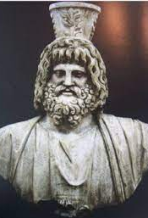
Zeus Helios (Megas) Serapis in the Eastern Desert
Life in the Eastern Desert of Egypt

Slide 2
Structure of the presentation
Worship of the Cult of Alexandrian gods e.g., Zeus Helios (Megas) Serapis in a broader Egyptian context and specifically in relation to the geographical locations in the Eastern Desert.
In what range of Eastern Desert contexts is ZHMS appearing?
What types of evidence do we have of ZHMS? – material culture and epigraphic.
Arguments about why do we see this syncretic development?
Notes:
Second bullet points – this includes the places e.g. Mons Claudianus and praesidium of Dios etc. Fourth point is about what function did this God serve?

Slide 3
Geographical scope of ZHMS evidence
Alexandria – the Serapeum – numerous statutes and reliefs dedicated to the God.
Luxor – start to see inscription by military directly dedicated to ZHMS.
The part of the eastern desert we are considering stretches from the Nile to the Red Sea harbours. Strategic trade routes set-up by the Ptolemies and exploited by the Romans.
The areas under focus for this presentation are:
Mons Claudianus
Berenike; and
Luxor
Notes:
Mention of course within Egypt mainland and the eastern desert. Point 1 – mention that this refers to where the Ptolemies set base but also where a Cult Serapis gained prominence during the reign of Ptolemy Soter Lagid I during the 3rd Century BCE and into Roman control over Alexandria. Mention Roman control mainly (this presentation being mainly Roman era)- G/ Tallet proposed that ZHMS was an Egyptian god tailored for Romans, especially soldiers. There is a spread of Egyptian gods in military compounds dating back to Nero in the Rhineland, which might suggest a broader trend to decentralize or decapitalize the gods in region- examples of this include places like Jawf, Bostra and Sur (Stoll, 2001)- these places also show a link to Jupiter with other deities like ZHMS, indicating a blending of military and civilian religious spheres of influence. (G Tallet, 2011).
From Alexandria we have the Cult of Isis-Serapis spreading into the Aegean – 4th century AD- possibly this poses the question how successful the amalgamation of the Greek God into Egypt had been-
If traders were taking the words of the Cult/ the iconography across the Aegean?

Slide 4
Isis’ transformation into a Hellenistic goddess
Ambigious timescale as took place without indigenous Egyptians and it happened using the Greek-Egyptian translation of Ancient Egyptian religion and culture.
First step of interpretatio Graeca- Greeks to rename Egyptian gods with Greek names because rebranding the words to link to Greek phonetics, sounds similar to Greeks, or because they had similar roles as the Greek deities.
It happened Interpretatio Graeca – a foreign deity with a member of the Greek panthenon-
Herodutus’ Histories – refers to Demeter and Dionysus as Greek gods instead of Isis and Osiris.
As non-Greek deities (e.g., Isis in the first instance,) spreads to Greek speaking regions, they start to be shown wearing Greek clothing, making them become more universally recognized.
Notes:
Isis is the primary goddess for the Egyptians- representing fertility and protection. Point one- then this translation of what the Greeks though was Ancient Egyptian culture and religion could have been a bit off. It in essence, creates these different hybrid versions of Egyptian gods but only from the Greek perspective- (later known as the Cult of Alexandrian gods?) For the Egyptians to accept a Greek ruler, the Ptolemies realised that it would be best to amalgamate the Hellenistic Greek
World with the older established Egyptian Gods. Some argue this was over developing the Ptolemies prestige as genuine Egyptian Pharoah’s.

Slide 5
Interpretatio Aegyptiaca
Also, there is the interpretation of Greek mythology and deities as originating from Egyptian traditions. (Merkelbach, 2001: 231; Bommas, 2006: 234-8). Serapis then as an origin of Isis or Osiris/ Wasir or Amet is easier to fathom as an Egyptian.
Diodorus Siculus (1.96- 7) and Plutarch (De Is, et 0s. 10), wrote about this because by the end of the second century BCE, the cults of Egyptian gods had spread across the Mediterranean, explaining the need for regional (perhaps Greek), translations of foreign religious ideas/concepts.
Blurred translations over time? – Plutarch “De Iside et Osiride” approx 120 BCE.
Plutarch’s focus is on the Cult of Isis not Serapis. But, late epigraphic evidence and material culture suggests both were accomodated.
Notes:
3rd point – with the expansion of the Cult of Isis practices across into the Aegean Plutarch publishes his book about Ancient Egyptian Cults and Myths, but this is from a Graeco-Roman perspective of the Egyptian perspectives/accounts/ sources and translations.
It is very possible that some of the sites we are going to explore later, including the praesidium of Dios near Berenike, used this method to identify Egyptian gods with their counterparts in other cultures
Or religions. I will return to this.

Slide 6
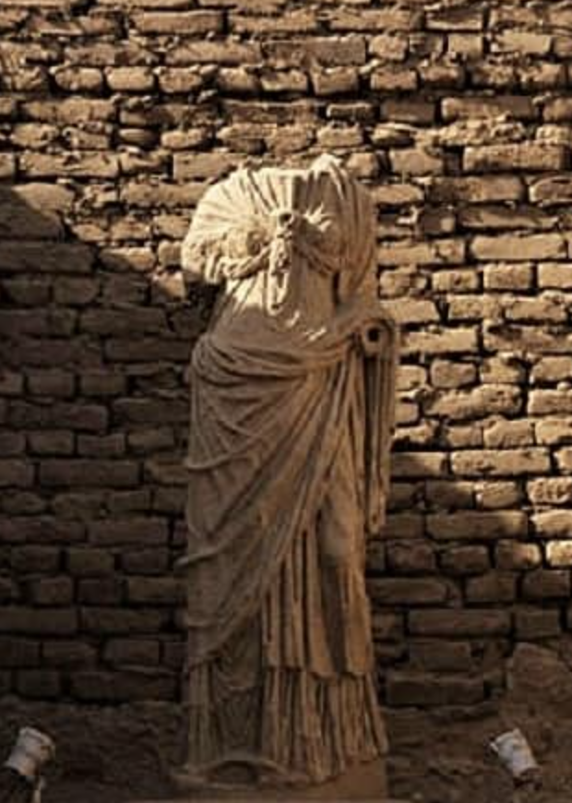
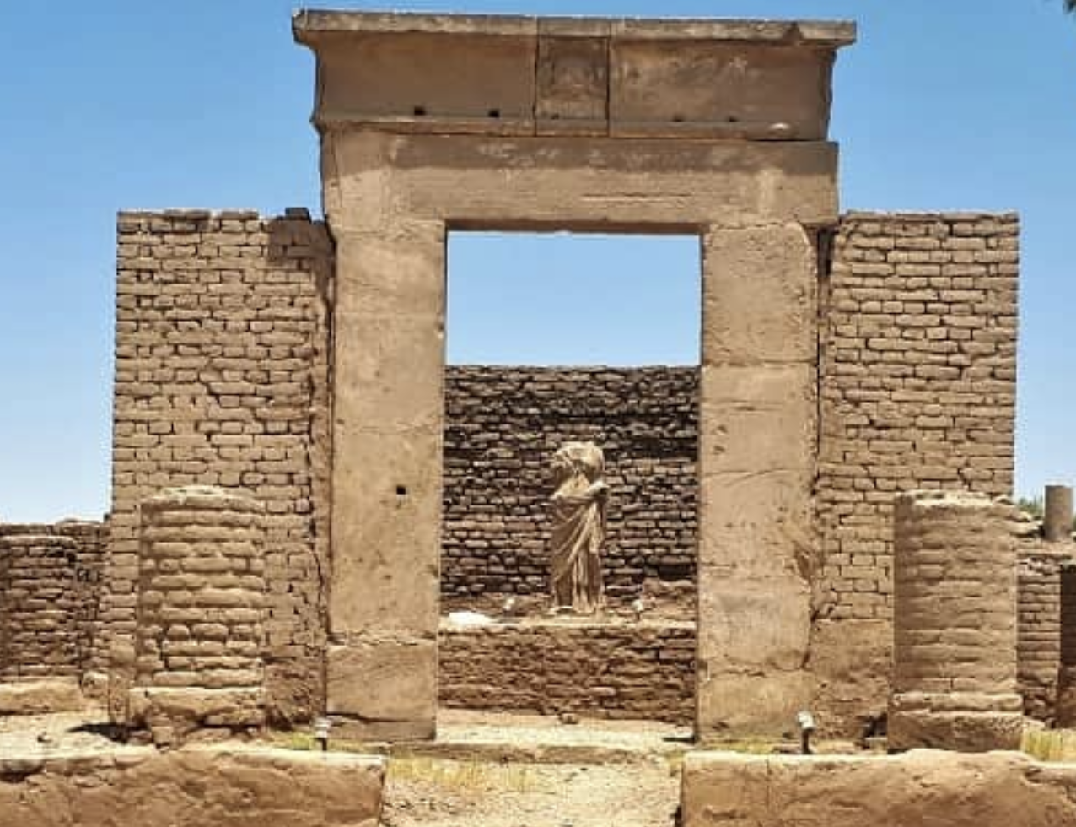
Zeus Helios (Megas) Serapis at Luxor
Temple surrounded by columns dedicated to ZHMS on Hadrian’s birthday, 24 January 126- limestone statute that has been preserved shows Isis in her Hellenistic form.
Notes:
Potentially suggests that the temple accomodated her worshippers too? \
Truly amalgating Zeus (Greek) within the Egyptian context/ family of the Gods (Isis)? – Hadrian saw Egypt as a place which eminates the divine power of the emperor. In this case, Serapis intertwined with Isis, represented a powerful fusion of religious ideals, promising a significant role in the future.
This is well supported by coins that were minted in Alexandria around 133-134 BCE. On this coin, we see Serapis associated with Zeus and Helios, offering the globe of the universe to the emperor, symbolising the emperors divine authority. This scene takes place at the Serapieion, a temple that Hadrian renovated and expanded after civil unrest in 115-117. The altar in the temple complex is inscribed with "Hadrianeion," emphasizing the emperor's connection to divine power. (Bricault, 149).
However, it is clear from the material culture and the archaeological record, that this site is a dedication to ZHMS, with Isis’ iconography being second to ZHMS.
Why? Perhaps again this idea of Serapis being the ptolemaic dynastic patron God.

Slide 7
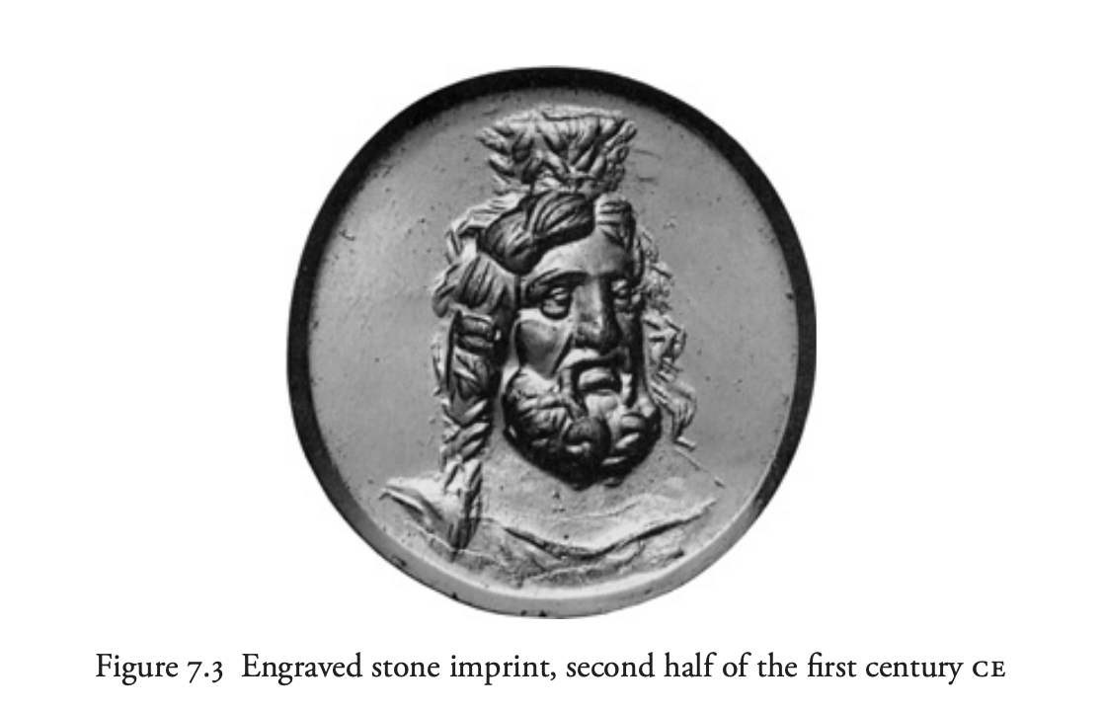

Slide 8
A syncretic deity as a consort of Isis?
Ptolemies think ZHMS the ideal source to create a dynastic god with genuine Greek origins. (Riggs, The Oxford Handbook of Roman Egypt, (2012), 25, Isis, Osiris and Serapis, p. 422)
Making ZHMS the consort of Isis- to amalgamate both Greek and Egyptian religions.
Expansion of the hellenised Isis-cults in the Thebaid under Trajan and Hadrian (F. Dunand) – After, the establishment of the Cult of Alexandrian gods, e.g., Isis and Osiris instead of Wasir and Amet (the original Egyptian versions).
Notes:
As I suggested earlier it is that Isis the main Egyptian goddess in the period was first hellenised,
But then there was a huge expansion campaign of the other gods including Zeus-Isis during later periods.
This is why we can start to see depiction/iconography later into the Roman empires dominion over Egypt.
At the same time 126, there was a renewed focus on Jupiter, another Roman god, particularly during the reign of Emperor Hadrian. Hadrian even depicted himself as Jupiter's favorite, showing how important these gods were in Roman beliefs. This shows that the various depictions or iconography of the blended Roman-Egyptian gods was not unusual during the later reign of these emperors.

Slide 9
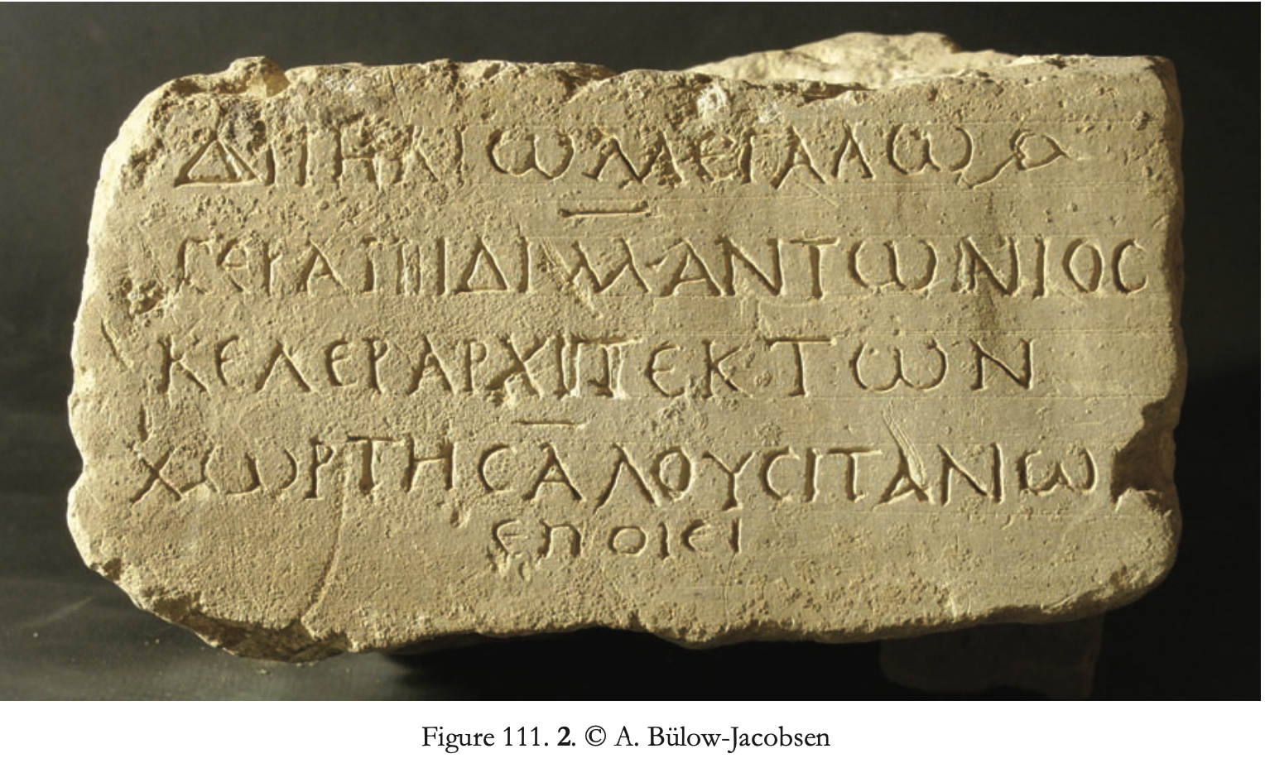
Mons Claudianus
A Roman quarry with bathhouse annexed, temple, and changing rooms. Water supply or hydreamata.
A dedication to ZHMS made by the Alexandrian Apollonios son of Ammonios, earliest depiction found- under Trajan. (I. Pan 38).
Military worshippers? – “To Zeus Helios Great Serapis, Marcus Antonius Celer, engineer of the First Cohort of Lusitanians, made (this).” - in its translation.
Cohors I Augusta Lusitanorum – garisoned in Iudaea in 90, attested in Egypt in 105.
Notes:
Under Trajan so we’re looking at about 98AD-117AD- and then the Hadrian one was 126- as was his birthday. But, here the inscription is simply to ZHMS without Isis being included, suggesting movement
Away from being accomodation to Isis? The actual description reads - ”The the Zeus Helios Great Serapis, for the fortune of our lord Caesar Trajan, when Encolpius was procurator and Quintus Accius Optatus, centurion, Apollonios, son of Ammonios, Alexandrine architect, dedicated this altar for the preservation of all his work.
Points 3- so we can link the inscription to the auxiliary military division- makes sense as Zeus is often worshipped
For- he being the King of the Gods in Greek mythology, but also Serapis as the king of healing-something that perhaps attacks from the desert dwelling kingdoms-might have been required.
Also, non-military worshippers-evidence of this- we can see from the historiography-early records by Arthur Weigall, that life in the eastern desert quarry was horrific.
We do not know why the Romans left Mons Claudianus, but we can put it to there either being a lack of edible water or that the third century crisis in other parts of the empire, caused the garisons to move, although the site is interesting to discuss ZHMS appearance, it’s also one the biggest quarrying sites, which unfortunately is under threat, because of modern exploitation and tourism.

Slide 10
Imperial slave Epaphroditos’ dedication
Possibly another temple in Mons Claudianus.
ideological control in the Graeco-Roman world?
Earlier literary sources of ZHMS found in Thebes and Ombos- suggests a movement from there to Upper Egypt.
G. Tallet, thinks that Zeus Helios Megas Sarapis was created in Alexandria. His spread in Upper Egypt was helped by the Roman army coming into the region.
Notes:
Point 1: It’s unclear whether the temple dedicated by Epaphroditos at Mons Claudianus is the same one mentioned in the dedication by Alexandrian Apollonios, son of Ammonios. The inscription was found on the floor though and it was not yet attached to anything- there was what seemed to be an altar-which Trajan had ordered to be built before the end of his reign but it had not finished construction.
However, it is clear about its structure- archaeological records infer that, there were bathhouses in Mons Claudianus (within the excavation site), and we can make the inferences between religious practices and the bathhouses. Bathing as an important ritual in Roman culture, was often associated with the purification of your health and a way to remove some ailments. It’s conceivable then that the Roman’s at Mons Claudianus might have included bathing into their religious observances, perhaps as ritual cleansing before worshipping their god, including the veneration of gods like ZHMS- being a syncretic god of healing.
Point 2: Marxist theory also examines how ruling classes maintain their power through ideological hegemony, or the dominance of their worldview and values. The dedication of a temple to Zeus Helios Megas Sarapis by a slave like Epaphroditos might be seen as a form of ideological control, as it reinforces the religious beliefs and cultural norms that support the existing social order- although Imperial slaves hold
More power than normal slaves but were still not free Roman citizens. This then might not so much be a dedication by a Slave because of his God, but instead he’s an agent of the emperor- and really it is
Seen as the emperor's dedication. Support of this can also be seen as it was found next to another smashed altar inscription- dedicated to Trajan. This would link well to the idea that the emperor was expanding Graeco-Roman deities through interpretatio Graeica. Also, possibility it was created in Thebes as interpretatio Greica (making Greek sense of Amun-Ra). (Bricault) However, it misses out the direct dedication in the inscription to Caesar Trajan, as the previous one does by Apollonius, so is it a dedication by him and not the agency then of the Caesar?
During Trajan’s reign also there’s mention of an altar being built like the one seen in Dios, but whether this is an altar will be discussed. (Bricault, 132).
Final bullet: makes sense because the later iconography in praesidium is this linked to Graeco-Roman deity without the Isis or Egyptian Styled deity alongside- such as that during Hadrian- maybe because of this idea of restoring Jupiter and some of the more obscure Graeco-Roman deities?

Slide 11
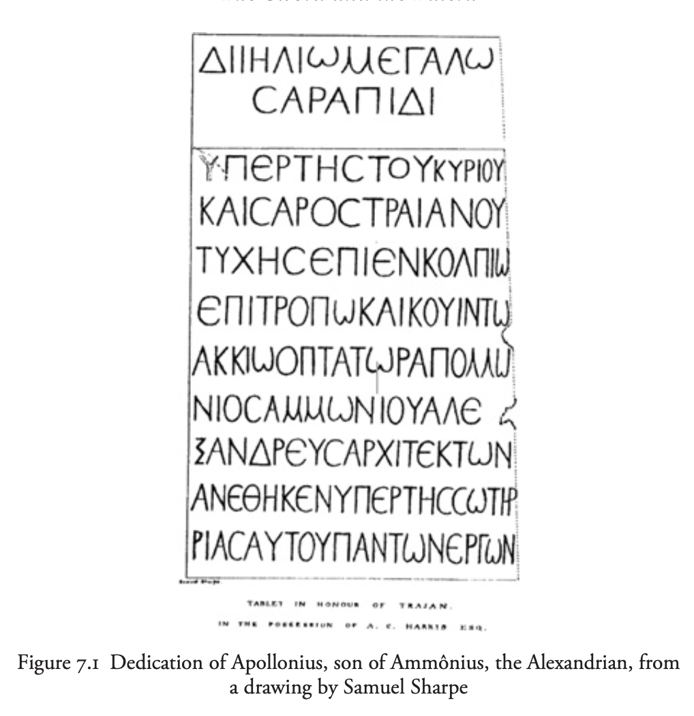
Here the mention of Serapis is in the center of the inscription…
Notes:
The location of the name Serapis being in the center is similar to the inscription by Apollonius. (Ibid).
Inferences can be made: Symbolic Importance: Placing Serapis at the center could signify the central role of this deity in the context of the inscription or the religious beliefs associated with it. Serapis might hold a pivotal position in the religious or cultural framework being depicted. Unity or Integration: It could imply a sense of unity or integration, where Serapis represents a synthesis of various religious or cultural elements. By placing Serapis at the center, it emphasizes the cohesive nature of these beliefs or concepts.

Slide 12
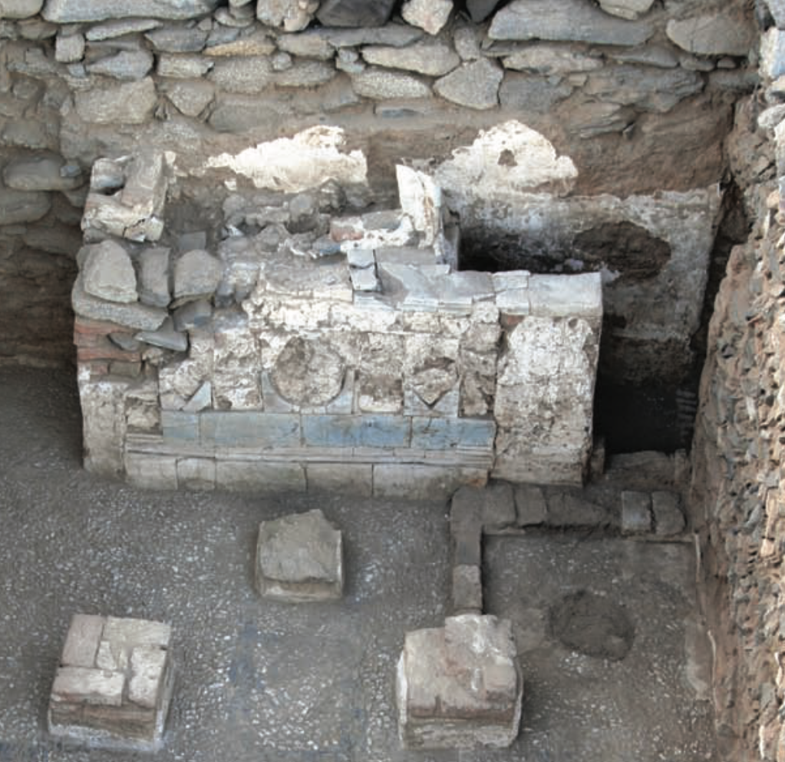
Shrine in the Praesidium of Dios
Three broken steatite statues discovered in layers near Berenike. One depicts a seated figure on a throne, likely to be ZHMS, (wielding a scepter/ spear) (Cuvigny 2010), and steatite, with which a clay Cerberus head is to be associated.
Another part is standing statue in the Egyptian Style- the other in Graeco-Roman- possibly linked to the ZHMS overall but unsure.
Notes:
Another interpretation of the steatite is that it is similar to the depiction of vexilla (army standardard-before legions), between two columns, as seen in iconographic representations from Hadrian’s wall, alligning with the suggested reconstruction for the Dios. This suggests that the picture you can see- was not so much a shrine to Serapis or ZHMS but the praesidium for such army standards. A plaque from Vindolanda provides further insight, another inference can be that, the vexilium was placed in a chest or wooden device to keep it upright without tilting it. This type of device, with four wooden holes in the podium, may have been used at the praesidium of Dios to support and display the uexiliums military standards when troops were not using them. (Redde. 2010).
Redde’s inference does not contradict the alter being a divine military shrine, as similar Western camps in the Roman empire, also feature various military gods, such as Jupiter, and the ruling emperor. This interpretation aligns with previous research by T. Sarnowski, who documented various dii militares and local gods in military shrines.
Point 1? Why Cerebus and ZHMS? – Cerberus is the three headed dog in Greek mythology making sure the dead cannot escape the unerworld, and Serapis is linked to the afterlife- Zeus being the king of the gods is then the protector and therefore perhaps as a guardian to help those reach the afterlife? – although this is one thought (H. Cuvigny, 485).
Second point- this is interesting as was the style deliberate to integrate both civilisations in terms- and deeper meaning of integrating Greek mythology into egyptian? Likely difficult to argue but possible
Based on that concept of interpretatio Aegyptiaca?
The shrine is located in room 52, within the preaesidium. It is situated south of the main gate, separted by room 53, with three large cisterns located to the south, of one which was completely empty – the other was described as above. It might be that there was stairways leading to bathhouse- as from western parts of the empire, and also similar to the temples in Rome to Jupiter maxima.

Slide 13
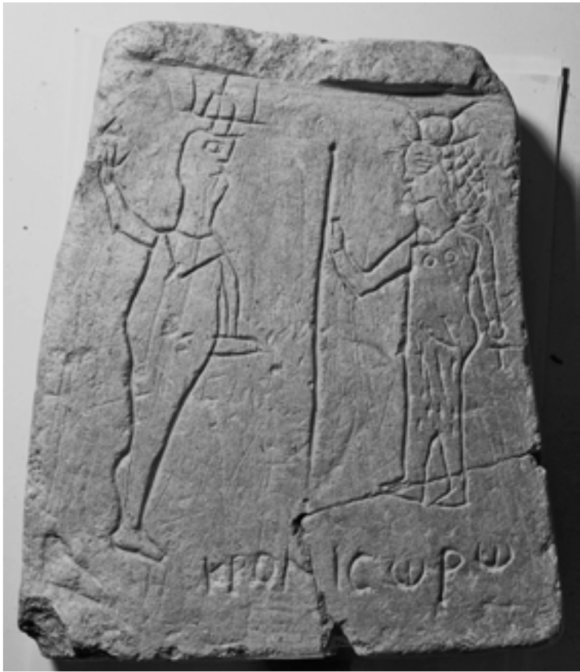
Is it a Tyche to Isis or ZHMS?
The description mentions that blocks 11 and 12 are likely the bases of pillars supporting a baldachin sheltering an altar and podiums.
The black rhombus in front of the podium makes it seem more important. This, with religious objects discovered in Dios, confirms that ZHMS was worshipped in Roman settlements, in Eastern Desert from Trajan onwards.
When was it? Too difficult to tell for certain as don’t have dates anywhere on material. But the floor is repaired well telling us… army did it? – again would link well to it being ZHMS not a different deity.
Notes:
Mention after the end: The fact that ZHMS is associated with one of these podiums suggests that it holds a prominent position within the sacred space, possibly as a focal point for worship or ritual activities.
The main god worshiped in this place is Zeus Helios Megas Sarapis, as mentioned in section 4 of the aedes. The first chapel was already dedicated to this god. In the second chapel, the worship of ZHMS is shown through the remains of a large statue of him sitting on a throne, some writings on the walls, and a simple small stone slab showing ZHMS sitting on a throne with a scepter or spear in his left hand and a dog named Cerberus next to him. There's also a big clay head of a dog, likely Cerberus, found nearby, which probably sat next to Sarapis on a raised platform. This group of objects might have inspired the creation of the small stone slab, which was likely made as an offering at the chapel. (Cuvigny; 523).
Second point: geometric shapes often held symbolic significance, and the rhombus, particularly if placed prominently in front of the podium, could be interpreted as a marker of significance or sanctity associated with the deity represented by the podium. The society in the forts aedes (where this is found) of the Eastern Desert was mixed, with both soldiers and civilians living there or passing through. You can see evidence of this from the graffiti on the praesidium- steatite plate of trapezoidal shape- inscriptions dedicated to “Zeus Helios great Serapis and to the Fortuna of the fort, Iulius Achillas, clerk”. In a typical military chapel, you'd expect to see worship of military standards, military gods, and emperors.
Points 3: it seems like this work happened when the army was in the fort, not during any later occupation that we don't know about. So, likely happened before the fort was left empty, which probably happened after the middle of the third century. Similarities in the histories of the shrines – Dios and Didymoi, both located on the Berenike road, suggest that their inner organization underwent changes from the second half of the second century and onwards, obscuring any architectural traces of the original layout- the same seems to appear true here. – also in one of the barracks rooms there was coins found from the 22nd year of Antonius Pius and ceramics from the second half of the second century- so we can pretty well date the forts provenance to around the reigns of Caracalla or Severus Alexander. Also, Redde argues that the praesidium does not have any fourth century materials used for its construction- so its likely that it is definitely not made 4th century and after-it also indicates limited travel between the forts during this time, but the continued occupation of the forts. (Ibid).
However, we can make the argument that settlers were not all military- Pliny the Elder mentioned stopping places long the roads, some equipped with wells and cisterns – at around 50 AD – infers that by the end of Augustus’ reign, the Berenike road became more important than the Myos Hormos road.- shown with several praesidia being built around 76 AD. (De. Gruytner, 2010, 245). Furthermore, we have Greek graffiti on the steatite. It was done by a man named Kronios, who seems uneducated- why?- his representation of Min and Isis in Egyptian style is crude. For Kronios, Isis might represent the Egyptian interpretation (interpretatio Aegyptiaca), of the Romanised version of the goddess Isis. Possibly as she symbolizes the Tyche or the center of worship of the praesidium- again perhaps with ZHMS as accommodating or as a consort to her? Also there is another grafitti, which was presumably kept in the chappel- it could refer to the auxiliary garrison, but it could refer to a detatchment the uexilium- There is a singly occurrence where the similar inscription means detachment in O.Claud. Inv. 7295 (Cuvigny, CdE 77, 2002, 238-248 [1p. 189]. In one case, it could then be seen as an inscription for the Goods luck of the garrison or good luck to our standard. Either way it carries military connotations, but it could be done by a civilian not the military.

Slide 14
A bit more about provenance and purpose
The inscription starts with ”Imperator” – unclear words to the right of it.
Solution proposed is to read and restore ”Se[uer--” suggesting a titularture (possible in the dative) of either Caracalla or Severus Alexander (Imperator Caesar M. Aurelius Seuerus Antonius/Alexander).
Seuerus not erased but Imperator and Caesar have.
Both Caracalla and Severus Antonius/Alexander faced domnatio memoriae.
Potential Oracle’s temple… (Cuvigny, 2010).
Notes:
Point about domnatio memoriae- boths memories were condemned, often after they died, results in the destruction of their images, inscriptions and other mentions in public places.
IT usually done to digrace the memory of an emperor deemed unworth to influence future generations. Caracalla was Marcus Aurelius Severus Antonius Augustus- tyranical ruler who killed thousands
Of citizens in Alexandria in 215 AD and unpopular in the Senate. And Severus Alexander- week military leader who was killed for this reason- Senate declared him public enemy.
Part about the oracles temple: Numebrs of inscriptions mentioned earlier-e.g., that by the uneducated man Nakaroi and others show that they were either asking for luck for a garison or for a standard. It could be that this was dedications or written versions of the wishes to the oracle in the temple- (Cuvigny 2010). Furthermore, if behind, what we assume is the statue of Serapis, there is a statuette of Jupiter wielding a lightning bolt. (Figure on the next slide)- we know worship of Jupiter has been linked to Oracles at the temple of Jupiter Optimus Maximum in Rome.

Slide 15
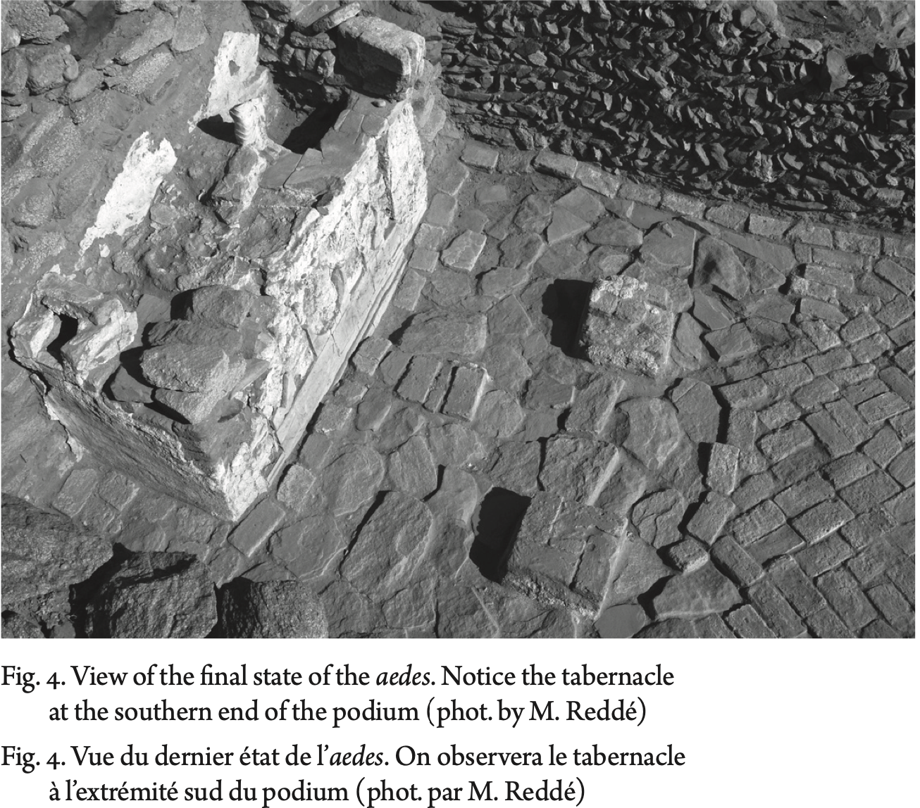

Slide 16
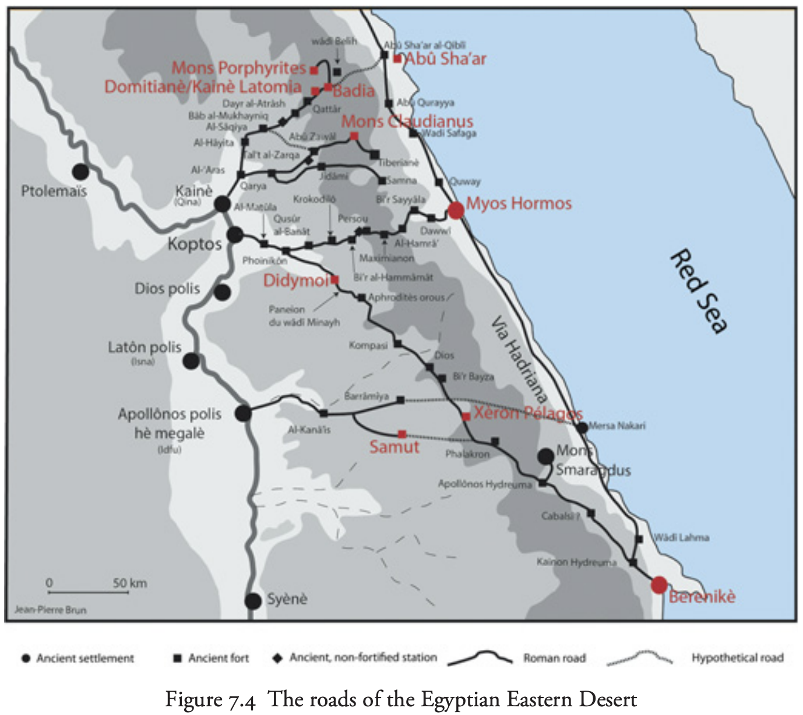

Slide 17
ZHMS and the military areas in the Eastern Desert
Makes sense that his iconography was popular here.
Didymoi temple/ site in the Eastern Desert near Berenike.
The presence of small votive offerings, like statuettes and terracotta figurines of Isis and Sarapis, along with Egyptian-style objects such as a sphinx and offering tables, suggests that worship of Zeus Helios Megas Sarapis was likely practiced at the Didymoi temple.(Redde, 2015, 305-8).
Additionally, the dedication to a god with an epithet that suits Zeus Helios Megas Sarapis and inscriptions thanking Sarapis for a dream further indicate his worship at the site- but also worshipper scope of worship… tbc on the next slide.
Notes:
Pont: he appealed to the social groups in these places- mining settlements, roadside stations and forts. Egyptian miner slaves they had become
Sufficiently Egyptian through perhaps coming form Thebes/ Ombos or Alexandria?
As in the Dios, in Didymoi we have the similar western military shrines (those similar to maybe the vexilium- as Redde suggests), which allows us to infer that there was a continuity of the religious practices, perhaps from Dios in Bernike- where pilgrames might have took place between the military, or individuals on trade expeditions might have settled for a short period of time.
For the managerial staff, who were often Greek-speaking and might be part of the elite in Alexandria, he was a Greek and possibly Alexandrian god. Some elite members even served as "naokoroi," or temple caretakers, for Sarapis. And for the few Western Romans, Zeus Helios Megas Sarapis could be seen as similar to Jupiter Optimus Maximus, as suggested by a certain inscription – specifically through Trajan’s reign.

Slide 18
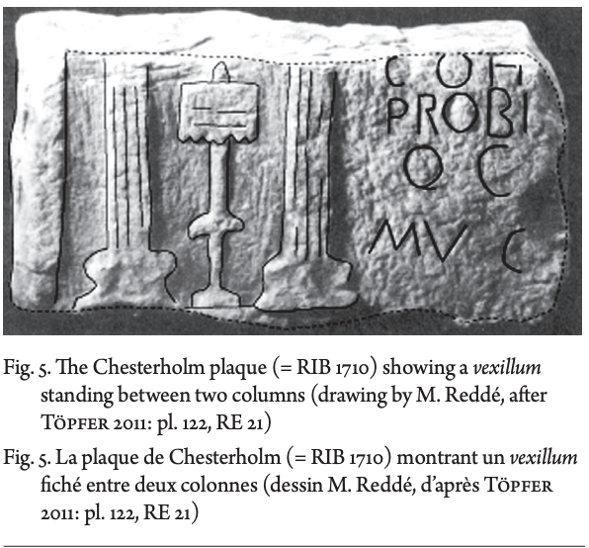

Slide 19
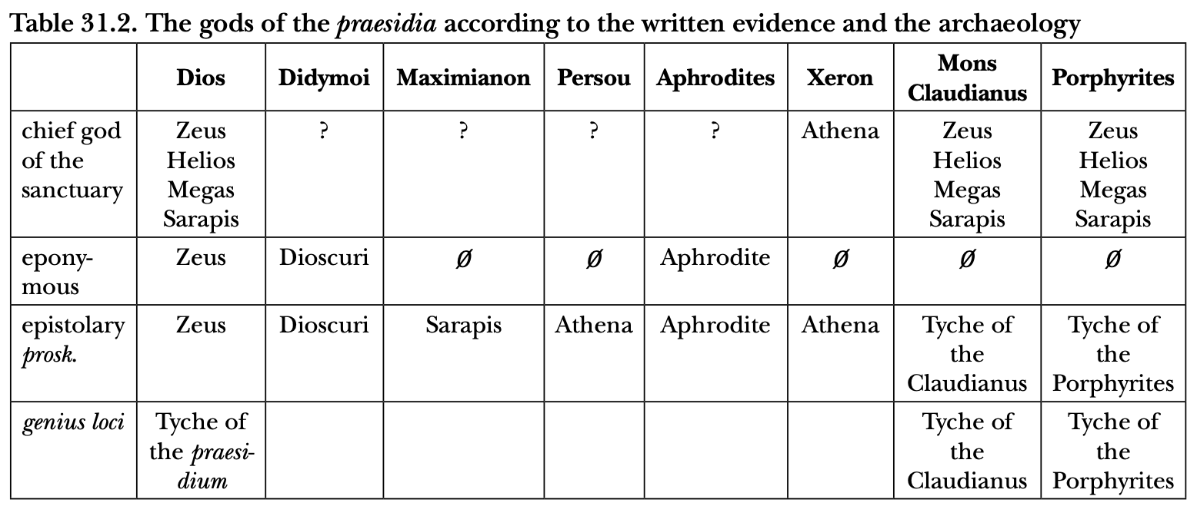
The Scope of worship of ZHMS
In the Roman desert settlements, the worship of Zeus Helios Megas Sarapis is often connected with other cults.
Notes:
Point: For example, at Dios, Zeus Helios Megas Sarapis is associated with the Tyche of the settlement, which is a Greek interpretation of the protective spirit of the place. This is a common practice, where military spirits are linked with one of the military gods like Jupiter, Minerva, Mars.

Slide 20
Is Isis iconography possibly in the praesidium of Dios?
A large female head found in the sand likely belongs to the standing statue originally placed on the podium. This statue would have been part of a group with a seated Zeus Helios Megas Sarapis, Cerberus, and a standing Tyche.
But the Tyche in the past has been linked to Isis…
So, the question remains is this, Isis?
It would make sense for Egyptians, Greeks, Romans to turn to the dominant deities in society.
Thank you for listening.
Notes:
Point: We can say yes because there is representation of Isis - Roman-Hellenic traits such as “Libyan curls”
Additionally, Tyche, often identified with Isis, is mentioned as part of the group with Zeus Helios Megas Sarapis and Cerberus. So, given the context and typical attributes associated with Isis, it's reasonable to surmise that the large female head found in the sand likely belongs to Isis. (O. Claud. IV 657, 658 and 811).
Last point: when faced with important decisions or uncertainties about the future. It's no surprise that the widely worshipped Zeus Helios Megas Sarapis offered this service even in the Eastern Desert, where his influence was strong. For example, at Mons Claudianus, there was a quarry called Chresmosarapis, meaning Sarapis's oracle. In Dios, a group of specialists called chresmologoi were permitted to conduct rituals in a chapel dedicated to Zeus Helios Megas Sarapis. They used texts specifically designed for travelers, suggesting a widespread belief in the deity's ability to provide guidance and assistance. (Ibid).

Slide 21
Bibliography
H. Cuvigny, “The Shrine in the praesidium of Dios (Eastern Desert of Egypt): Graffiti and Oracles in Context”, Chiron, 40, 2010, p. 245-299.
H. Cuvigny, “Religion and Magic”, in Rome in Egypt’s Eastern Desert: Volume Two, 2021, New York University Press,
M. Redde, “L’aedes du praesidium de Xeron Pelagos (Egypte)”, Proceedings of the 22nd International Congress of Roman Frontier Studies, Ruse, Bulgaria September 2012, p. 655-660.
O. Kaper, “Religious prospects of the mine in the Eastern Desert in Ptolemaic and Roman times”, In Life on the Fringe: Living in the Southern Egyptian Deserts during the Roman and Early-Byzantine Periods, Leiden: Research School CNWS, 1998.
R. Jackson, “Exploring Romes Egyptian Frontier”, in At Empire’s Edge, 2002, Yale University Press.

Slide 22
Bibliography
M. Redde, ”The Layout of a Military Shrine in Egypt’s Eastern Desert”, Ad. Fines Imperii Romani Studia Thaddaeo Sarnowski septuagernario ab amicis, collegis discipulisque dedicata, Archaebook, 2015, halsh-01410310.
E. Birley, L. Richmond J. Stanfield, 1936, “Excavations at Chesterholm-Vindolanda”: Third Report, Archaeologica Aeliana 13, 218-257.
H. Cuvigny, et al., 2011, “Didymoi, Une garnison romaine dans le desert oriental d’Egypte. I. Les fouilles et la materiel, FIFAO, 64, Le Caire.
O. Stoll, 1992, Die Skulpturenausttatung romischer Militaranlagen an Rhein an Donau. Der Obergermanisch-Ratische Limtes, Pharos, I, St Katherinen.
G. Tallet, 2011, Zeus Helios Megas Serapis un dieu Egyptien “pour les Romains”? [In] L’oiseau et la poisson. Cohabitations religieuses dans les mondes grec et romain, N. Belayche, J-D. Dubois [eds.], Paris, 227-261.

Slide 23
Bibliography
H. Cuvigny, 2002, Le troisieme globe celeste en argent connu de l’antiquite, A. Kugel, Spheres. L’art des mecaniques celestes, p. 22-27.
L. Bricault, 2024, The Sword and the Patera – Zeus Helios Great Serapis, [in], The names of the Gods in Ancient Mediterranean Religion, Cambridge University Press, p. 129-156.
L. Bricault, 2005, ‘Zeus Helios Megas Serapis’, in Christian Cannuyer, et al., La langue dans tous ses etats: Michel Malaise in honerem, Bruxelles/Liege/Leuven, Soceite belge d’ etudes orientales, 243-254.
Historia Augusta, Life of Hadrian 7.12: six days of games and a thousand wild beasts on 24th January 119; CIL VI 33885: distribution of sportulae on the occasion of Hadrian’s birthday celebrated by the college of ivory and citron wood merchants (negotiatores eborarius aut citriarius) in Rome.

