Slide 1
Module Name : Instrumentation and Control
Module Code : ACDB5011
Topic : Control Mechanisms - Stability

Slide 2
Stability
ACDB5011 – Instrumentation and Control
The stability in a control system is defined as the ability of any system to produce bounded output when a bounded input is applied to it.
Bounded value of a signal represents a finite value.
Stability can also be defined as a measure of the tendency of a system response to return to zero after being disturbed.

Slide 3
Bounded Input , Bounded Output Stability (BIBO)
ACDB5011 – Instrumentation and Control
A System is said to be BIBO stable if
  For the Bounded input, we have Bounded Output
  In the absence of input, output must tend to zero irrespective of initial conditions.

Slide 4
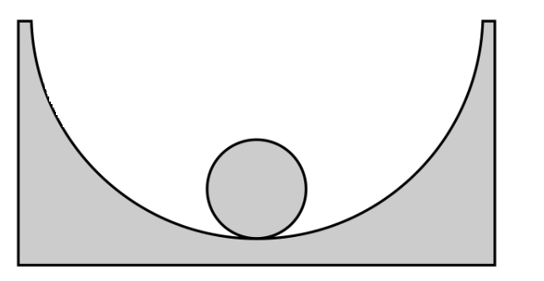
Example of Stable System
ACDB5011 – Instrumentation and Control
Consider a ball inside a bowl, the ball is initially at rest in equilibrium point at the bottom of the bowl.

Slide 5
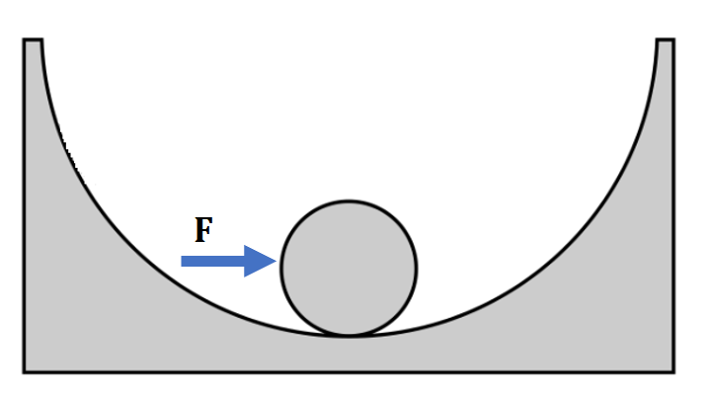
Example of Stable System
ACDB5011 – Instrumentation and Control
If the ball is disturbed and pushed away from its equilibrium point, then the ball will start to oscillate until its friction eventually comes to rest and to its equilibrium point.
Time

Slide 6
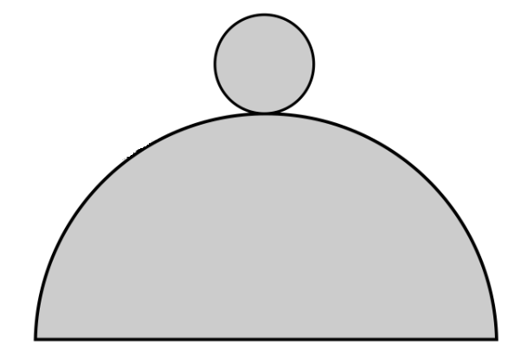
Example of Unstable System
ACDB5011 – Instrumentation and Control
Consider a ball placed on a top of a mount, the ball is initially at rest or at equilibrium

Slide 7

Example of Unstable System
ACDB5011 – Instrumentation and Control
F
If the ball is disturbed, it will roll down the hill away from the equilibrium and coming back to the equilibrium will tends to be infinity.
Time
$$∞$$

Slide 8
What if the System is not stable?
ACDB5011 – Instrumentation and Control
If a system is inherently unstable no amount of effort by the control system will achieve predictable outcomes.
In fact, the instability could be dangerous, leading to situations that could cause structural, environmental or indeed personal damage.

Slide 9
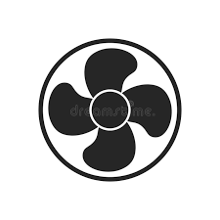

How to make a system stable in an unstable system?
ACDB5011 – Instrumentation and Control
Actuator
Fan
Actuator
Fan
Plant
Controller
Controller Blocks
Voltage
Reference
Ball Location
+
PID
Fan
PLANT
-
Controller
Actuator
RADAR
Sensor

Slide 10
How to make a system stable in an unstable system?
ACDB5011 – Instrumentation and Control
The system can become stable by adding feedback control.
The Plant consists of ball and a mount and the output of the plant is the horizontal position of a ball.

Slide 11
How to make a system stable in an unstable system?
ACDB5011 – Instrumentation and Control
RADAR
  The position of the ball can be measured using a sensor(RADAR) and then feedback the measured position.
  The RADAR also predicts the time it takes to return.
  The RADARs are fixed on the either side of the mount.

Slide 12
How to make a system stable in an unstable system?
ACDB5011 – Instrumentation and Control
Comparator
  Initially the reference position is zero since the ball was initially at the top of the mount.
  The comparator compares the feedback value and the reference value which is then given to the controller(PID, PD, PI).

Slide 13
How to make a system stable in an unstable system?
ACDB5011 – Instrumentation and Control
Actuators
The values are then given to the actuators (Variable Speed Fans) which are at the either sides of the plant which is used generate a force to blow back to the hill.
The controller takes the inputs from the RADAR and feed the error turns to the PID controller and hence these system is used to reverse the motion of the ball.

Slide 14
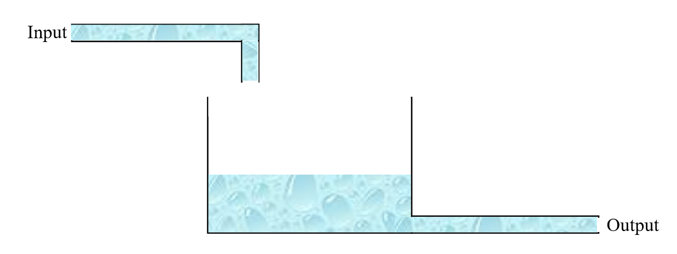
Scenario 1 -Stability of a system
ACDB5011 – Instrumentation and Control
Lets consider a tank filled with liquid which has a discharge line at its base.

Slide 15
Scenario 1 -Stability of a system
ACDB5011 – Instrumentation and Control
Consider initial input flow - I₁,
Level- L₁,
Output - O₁, a
At equilibrium; I₁ = O₁
Inherent Regulation
  L1- When I1 is slightly reduced
  L2- Level falls from L1
  When the water level falls , then the corresponding hydrostatic pressure (head) also falls.
  Therefore, the output flow also reduce, which is O2.
  Once again equilibrium will be reached when the new output flow equals the reduced input flow i.e. I2 = O2.

Slide 16
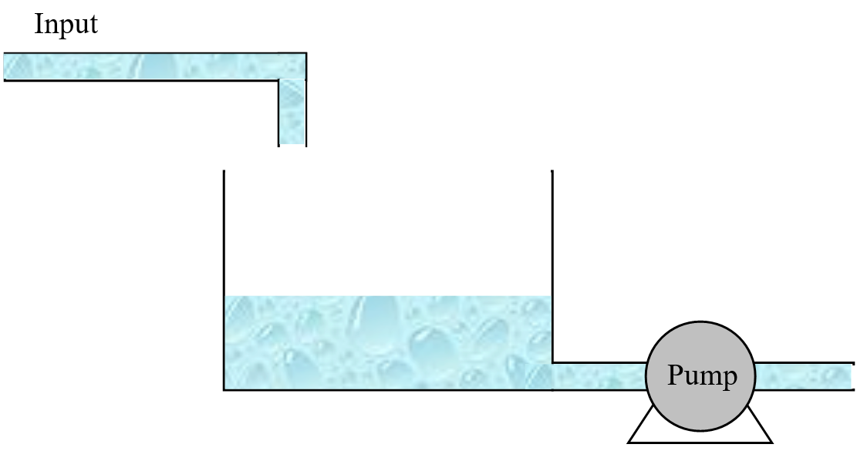
Scenario 2 –When a pump is installed at the discharge line
ACDB5011 – Instrumentation and Control
Without Inherent Regulation
Consider pump is installed on the discharge line that operates at a constant rate.
If the input flow is reduced below the equilibrium flow rate the tank will eventually run dry.
The pump effectively changes the output characteristics of the system.

Slide 17
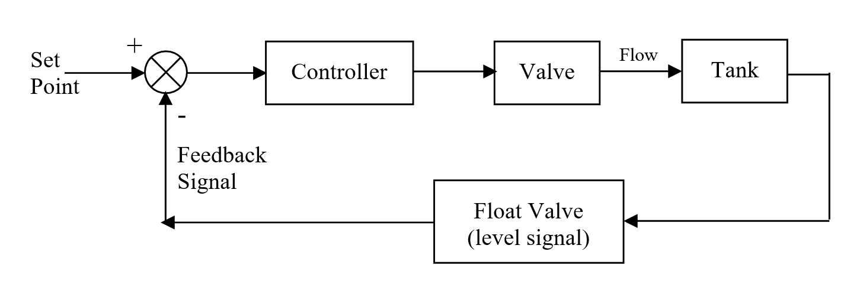
ACDB5011 – Instrumentation and Control
Liquid Level Control System Control Blocks

Slide 18
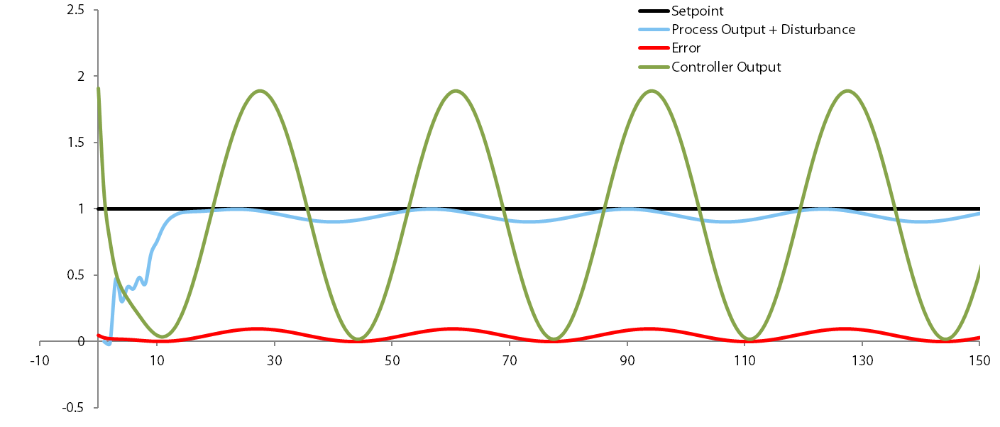
Example- Controller Analysis
ACDB5011 – Instrumentation and Control

Slide 19
Controller Analysis
ACDB5011 – Instrumentation and Control
The black line shows the set-point of the system.
Light blue line shows the process output with disturbance.
Red shows controller error
Green shows controller effort.

Slide 20
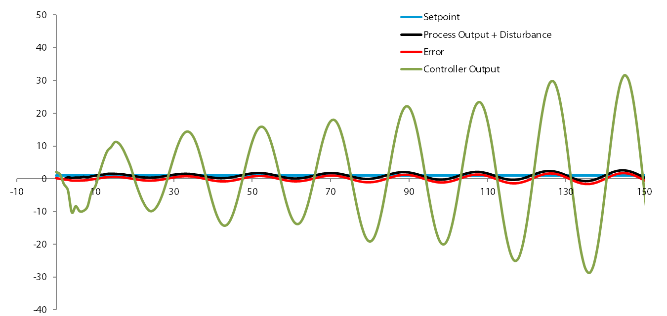
Controller Analysis – When Lag is added
ACDB5011 – Instrumentation and Control

Slide 21
Controller Analysis – When Lag is added
ACDB5011 – Instrumentation and Control
Adding in a small delay in the system creates an amount of lag
The additional lag in the system changes the phase relationship between the controller and the plant
System may have a positive/ negative feedback driving system resulting instability of the plant.

Slide 22
How to Predict the Performance and Stability?
ACDB5011 – Instrumentation and Control
Below are examples of some of these tools which help to predict performance and stability,
    Software – such as Matlab, Simulink and CODAS.
    Pole zero plots
    Nyquist plots
    Bode plots

