Slide 1

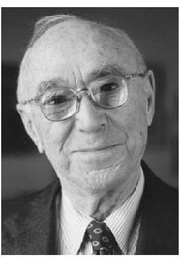

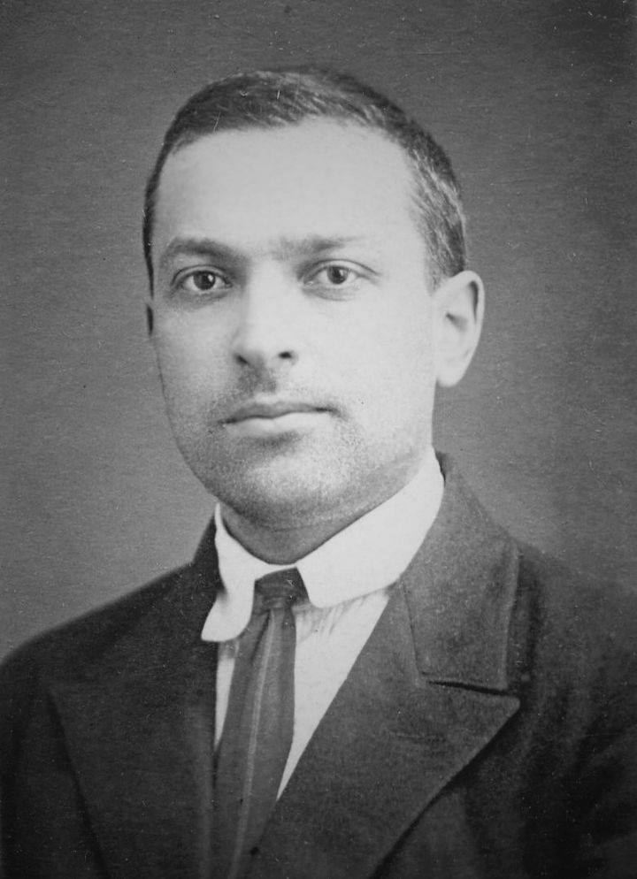
Exploring The Hidden Curriculum
What is the hidden curriculum?
What is taught unofficially.
Discreetly teaches beliefs, attitudes and values.
Teachers expectations of pupils.
Teachers interactions (including discipline).
Examples of the hidden Curriculum
Policies and school rituals.
Grading Systems
Texts treated as the most authoritative sources of knowledge.
Arrangement of time, facilities, materials and examinations. (Cornbleth, 1991)
‘The hidden curriculum involves the learning of attitudes, norms, beliefs, values and assumptions often expressed as rules, rituals and regulations.’
(Seddon, 1983)
Norms
Lining up
Raising hand
Not talking when teacher talks
Being punctual
Manners
Attendance
Sitting Correctly at desk.
Saying prayers
Expectation of bringing equipment,
Values
Determination
Doing your best
Perseverance
Responsibility
Respect
Growth mindset
Procedures
Policies
Behaviour:
Bullying
Discrimination
Rewards and Sanctions
Uniform/Dress Code:
Suitable clothing (smart dress code or uniform)
Message to parents and children:
You must be aware of teacher/adult pleasing behaviours.
Schools uphold limited academic skills – logical, mathematical and linguistics and demean and marginalise the rest. (Lynch, 1989)
Theorists
Jerome Bruner
1915-2016
Cognitive and developmental psychologist.
Bringing together the work of Piaget and Vygotsky.
Focused on the importance of culture in learning (Pound, 2009)
Developed the concept of ‘spiralling’.
Refer back to previous learning in order to understand new concepts.
Functionalist
Emphasis on positive aspects of school .
Education plays a role of ensuring society functions correctly by teaching values and appropriate behaviours.
Prepares children for adult working life
Just seen as reinforcing society’s values:
Learn how to follow instructions.
Wearing an appropriate dress code
Marxist
Keeps everyone in their place and teaches people to just follow the rules and do as they are told
A way of forcing children to be compliant and passive
Almost entirely negative
Argue that hidden curriculum produces unequal environment for children to learn.
Lev Vygotsky
(1896-1934)
Believed that children construct knowledge actively but should
Bruner developed his theories based on Vygotsky’s emphasis on culture and society. (Pound, 2009)
Led peer tutoring approaches.
Did not support testing – believed what could be observed from how a child carried out a task would reveal more.
OR
Successful Futures
New Curriculum aims to produce:
Ambitious capable learners
Ethical informed citizens
Enterprising, creative contributors, ready to play a full part in life and work.
(Welsh Government, 2015)
“Learning should be fun and interesting – not just learning for assessments or qualifications.” (Donaldson, 2018)
The Future of the Hidden Curriculum:
“The semiprivate nature of the hidden curriculum is essential to its existence. The more it becomes public, the more it becomes part of formal curriculum.”
(Snyder, 1970 p. 7)
PUPIL VOICE
The requirement for pupil voice stems from the United Nations Convention on the rights of the child (1989).
Pupil Voice shapes the curriculum (Estyn, 2018)
An end goal of ensuring that pupils understand that their views are important and that voicing opinions can change the world.
”Success of pupil voice depends on structuring the processes by which meaningful contributions can be made” (Bragg, 2007 p512)

Slide 2
Reference List:
Cornbeth, C. (1991) Curriculum in Context. London: Falmer Press
Estyn (2018) Pupil Voice Shapes The Curriculum. (online) Available at: Estyn (gov.wales) Accessed: 18th December 2020.
Glatthorn, A.A. (1999) What is curriculum? IN B.S. Stern & M. L. Kysilka (ED.), Contemporary Reading in Curriculum (PP. 27-32). Curriculum alignment revisited. Journal of Curriculum & Supervision, 15(1), 26-35.
Great Britain (2002) The Education Act. London :HMSO
Jackson, P. (1968). Life in Classrooms. New York: Holt, Rinehart and Winston.
Lynch, K. (1989). The Hidden Curriculum, London: Falmer Press.
Pound, L. (2006). How Children Learn. London: MA Education.
Seddon, T. (1983) ‘The Hidden Curriculum: An Overview.’ Curriculum Perspectives.
Snyder, B. (1970). The Hidden Curriculum: A noted educator and psychiatrist examines a major cause of college student unrest. New York: Alfred A Knopf.
UNCRC (1989) Online : http://www.unicef.or…/pdfs.uncrc.pdf
Welsh Government (2015) Successful Futures. (Online) successful-futures.pdf (gov.wales) Accessed: 12th December 2020.

