Slide 1
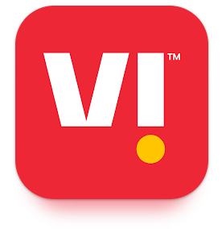


CHANGE AND STABILITY MANAGEMENT

Slide 2

Change Management: A methodical strategy to dealing with the transition or transformation of an organization's objectives, procedures, or technologies is called change management.
Changes in an organization that significantly affect it as a whole are referred to as organizational changes. Different organizational change calls for different approaches and these are descriptions of the five major types of organizational changes.
Strategic change is one that is made to key aspects of a company's operations in order to counter new threats or take advantage of fresh commercial possibilities. Changes of this nature includes changes to the business's policies, structure or processes.
Structural change is a modification in a managerial hierarchy, line of command, control systems, employment structure, or administrative regulations.
Technological change are related to modifications to the technologies or procedures the organization uses. This might mark the debut of new software or a system in the organization.
People-Oriented change refer to the process of hiring new employees, changes in employee performance or skill levels, etc.
Transformational change is a summation of all the aforementioned changes made to improve the operations, culture, and values of an organization. It totally alters the strategy and operations of the company.

Slide 3
An Indian telecom company called Vodafone Idea (or Vi) has headquarters in Gandhinagar and Mumbai. It is a GSM operator that serves all of India. With 228.60 million subscribers as of December 31, 2022, Vi is the third-largest mobile telecommunications network in India and the eleventh-largest mobile telecommunications network worldwide. In order to build a new firm called Vodafone Idea Limited, Idea Cellular and Vodafone India merged on August 31, 2018.On September 7, 2020, Vodafone Idea launched its new brand identity, "Vi," which combines the business's formerly distinct identities of "Vodafone" and "Idea" into a single, cohesive brand.
In an effort to provide the cash-strapped company a lifeline and stop the telecom sector from becoming a duopoly, the Government of India authorised and ordered the company to convert its AGRs payable at Rs. 16100 Crore to equity on February 3, 2023.
YOU Broadband is a wholly owned subsidiary of Vodafone Idea LTD which provides fixed line broadband and voice services in major cities of India.
Akshaya Moondra is managing VI as CEO along with Abhijeet Kishore as COO of the company.
Vodafone Group and Aditya Birla Group are the main promoters.

Slide 4

MERGER
A merger is a business transaction in which two or more companies combine to form a single new entity.
There are different types of mergers, and there are many reasons why businesses choose to combine with their rivals. Typically, companies merge to increase their market share, diversify their portfolio, or expand their reach.
All of this is done to increase shareholder confidence in the business and produce value.
Another type of merger is a horizontal merger, which happens when businesses operating in the same industry unite to form a single corporation. In essence, it is a merger of rival companies that offer the same services or goods.

Slide 5
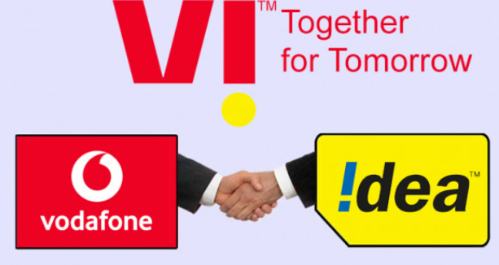
Official announcement of completion VI merger was made on
31st August, 2018.

Slide 6
VI – MERGER (Drivers of Change)
Vodafone and Idea both were significant players in the Indian telecom industry, but in 2016 a new competitor, Jio, entered the market and quickly took the lead, making all other competitors in the market for telecom services vulnerable. Hence, the VI merger was a preventive measure taken by vodafone and Idea to ensure their survival in the market against the advent of a new competition.
As a result of Jio's domination in the Indian telecom market upon its introduction there in September 2016, other large firms were forced to take hazardous measures in order to maintain their position in the market. In 2017, Vodafone and Idea announced their merger, having a significant impact on the Indian telecom industry.
In terms of subscriber numbers, Vodafone India was the second-largest telecom company in India, and Idea Cellular Ltd was in third place.
This merger not only resulted in the creation of a new telecom giant, but it also had far-reaching effects on the market, services, employees, and customers. It also encouraged more mergers in the telecom industry.

Slide 7
Impact of Merger
This combination sparked more mergers and the acquisition of other telecom firms, including Telenor and Reliance, which Bharti Airtel acquired.
Due to the problematic entry of Jio, the merger company has taken a number of actions, including price renewal.
The merger assisted Idea and Vodafone in paying off their debt, and a sizable amount of credit will be injected into the joint venture.
The effects of the merger could be seen in the level of service delivered.
The savings, synergies, and spectrum in rapid growth were also affected by this.
The merger has decreased operating expenses to roughly 60% of overall expenses, which will let the company provide services of higher quality and effectiveness.

Slide 8
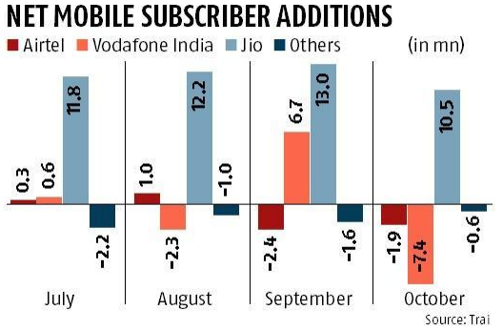
Impact of Merger
India's telecom sector was growing not too long ago, with a dozen carriers competing for market share in a country with a billion users.
But, Reliance Jio entered the market with extremely low prices four years ago and some operators were forced out of the competition to offer wireless services as a result of a vicious pricing war that broke out, leaving many with visible wounds. Just Bharti Airtel and Vodafone Idea remain as private providers competing with Jio today.

Slide 9
SWOT Analysis
Strength
Gigantic Customer Base
New Brand capital Marketing
Massive Network Coverage
Extensive Infrastructure
Great Deals for consumers
Weakness
Financial Losses
High Debt
Unable to use optimum resources
Outsourcing Operations
Coping with change
Opportunities
Market Development
Strategic Partnership
Advancement in technology
Untapped scope of Current Market
Threat
Competition
Huge Losses
Threat from competitor
Government Regulations

Slide 10
Kotter’s 8 Step Change Model
1. Create Urgency:
As soon as the companies learnt about the threat of new competitor’s increasing hold on market share and it’s threat to existence of the company they immediately and strategically took preventive step and decided to merge into a new entity.
2. Form a powerful coalition:
Vodafone and Idea two of them were holding a great position in market i.e. 2nd and 3rd respectively and hence their merger was a powerful coalition.
3. Create a vision for Change:
With the entry of new competitor providing extra ordinary services to customer at economical rates VI made alterations in it’s vision statement according to the present market scenarios.
4. Communicate the Vision:
After taking the steps to change and creating vision for change they clearly communicated their vision with everyone about merging taking back the major hold of market and provide better quality of service.

Slide 11
Kotter’s 8 Step Change Model
5. Empower Action:
The decision was soon successfully implemented and change took place effectively after taking empowering actions.
6. Create Quick wins:
After the merger they came back to market with effective steps having highest number of subscribers and providing cut throat competition.
7. Build on the change:
Not only the merging the companies assets and getting hold of maximum subscribers, even after merger they kept on trying their best to provide quality and economical service to it’s customers.
8. Make it stick:
The brand is constantly trying to improve and building strong relationship with it’s customers.

Slide 12
Conclusion
After looking at the kotter’s theory of change model we can conclude that the organization has taken the right steps.
The change benefited the organization as it thrive through the though time, not only survived but was able to compete in market.
The customers were the one who is most benefited in this competitive times.
Some Employees of the organizations went through a hard time and had to deal with the negatives of the change, but looking at the bigger picture we can say that the change only benefited the organization.
Organization not only survived but due to change currently they hold combined assets have more resources compared to others which becomes it’s strength.
Due to the change organization also holds the highest number of subscribers in the market.

Slide 13
References
https://www.apty.io/blog/types-of-organizational-change/
https://en.wikipedia.org/wiki/Vodafone_Idea_Ltd
https://www.myvi.in/vodafone-idea/management-team
https://www.myvi.in/vodafone-idea/promoters
https://papers.ssrn.com/sol3/papers.cfm?abstract_id=3496463
https://www.bhaskarhindi.com/technology/news/vodafone-idea-rebranded-as-vi-company-announced-161046
https://www.hrkatha.com/news/vodafone-idea-merger-loss-of-jobs-for-thousands/#:~:text=The%20temporary%20staff%20as%20well,part%20of%20the%20merger%20deal
https://www.business-standard.com/article/companies/vi-is-we-two-yrs-after-merger-voda-idea-integrates-to-create-new-identity-120090700456_1.html

