Slide 1
MSc Plismona (Arweinydd Weithredol a Strategol)
MSc Policing (Operational & Strategic Leadership)
2025
Cyflwyniad Modiwl Traethawd Hir
Dissertation Module Introduction

Slide 2

Learning outcomes
To provide an overview of the dissertation module
To introduce you to the requirements of a ‘Dissertation proposal’
To be aware of key submission dates
Address any early concerns you may have

Slide 3

3rd Year Studies
How do you feel about your 3rd year studies?
Notes:
So lets start by finding out how you all feel about this you3rd and final year of your programme – and hopefully by the end of todays session some of those feelings may be alleviated or addressed.

Slide 4
Module Introduction
What is a dissertation?
‘A long essay on a particular subject, especially written for a university degree’
‘A large research project undertaken at the end of a degree – involving in-depth consideration of a problem or question chosen by the student’
Notes:
How would you define or describe what a ‘dissertation’ is? Use the chat box
Your dissertation or project is probably the single most important written assignment that you will undertake or produce during your course.
It is often seen as a key indicator of a student’s capabilities as a student/researcher.
It differs to your other assignments in relation to the following:
Its word count – significant word count
Its structure – specific structure/format is required
And the fact that it is an independent piece of work of which the student has control – i.e. chooses the subject/topic, its direction and how it is undertaken

Slide 5

MSc Professional Investigation – dissertation
Aim – to provide the student with the opportunity to produce a substantial specialist body of work which has been instigated , developed and produced as a consequence of their own research initiative’.
Notes:
The aim of your dissertation module is:
Aim – to provide the student with the opportunity to produce a substantial specialist body of work which has been instigated , developed and produced as a consequence of their own research initiative’.
It therefore enables you to undertake a major project of your choice, that includes research and enquiry into an aspect of operational/strategic leadership which , demonstrates your academic skills such as critical thinking, analysis, synthesis and evaluation of assumptions, abstract concepts and data. Not forgetting that ultimately you will need to be able to communicate your research conclusions clearly to specialist and non-specialist audiences.
Most university students will be required to undertake a project of their choice in their final year of studying.
This one piece of work is worth 60 credits – so it is a substantial piece of work

Slide 6

Advantages of undertaking a dissertation
Opportunity for you to identify and learn more about a particular topic that interest you
Personal development within a specialisation - current/future
Personal Ownership
Allocated supervisor
Notes:
What do you think are the advantages of undertaking such a project/dissertation??
There are a number of advantages of undertaking a project/dissertation – although it may not feel like it now!
e.g.
Great opportunity for you to identify and learn more about a particular topic that interest you
May help you develop in your role within a specialisation that you are currently employed within or in which you aspire to be in the future
Ownership – you take ownership – its independent study that you chose and you drive it - BUT you will be supported
New skills
Allocated supervisor with whom you will work on a one to one basis

Slide 7

The Assignment Brief
Write a 15,000 word project/dissertation
Based on a topic of your choice – relevant to your degree programme
3 distinct parts:
  Project proposal – 1500 words ( formatively assessed)
  Ethics – 500 words (formatively assessed)
  The project – 15,000 words ( Summative assessment 100% of marks)
Notes:
This is your assignment brief - I will circulate in a booklet format for you with specific guidance regarding content, structure, submission dates etc. available on Moodle
To produce a 15,000 word project on a topic of your choice which is related to your degree programme.
Your 15,000 word project is divided into 3 distinct parts:
Project/dissertation proposal – 1500 words (Formatively assessed)
Ethics form - 500 words (Formatively assessed)
The project document – 100% marks – 15,000 words ( Summatively assessed)

Slide 8

Submission – Key dates
Dissertation proposal
  23:59hrs 3th December 2025
Ethics form
  23:59hrs 3th December 2025
Dissertation
  23:59hrs 3rd July 2026

Slide 9

Dissertation Support
Allocated a named supervisor
Time-tabled support ( March to November)
Formative feedback opportunities
Notes:
One to one sessions can be either 30 mins or 1 hour – but cannot exceed 4hrs
Time-tabled March to November
It’s important that you attend these sessions and come fully prepared.
They will be diarised and agreed between you and me, it may not be possible to rearrange.
I will provide further information in relation to what the supervision sessions are and student responsibilities. The student will lead these sessions therefore it is important that they come prepared with any questions, queries or concerns to be discussed.
Draft submissions are encouraged – however each section can only be submitted once – advise will be provided in relation to any adjustments that should be made and that it is up to the student as to whether they take onboard that advice. Once returned with feedback it will not be subject to further feedback until it is finally submitted and graded/marked.

Slide 10
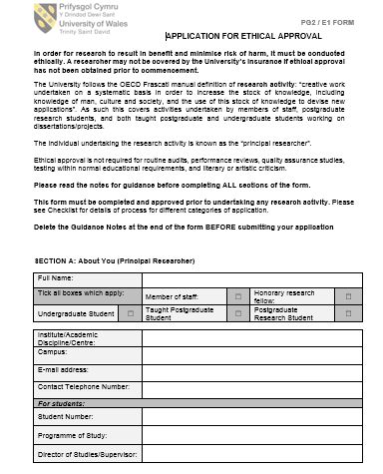
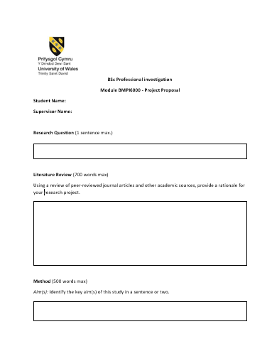
Presentation of work
Dissertation Proposal
Ethics form
Notes:
UWTSD template will be provided in relation to the Ethics form and I have put together a proposal template to assist you with structuring your proposal document
You are required to complete these and submit via Turnitin
DO NOT create your own templates
I will circulate the forms by email and they will be available on Moodle this week – have a look at them and get familiar with the contents.

Slide 11

Dissertation
Front sheet
Declarations
Acknowledgements
Contents
Abstract
Introduction
Literature review
Research methodology
Analysis of results
Conclusion and recommendations
Bibliography
Appendicies
Notes:
The university requires the submission of the dissertation to follow an agreed structure:
The following sections will appear in the final dissertation/project document submitted
( doesn’t include your proposal or ethics form) – keep to the accepted structure!
Front sheet
Declarations
Acknowledgements
Contents
Abstract
Introduction
Literature review
Research methodology
Analysis of results
Conclusion and recommendations
Bibliography
Appendicies

Slide 12
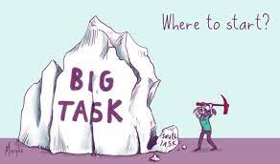
“Where do I start?”
Topic area – relevant to your course
Personal interest
Too wide – explore different aspects – narrow it down
Consider topical issues – in the media/in Force
Devise a question relevant to the topic area you want to research
Question may change BUT don’t change the topic area.
Notes:
Topic area – relevant to your course- Professional investigation
Personal interest – something you enjoy researching/discussing /reading about - it will keep you motivated
Too wide – explore different aspects – narrow it down – supervisor may assist you
If you are having difficulty choosing an area consider:
Current/topical issues – in the media/in Force
Once you have confirmed your area/topic you need to
Devise a question relevant to the topic area you want to research
Question may change BUT don’t change the topic area.
I have a list of research areas which have been forwarded by the Forces should anyone be struggling to think of a subject area – if so drop me and email so that we can discuss.

Slide 13

Dissertation proposal
Identify issue/problem worthy of researching
To encourage you to read and understand the published literature, particularly peer-reviewed journal articles
Plan your project and consider potential difficulties
Opportunity to obtain formal feedback on your project so you can amend any issues before you complete your dissertation.
Notes:
Your research proposal is all about your early ideas around your research area.
It will highlight an issue which you wish to research or a problem that you feel si worthy of researching
It encourages you to read and understand the published literature around your chosen subject, particularly peer-reviewed journals and articles so that you have a better understanding of the subject and can possible highlight ‘gaps’ that exist in knowledge or research which gives you the grounds to do your specific research
It gives you a framework to assist you in planning your project/research and to consider the potential difficulties that you may have to overcome – it gets you to think about these things early on so that you can navigate around them
Importantly it gives you the opportunity to obtain formal feedback from me on your research areas so that you can amend any issues before you complete your dissertation

Slide 14
Dissertation Proposal
WHAT?
What are you doing? (what is your focus)
WHY?
Why are you doing it? (why is this area important?)
HOW?
How are you going to do it?
  1500 words
  Template provided
  Submission by:
  23:59hrs 3rd December 2025
Notes:
3 important questions to ask yourself when considering your research topic/subject
WHAT are you going to do – what is your focus?
WHY – why are you research that particular area, why is it important??
HOW – how are you going to do it, how will you get the information you need to succeed in your research to answer any research questions.

Slide 15

Research Question
Should set proposal up for reader
Think about:
  Step 1 – what interests you?
  Step 2 – explore the issue / read around for ideas
  Step 3 – focus your topic
  Step 4 – formulate a question
  Step 5 – refine question
Notes:
Your research question should set up your proposal for the readers.
It should also be narrow in focus and give you a way of evaluating your answer.
5 steps to assist you:
What interests you
explore the issue/read around the topic/subject for ideas – identify any gaps
focus
Formulate a question/statement
Refine your question

Slide 16

Refining the Research Question
1. Debateable
Not an easy yes/no answer
Need to be able to explore the question and requires you to explain or defend answer using data.
2. Plausible
Can it be answered?
3. Consequential
Impact?
Notes:
Words that External Examiners like
Critical/critically
Analysis/Analyse
Evaluation/Evaluate
Synthesis/synthesise - A synthesis is a written discussion incorporating support from several sources of differing views. This type of assignment requires that you examine a variety of sources and identify their relationship to your dissertation

Slide 17

Project Aims & objectives
Over arching aim – be succinct
Objectives – the steps you are going to take to answer your research aim or question
A specific list of tasks needed to be done to accomplish the goals of the project
Must be clear & achievable
Usually numbered so that each reads as an ‘individual’ statement to convey intentions
The dissertation aim, objectives & research question, MUST be aligned
Notes:
Each dissertation should begin with an aim and objectives.
Your over arching aim for your research should be presented succinctly within one sentence if possible.
Your objectives are based on the steps that you are going to take to answer your research question or aim and should set out the questions that you need to answer in order to address your research question – in other words a specific list of tasks needed to be done to accomplish the goals of your project/research
Your objectives must be clear and achievable and should not be
Too vague or broad in scope – aims are often over-optimistic of what the project can achieve
Repeat each other in different terms
Be a list of things related to an unspecified way to your topic
They can be numbered so that each reads as an individual statement to convey its intentions
Finally
The dissertation aim, objectives and research question must be aligned

Slide 18

Literature Review
Use chosen research question as basis for literature scope
You should review the related literature and provide a rationale for your own study - give your proposal purpose
Concise
  This will not necessarily include every study reported in a particular area but should be a selective account of major studies.
  It is NOT a history lesson for your reader
Notes:
One of the larger parts of your research and one of the biggest chapters that you will write.
More detailed information will be provided in a lesson specifically looking at Literature review
Ways to approach:
Use chosen research question as basis for literature scope – a starting point for you
You should review the related literature and provide a rationale for your own study - give your proposal purpose, identify gaps and critically explore the literature that’s already out there
Concise
Your lit review will not necessarily include every study reported in a particular area but should be a selective account of major studies that have been undertaken or authoratively written about.
It is NOT a history lesson for your reader – so steer away from this.

Slide 19

Methodology
The method section should describe the process of how you plan to conduct your research and follow a similar structure to the method section of your dissertation (just shorter).
  Justify your selection of research techniques and sampling
  Use previous research on same topic: what methods did they employ?
  Be realistic and appropriate
Notes:
This section is very important as it provides an overview of how you are going to carryout your research or how you plan to address your research question
It will provide a plan of your work and describe the activities you feel are necessary to complete your project
It should contain sufficient information for the marker to determine whether the methodology is sound and appropriate
In this section you should make a case to show that your approach is the most appropriate and valid way of addressing the research question.
NO RESULTS are given at the proposal stage as you haven’t started on it yet – however you need to give some idea about what kind of data you will be collecting and what statistical procedures will be used in order to answer the question
Ethical issues and risks – you may mention the limitations and weaknesses of the research which may justify some issues that will occur ( e.g. COVID)
Every student will be required to submit an ethics form – so its relevant to highlight any issues you may have at this early stage and which can be addressed when you submit your ethics form

Slide 20
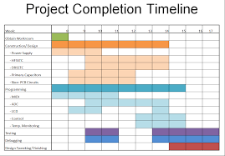
Proposed Timeline
Include a proposed timeline, using either a table format or a ghant chart, which clearly shows plan of action for completion of your dissertation with specified dates and tasks. For instance,

Slide 21

Outcomes
Who would be interested in your dissertation and its findings?
Is there potential for future research on the subject?
Does it provide new avenues of research? Support current strategies/decision-making?
Demonstrate your awareness of its contribution to that area of research
‘So what?’
Notes:
Finally
What will be the outcomes of your research –
Ask yourself :
Who would be interested in your dissertation and its findings?
Is there potential for future research on the subject?
Does it provide new avenues of research? Support current strategies/decision-making?
Demonstrate your awareness of its contribution to that area of research
‘So what?’

Slide 22

Referencing
Use the Harvard referencing style - available on Moodle /Library pages
Start your reference list early on – from day 1 (excel spreadsheet/word document etc.)
Notes:
Does anyone need any input on referencing or a refresher lesson – timetabled!
How are you going to keep on top of your bibliography/reference lists?? Start it early
Are you going to use software to assist you or the old fashioned way of doing it by hand?
Either way – referencing is very important at this stage and will be scrutinised in your final submission so needs to be spot on

Slide 23
Concerns
What are your concerns for this module?
Notes:
That’s a brief overview of the module. But lets return to an earlier slide to make sure that those early concerns have now been addressed for NOW! As we go through the year we can address any others that raise their heads.
Each element of the dissertation process will be the subject of a lesson over the coming weeks.
And resources will be posted on moodle at the end of each lesson so that you can dip in and out or refer back to specific points.
Use of MENTIMETER

Slide 24
Learning outcomes
To provide an overview of the dissertation module
To introduce students to the requirements of a ‘Dissertation proposal’
To be aware of key submission dates
Address any initial concerns

Slide 25

Next lesson will be on Wednesday 8th October at 5.30pm

