Slide 1


Hotel Trinity
Special Valentines Menu
Student: Bogdan George Pantiru
ID: 2212170

Slide 2


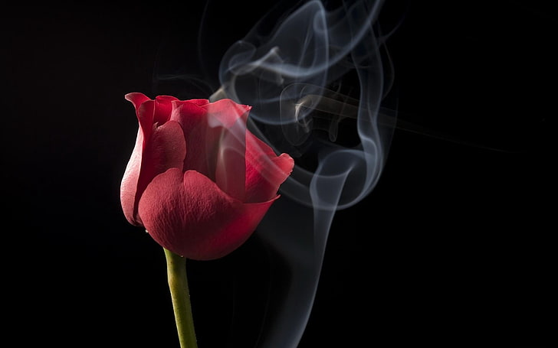
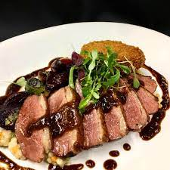
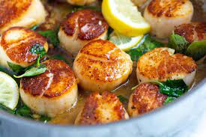
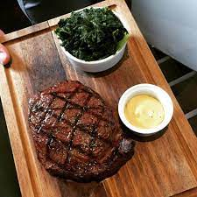
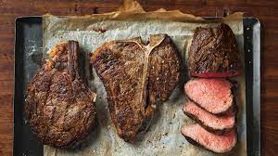
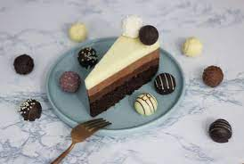
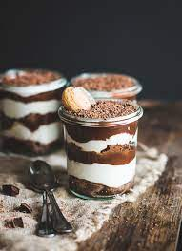
THREE COURSE MEAL FOR £90 Per Person
STARTERS
Duo of Duck
(smocked duck breast,beetroot,orange)
2. Beetroot & Red Wine Tarte Tatin (VE)
(Pickled Golden Beetroot, toasted pumpkin seeds, wild rocket)
3.Pan Seared Scallops
(Celeriac Puree)
MAINS
1.Portobello Mushroom, Chestnut & Spinach
(Heritage potatoes, sauteed beech mushroom, asparagus)
2.Whole Lemon Sole
(Prawn, lemon & parslay butter)
3.30 Day aged 10oz Rib Eye Steak
( 10oz Steak, bordelaise souce , dressed watercress)
DESSERTS
Chocholate Trio
(Double chocholate ice creem in home-baked brandy snap basket)
2. Passion fruit panna cotta
3. Tiramisu

Slide 3

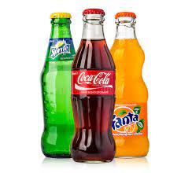
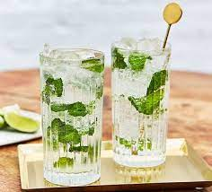
Allergen Information
Beverage List
Cocktail Recipes
Our easy to use allergen guide is availible for you to use on the food section of our website .
Please informe the stuff if you have any allergy
Cola
Fanta
Sprite
Mojito
Cosmopolitan
Sidecar

Slide 4
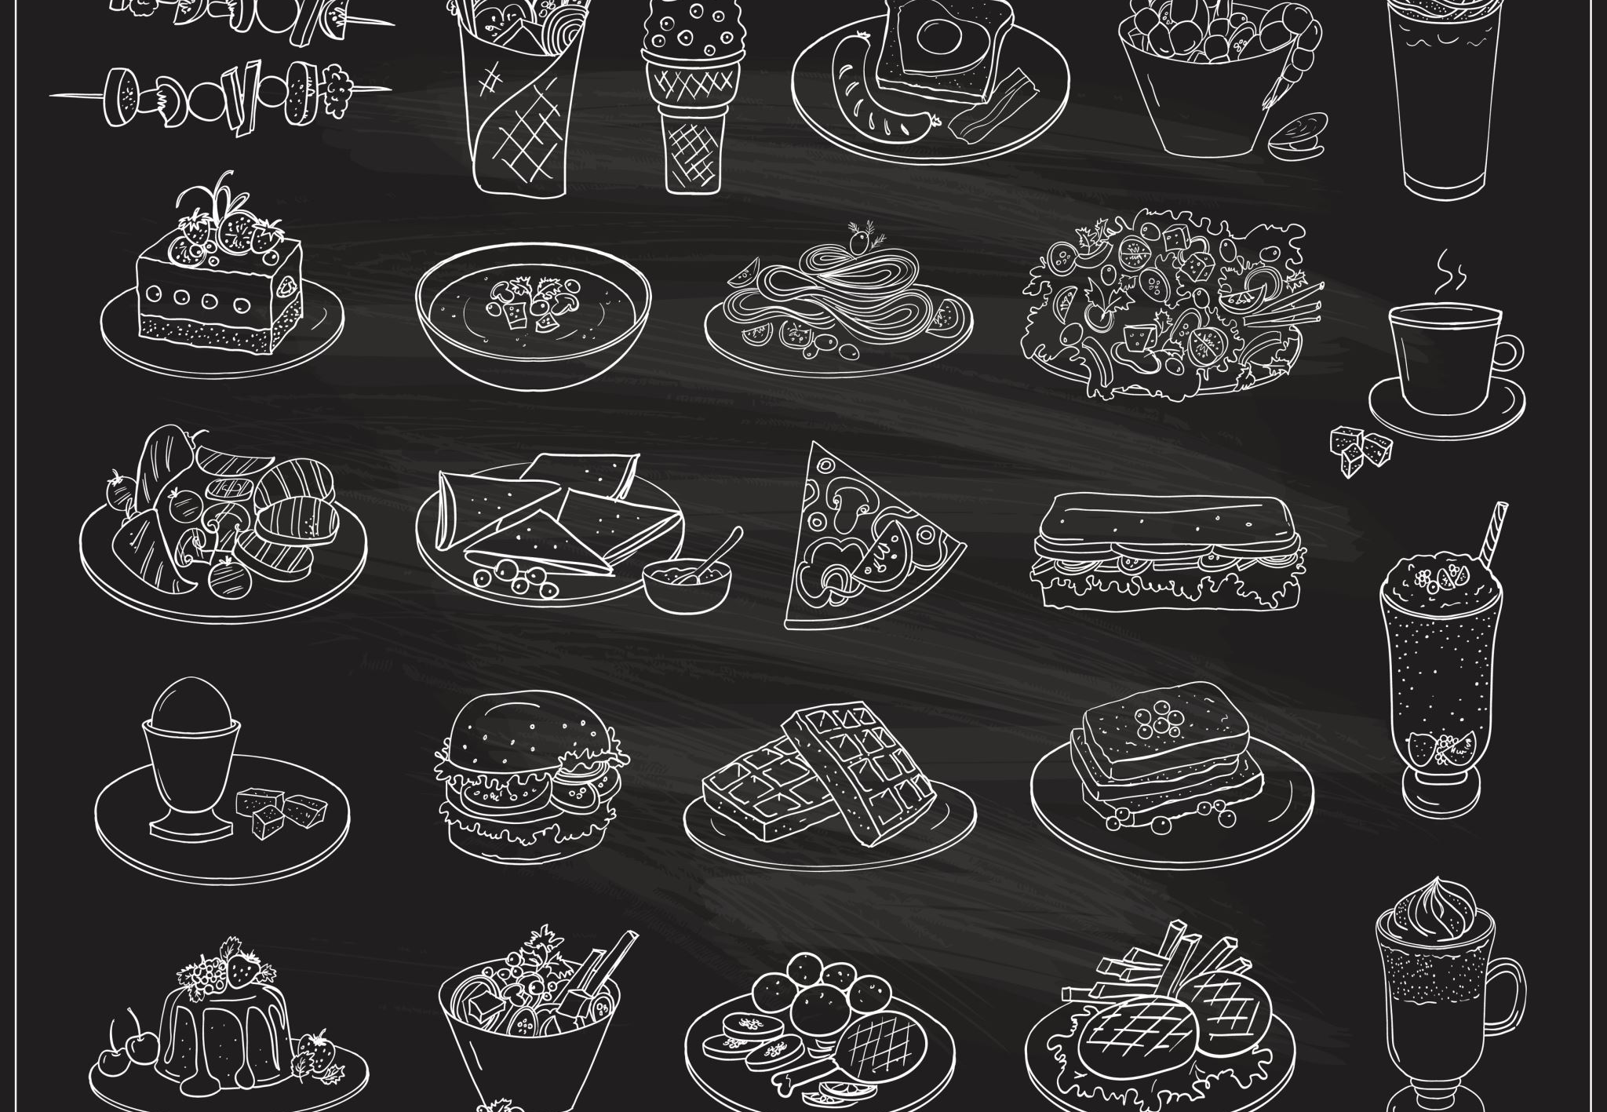
REFERENCES:
Boussard, S. (2021) Food and Beverage Management in the Luxury Hotel Industry. New York: Business Expert Press.
Davis, B., Lockwood, A., Pantelidis, I. and Alcott, P. (2018) Food and Beverage Management. 6th edn. London:
Hoover, A. (2021). Exploring the Holy Trinity Menu: An Introduction to British Cuisine. The British Food Journal, 22(2), pp.72-77.
Routledge.Johnston, R. (2012) Service operations management: improving service delivery. 4th edn. Harlow, England: Pearson.
Motarjemi, Y. and Lelieveld, H. (2014) Food safety management: a practical guide for the food industry. Amsterdam: Academic Press.
Miles, J. (2020). Exploring the Holy Trinity Menu. British Food Journal, 21(6), pp.110-114.
Valentine's Day Cocktail Recipes" by Town & Country, 12 Jan. 2021, Town & Country Magazine

