Slide 1



STUDENT NAME: SHAZIA BEGUM
STUDENT NUMBER: 2117727
MODULE NAME: Introduction to physiology
MODULE CODE: BMHP5003
LECTURES NAME: Gillian Weaver

Slide 2
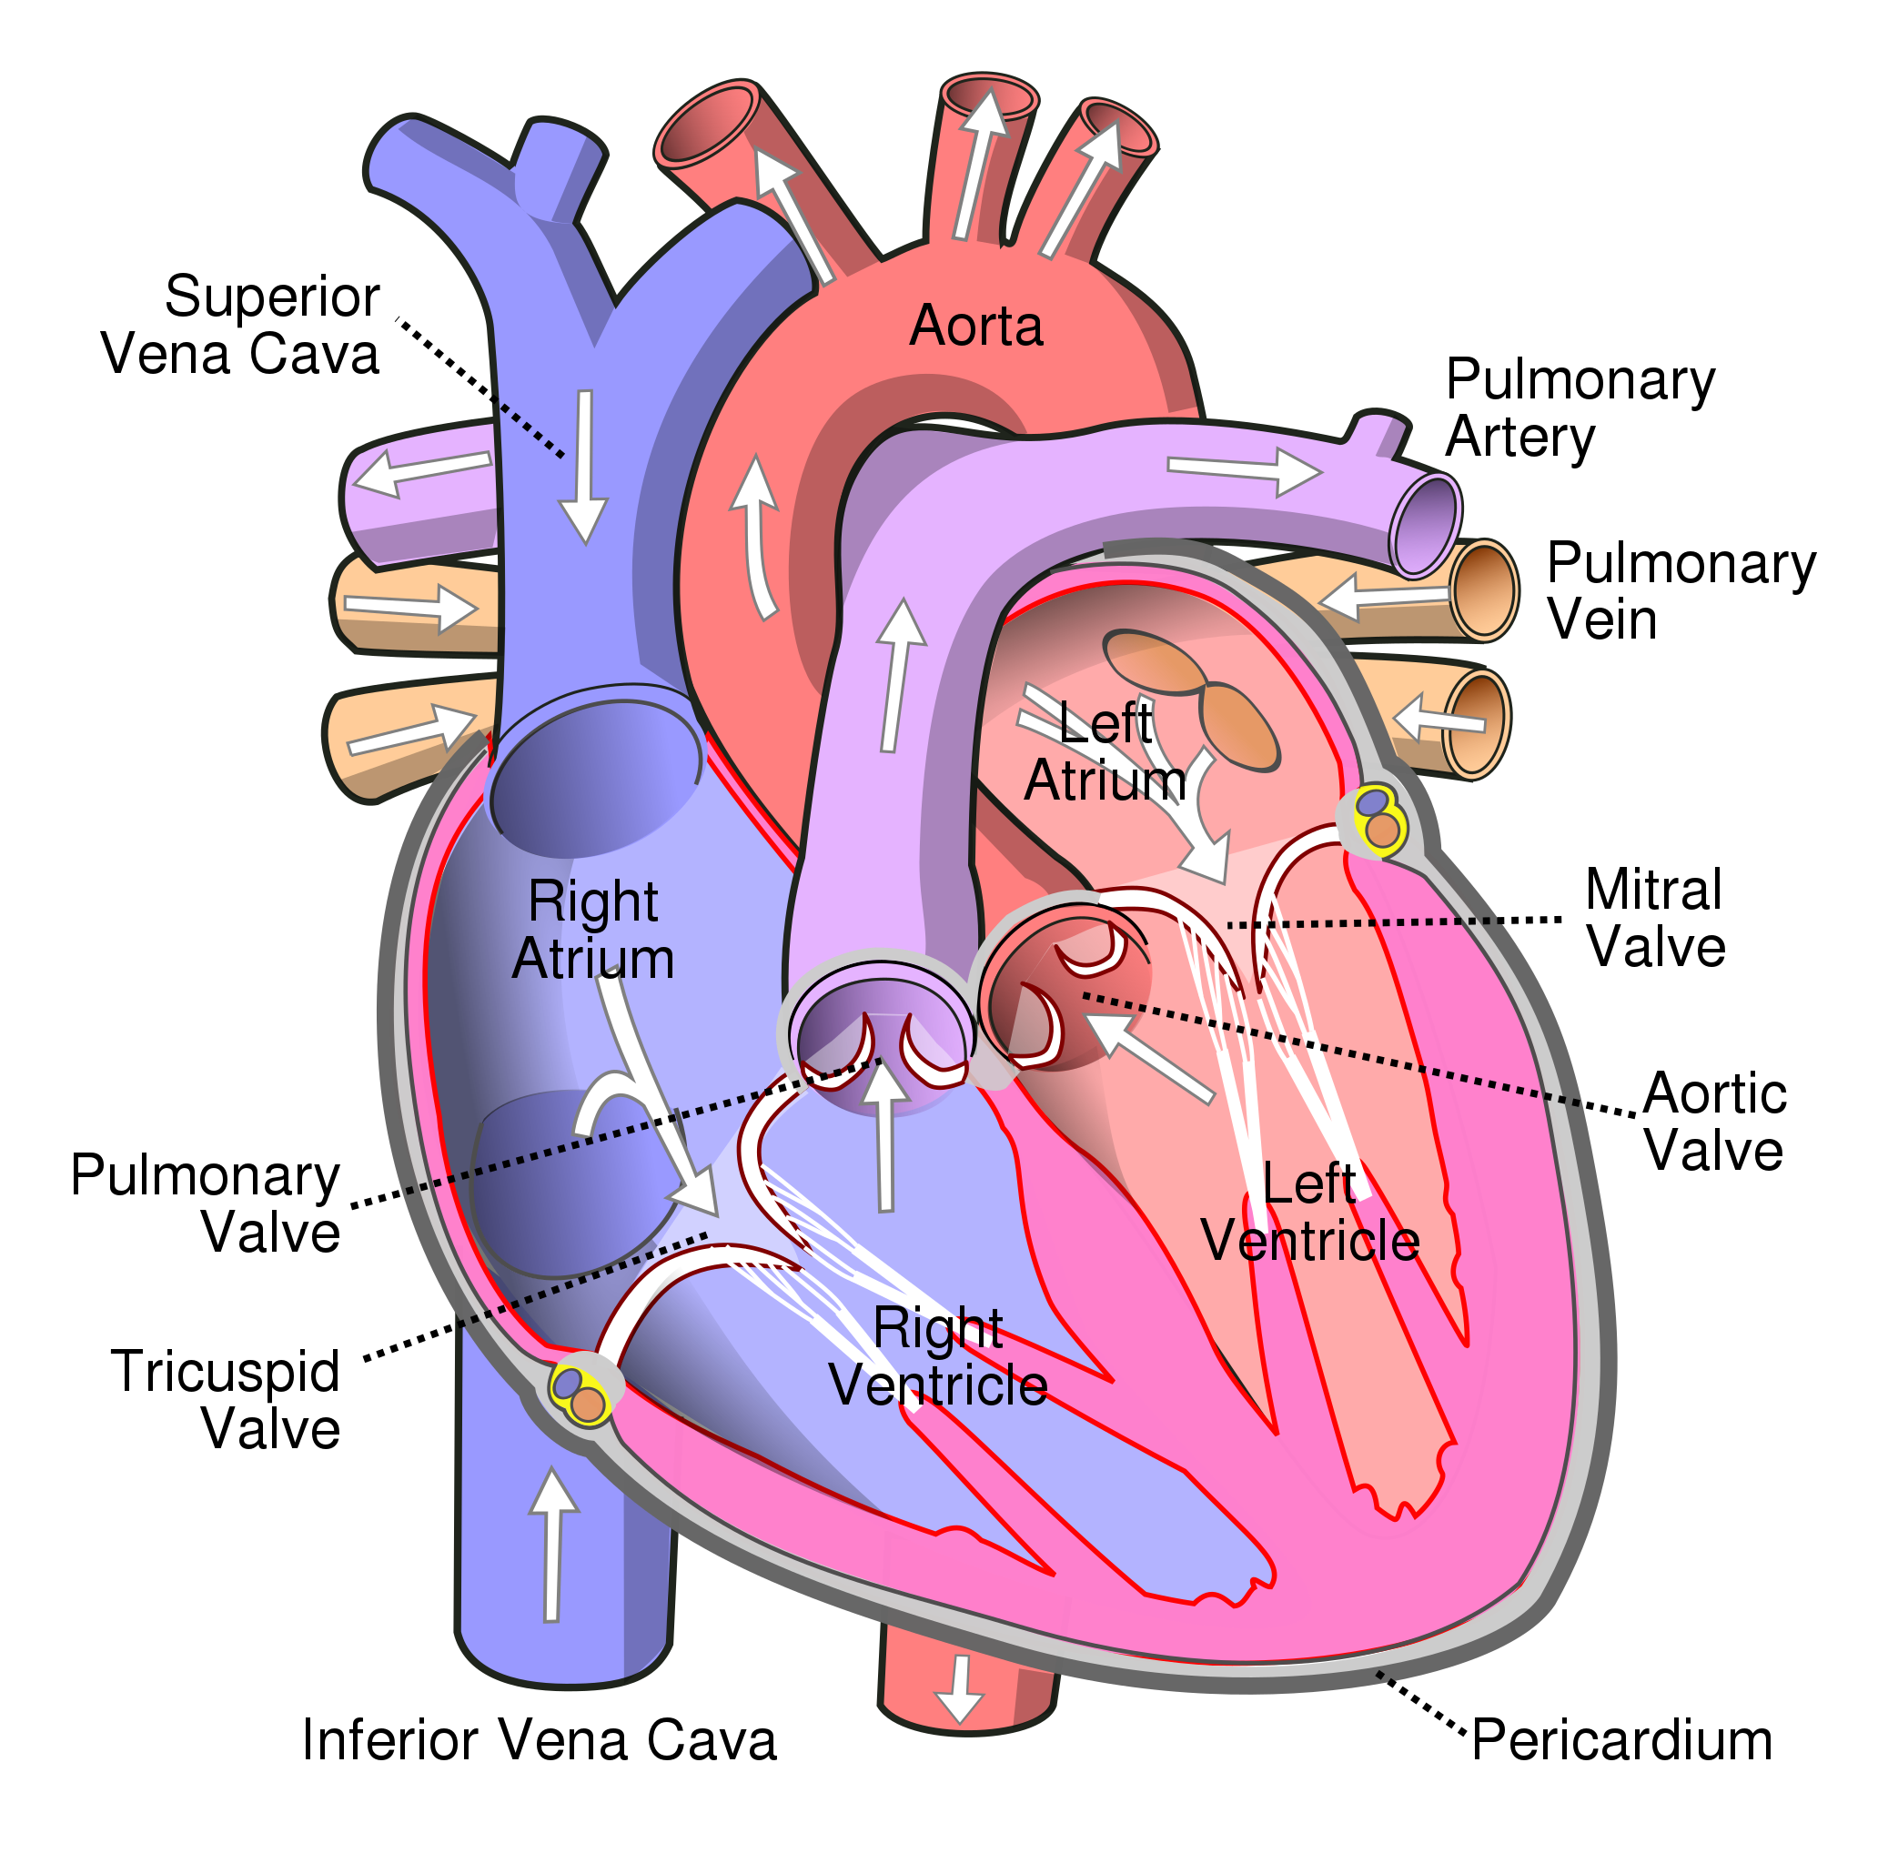
The Heart
The largest arterial branch in the heart, the aorta, exits the left side of the heart. Its role is to take oxygenated blood and supply it to the arteries and capillaries.
The arteries carry oxygenated blood from the heart throughout the body (Gupta, 2020).
Between the lungs in the thoracic cavity is where the heart is placed.
The heart is a complex organ with four distinctive chambers
(Litviňuková, 2020).
4 The pulmonary artery pushes the deoxygenated blood into the lungs
The aorta is the body's largest major artery (Jana, 2019).
The pulmonary system returns deoxygenated blood from the lungs to the heart once it has been oxygenated.
The heart's right-side pumps deoxygenated blood, while the left side carries oxygenated blood.
5 The oxygenated blood re-enters through the pulmonary vein. The most common cause of heart failure is excessive activity in the pulmonary veins (Frank et al., 2021).
1 Blood enters the Vena Cava after losing oxygen to the body system.
The left atrium receives blood from the lungs that is oxygenated and places it into the left ventricle.
The left atrium receives oxygenated blood from the lungs and circulates it across the body (Whiteman 2019).
2 The deoxygenated blood is then pushed into the right atrium.
The mitral valve opens when it is full and pushes the oxygenated blood into the left ventricle.
mm
Deoxygenated blood can be pushed into the right ventricle because of to the pulmonary valve.
Blood exiting the left ventricle of the heart and flowing into the body's major arteries are controlled by the aortic valve.
The tricuspid valve opens when the right atrium is full of deoxygenated blood.
6 To exchange fluid and nutrients with the tissues and cells, the left ventricle pumps blood into the aorta and onto numerous branches of the systemic circuit. Cells then use the nutrients and oxygen that have been released from the capillaries.
As a result of medical conditions, the left ventricle regularly changes structure and function (Cutugno, 2021).
3 The deoxygenated blood travels into the right ventricle.
(Cardiology Associates, 2019).
The two-vena cava serve the same function of transporting deoxygenated blood.
In the middle chamber of the heart, the superior vena cava is the largest central systemic vein.(Sonavane et al., 2015).
The pericardium is a membrane outside the heart
Aortic aneurysms rarely generate visible symptoms, except when they rupture, which is often fatal. (Xiao et al.,2021)
Aortic aneurysms are medical conditions that permanently enlarge the aorta and are most frequently found in the infrarenal and upper thoracic areas (Davis and Lu 2019).
The right-sided inferior vena cava is the usual channel through which blood from the lower body drains (Oliveira and Martins, 2019).
When the walls of the heart are not strong enough u can have an aortic aneurism

Slide 3
Reference Page
Cardiology Associates, (2019) Human Heart. Available at : https://www.cardofmich.com/anatomy-human-heart-fun-facts/ (Accessed 6June 2022).
Cutugno, S., Ingrassia, T., Nigrelli, V. and Pasta, S. (2021) 'On the left ventricular remodelling of patients with stenotic aortic valve: A statistical shape analysis,' Bioengineering, 8(5), p.66.
Davis, F.M., Daugherty, A. and Lu, H.S. (2019) 'Updates of recent aortic aneurysm research,' Arteriosclerosis, thrombosis, and vascular biology', 39(3), pp.e83-e90.
Frank, D.B., Levy, P.T., Stiver, C.A., Boe, B.A., Baird, C.W., Callahan, R.M., Smith, C.V., Vanderlaan, R.D. and Backes, C.H. (2021) 'Primary pulmonary vein stenosis during infancy: State of the art review,' Journal of Perinatology, 41(7), pp.1528-1539.
Gupta, P. (2020) 'What your blood tells? A review,' Journal of Cell and Tissue Research, 20(2), pp.6897-6913.
Jana, S., Hu, M., Shen, M. and Kassiri, Z. (2019) 'Extracellular matrix, regional heterogeneity of the aorta, and aortic aneurysm,' Experimental & molecular medicine, 51(12), pp.1-15.
Litviňuková, M., Talavera-López, C., Maatz, H., Reichart, D., Worth, C.L., Lindberg, E.L., Kanda, M., Polanski, K., Heinig, M., Lee, M. and Nadelmann, E.R. (2020) 'Cells of the adult human heart,' Nature, 588(7838), pp.466-472.
Oliveira, J.D. and Martins, I. (2019) 'Congenital systemic venous return anomalies to the right atrium review,' Insights into Imaging, 10(1), p.115.
Sonavane, S.K., Milner, D.M., Singh, S.P., Abdel Aal, A.K., Shahir, K.S. and Chaturvedi, A. (2015) 'Comprehensive imaging review of the superior vena cava,' Radiographics, 35(7), pp.1873-1892.
Whiteman, S., Saker, E., Courant, V., Salandy, S., Gielecki, J., Zurada, A. and Loukas, M. (2019) 'An anatomical review of the left atrium,' Translational Research in Anatomy, 17, p.100052.
Xiao, J., Borné, Y., Bao, X., Persson, M., Gottsäter, A., Acosta, S. and Engström, G. (2021) 'Comparisons of risk factors for abdominal aortic aneurysm and coronary heart disease: a prospective cohort study,' Angiology, 72(1), pp.24-31.

