Slide 1
Network Essentials
Week2: Wireless and Mobile Networks

Slide 2
Wireless Networks
In addition to the GSM and 4G/5G transmitters and receivers, smartphones make connections in a variety of ways.
GPS | It uses satellites to transmit signals that cover the globe. The smartphone can receive these signals and calculate the phone’s location to an accuracy of within 10 meters.
Wi-Fi | Wi-Fi transmitters and receivers located within the smartphone enable the phone to connect to local networks and the internet. The phone needs to be within the range of the signal from a wireless network access point to receive and send data on a Wi-Fi network. Wi-Fi networks are usually privately owned but often provide guest or public access hotspots. Wi-Fi network connections on the phone are like network connections on a laptop computer.
Bluetooth | It is a low-power, shorter range wireless technology that is intended to replace wired connectivity for accessories such as speakers, headphones, and microphones. It can also be used to connect a smartwatch to a smartphone. Because Bluetooth technology can be used to transmit both data and voice, it can be used to create small local networks. It is wireless technology that allows multiple devices to communicate over short distances.
NFC | It is a wireless communication technology that enables data to be exchanged by devices that are in very close proximity to each other, usually less than a few centimeters. It uses electromagnetic fields to transmit data.
Notes:
3: Wireless and Mobile Networks
3.1: Wireless Networks
3.1.3: Other Wireless Networks
3.1.4 Check Your Understanding - Wireless Networks

Slide 3
Mobile Device Connectivity
Mobile Devices and Wi-Fi
With mobile devices becoming more powerful, many tasks that needed to be performed on large computers connected to physical networks can now be completed using mobile devices on wireless networks.
Almost all mobile devices can connect to Wi-Fi networks.
It is advisable to connect to Wi-Fi networks when possible because data used over Wi-Fi does not count against the cellular data plan.
Wi-Fi radios use less power than cellular radios, so connecting to Wi-Fi networks conserves battery power.
It is important to use security when connecting to Wi-Fi networks.
These precautions should be taken to protect Wi-Fi communications on mobile devices:
  Never send login or password information using unencrypted text (plaintext).
  Use a VPN connection when possible if you are sending sensitive data.
  Enable security on home networks.
  Use WPA2 or higher encryption for security.
Notes:
3: Wireless and Mobile Networks
3.2: Mobile Device Connectivity
3.2.1: Mobile Devices and Wi-Fi

Slide 4
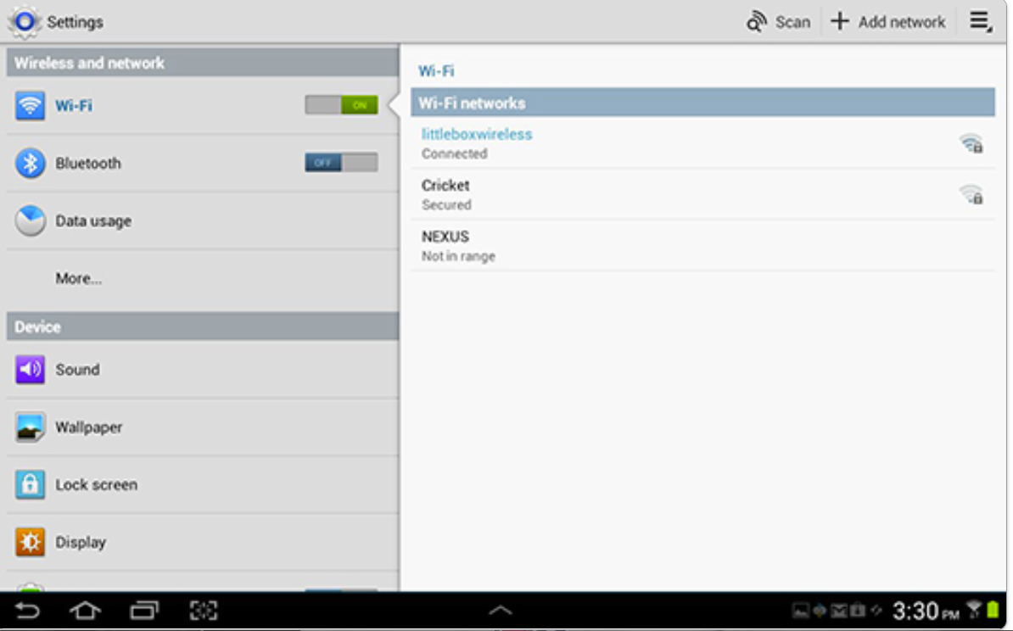
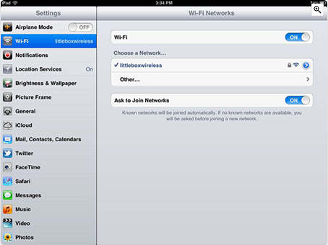
Mobile Device Connectivity
Wi-Fi Settings
Two of the most popular operating systems for mobile devices are Android and Apple iOS.
Each operating system has settings that enable you to configure your device to connect to wireless networks.
Android Wi-Fi Switch
IOS Wi-Fi Switch
Notes:
3: Wireless and Mobile Networks
3.2: Mobile Device Connectivity
3.2.2: Wi-Fi Settings

Slide 5
Mobile Device Connectivity
Wi-Fi Settings (Cont.)
To connect an Android or iOS device when it is within the coverage range of a Wi-Fi network, turn on Wi-Fi and the device then searches for all available Wi-Fi networks and displays them in a list.
Touch a Wi-Fi network in the list to connect.
Enter a password if needed.
When a mobile device is out of the range of the Wi-Fi network, it attempts to connect to another Wi-Fi network in range.
If no Wi-Fi networks are in range, the mobile device connects to the cellular data network.
When Wi-Fi is on, it will automatically connect to any Wi-Fi network that it has connected to previously.
If the network is new, the mobile device either displays a list of available networks that can be used or asks if it should connect to it.
Notes:
3: Wireless and Mobile Networks
3.2: Mobile Device Connectivity
3.2.2: Wi-Fi Settings (Cont.)

Slide 6
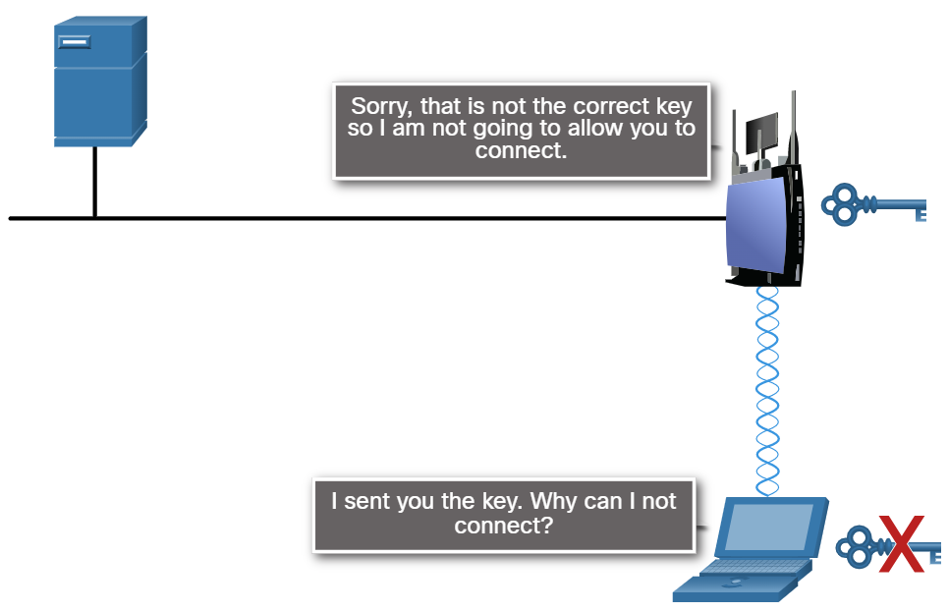
Mobile Device Connectivity
Configure Mobile Wi-Fi Connectivity
If your mobile device does not prompt to connect to a Wi-Fi network, the network SSID broadcast may be turned off, or the device may not be set to connect automatically.
You can manually configure the Wi-Fi settings on the mobile device.
Remember that SSIDs and passphrases must be typed exactly as entered on the wireless router setup or the device will not connect properly, as shown in the figure.
SSID is the name assigned to a wireless network.
Passphrase is what we normally use as the “wireless password”.
Notes:
3: Wireless and Mobile Networks
3.2: Mobile Device Connectivity
3.2.3: Configure Mobile Wi-Fi Connectivity

Slide 7
Mobile Device Connectivity
Configure Mobile Wi-Fi Connectivity (Cont.)
To connect to a Wi-Fi network manually on an Android device, follow these steps:
Step 1. Select Settings > Add network.
Step 2. Enter the network SSID.
Step 3. Touch Security and select a security type.
Step 4. Touch Password and enter the password.
Step 5. Touch Save.
To connect to a Wi-Fi network manually on an iOS device, follow these steps:
Step 1. Select Settings > Wi-Fi > Other.
Step 2. Enter the network SSID.
Step 3. Touch Security and select a security type.
Step 4. Touch Other Network.
Step 5. Touch Password and enter the password.
Step 6. Touch Join.
Operating systems for mobile devices are updated frequently and may be customized by the device manufacturer.
Notes:
3: Wireless and Mobile Networks
3.2: Mobile Device Connectivity
3.2.3: Configure Mobile Wi-Fi Connectivity (Cont.)

Slide 8
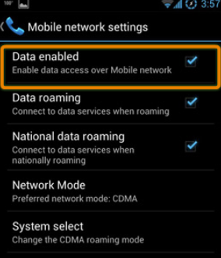
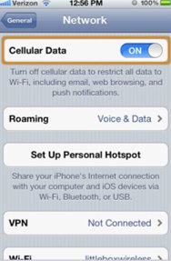
Mobile Device Connectivity
Configure Cellular Data Settings
Cellular data plans are offered by most cell phone carriers, but the bandwidth limitations and charges for usage vary widely by carrier, and by plan within carriers, so many mobile device users only use their cellular data plans when Wi-Fi service is not available.
Android Cellular Data
To turn on or off cellular data use the following path:
Settings > touch More under Wireless and Networks >
touch Mobile Networks > touch Data enabled
iOS Cellular Data
To turn on or off cellular data use the following path:
Settings > Cellular Data > turn cellular data on or off.
Notes:
3: Wireless and Mobile Networks
3.2: Mobile Device Connectivity
3.2.4: Configure Cellular Data Settings

Slide 9
Mobile Device Connectivity
Configure Cellular Data Settings (Cont.)
​Mobile devices are preprogrammed to use a Wi-Fi network​ for internet if one is available and the device can connect​ to the access point and receive an IP address. ​
If no Wi-Fi​ network is available, the device uses the cellular data capability​ if it is configured.
Most of the time, transitions from one network​ to another are not obvious to the user.
For example, as a mobile device moves from an area of 4G coverage to 3G coverage, the 4G radio shuts off and turns on the 3G radio.
Connections are not lost during this transition.
Notes:
3: Wireless and Mobile Networks
3.2: Mobile Device Connectivity
3.2.4: Configure Cellular Data Settings (Cont.)

Slide 10
Mobile Device Connectivity
Simple Connectivity with Bluetooth
Bluetooth technology provides a simple way for mobile devices to connect to each other and to wireless accessories.
Bluetooth is wireless, automatic, and uses very little power, which helps conserve battery life.
Up to eight Bluetooth devices can be connected at any one time.
These are some examples of how devices use Bluetooth:
  Hands-free headset - A small earpiece with a microphone can be used for making and receiving calls.
  Keyboard or mouse - They can be connected to a mobile device to make input easier.
  Stereo control - A mobile device can connect to a home or car stereo to play music.
  Car speakerphone - A device that contains a speaker and a microphone can be used for making and receiving calls.
  Tethering - A mobile device can connect to another mobile device or computer to share a network connection. Tethering can also be performed with a Wi-Fi connection or a cable connection such as USB.
  Mobile speaker - Portable speakers can connect to mobile devices to provide high-quality audio without a stereo system.
Notes:
3: Wireless and Mobile Networks
3.2: Mobile Device Connectivity
3.2.6: Simple Connectivity with Bluetooth

Slide 11
Mobile Device Connectivity
Bluetooth Pairing
Bluetooth pairing occurs when two Bluetooth devices establish a connection to share resources.
For the devices to pair, the Bluetooth radios are turned on, and one device begins searching for other devices.
Other devices must be set to discoverable mode (visible), so that they can be detected.
When a Bluetooth device is in discoverable mode, it transmits the following information when another Bluetooth device requests it:
  Name
  Bluetooth class
  Services that the device can use
  Technical information, such as the features or the Bluetooth specification that it supports
During the pairing process, a personal identification number (PIN) may be requested to authenticate the pairing process.
The PIN is often a number but can also be a numeric code or passkey.
The PIN is stored using pairing services, so it does not have to be entered the next time the device tries to connect.
This is convenient when using a headset with a smart phone, because they are paired automatically when the headset is turned on and within range.
Notes:
3: Wireless and Mobile Networks
3.2: Mobile Device Connectivity
3.2.7: Bluetooth Pairing

Slide 12
Mobile Device Connectivity
Bluetooth Pairing (Cont.)
To pair a Bluetooth device with an Android device, follow these steps:
Step 1. Follow the instructions for your device to place it in discoverable mode.
Step 2. Check the instructions for your device to find the connection PIN.
Step 3. Select Settings > Wireless and networks.
Step 4. Touch Bluetooth to turn it on.
Step 5. Touch the Bluetooth tab.
Step 6. Touch Scan for devices.
Step 7. Touch the discovered device to select it.
Step 8. Type the PIN.
Step 9. Touch the device name again to connect to it.
Remember that mobile device operating systems are updated frequently. Always refer to the documentation of the manufacturer for your specific model device for the latest command reference.
Notes:
3: Wireless and Mobile Networks
3.2: Mobile Device Connectivity
3.2.7: Bluetooth Pairing (Cont.)

Slide 13
Mobile Device Connectivity
Bluetooth Pairing (Cont.)
To pair a Bluetooth device with an iOS device, follow these steps:
Step 1. Follow the instructions for your device to place it in discoverable mode.
Step 2. Check the instructions for your device to find the connection PIN.
Step 3. Select Settings > Bluetooth.
Step 4. Touch Bluetooth to turn it on.
Step 5. Touch the discovered device to select it.
Step 6. Type the PIN.
Remember that mobile device operating systems are updated frequently. Always refer to the documentation of the manufacturer for your specific model device for the latest command reference.
Notes:
3: Wireless and Mobile Networks
3.2: Mobile Device Connectivity
3.2.7: Bluetooth Pairing (Cont.)

Slide 14
Mobile Device Connectivity
Explore Your Network Settings on Your Mobile Device
Now that you have reviewed the steps to configure and verify your Wi-Fi, cellular, and Bluetooth access, explore these settings on your own phone.
If you have access to a Bluetooth device, like headphones or a speaker, connect it to your phone.
Notice that you can be using all three of these wireless services simultaneously, each serving a different role.
You could be listening to music (Bluetooth), researching on the internet (Wi-Fi), and receiving text messages (cellular).
Notes:
3: Wireless and Mobile Networks
3.2: Mobile Device Connectivity
3.2.8: Explore Your Network Settings on Your Mobile Device

Slide 15
Wireless and Mobile Networks Summary
Cell phones use radio waves to transmit voice signals between antenna-mounted towers, located in specific geographic areas, until delivered to their destinations.
This type of network is used when sending text messages or making a phone call to another mobile or wired phone.
A GSM network is the most common type of cellular telephone network.
The abbreviations 3G, 4G, 4G-LTE, and 5G are used to describe enhanced cell phone networks that are optimized for the fast transmission of data, with 4G currently the most dominant.
NFC is a wireless communication technology that enables data to be exchanged by devices that are in very close proximity to each other, usually less than a few centimeters.
Wi-Fi transmitters and receivers located within most smartphones enable the phone to connect to local networks and the internet.
Wi-Fi networks are usually privately owned but often provide guest or public access hotspots.
A hotspot is an area where Wi-Fi signals are available.
Precautions should be taken to protect Wi-Fi communications on mobile devices including - never sending login or password information using plaintext, using a VPN connection, if possible, when sending sensitive data, and enabling security on home networks.
WPA2 or higher encryption should be used for security.
Notes:
3: Wireless and Mobile Networks
3.3: Wireless and Mobile Networks Summary
3.3.1: What Did I Learn in this Module?

Slide 16
Wireless and Mobile Networks
Terms
Wireless Networks Mobile Device Connectivity Global Positioning System (GPS) Wi-Fi Bluetooth Near Field Communication (NFC) Hands-free headset Keyboard or mouse Stereo control Car speakerphone Tethering Mobile speaker
Notes:
1 – Networking Today
New Terms and Commands

Slide 17
Questions?

Slide 18


