Slide 1


Digital skills and research methods
MODULE CODE: BMSW4003
LECTURER: MR SUNETH FERNANDO

Slide 2

Our Team:
GROUP LEADER: ABDUL– ID:2119999
TEAM MEMBERS:
FARIDA- ID:2123556
S. BARRY – ID:2120301
ABDI RAHMAN - ID: 2121164

Slide 3

The history of British airways:
I am presenting The British Airways: A sustainable airline, serving community over 100 years across the globe.
In April 1940, the airplane company British airways was founded by the British government in order to regulate two of the most nationalized airline businesses. These two companies known as the BOAC and BEA were merged.
(Duignan., 2022)

Slide 4

Early technology used by B.A
In the early stages of the British Airways there was no technology invented, therefore people resorted to manual operations in order to promote their business and gain customers and recognition such as:
Travel Agencies
Ticket counter in Airports
Promoting their business through leaflet, fliers via post
Word of mouth that helps attract customers
Travel Magazines

Slide 5

Current technology used by B.A
Over periods of time, the operation of British Airways has immensely evolved due to technology now being introduced. This has benefitted the airline company in many ways as they can now alternate to newer efficient methods of elevating their business. They do this through the use of:
Biometric Technology : in collaboration with U.S Customs & Border protection ( CBP)
Digital queuing method by QMATIC – this allows consumers to virtually check in.
QR reader boarding pass by scanning code technology
The British Airways apps – This app makes booking ,boarding and accessing everything about the flights easier compared to before
(Brandler, 2021)

Slide 6

Insights to the modern technology
•British Airways created an eco-friendly and employee-friendly working environment.
•AI technology
•Integrate all employees in a single platform
Makes the task easy

Slide 7

Create effective communication environment
•Integrate and connect the all staff in a single platform
•Easy access and transferring the messages.
•Freedom of choice and right to say personal observation.

Slide 8
Raise Quality Standards
•Provide a comfort and better service experience
•Uses of different modern robotics systems
•Reduce the costs
•Save time
•Making effective air service decision

Slide 9
Online Experience
•Online flight booking system
•Information system
•Using AI for ensuring the scalability and testability
Website

Slide 10
Lessons learned…
After participating in this group project and taking leadership, I have learnt to collect ideas from my team members and correlate everyone's data and research all into one presentation.
The skills we have achieved from this project are:
Teamwork
Co-operation
Effective communication
Motivation
Time management
Problem solving

Slide 11
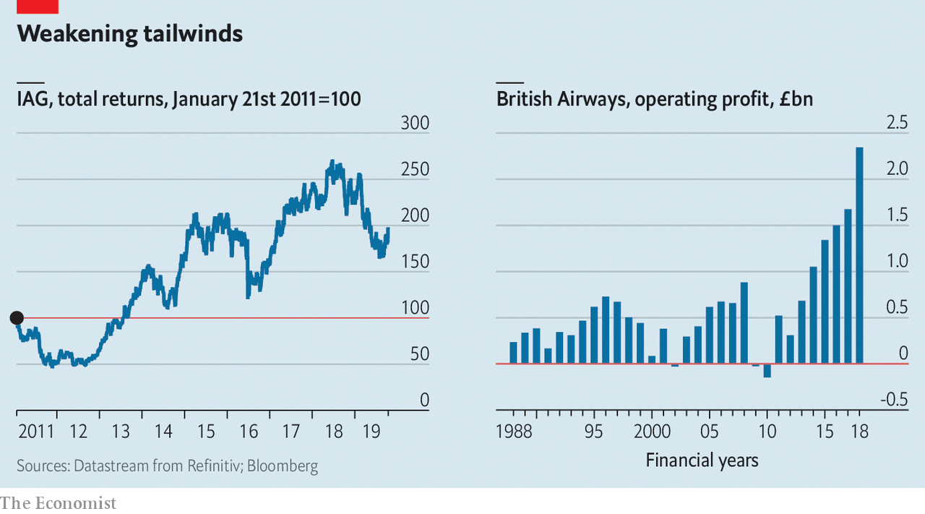
Conclusion
An absence of technologies does not work as a barrier to the airline.
The utilization of leaflets, magazines and fliers has aided the airline to achieve customers

Slide 12
References
Brandler, H., 2021. businesstraveller.com. [Online] ​
Available at: https://www.businesstraveller.com/business-travel/2021/05/12/british-airways-trials-digital-queuing-technology/​
[Accessed 20 03 2022].​
Duignan., B., 2022. Britinnica. [Online] ​
Available at: https://www.britannica.com/topic/British-Airways-PLC​
[Accessed 20 03 2022].​
​
Djumalieva, J. and Sleeman, C., 2018. Which digital skills do you really need?. London. Recuperado de https://www. nesta. org. uk/report/which-digital-skills-do-you-really-need.
Gui, M. and Argentin, G., 2011. Digital skills of internet natives: Different forms of digital literacy in a random sample of northern Italian high school students. New media & society, 13(6), pp.963-980.
Jara, I., Claro, M., Hinostroza, J.E., San Martín, E., Rodríguez, P., Cabello, T., Ibieta, A. and Labbé, C., 2015. Understanding factors related to Chilean students' digital skills: A mixed methods analysis. Computers & Education, 88, pp.387-398.
Van Laar, E., Van Deursen, A.J., Van Dijk, J.A. and De Haan, J., 2017. The relation between 21st-century skills and digital skills: A systematic literature review. Computers in human behavior, 72, pp.577-588.

