Slide 1
Group Presentation- Case Study: Greenfield Home Care Agency
Student Name: Nisreen Mubarik
Student Number: 2506382
Shabana Malik 2525274
Bibi Tabasam 2519902
Module Title: Digital Skills and Research Methods
Module Code: LCHS4007
Lecturer’s Name: Markus Klingelfuss

Slide 2
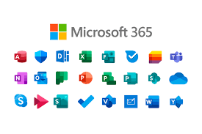
Introduction
Overview of Greenfield Home Care Agency
Recent adoption of Microsoft 365
Focus on improving:
Efficiency
Data safety
Staff collaboration
Presentation covers three areas:
Productivity applications
Communication and collaboration tools
Digital safety practices

Slide 3
Excel
Excel can be used as it is cost effective, flexible and its familiar with many staff members. (Mc Cormick B Mc Cance (T.) , 2017
How excel supports or can be used for person centred care.(health foundation,2016)
Spreadsheets for eg: Meal choices, Halal vegetarian etc.
Communication needs: eg hearing, vision, language preference.
Likes and dislikes
Mobility levels, assistance required.

Slide 4
Care Planning And Goal Tracking
Excel can be used
Note individual abilities and changes
Progress of individuals
This gives us the ability to help with continuity of changes.
Scheduling and continuity of care
Gives consistency to each client
Visiting times
Supports trust
Emotional well being (Kitwood,1997)

Slide 5
Scheduling & continuity of care
Excel has been previously used to improve services for rotas, shift schedules, overtime, availability, identifying problems.
Incident risk and tracking
falls, safe guarding
Support audits, training supervision to meet CQC requirements to help improve services.
Communication and sharing information for example updates, emergency contact details.
Advantages are easy use and understand, customised and supports data.

Slide 6

COMMUNICATION AT GREENFIELD
Case Study Context
Greenfield supports older adults living independently
Staff include:
  Care coordinators
  Visiting carers
  Nurses
  Administrative staff
Microsoft 365 has recently been introduced
Staff are still developing confidence using digital tools
(EF-group, 2025)
Notes:
Lesson descriptions should be brief.

Slide 7

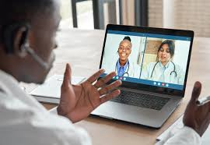
WHAT IS MICROSOFT TEAMS?
Microsoft Teams
A communication and collaboration tool within Microsoft 365 (Microsoft, 2025)
Used for:
  Messaging
  Online meetings
  Sharing information
Supports communication across different staff roles

Slide 8
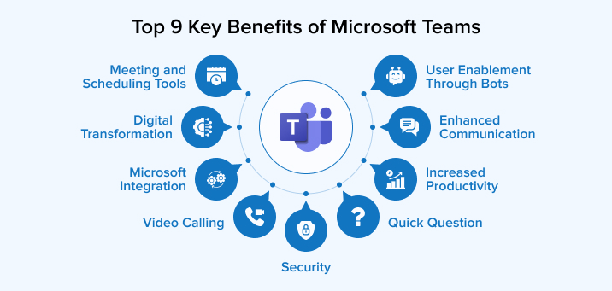
BENEFITS OF MICROSOFT TEAMS
Benefits
Improves communication between staff
Supports collaboration across the organisation
Helps staff stay connected in different locations
Supports the organisation’s use of Microsoft 365
(Sharma, 2021)
(Jeffery, Fellow and University College London Hospital, 2020)

Slide 9
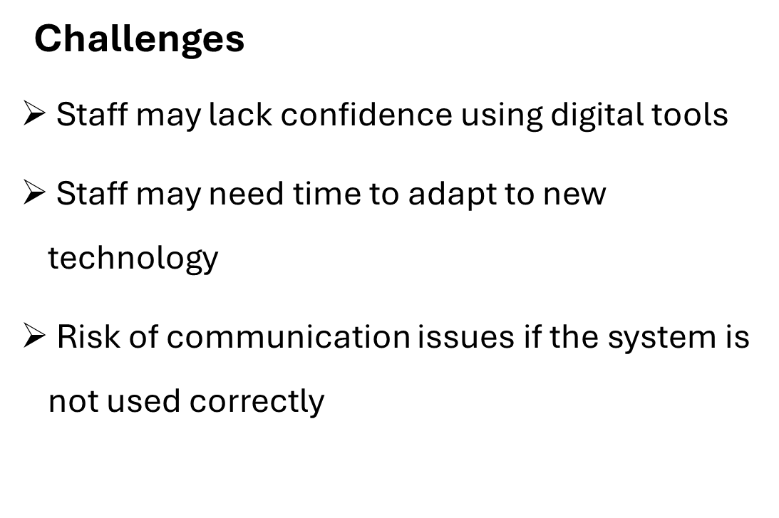
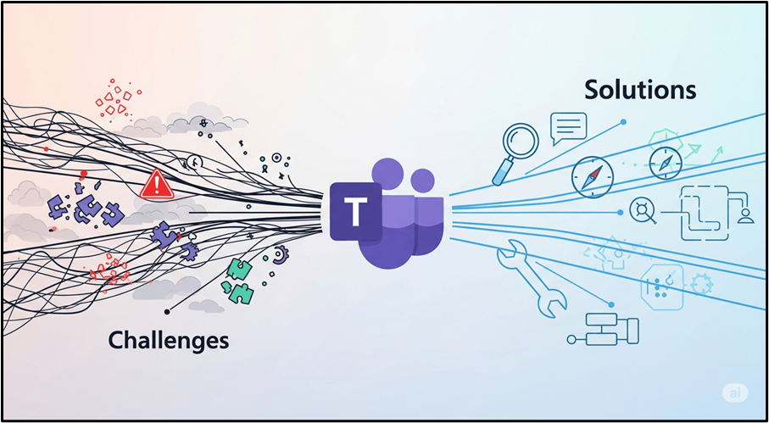
Changes of using of Microsoft team​

Slide 10
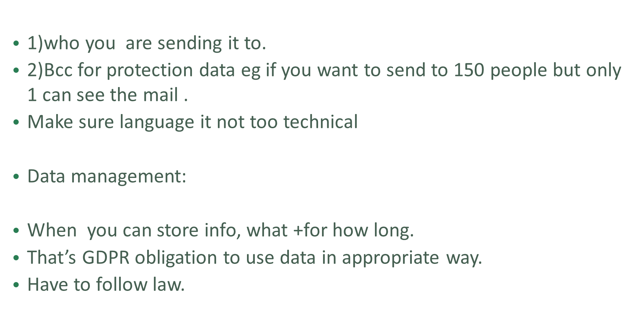

Email awareness

Slide 11

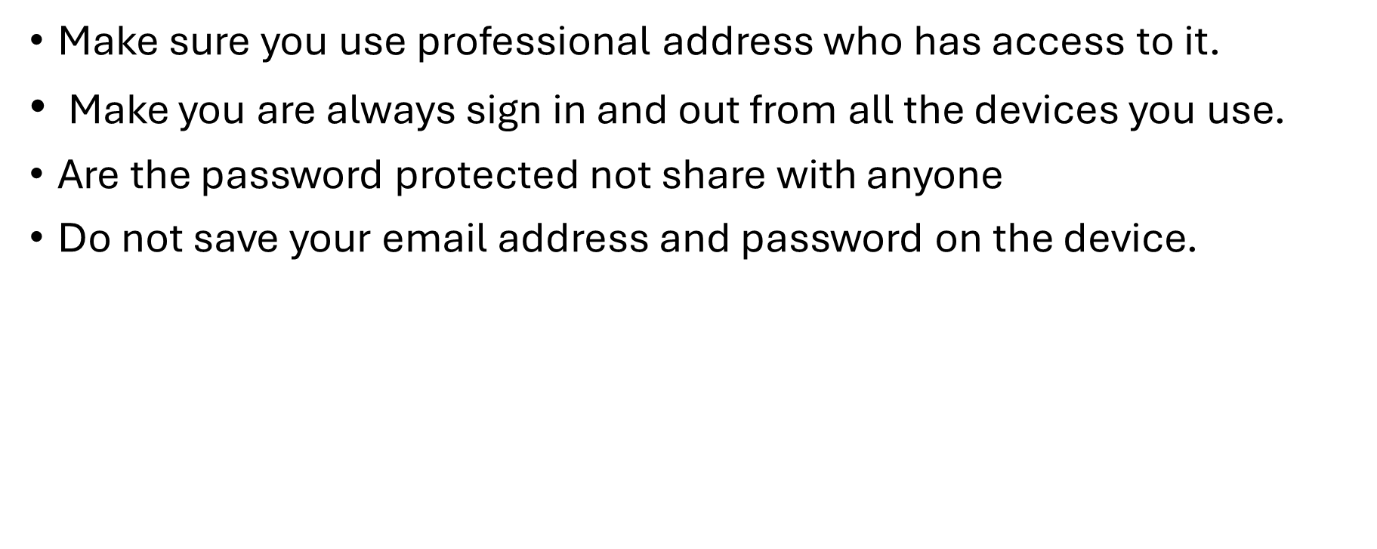
Digital plan for Greenfield homecare Agency

Slide 12
EVALUATION AND CONCLUSION
Microsoft Teams ,Data safety and Excell are a few of the tools from Microsoft 365 that can support the staff at the Greenfield Homecare Agence with communication and collaboration
Useful for staff working across different locations
Helps improve efficiency within the organisation
Supports Greenfield’s move towards digital working
Effectiveness depends on staff confidence and training

Slide 13
Reference list
Bowen, C. (2025) Microsoft Teams Migration Challenges and How to Overcome Them? Available at: https://vocal.media/01/microsoft-teams-migration-challenges-and-how-to-overcome-them (Accessed: 25 January 2026).
EF-group (2025) EF-group’s Post, Linkedin.com. Available at: https://www.linkedin.com/posts/ef-group-social_hc-one-launches-inaugural-chef-of-the-year-activity-7313824823288168448-wn7L (Accessed: 25 January 2026).
Jeffery, N., Fellow, U. and University College London Hospital (2020) Teams helping bridge the gap, NHS Digital. Available at: https://digital.nhs.uk/blog/transformation-blog/2020/teams-help-bridge-the-gap (Accessed: 25 January 2026).

Slide 14
Microsoft (2025) What is Microsoft Teams? - Microsoft Support, support.microsoft.com. Available at: https://support.microsoft.com/en-gb/topic/what-is-microsoft-teams-3de4d369-0167-8def-b93b-0eb5286d7a29 (Accessed: 25 January 2026).
Sharma, I. (2021) Benefits of Microsoft Teams for Businesses - TatvaSoft Blog, Software and Technology Blog - TatvaSoft. Available at: https://www.tatvasoft.com/outsourcing/2021/10/benefits-of-microsoft-teams-for-businesses.html (Accessed: 25 January 2026).
Health Foundation, (2016) Person- Centered care made simple what every person should know about person-centered care. The Health Foundation.
Kitwood, T., (1997) Dementia Reconsidered: The Person Comes First. Open University Press.
McCormack, B. & McCance, T., (2017) person centered practice in Nursing and Health Care: Theory and practice 2nd ed. Wiley Blackwell.
The national cyber security centre at
www.ncsc.gov.uk ND
https://www.enlaitenedtech.com.ng/2024/11/what-is-digital-safety-and-why-it-matters.html
https://stiganmedia.com/recent-email-scam-awareness/

Slide 15

Qu

