Slide 1
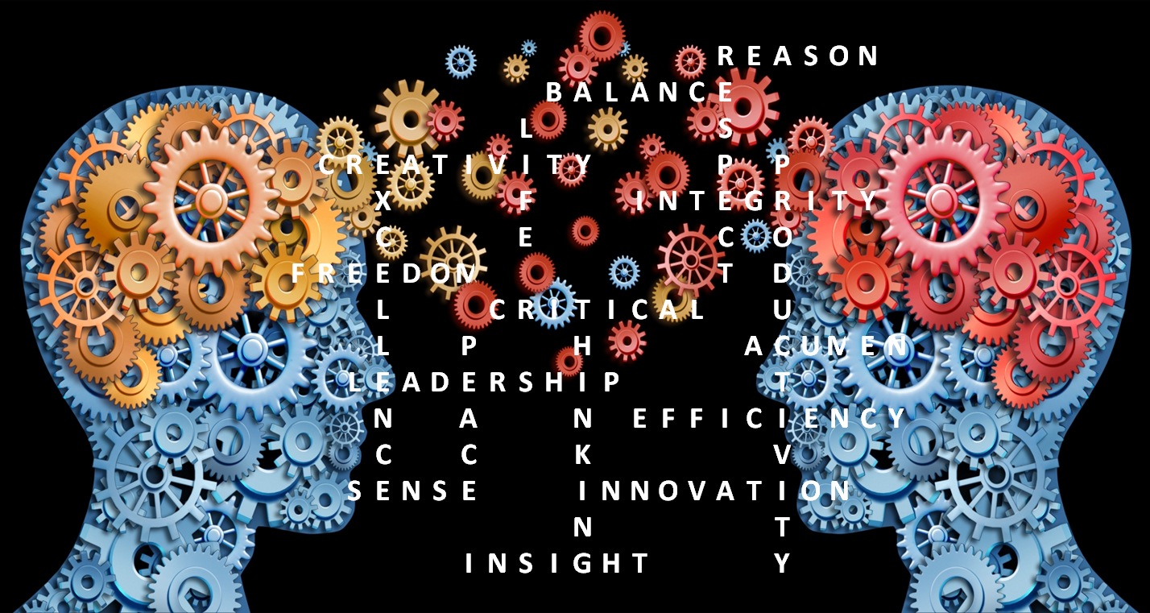
Gregorc (1985) suggested that 95% of individuals have specific learning style preferences.
Skills and Personal qualities that influence the development of critical thinking in Psychology.
There is an connection between student interest in subject and critical thinking skills. Student level of interest is linked positively to essential learning outcomes such as critical thinking (Carini et al., 2006).
Referencing shows that your work has a truthful base.
It allows the reader to find and get the sources for their own use.
Referencing shows the research you have carried out to reach your conclusions.
It shows that you’ve done your research and analysed the evidence and finding
have shown where you have got this information from.
Actively making students have a interest in a lesson by encouraging learning scenario where learners have to think and consider the information in that front of them rather and really getting all the facts rather than just dismissing it.
You need to read it and analyse what you are reading and understand it.
Making sure that you take notes in class and ask questions if you are not understanding a subject.
Critical thinking while studying psychology is important this means making logical judgments that are well-thought out. It requires wanting to see the evidence that is involved to support a specific argument and conclusion.
Critical thinking is when we use our cognitive skills or strategies that increase the probability of a desired outcome. Critical thinking is focused, rational, and goal-directed. this kind of thinking is involved in solving problems, formulating inferences, calculating likelihoods, and making decisions and showing the facts.
Everyone has a different learning style and a different way of studying and critical thinking in psychology can come in many forms.
(Whittington, (2000) reported that individual and group discussion's, written reports, presentations and lab tests showed higher cognitive levels which then led to better critical thinking skills in students.
( Bransford, Sherwood, and Sturdevant, (1987) said that the key to developing critical thinking skills in students is developing their ability to define problems precisely, and then diverting problems into manageable sections.
Research, reading, writing and personal skills help when it comes to critical thinking you are looking at all the pieces of information and putting them together to come up with a conclusion.
Reading books, articles and journal's expand your knowledge in the subject and also gives evidence that backs up your findings.
There are also personal skills that can help with your work and assessment's one of these is time management.
Being organized helps when looking through your research and putting your findings together making sure everything has its place and you have a place to work.
Making sure that you do your research on the subject through reading journal's, books and articles this can strengthen your argument allowing you or verify your finding and show the reader that you have verified your findings too.
Students who take part in combined learning perform better on the critical- thinking tests than students who study individually (Gokhale, 1995).
Vygotsky (1978) suggested that students are capable of performing at higher intellectual levels when they are asked to work in group situations than when asked to work individually.
When working in groups you can learn a diversity of knowledge and experiences from others (Gokhale, (1995).

Slide 2
1. Facione, P.A , Facione, N.C and Giancarlo, C.A.F., (1997)., Professional judgment and the disposition toward critical thinking.
2. Holmes, N. G, Wieman, C. E and Bonn, D. A., (2015)., PSY710: teaching critical thinking.
3.Myers, B.E, Dyer, J. E., (2006)., The influence of student learning style on critical thinking skill., university of florida.
4. Stanovich, K.E., (1986)., Matthew effects in reading: some consequences of individual differences in the acquisition of literacy., Oakland university.
5. Yanchar, S.C, Slife, B.D and Warne. R., (2008)., Critical thinking as disciplinary practice., Review of general psychology
Picture.
https://upload.wikimedia.org/wikipedia/commons/d/d8/Critical_Thinking_Skills_Diagram.jpg

