Slide 1


Politics and Policing
Name: Jonathan Griffiths
Student Number: 2110925
Submission date: July 7th 2023

Slide 2

Contents
1. Policing and Politics – An Introduction
2. Politics – It’s Impact upon Policing
3. Do politicians dictate Policing Priorities?
4. Partnerships
5. Police and Crime Commissioners – locally accountable?
6. Conclusion
7. References

Slide 3

Politics and Policing – An Introduction

Slide 4
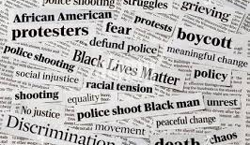
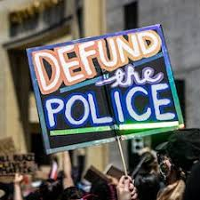
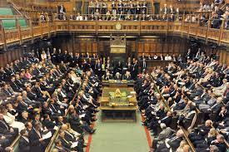
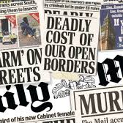
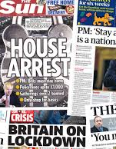

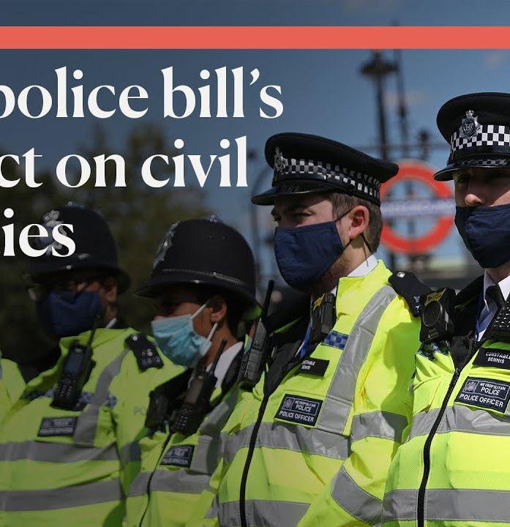

Politics – it’s impact upon Policing
Bradford (2014)
Ellison et al. (2018)
Loader and Mulcahy (2003)
Reiner (2010)

Slide 5
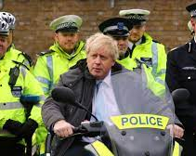
Do Politicians Dictate Policing Priorities?
The 20,000 – Police Uplift
Casey (2023)
Police Federation (2023)
Sindall and Sturgis (2013)
ITVX (2019)

Slide 6


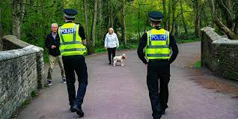

The impact of Political Decisions on Wider Partnerships
References
Norfolk Constabulary (2023)
Metropolitan Police (2023)
Policing Insight (2023)

Slide 7
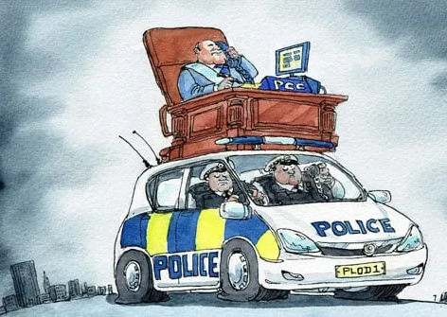
Police and Crime Commissioners – Locally accountable?
The Economist (2011)
Bowling et al (2019)
Electoral Commission (2023)

Slide 8

Conclusions
Multi-Faceted
Operational Independence
Legitimacy

Slide 9
References

Slide 10
Bowling et al. (2019) The Politics of the Police. Oxford: Oxford University Press
Bradford, B. (2014). Self-legitimacy, Police Culture and Support for Democratic Policing in an English Constabulary. British Journal of Criminology, 54: 1023-46
Casey (2023). An independent review into the standards of behaviour and internal culture of the Metropolitan Police Service. Available at: https://www.met.police.uk/SysSiteAssets/media/downloads/met/about-us/baroness-casey-review/update-march-2023/baroness-casey-review-march-2023a.pdf (Accessed July 1st 2023)
Crawford, A., et al. (2019). The politics of evidence-based policing: A review. Policing and Society, 29(3), 235-253.
Ellison, G., Evans, M., & Hopkins, M. (2018). Police and Crime Commissioners in England and Wales: changing the architecture of policing? Policing and Society, 28(3), 334-349.
France, A. (1894) The Red Lily. Paris: Calmann-Levy
Goldsmith, A. J. (2015). The politics of policing: Between force and legitimacy. Oxford: Routledge.
Gyford, J., & Loader, I. (2016). Partnerships and collaboration in public policy implementation. Policy Studies, 37(3), 295-310.
Home Office (2015). The Strategic Policing Requirement. Available at: https://www.sussex-pcc.gov.uk/media/1079/strategic-policing-requirement-march-2015.pdf (Accessed July 3rd 2023)
Home Office (2023) The Strategic Policing Requirement. Available at: https://assets.publishing.service.gov.uk/government/uploads/system/uploads/attachment_data/file/1165007/Strategic_Policing_Requirement_V1.3.pdf (Accessed July 3rd 2023)
ITVX (2019) Tory Leadership Contest: Boris Johnson promises 20,000 extra police officers if he becomes Prime Minister. Available at: https://www.itv.com/news/2019-07-04/boris-johnson-promises-20-000-extra-police-within-three-years-as-pm (Accessed July 2nd 2023)
Johnston, L., et al. (2009). Policing terrorism: An executive's guide. Oxford: Routledge.
Jones, T. (2006). The politics of crime control: Essays in honour of David Downes. Oxford: Oxford University Press.

Slide 11
Jones and Jones (2022) The Welsh Criminal Justice System: On the Jagged Edge. Cardiff: University of Wales Press
Leighton, P. (2016). The politics of policing: Between force and legitimacy. Oxford: Routledge.
Loader, I and Sparks, R. (2002) Contemporary landscapes of Crime, Order and Control: Governance, Risk and Globalization in Maguire et al (ed.), The Oxford Handbook of Criminology. Oxford: Oxford University Press
Loader, I. and Mulcahy, A. (2003). Policing and the condition of England. Oxford: Oxford University Press
Loader, I., & Walker, N. (2007). Civilizing security. Cambridge University Press.
Loveday, B. (2015). Partnership working in policing: A critical appraisal of the literature. Policing and Society, 25(1), 104-124.
Maitland, R. (1885). Justice and Police. London: Macmillan
McLaughlin, E., & Muncie, J. (2013). The Sage dictionary of criminology. Sage Publications.
Metropolitan Police (2023). Available at: https://www.met.police.uk/ (Accessed July 2nd 2023)
Morrell, K. and Bradford, B. (2018) Policing and Public Management: Governance, Vices, and Virtues. Oxford: Routledge
Namier, L. (1982). The Structure of Politics at the Accession of George III. 2nd ed., London. Macmillan.
Newburn, T. (2017). Handbook of policing. Oxford: Routledge
Norfolk Constabulary (2023). Children and Young People Strategy. Available at: https://www.norfolk.police.uk/advice/child-protection/children-and-young-people-strategy (Accessed July 3rd 2023)

Slide 12
Oborne, P. (2007) The Triumph of the Political Class. London. Simon and Schuster.
Police Federation (2023) Police Uplift Programme: A Flawed Success Story. Available at: https://www.polfed.org/news/latest-news/2023/police-uplift-programme-a-flawed-success-story/ (Accessed on July 2nd 2023).
Police Foundation (2022) Policing the Pandemic. Available at: https://www.police-foundation.org.uk/wp-content/uploads/2010/10/policing_the_pandemic_final.pdf (Accessed June 10th 2023)
Policing Insight (2023). Mental Health and Policing 2023: Right Care Right Person – a fundamental change. Available at: https://policinginsight.com/features/mental-health-and-policing-2023-right-care-right-person-a-fundemental-change/ (Accessed July 7th 2023)
Reiner, R. (2010). The politics of the police. Oxford: Oxford University Press.
Reiner, R and O’Connor, D. (2015) ‘Politics and Policing: The Terrible Twins’, in J. Fleming (ed.), Police Leadership. Oxford: Oxford University Press
Rowe, M. (2010). Policing beyond the police: Public security in uncontrolled spaces. New York: Springer.
Sindall, & Sturgis, P. (2013). Austerity policing: Is visibility more important than absolute numbers in determining public confidence in the police? European Journal of Criminology, 10(2), 137–153. https://doi.org/10.1177/1477370812461237
The Economist (2011) Quis Custodiet. Available at https://www.economist.com/britain/2011/06/16/quis-custodiet (Accessed July 2nd 2023).
The Electoral Commission (2023). Police and Crime Commissioner Elections. Available at: https://www.electoralcommission.org.uk/who-we-are-and-what-we-do/elections-and-referendums/past-elections-and-referendums/police-and-crime-commissioner-elections (Accessed July 6th 2023)

