Slide 1
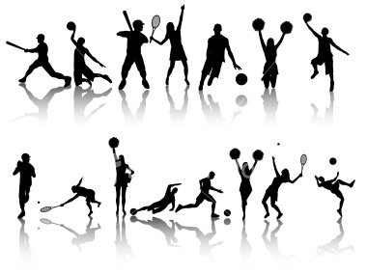

Community Sports Development
Mark
Napieralla

Slide 2
Task-
Find out information on the Swansea Sport and health team
What are their priorities / targets
What are they currently delivering
What project have they / are they involved with
What events are they supporting / creating

Slide 3
Community Sports Development
The aims of todays lecture:
To discuss sports development theory
Research the views / thoughts of young people in sport
To present the findings to the group

Slide 4
Community Sports Development
Definitions:
Sport- Has been defined as :
Competitive , rule governed games involving some degree of physical activity and exercise.
(Collins ,2009)
Development- Has been defined as :
Do develop something or someone suggests a transition of progressive stages where new and improved outcomes are both possible and desirable
(Collins,2009)

Slide 5
Community Sports Development
Definitions:
Physical Activity- :
Physical activity is defined as any bodily movement produced by skeletal muscles that requires energy expenditure
(World Health Organisation, 2020)

Slide 6

Community Sports Development
Definitions:

Slide 7
Community Sports Development
Brief History Wales and England:
1980 ‘s -1990- Very little investment in sport, small NGB’s
1990’s-2000- More investment- outreach projects, tops programmes, dragon sport, ssdo’s
2000-2010- More investment, lottery funding, 2008 England cuts funding, 5x60 in Wales
2012- Olympics- England cuts community sports partnerships
2012- 2020- New policies, reduction in funding, huge targets in Wales (aspirational)
2020-24- Further cuts / COVID / Cost of living
2022-24- Covid recovery funding

Slide 8
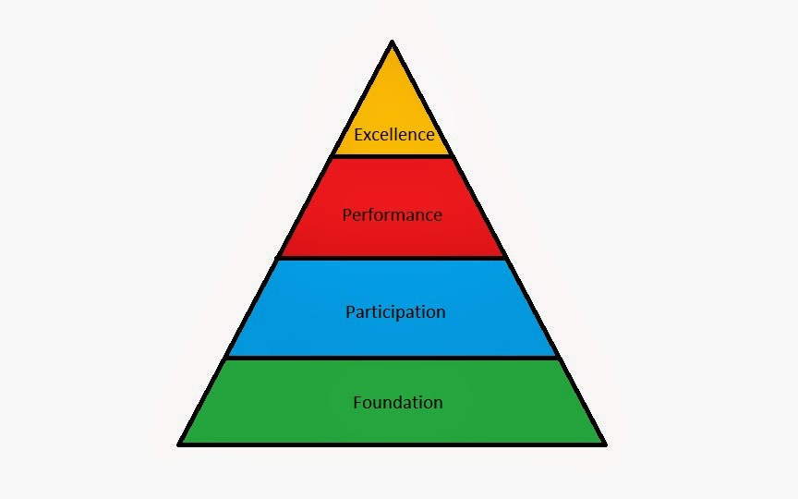
Community Sports Development
Sports development theory- : The sports development continuum

Slide 9
Community Sports Development
Sports development theory- : The sports development continuum
Foundation:
Early development of physical literacy.
What is physical literacy?
Amelia-Video
https://www.youtube.com/watch?v=R8PIXqp3JpA

Slide 10
Catching?
Adapted From Mike Jess, University of Edinburgh

Slide 11
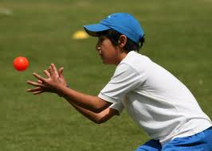
CAN’T CATCH?
Notes:
11

Slide 12
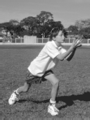
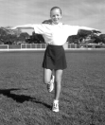
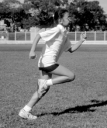

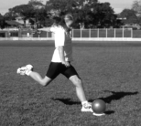
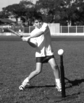
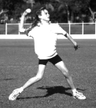
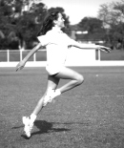
Adapted From Mike Jess, University of Edinburgh
Notes:
12

Slide 13
Community Sports Development
Sports development theory- : The sports development continuum
Participation- sport activity undertaken primarily for fun, enjoyment and often basic levels of competence, health and fitness
Performance- (Could include above) A move from basic competence into more structured form of competitive sport at club or county level, or indeed at an individual level for personal reasons.
Excellence- is about reaching the top and applies to performers at the highest national and international levels.

Slide 14
Community Sports Development
Sports development theory- : The sports development continuum
5 examples
Of each

Slide 15
Community Sports Development
Sports development theory- : The sports development continuum
What are the factors affecting the movement from:
Group 1- Participation Performance
Group 2- Performance Elite
Breakout room task- Discussion, presentation of findings back to the group.

Slide 16
Community Sports Development
Sports development theory- : The sports development continuum
What are the factors affecting the movement from:
1- Participation Performance
Opportunities, awareness, resources, facilities, family, friends, peer pressure, the coach, skills, confidence, ability, money, travel, time / other commitments, other sports, previous experience, passion, commitment, role models, sporting events and publicity.

Slide 17
Community Sports Development
Sports development theory- : The sports development continuum
What are the factors affecting the movement from:
1- Performance Elite / Excellence
Opportunities, resources, facilities, family, friends, peer pressure, the coach, skills, confidence, ability, money, travel, time / other commitments, previous experience, passion, commitment, role models, sporting events and publicity.
Luck, Governing Body, Funding (lottery), climate, injury, lifestyle, diet, psychology, Sports Science, rest, technology,

Slide 18
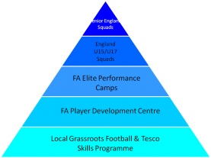
Community Sports Development
Football- modified continuum

Slide 19
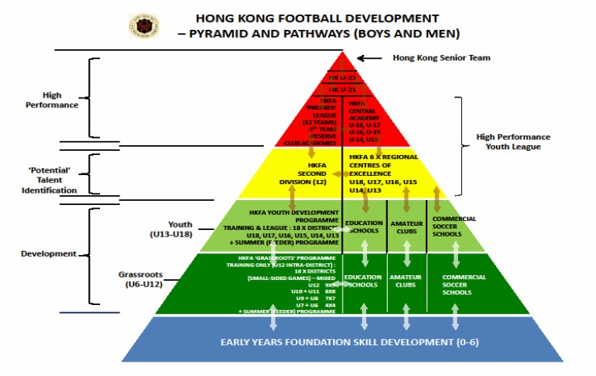

Slide 20
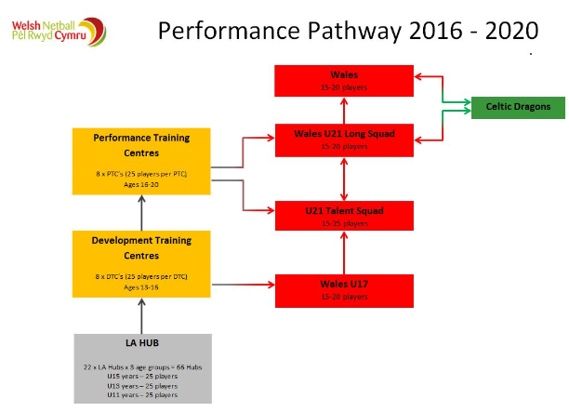

Slide 21
Community Sports Development
Sports development theory- : Where does it take place?
Where does sports
Development take
Place?
Why might it take
Place there?

Slide 22
Community Sports Development
Sports development in practice:
Planning to develop an activity for young people
Where do we start?
What have we done in this module? What has been achieved?

Slide 23
Community Sports Development
What has been achieved?:
https://www.youtube.com/watch?v=Eeg9cCyuL_w

Slide 24
What has been achieved?:

Slide 25
Community Sports Development
What has been achieved?:

Slide 26
Community Sports Development
Where to start? Sports Wales Sports Survey :
Sport survey video
https://www.youtube.com/watch?v=7BRHKYFXzZM
Background- 2011 first survey – not very positive
2013- 110,000 responses biggest children survey in Europe
2015-116,00 responses setting new records and showing an improvement in participation
2018- over 120,000 responses with over 1000 schools supporting it. Biggest children's survey in Wales and possibly the world.
2022- 116,000 from 1000 schools
Notes:
https://www.youtube.com/watch?v=7BRHKYFXzZM

Slide 27
Community Sports Development
Sports development in practice:
Sport Survey Task- interpreting data
Your task- in 2 groups- use the sport survey to find out information about what sports children want to take part in, why they want to take part and some of the key points of information you could use when planning a sports session / project for sports development. Split the team to look at different pages to split the report.
Group 1 – Penllergaer 2018
Group 2- Ysgol Bae Baglan 2018
Presentation back to group

