Slide 1
Analyzing, Ethically Hacking and Securing the SWANSEA.ACCA Network
Uri Neto | Student Number: 2327255
BSc Applied Computing | Advanced Cybersecurity (ACCB6000)
Presentation
1

Slide 2
Presentation structure
The presentation follows the assessment brief structure:
Slide 1 covers Kali setup and connectivity validation.
Slide 2 covers information gathering and vulnerability assessment.
Slide 3 summarizes the prioritized findings.
Slide 4 presents exploitation and post-exploitation evidence.
Slide 5 gives the mitigation plan [1].
• Manual discovery and service enumeration were performed with Nmap [4], automated vulnerability assessment with Nessus [5], FTP exploitation was discussed against established security considerations [6], and the mitigation strategy draws on NIST guidance for testing, firewalls, server hardening, TLS, and monitoring [1]–[3], [7], [8].
2

Slide 3
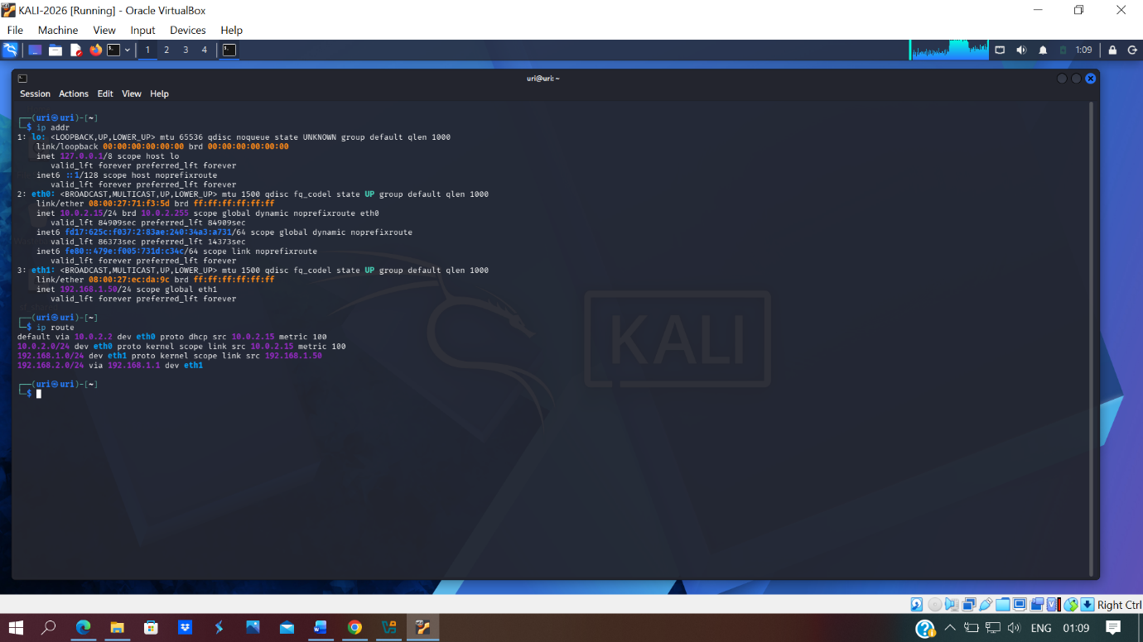
Slide 1 – Kali Linux IP configuration
• The Kali assessment host was configured on the Swansea subnet as 192.168.1.50/24 on eth1, giving the tester authorised internal visibility of the target estate.
• The route configuration also showed reachability toward the London subnet via 192.168.1.1, which established the platform required for later scanning and validation activities in line with structured testing practice [1].
The Kali assessment host was configured on the Swansea subnet as 192.168.1.50/24 on eth1.
The route table confirms reachability to the London subnet via 192.168.1.1.
3

Slide 4
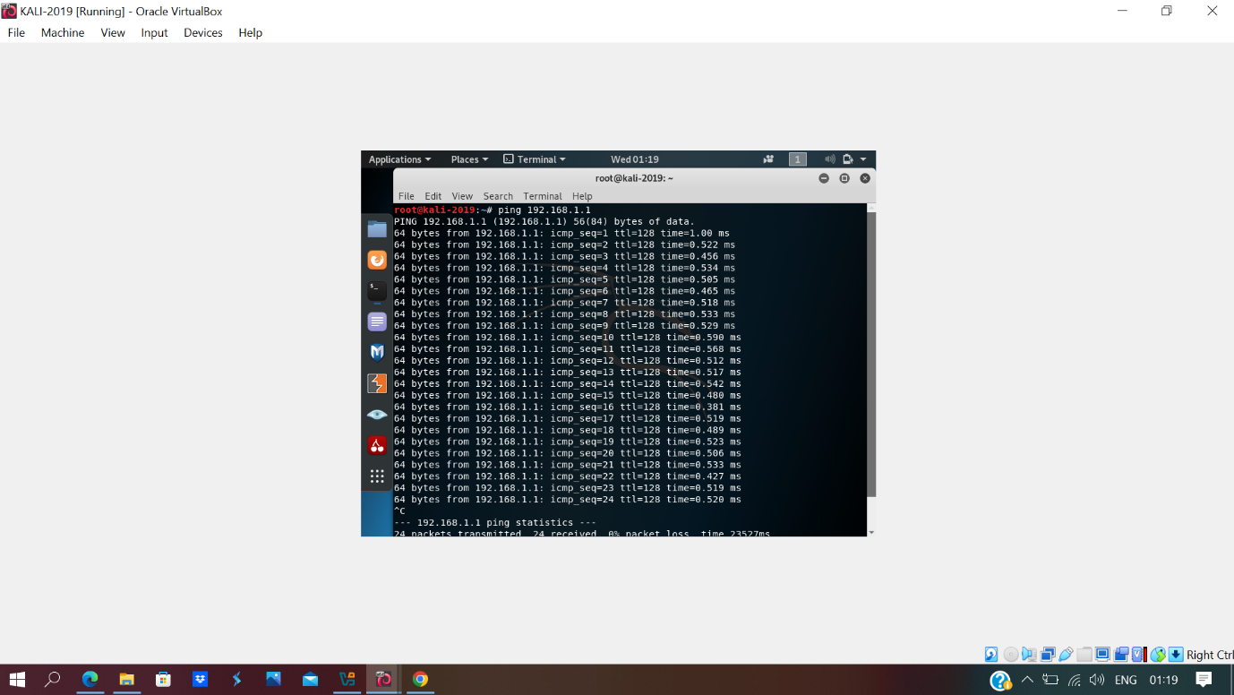
Slide 1 – Connectivity to S-DC
• ICMP replies from 192.168.1.1 confirmed successful connectivity to the Swansea domain controller before enumeration began.
• Validating access to core infrastructure first reduced the risk of misleading scan results and followed a controlled testing workflow [1].
Ping responses from 192.168.1.1 confirm successful connectivity to the Swansea domain controller.
This validated local access before scanning and vulnerability assessment.
4

Slide 5

Slide 1 – Connectivity to ClientS1
• The Windows client at 192.168.1.10 responded successfully to ICMP echo requests from the Kali host.
• This confirmed that endpoint devices in the Swansea subnet were reachable and ready for authorised assessment activity [1].
The Windows client at 192.168.1.10 responded successfully to ICMP echo requests.
This confirmed that the assessment host could reach endpoint devices in Swansea.
5

Slide 6

Slide 1 – Connectivity to L-CD
• Successful replies from 192.168.2.1 showed that the site-to-site path to the London server was operational during testing.
• Cross-site reachability was important because the assessment scope covered hosts in both network locations [1].
Successful replies from 192.168.2.1 show that the site-to-site path to London was working.
This was essential because the assessment scope covered both network locations.
6

Slide 7
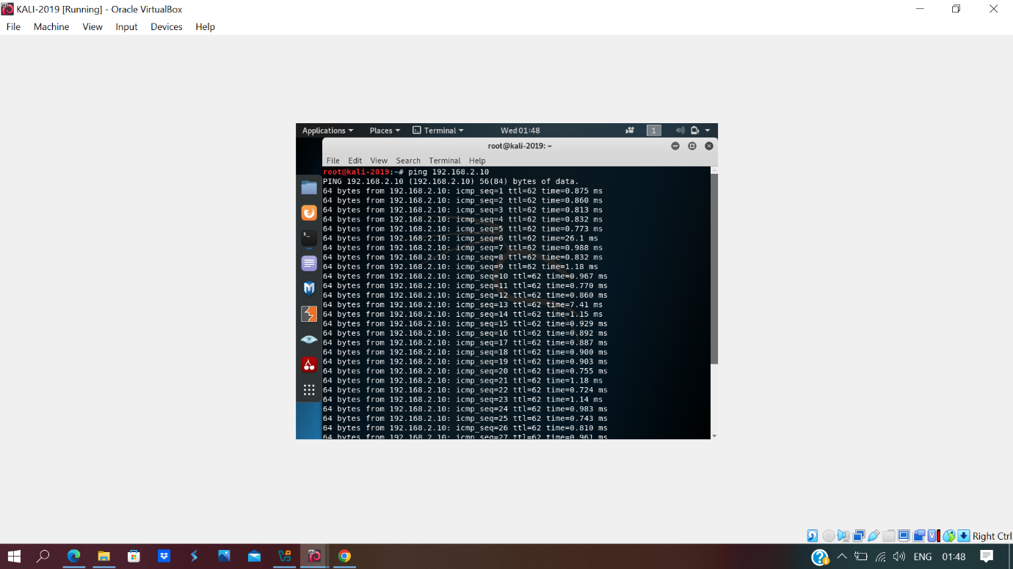
Slide 1 – Connectivity to ClientL1
• The Debian client at 192.168.2.10 was reachable from the Kali host across the inter-site link.
• This completed the connectivity checks needed before host discovery and service enumeration were performed [1].
The Debian client at 192.168.2.10 was reachable from the Kali host.
This completed end-to-end validation of the authorised internal testing platform.
7

Slide 8
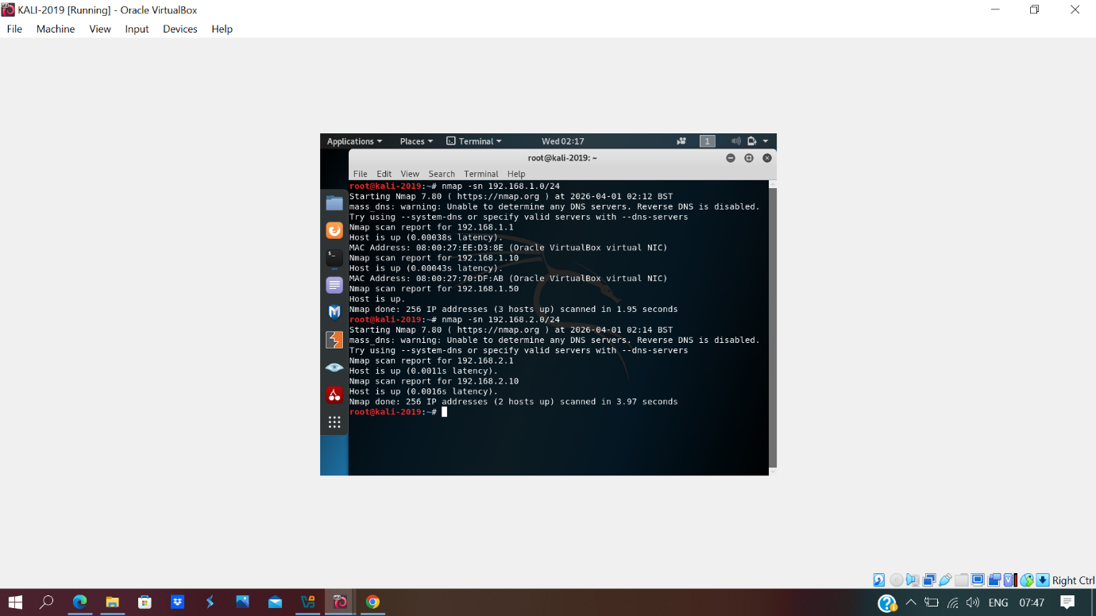
Slide 2 – Live host discovery
• Nmap host discovery identified active systems on both 192.168.1.0/24 and 192.168.2.0/24, confirming visibility of S-DC, ClientS1, Kali, L-CD, and ClientL1 [4].
• These results established the live asset set that was carried forward into service enumeration and vulnerability analysis [1], [4].
Nmap host discovery identified active systems on both 192.168.1.0/24 and 192.168.2.0/24.
The scan confirmed visibility of S-DC, ClientS1, Kali, L-CD, and ClientL1.
8

Slide 9
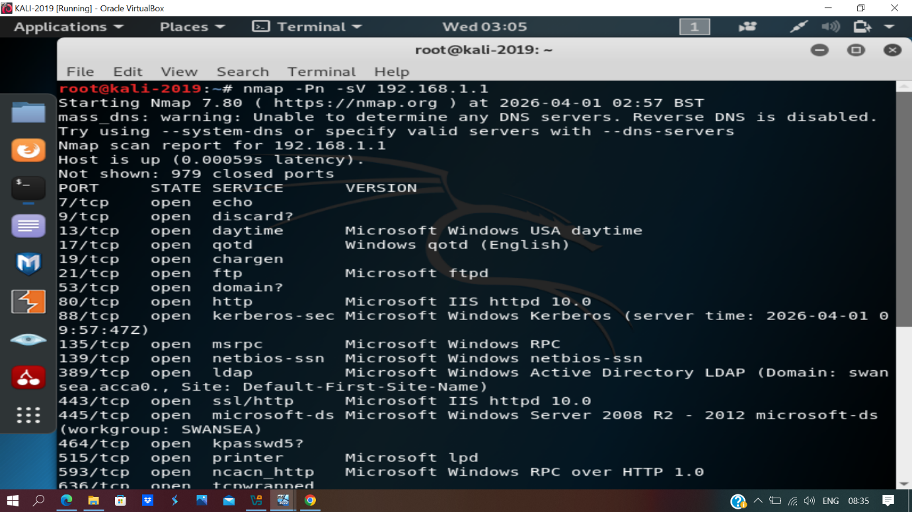
Slide 2 – S-DC service enumeration
• The S-DC scan revealed FTP, DNS, HTTP, Kerberos, LDAP, SMB, and RPC-related services, demonstrating that the server provided multiple critical enterprise functions [4].
• Because domain, file-transfer, and web-related services were exposed together, S-DC represented the highest-risk host for follow-up assessment [3], [4].
The S-DC scan revealed FTP, DNS, HTTP, Kerberos, LDAP, SMB, and RPC-related services.
This broad service exposure indicated that S-DC was both critical and high-risk.
10

Slide 10
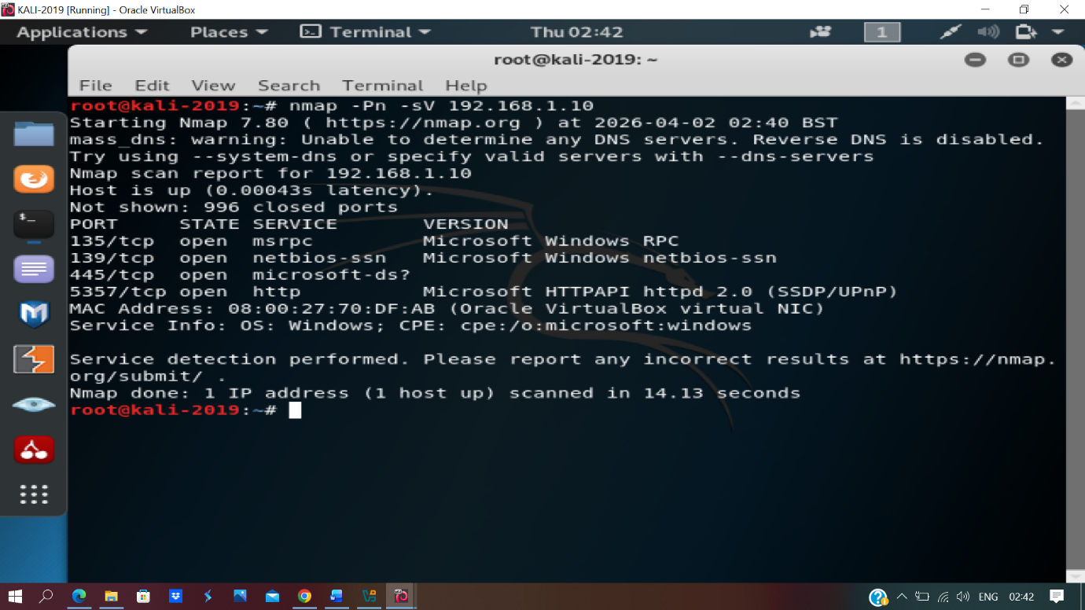
Slide 2 – ClientS1 service enumeration
• ClientS1 exposed SMB, RPC, and HTTPAPI-related ports including 135, 139, 445, and 5357, which is consistent with a Windows client role on the domain [4].
• These findings were later reinforced by Nessus, particularly around SMB-related configuration weaknesses that affect client-side hardening priorities [4], [5].
ClientS1 exposed SMB, RPC, and HTTPAPI-related ports including 135, 139, 445, and 5357.
These findings supported later review of SMB signing and client-side hardening.
12

Slide 11
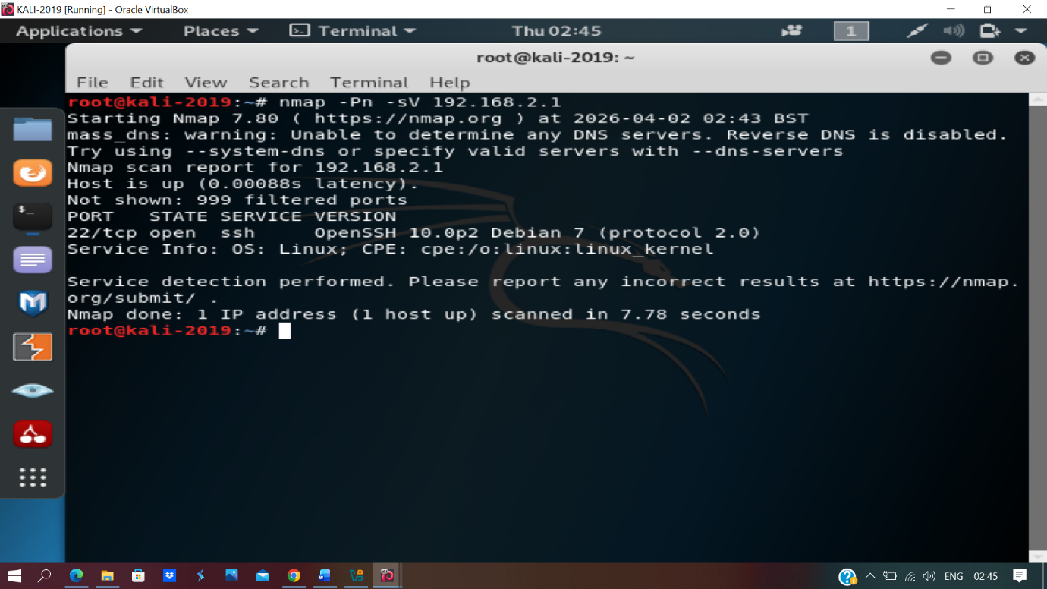
Slide 2 – L-CD service enumeration
• L-CD exposed SSH on port 22/tcp and returned a Linux fingerprint during enumeration, indicating a comparatively narrower attack surface than S-DC [4].
• Even so, remote administration services still require hardening, patching, and access control to limit misuse [3], [4].
L-CD exposed SSH on port 22/tcp and returned a Linux fingerprint.
Compared with S-DC, its attack surface was more limited.
11

Slide 12
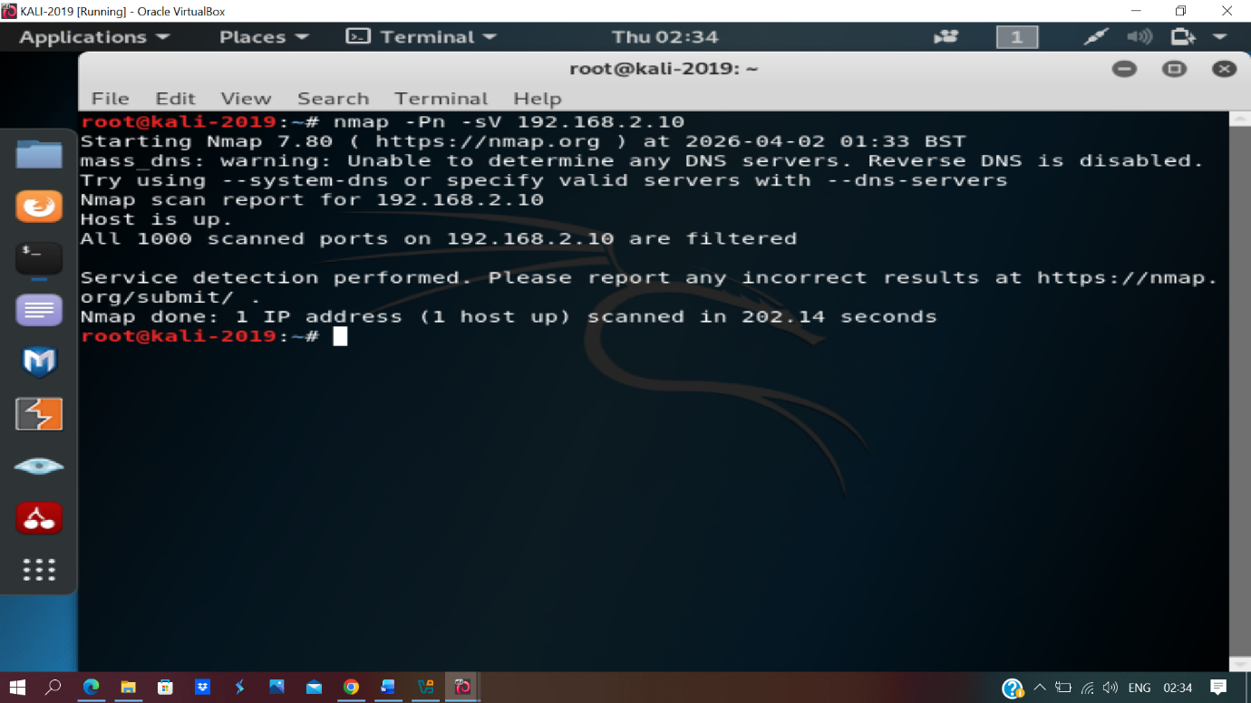
Slide 2 – ClientL1 service enumeration
• The ClientL1 scan showed all 1000 tested ports filtered with no clearly exposed services, indicating a smaller externally visible attack surface on the Debian client [4].
• Although this reduced direct exposure, the host still remained within assessment scope and required routine maintenance and monitoring [3], [4].
The ClientL1 scan showed all 1000 tested ports filtered with no clearly exposed services.
This indicated a smaller externally visible attack surface on the Debian client.
13

Slide 13
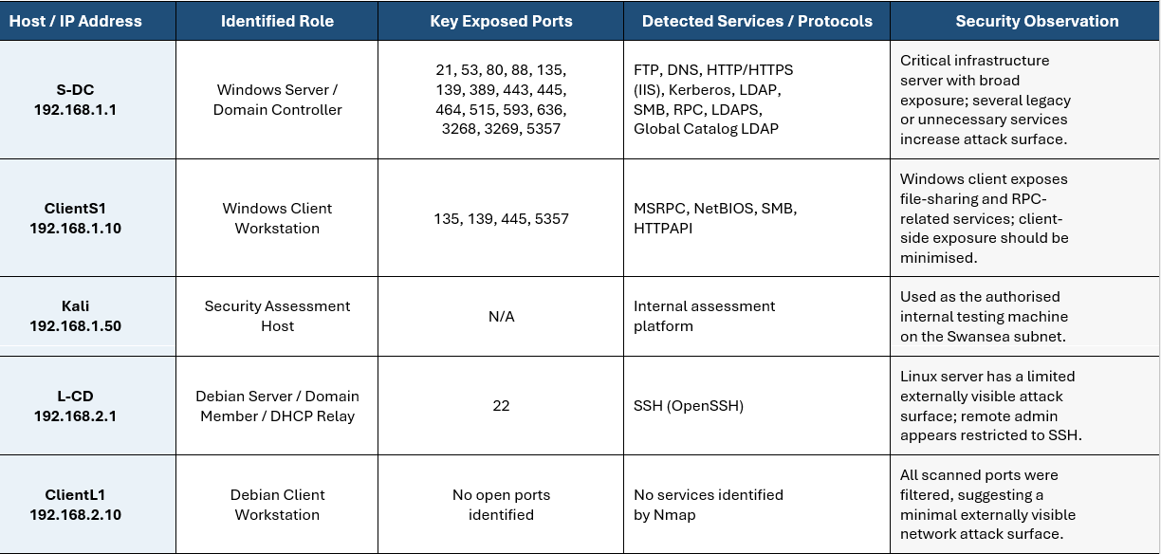
Slide 2 – Information gathering summary
• The information-gathering summary maps each host to its role, key ports, and detected protocols using the combined results of Nmap enumeration and Nessus review [4], [5].
• S-DC had the broadest attack surface, L-CD mainly exposed SSH, ClientS1 exposed Windows-related services, and ClientL1 showed a much smaller externally visible footprint [4], [5].
The summary table maps each host to its role, key ports, and detected protocols.
S-DC had the broadest attack surface, while L-CD mainly exposed SSH and ClientL1 showed no open ports.
9

Slide 14
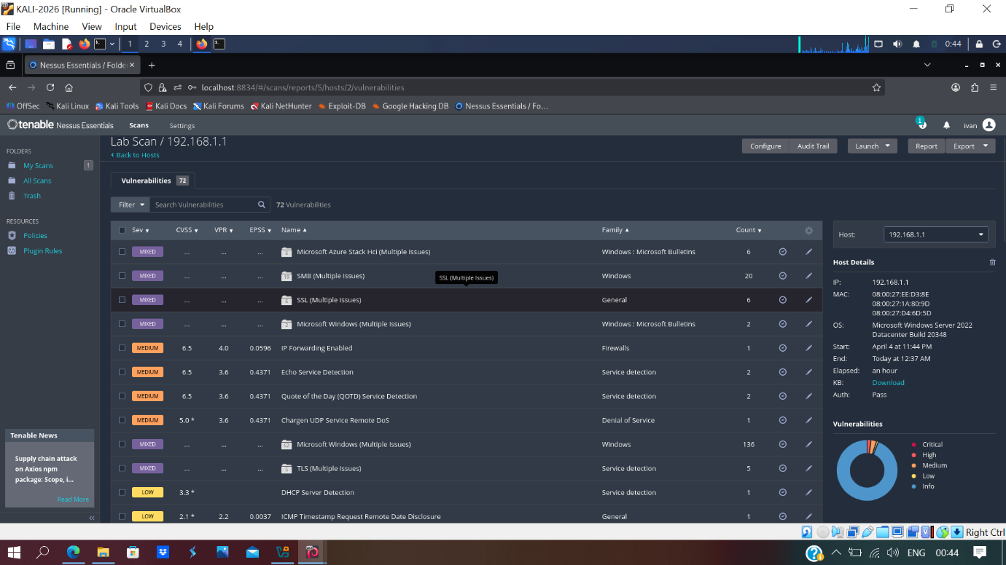
Slide 2 – Nessus scan results for S-DC
• Nessus confirmed that S-DC had the broadest and riskiest attack surface in the environment, with grouped Windows, SMB, SSL, and TLS issues plus several service-detection findings [5].
• The highest-priority medium findings included IP forwarding enabled, Echo Service Detection, QOTD Service Detection, and Chargen UDP exposure, all of which informed the later mitigation plan [5].
14

Slide 15
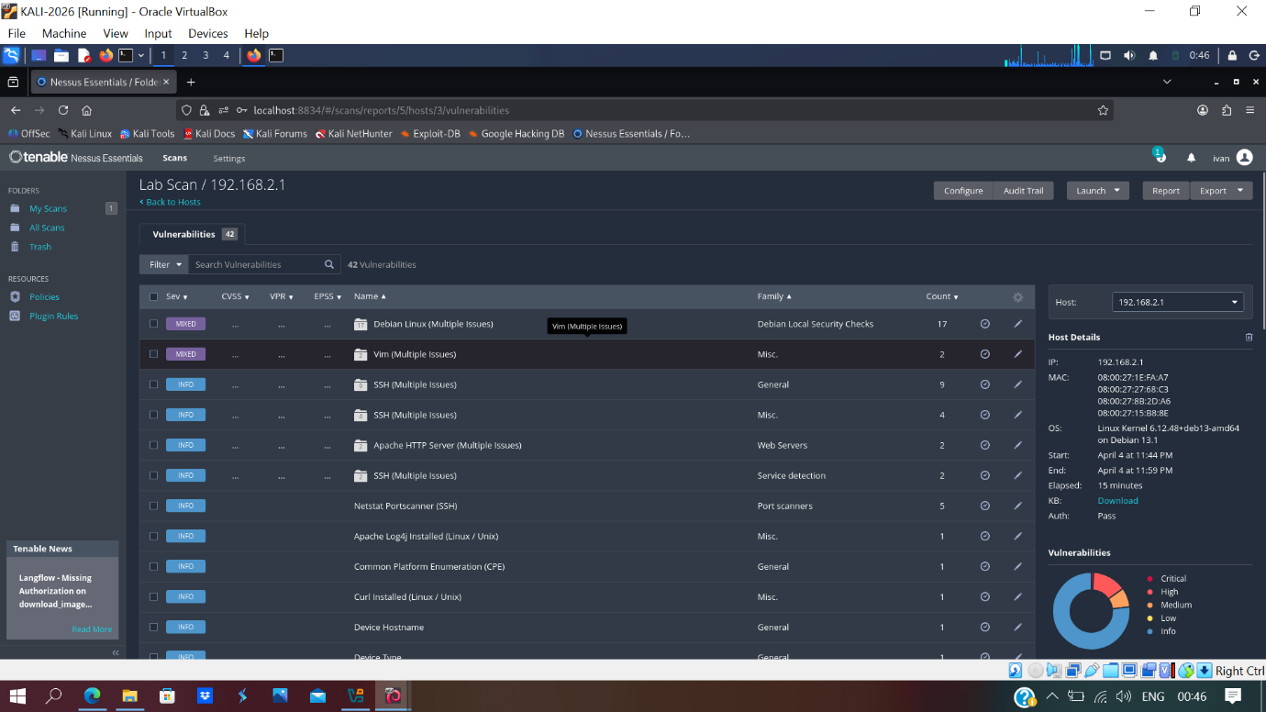
Slide 2 – Nessus scan results for ClientS1
• On ClientS1, Nessus highlighted SMB Signing not required as a medium-severity weakness and ICMP Timestamp Request Remote Date Disclosure as a low-severity issue [5].
• These findings matter because they can support relay abuse, reconnaissance, and later client-side hardening decisions in enterprise networks [3], [5].
16

Slide 16
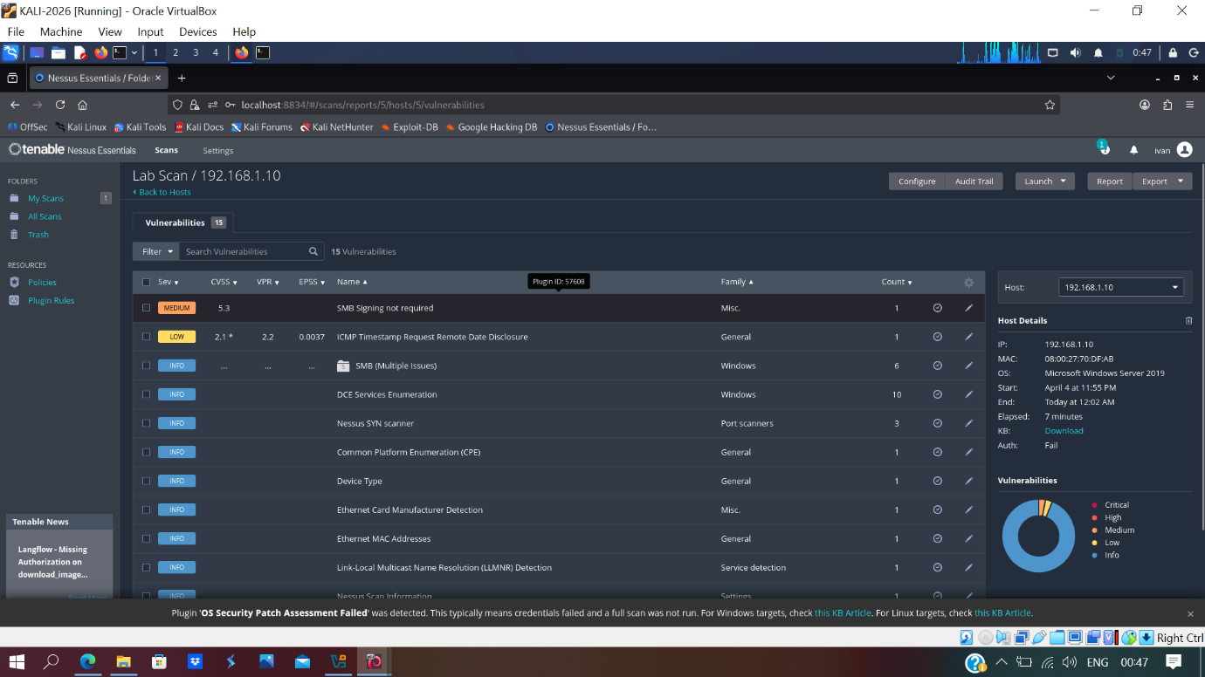
Slide 2 – Nessus scan results for L-CD
• The Nessus results for L-CD showed a narrower attack surface than S-DC, which was consistent with its more limited Linux-based role in the London segment [5].
• Even with fewer findings, the host still required secure configuration review, patch management, and firewall control because it contributes to inter-site functionality [2], [3], [5].
15

Slide 17
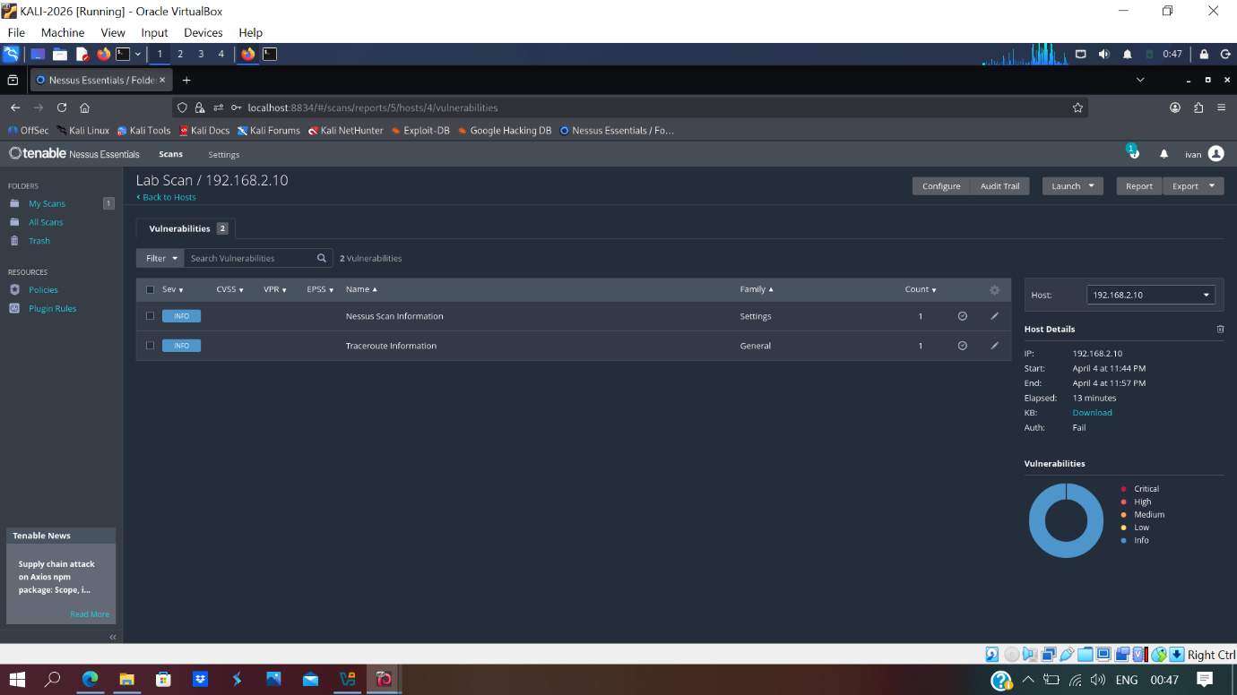
Slide 2 – Nessus scan results for ClientL1
• The Nessus scan for ClientL1 indicated a relatively low externally visible attack surface compared with the Windows systems, but it still formed part of the assessed estate [5].
• Including this scan demonstrates full Nessus coverage of the four hosts assessed across the Swansea and London sites [5].
17

Slide 18
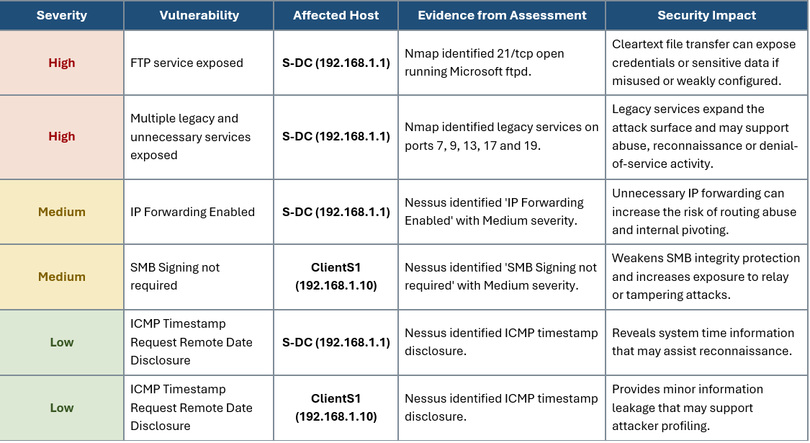
Slide 3 – Prioritised vulnerabilities
• The final six findings were prioritised as two High, two Medium, and two Low severity issues, matching the assessment requirement.
• High risks centred on FTP exposure and legacy-service findings, Medium risks included IP forwarding and SMB signing weaknesses, and Low risks included timestamp disclosure and lower-impact information exposure [5], [6].
The final six findings were prioritised as 2 High, 2 Medium, and 2 Low severity issues.
High risks centred on FTP exposure and legacy services; Medium risks included IP forwarding and SMB signing; Low risks were timestamp disclosures.
18

Slide 19
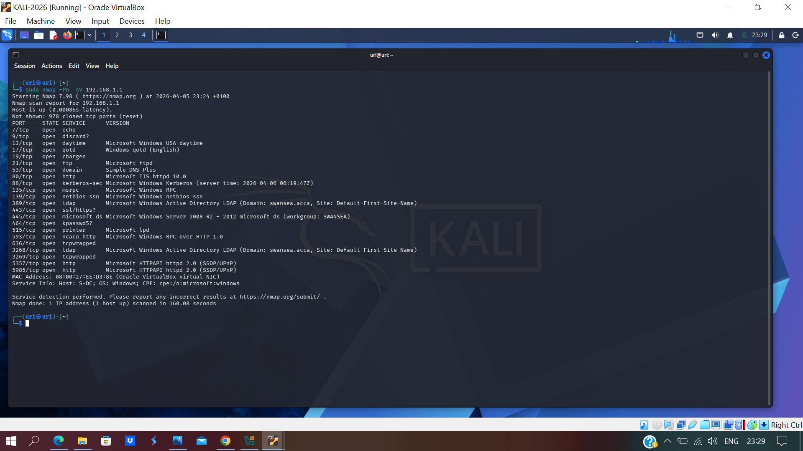
Slide 4 – Nmap evidence of FTP exposure
• Port 21/tcp on S-DC was confirmed open and running Microsoft ftpd during Nmap enumeration, making it a suitable exploitation target [4].
• FTP is a legacy protocol with well-known security weaknesses, especially when authentication and data transfer are not adequately protected [6].
Port 21/tcp on S-DC was confirmed open and running Microsoft ftpd.
This was selected as the exploitation target because anonymous FTP can expose sensitive files.
19

Slide 20
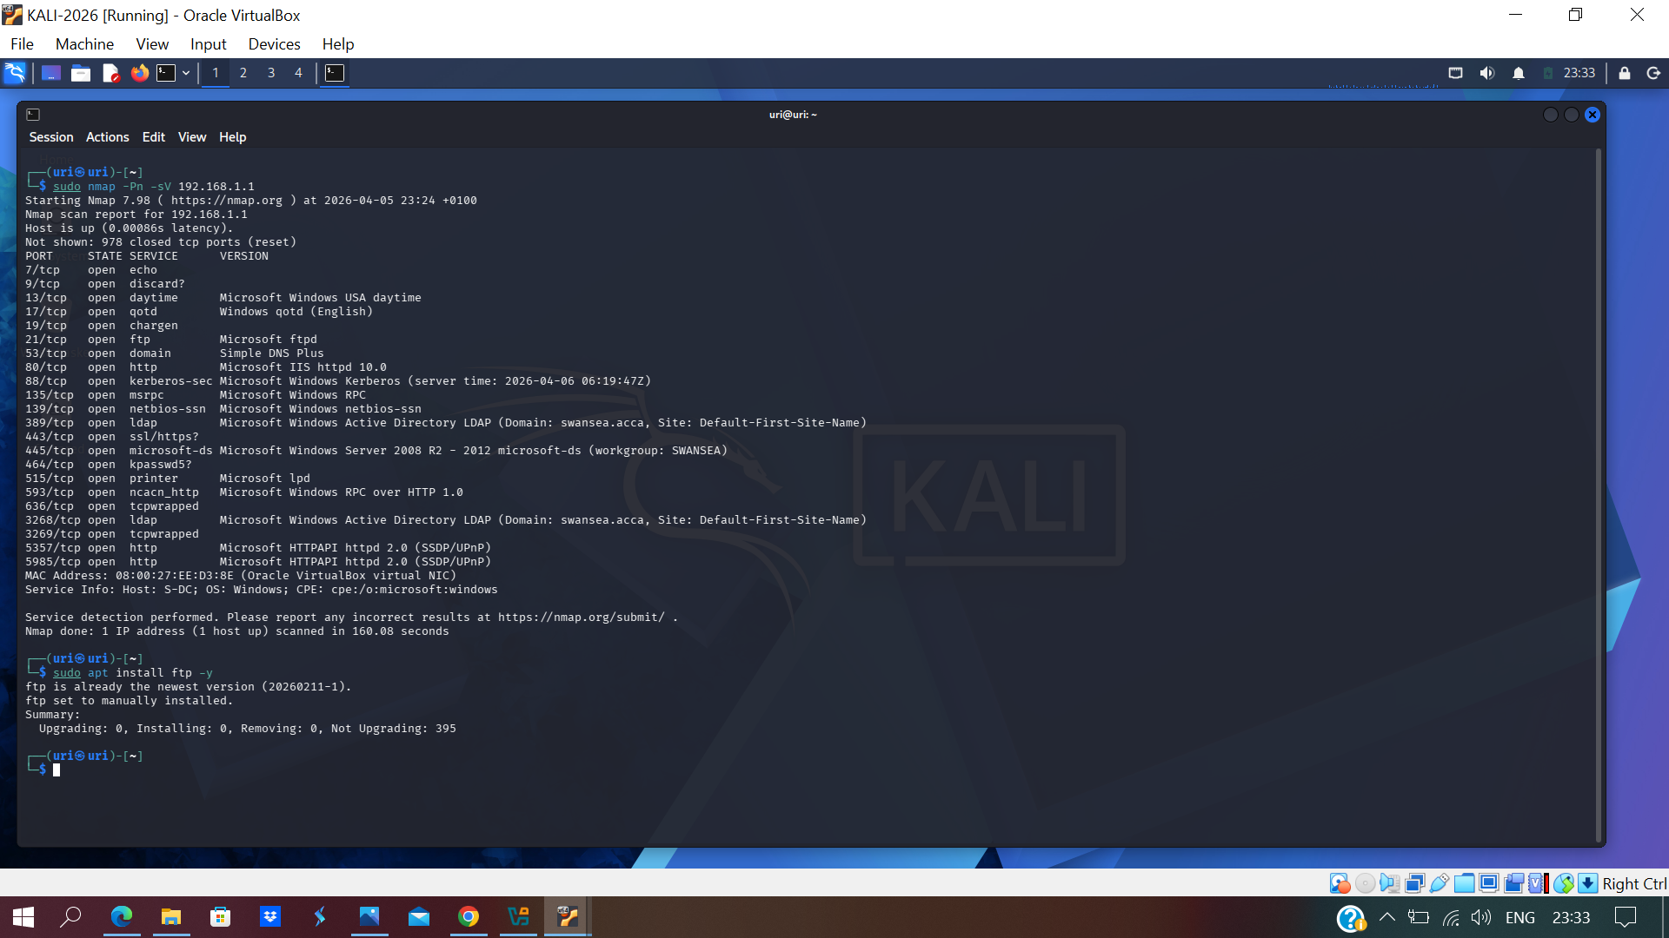
Slide 4 – FTP client preparation
• The Kali host was prepared with the FTP client required to interact with the exposed service from the authorised internal assessment machine.
• This step supported a controlled exploitation workflow based on the identified FTP weakness and its security implications [1], [6].
The Kali host was prepared with the FTP client needed to interact with the exposed service.
This ensured the exploitation step could be executed from the authorised internal assessment machine.
20

Slide 21
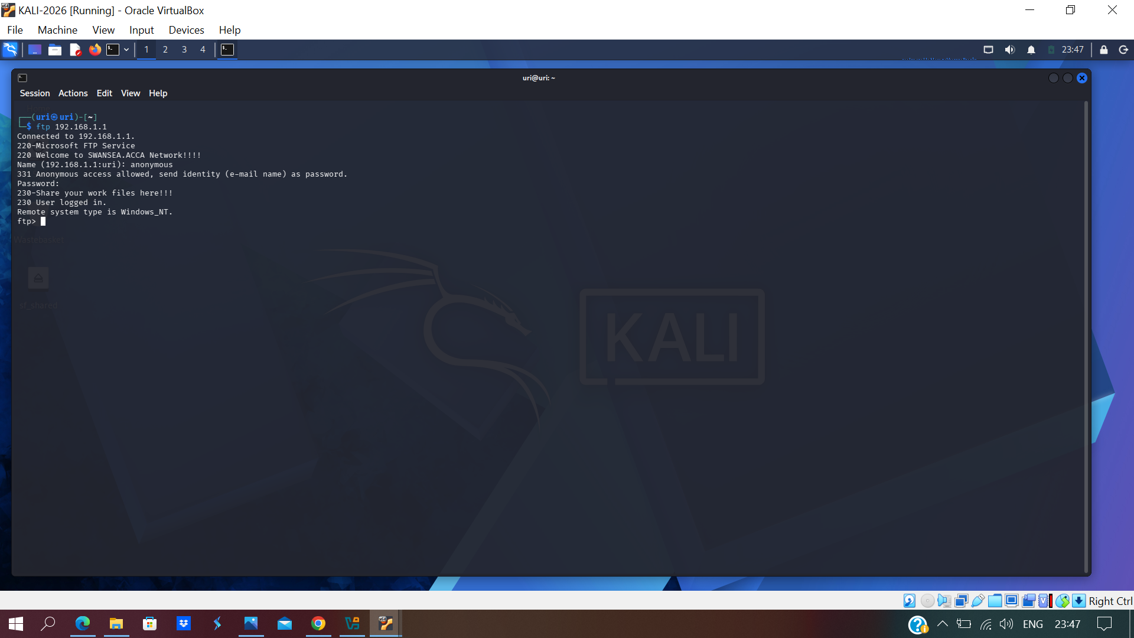
Slide 4 – Anonymous FTP connection established
• The FTP service accepted an anonymous login to 192.168.1.1 without valid administrative credentials.
• This demonstrated a clear access-control failure on a critical server and aligned with established FTP security concerns around unauthorised access [6].
The FTP service accepted an anonymous login to 192.168.1.1 without valid administrative credentials.
This demonstrates a clear access-control weakness on a critical server.
21

Slide 22
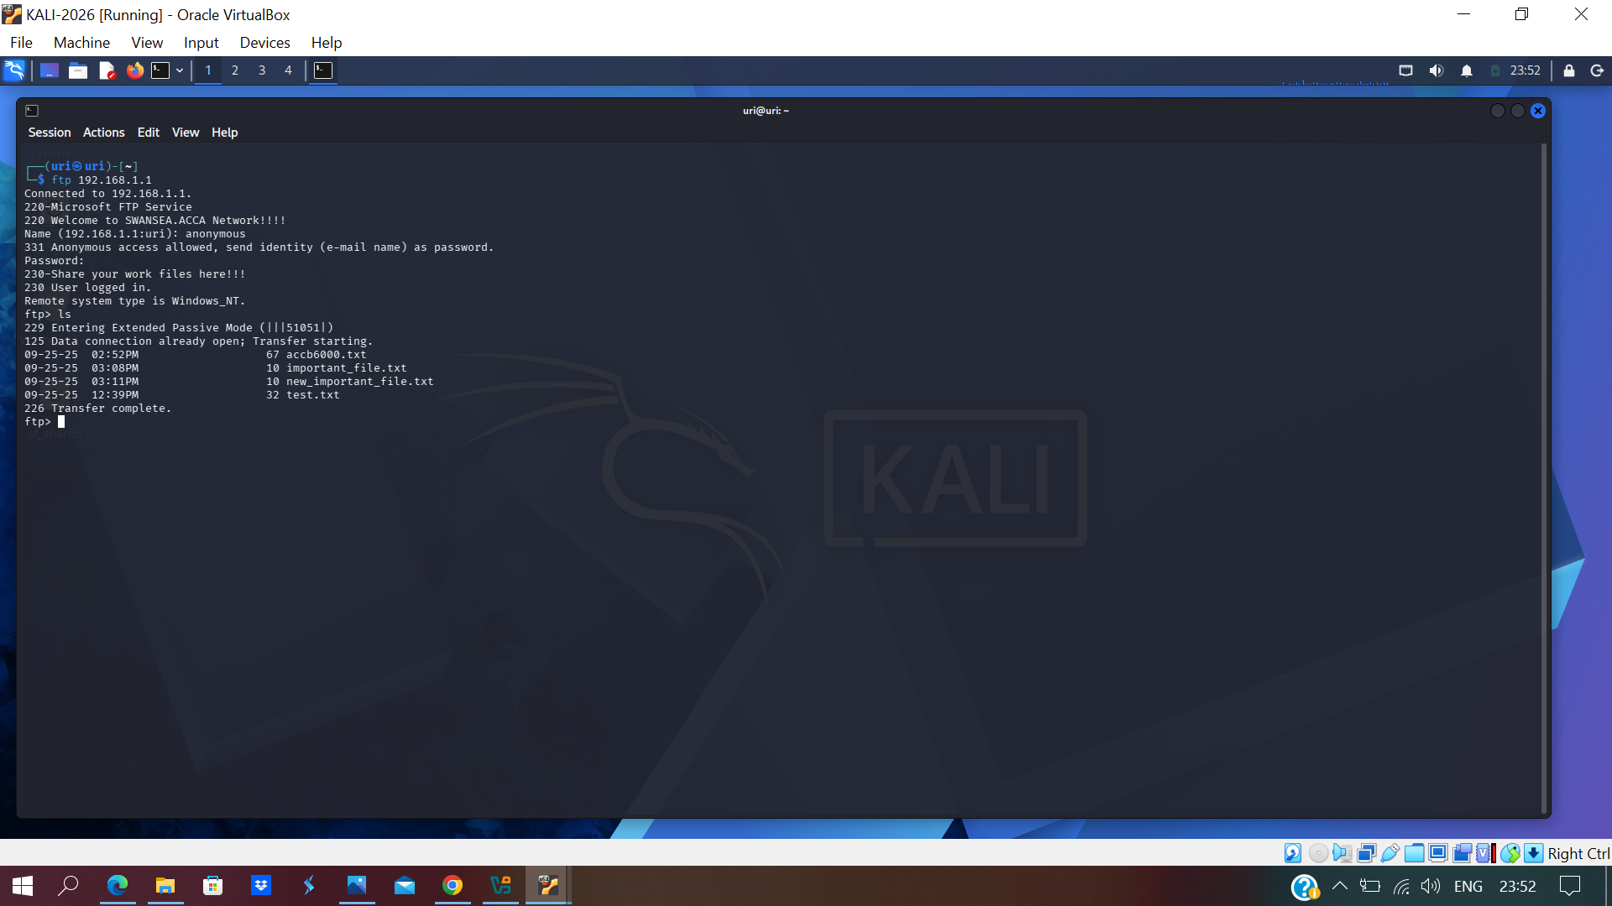
Slide 4 – Listing files on the target
• After authentication, the remote directory could be enumerated and multiple files became visible to the attacker.
• This showed that the weakness exposed real server content rather than only a service banner, increasing the confidentiality risk [6].
After authentication, the remote directory could be enumerated and multiple files became visible.
This shows that the vulnerability exposed real server content, not just the service banner.
22

Slide 23
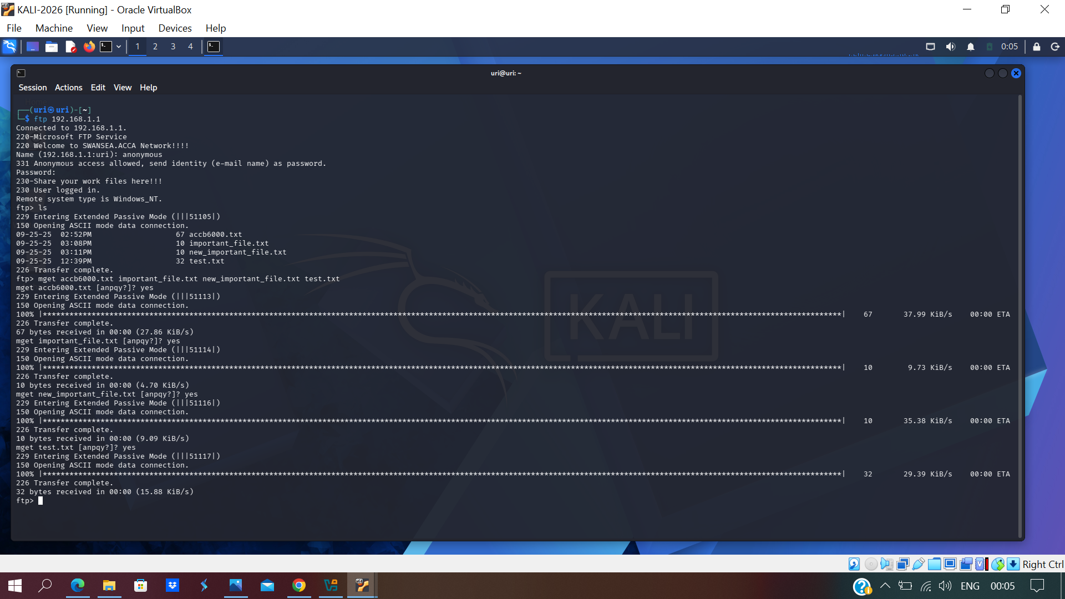
Slide 4 – Downloading files from S-DC
• Multiple files were transferred successfully from S-DC to the Kali workstation.
• The transfer proved practical exploitation and a direct confidentiality impact because sensitive server data could be extracted without legitimate credentials [6].
Multiple files were transferred successfully from S-DC to the Kali workstation.
This confirms practical exploitation and a direct confidentiality impact.
23

Slide 24
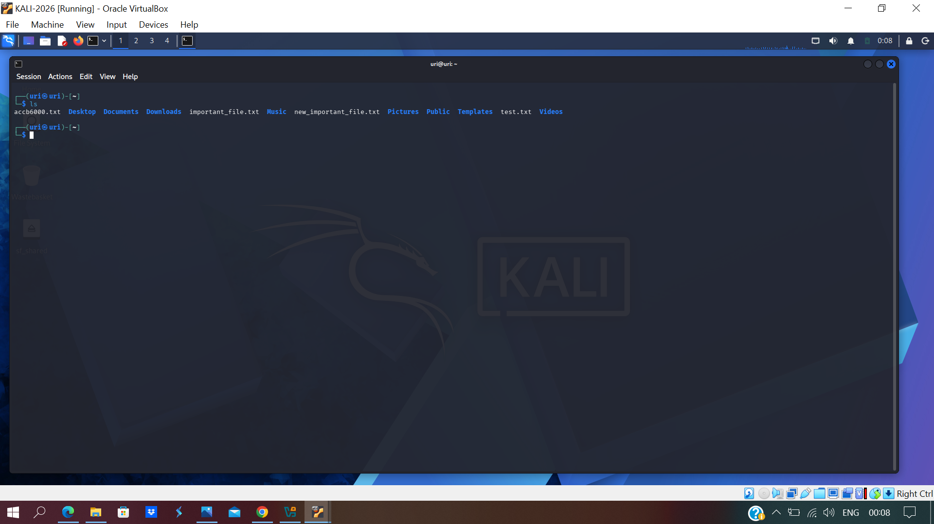
Slide 4 – Files retrieved to the attacker host
• The downloaded files were present locally on the Kali host after the FTP transfer completed, verifying that exploitation led to actual data extraction.
• This evidence strengthened the classification of the FTP issue as a high-severity weakness affecting a critical server [5], [6].
The downloaded files were present locally on the Kali host after the FTP transfer completed.
This verified that the exposure resulted in actual data extraction from the target.
24

Slide 25
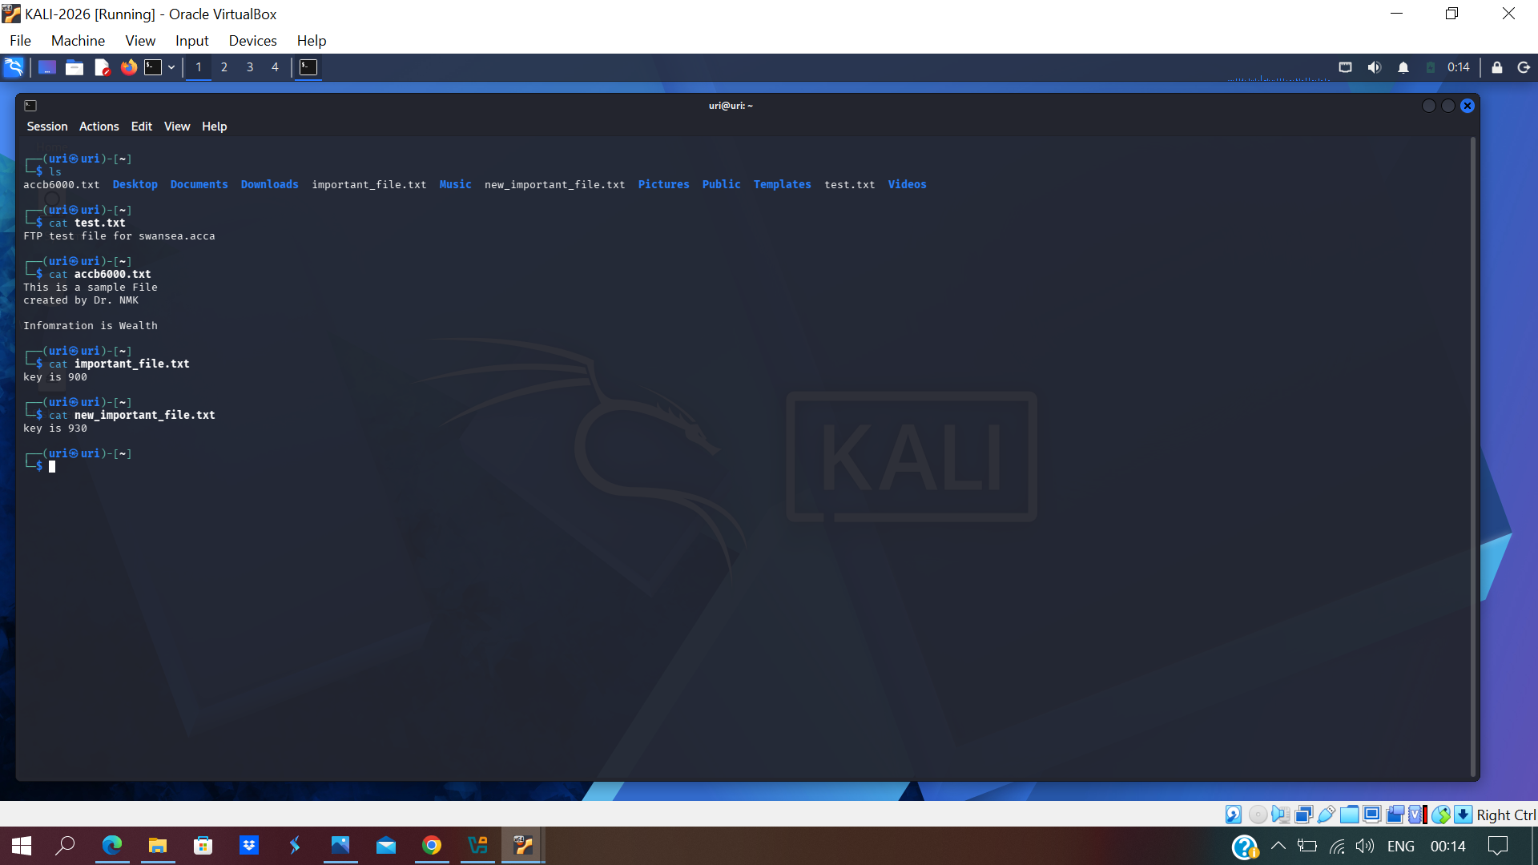
Slide 4 – Post-exploitation review of extracted data
• The retrieved files contained readable internal content and key-related values that could support later reconnaissance or follow-on attacks.
• Although full system takeover was not achieved, the unauthorised disclosure still represented a meaningful post-exploitation impact on confidentiality [6].
The retrieved files contained readable internal content and key-related values.
Although full system takeover was not achieved, the breach still exposed potentially useful operational information.
25

Slide 26
Slide 5 – Implemented and recommended security measures
Server hardening:
Disable FTP or replace it with SFTP; remove anonymous access; restrict file permissions; disable legacy services such as echo, discard, daytime, QOTD and chargen.[6]
Patch and configuration management:
Apply Windows and application updates; address SMB, SSL and TLS weaknesses; enable SMB signing where required; disable unnecessary IP forwarding.[7]
Firewall and access control:
Limit sensitive ports to trusted hosts only; enforce least privilege; use ACLs to reduce unnecessary cross-subnet access.[2]
Monitoring and secure communications:
Maintain encrypted services and VPN protection; use Wireshark and log review to detect unusual FTP activity, failed connections and suspicious internal traffic.[8]
• Patch and configuration management: apply Windows and application updates, address SMB/SSL/TLS weaknesses, enable SMB signing where required, and disable unnecessary IP forwarding [3], [5], [7].
• Firewall and access control: restrict sensitive ports to trusted hosts only, enforce least privilege, and use ACLs to reduce unnecessary cross-subnet access [2].
• Monitoring and secure communications: maintain encrypted services and VPN protection, and
26

Slide 27
Key conclusion
• The SWANSEA.ACCA network was successfully enumerated from the internal Kali assessment host using a structured testing approach [1], [4].
• S-DC presented the largest attack surface and the highest-risk issues, especially anonymous FTP exposure confirmed through Nessus and live exploitation evidence [5], [6].
• The key mitigation priorities are service hardening, secure file transfer, stronger access control, patching, and ongoing monitoring across both sites [2], [3], [7], [8].
27

Slide 28
References (IEEE style)
[1] K. Scarfone, M. Souppaya, A. Cody and A. Orebaugh, Technical Guide to Information Security Testing and Assessment, NIST SP 800-115, 2008.
[2] K. Scarfone and W. Jansen, Guidelines on Firewalls and Firewall Policy, NIST SP 800-41 Rev. 1, 2009.
[3] K. Scarfone, W. Jansen and M. Tracy, Guide to General Server Security, NIST SP 800-123, 2008.
[4] G. F. Lyon, Nmap Network Scanning: The Official Nmap Project Guide to Network Discovery and Security Scanning. Insecure.Com LLC, 2009.
[5] Tenable, Welcome to Tenable Nessus 10.11.x, Tenable Documentation, 2026.
[6] M. Allman and S. Ostermann, FTP Security Considerations, RFC 2577, IETF, May 1999.
[7] K. A. McKay and D. F. Cooper, Guidelines for the Selection, Configuration, and Use of TLS Implementations, NIST SP 800-52 Rev. 2, 2019.
[8] Wireshark Foundation, Wireshark User's Guide, 2026.
28

