Slide 1

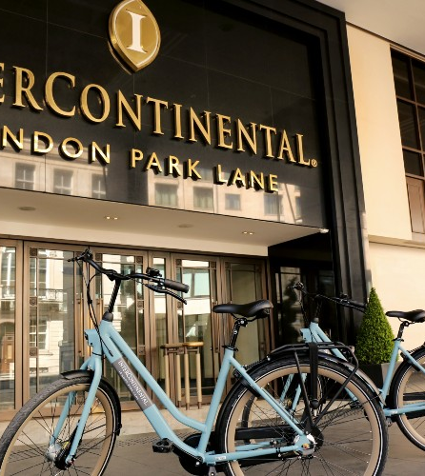
Module Code:LCBB5004
Module Name: Managing People
Model Tutor: Mushfiqur Rahman
Module Title: Assessment 1
Student Name: Angel Angelov
Student Number:2120247

Slide 2
Introduction
What is talent acquisition Manager?
Three strategies for short term talent acquisition!
Three strategies for long term talent acquisition !
Identify and explain two monetary and non-monetary methods!

Slide 3

Intercontinental hotel Park Lane
InterContinental London Park Lane, located at one of the capital's most famous addresses, offers modern elegance in the heart of Mayfair.
The hotel's exquisite natural decor and award-winning seasonal cuisine are inspired by its location overlooking the Royal Parks.

Slide 4
What is Talent acquisition Manager?
Talent Manager is the process of attracting
Developing, motivating and retain top talent

Slide 5
Short term talent acquisition
Assess
Assess the skills and demand or period for hiring-manager need to analyze the demand identify the skill requirements.
Develop
Develop a clear job description-the employers need to job description are accurate, complete and up-to-date.
Check
Check quality of hire and cost or employment terms-stringent scrutiny is ensuring the right employee is hire or project can be delay and buget is overruns.

Slide 6
Long term talent
Create a long-term hiring plan-long-term recruitment is an ongoing process that requires extra planning and preparation.
Focus on better employer branding- play role in talent acquisition strategy as it influence an organization’s reputation from candidate.
Use online job portal for fast and better recruitment progress –managers can used online web portals to post jobs. Employers can talk with potential candidates on social platforms in real time talk for faster response and easier communication .

Slide 7
Two monetary methods
Include employee paid time off, bonuses cash reward.
Additional monetary incentives include annual or semi-bonuses
Monetary rewards motivate employees to produce optimally

Slide 8
Two non-monetary methods
These rewards include:
Flexible hours
Training
Opportunities and ability to work independent
Non-monetary incentives rewards employee performance through perks and opportunities

Slide 9
References
1-https://www.youtube.com/watch?v=NwufHwariTI
2-https://www.youtube.com/watch?v=pSPhz7QK8eM
3- https://www.saviom.com/blog/how-to-plan-for-short-term-and-long-term-talent-acquisition-strategy/

