Slide 1

Program: BA Business Management
Module: Introduction to Leadership and Management, LCBB4015
Assignment Component 1: Practical: Group Presentation
Lecturer: Ivan Rodriguez Hernandez
Student: Mandica Gabriel Stochita, 2230353
Alina Ionela Scarlaciuc, 2318839
Kiran Begum, 2106720
Angel Udrea, 2429380
Date: 15/06/2025

Slide 2
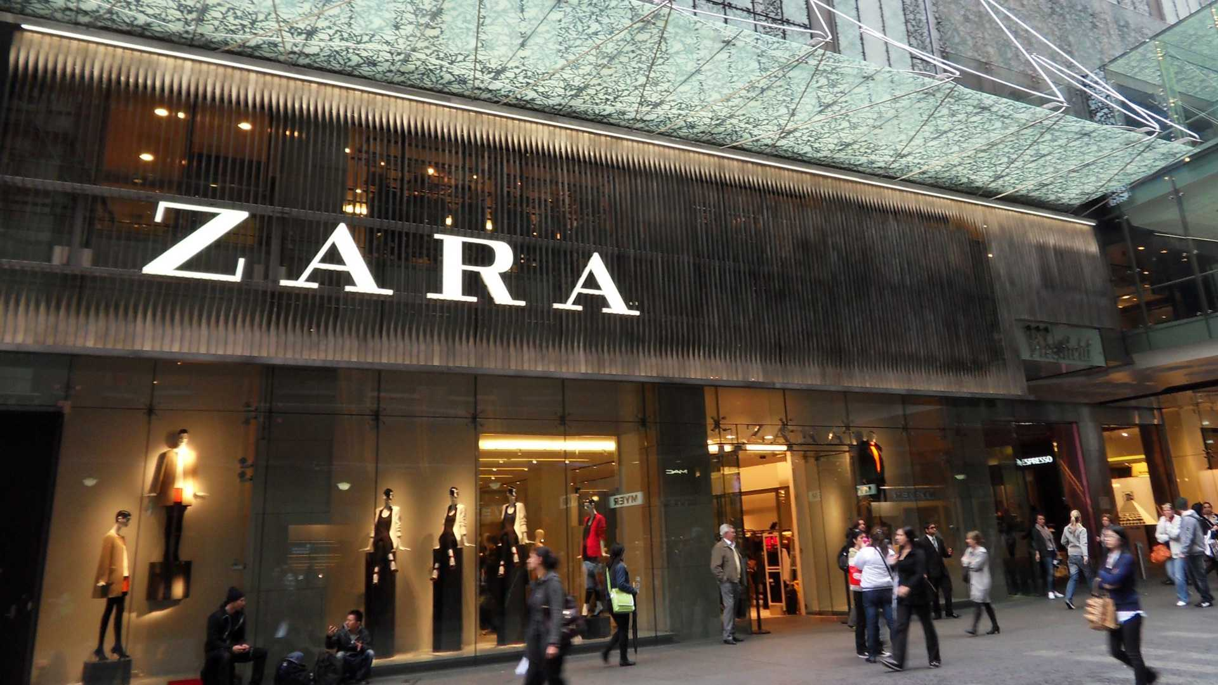
Alina Scarlaciuc
Table of content
Managerial roles in contemporary business
Mintzberg’s Managerial Roles and Application at Zara
Figurehead
Leader
Liaison
Monitor
Disseminator
Spokesperson
Entrepreneur
Disturbance Handler
Resource allocator
Negotiator
Development at Managerial Roles at Zara
Contribution to Organizational Performance
Sustainability champion
Conclusion
References
(Fashion Daily Europe, 2022)

Slide 3
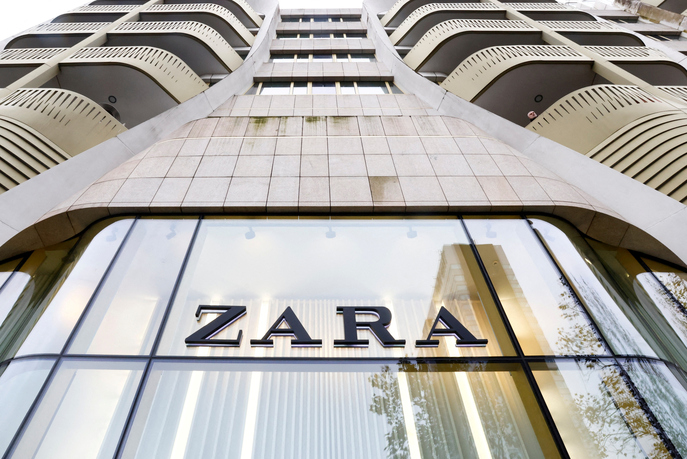

Managerial Roles in Contemporary Business
A Case Study of

Slide 4
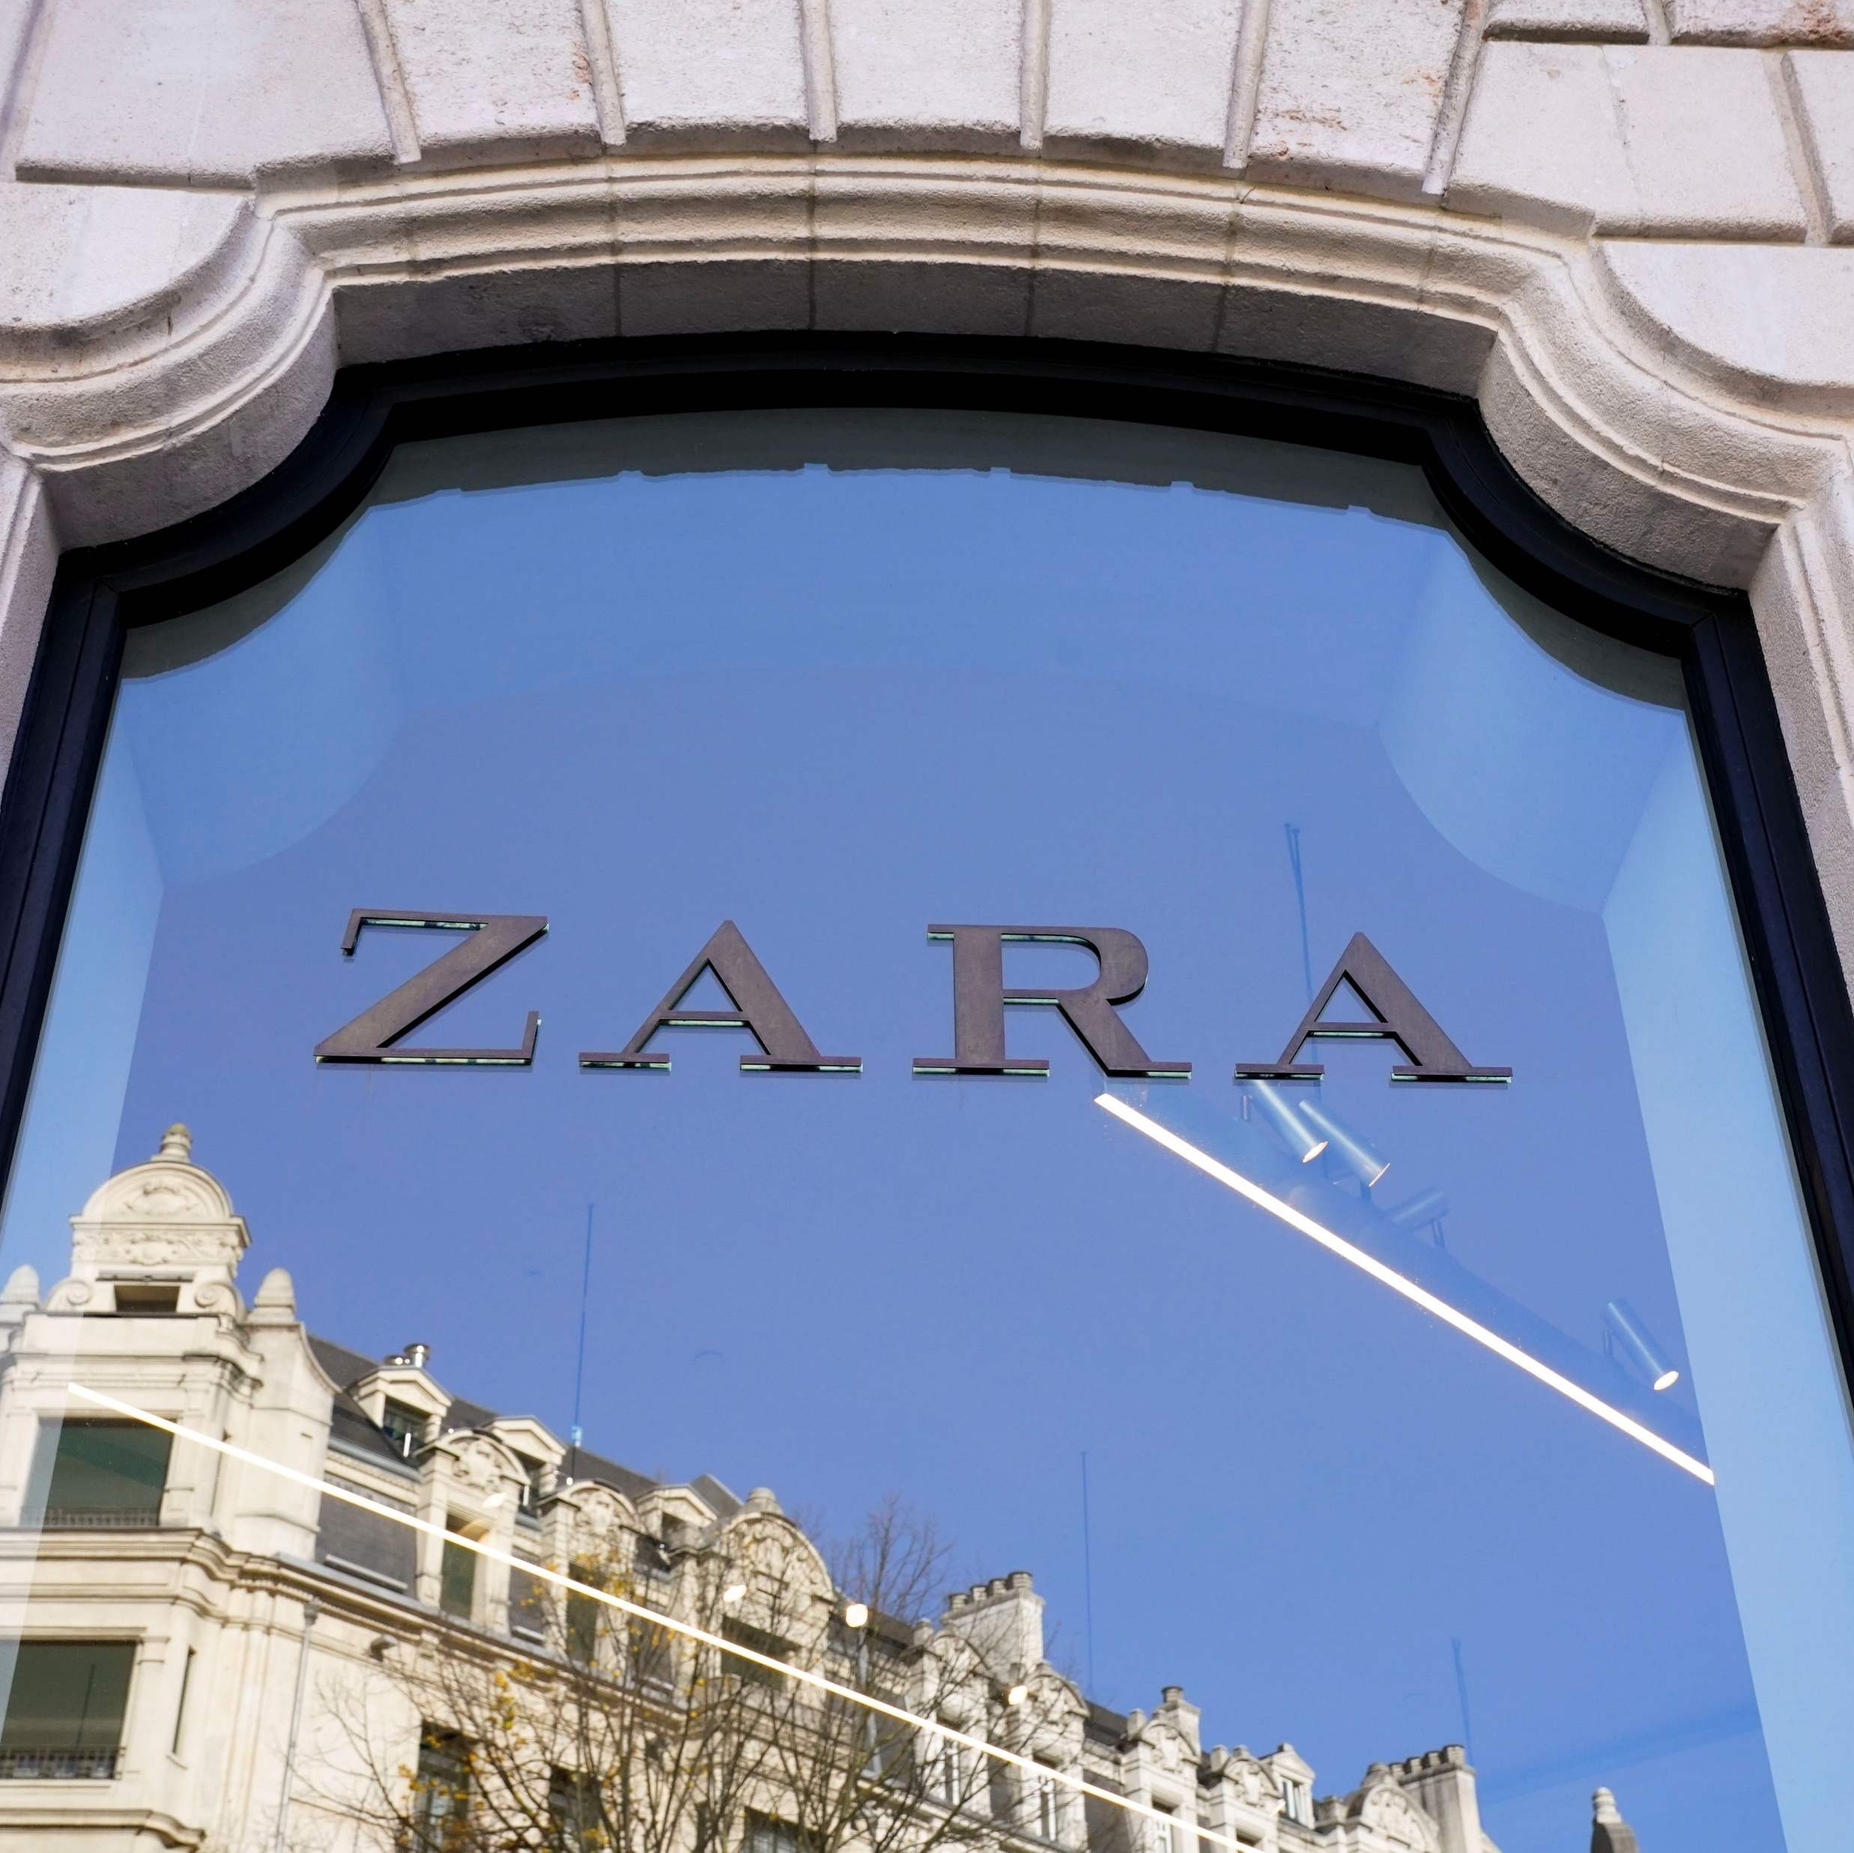



Mintzberg’s Managerial Roles and Application at
Angel Udrea
The rapidly changing global market requires effective management to achieve business sustainability and competitive advantage. The ten managerial roles model developed by Henry Mintzberg (1973) helps organizations understand the duties of their managers. The presentation uses Mintzberg’s theory to analyze Zara as a fast fashion global leader to study how its managers execute these roles and how they build these roles and what role each plays in organizational performance.
It also proposes an additional managerial role that is increasingly relevant in the digital age. Mintzberg divides managerial roles into three categories: interpersonal, informational, and decisional.
( Fashion Retail Weekly, 2022)

Slide 5

Figurehead
Kiran Begum
The store and regional managers at Zara function as figureheads because they embody the brand through their presence at stores and corporate events and community-based initiatives. The presence of these managers maintains Zara's corporate image and creates unity within the organization (Mintzberg, 1973).
Store managers take charge of seasonal store launches and customer-facing events which help maintain Zara's brand identity through personal interactions.
The regional managers take part in fashion expos and represent the company at sustainability forums to match Zara's image with corporate values.
The managers conduct local community initiatives including clothing donation programs and environmental clean-up campaigns which boost employee morale and increase brand visibility in public spaces.
( Fashion Retail Weekly, 2022

Slide 6

Leader
Kiran Begum
The managers at Zara oversee diverse multicultural teams which operate in different global locations. They motivate their staff members while delivering training programs and handling performance management tasks. The leadership approach plays a crucial role in sustaining Zara's outstanding customer service and operational efficiency (Robbins et al., 2020).
Store managers schedule frequent team meetings to ensure staff members understand their daily objectives and customer service requirements.
The onboarding process for new employees at Zara includes technical training alongside cultural orientation to achieve a perfect team match.
The managers in Dubai and London regions modify their communication approaches to match local cultural differences which leads to better staff collaboration.
Through their practice of recognizing outstanding employees and providing advancement prospects managers both enhance employee spirits and sustain superior service quality throughout Zara's worldwide operations.
(Workplace Today, 2023)

Slide 7




Liaison
Kiran Begum
Zara managers maintain regular contact with supply chain partners and designers and marketing teams to achieve quick responses to fashion trends. The established relationships help Zara decrease its lead times while maintaining its fast-paced operations (Daft, 2016).
Store managers at Zara use designer feedback from customer input to determine which fashion trends are becoming popular. The designers can produce new items that match current trends because of this process.
Through supply chain partner collaboration Zara achieves quick product manufacturing and store delivery within a few weeks. The entire process from beginning to end operates within their internal system. This gives them complete authority to direct the final product.
Zara maintains ethical production standards through its efforts to promote fair labor practices and better working conditions across its supply chain operations. The company maintains rigorous standards to support responsible manufacturing practices and transparent operations.
The marketing teams track social media and fashion influencer trends which they use to inform design and production teams about current trends for Zara to stay agile and trend-responsive.
The company provides new employees with onboarding programs that combine technical training with cultural orientation to create a perfect team match.
The managers in diverse locations such as Dubai or London adapt their communication methods to suit different cultural environments which enhances staff collaboration.
Through recognition programs and career development opportunities managers enhance staff morale and sustain high service quality throughout Zara's worldwide operations.
(Office life Magazine,2022)

Slide 8

Monitor
Kiran Begum
Zara managers track fashion trends and sales data and quality control and customer feedback. The store managers at headquarters receive real-time customer preferences which guide the development of new products (Griffin, 2019).
The design and production teams receive immediate information about frequently requested items from store managers. The headquarters of Zara uses collected data to modify their upcoming collections while sometimes launching new products within a few weeks.
The sales performance monitoring system enables managers to modify inventory levels when products show different sales performance between regions. Through its quick feedback mechanism Zara maintains market leadership in fast fashion by following consumer preferences.
The company runs onboarding programs for new employees which combine technical training with cultural orientation to create a perfect team match.
Managers in diverse locations such as Dubai and London modify their communication approaches to match local cultural differences which enhances staff collaboration.
Through performance recognition and career advancement opportunities managers sustain high service quality and boost employee morale throughout Zara's worldwide operations.
(Workplace Today, 2023)

Slide 9

Disseminator
Alina Scarlaciuc
The managers at Zara serve as the link between head office strategic information and staff members. They maintain open communication channels to deliver visual merchandising updates and promotional information and new collection details to staff members (Lussier, 2021).
The managers at Zara maintain essential responsibility to drive team motivation while creating positive workplace environments. They address employee concerns right away while promoting teamwork which leads to high staff engagement and productivity levels that benefit the company's quick retail operations.
Zara maintains its position as a trendsetter in the industry.
(Workplace Today, 2023)

Slide 10




Spokesperson
Alina Scarlaciuc
Managers function as representatives who handle communications with local media and landlords and stakeholders. The positive brand image and strong external relationships result from this approach (Mintzberg, 1973).
The head office receives feedback from external parties through managers who collect this information. The two-way communication process enables Zara to modify its strategies based on local market conditions and customer preferences which strengthens the brand's position in different regions.
Zara faces major company risks to its reputation which managers must constantly monitor and prepare for.
(Business Insight Media, 2021)

Slide 11

Entrepreneur
Alina Scarlaciuc
The business model of Zara depends heavily on innovation. The management team proposes changes to store displays and floor arrangements which help Zara achieve local innovation within its worldwide strategy (Robbins et al., 2020).
The innovative approaches at Zara both enhance customer shopping experiences and help the company quickly adapt to new fashion trends and customer requirements. Zara maintains its fast-fashion leadership through manager empowerment for experimentation and new idea implementation.
The family business of Zara started in 1975 when Amancio Ortega and Rosala Mera established it in downtown Galicia of northern Spain and has since expanded to 2,264 stores across 96 countries in major cities (The Enterprise World,2023)
(Workplace Today, 2023)

Slide 12

Disturbance Handler
Gabriel Stochita
Zara managers handle supply delays and staff shortages and employee issues and customer complaints immediately. The managers' ability to resolve disturbances maintains operational continuity and customer satisfaction (Griffin, 2019).
These managers also take proactive steps to identify potential problems before they become major issues. Through their implementation of preventive measures and their practice of open communication with their teams they reduce operational disruptions while maintaining store efficiency.
(Office life Magazine,2022)

Slide 13

Resource Allocator
Gabriel Stochita
Zara’s managers use floor space, staff shifts and stock efficiently to maximize productivity and sales. This role supports the company’s high inventory turnover model (Daft, 2016).
The analysis of sales data and customer traffic patterns enables managers to make strategic decisions about resource distribution. The strategic approach enhances sales performance while minimizing waste which supports Zara’s sustainability goals and operational excellence.
During Covid 19, Zara was quick to move their shop floor staff to their warehouses. The use of this particular resource ‘staff’ was detrimental in saving the company during what would be a hard time for businesses.

Slide 14

Negotiator
Gabriel Stochita
Managers regularly negotiate with suppliers, landlords, and team members over shifts, deliveries, and budgets. Effective negotiation helps control costs and enhance performance (Lussier, 2021).
Strong negotiation skills enable managers to build long-term partnerships that benefit Zara through better terms and collaborative problem-solving. This contributes to a more resilient supply chain and a motivated workforce, both critical to sustaining the company’s competitive advantage.
(Business Insight Media, 2021)

Slide 15

Development of Managerial Roles at Zara
Gabriel Stochita
Internal training programs for new and current managers
Job rotation to provide exposure across different roles and departments
Decentralized decision-making, encouraging entrepreneurial thinking
Performance management systems that focus on responsiveness and leadership
The company’s flat hierarchy also allows for faster development of leadership and interpersonal roles at all levels.
(Office life Magazine,2022)

Slide 16

Contribution to Organizational Performance
Angel Udrea
Responsiveness to market trends (monitor, disseminator, entrepreneur)
Operational efficiency (resource allocator, disturbance handler)
Brand consistency and engagement (figurehead, spokesperson)
Agility and innovation (liaison, entrepreneur, negotiator)
Zara’s ability to deliver new collections to stores in under three weeks is a direct outcome of managerial effectiveness across all ten roles (Robbins et al., 2020).

Slide 17

Sustainability Champion
Angel Udrea
The proposed business role for today's context is Sustainability Champion. The manager implements environmental and ethical practices throughout operations starting from material sourcing to waste management. The fashion industry needs this role to maintain long-term brand credibility and compliance because environmental impact scrutiny continues to rise.
(Business Insight Media, 2021

Slide 18
Conclusion
Angel Udrea
Mintzberg’s ten managerial roles continue to be highly relevant in contemporary business. Zara uses these roles to keep its operations efficient and agile and competitive in the fast fashion industry. The Sustainability Champion role will become essential for ethical and future-focused business leadership as consumer expectations continue to evolve.

Slide 19

ANY QUESTIONS?

Slide 20
References
Business Insight Media(2021) Team of Professionals collaborating in a modern office. Available at: https://www.businessinsightmedia.com/office-teamwork-photo Accessed: 5th June 2025
Daft, R.L., 2016. Management. 12th ed. Boston: Cengage Learning.
Fashion Daily Europe(2022) Zara front store at Oxford Street, London. Available at: https://fashiondailyeurope.com/zara-London-storefront Accessed 7th June 2025
Griffin, R.W., 2019. Management. 13th ed. Boston: Cengage Learning.
Lussier, R.N., 2021. Management Fundamentals: Concepts, Applications, and Skill Development. 9th ed. Sage Publications.
Mintzberg, H., 1973. The Nature of Managerial Work. New York: Harper& Row.
Robbins, S.P., Coulter, M. and DeCenzo, D.A., 2020. Fundamentals of Management. 11th ed. Pearson.
The Enterprise World. (2023) Zara- A success story. Available at: https://theenterpriseworld.com/zara-a-success-story/ Accessed: 7th June 2025

