Slide 1

Children, young people and families.
Saba Parveen- 2014411
Saiqa BIBI- 2020850
CHARNAI CLARKE- 2007510
OTISON OSAZUWA EKUNWE- 1921110
SUZANNE SUTTON- 1907308

Slide 2
Introduction
Welcome to our group presentation. This presentation is based on a case study about a boy called John who had many complex health needs. His mother also suffered from mental health. Together as a group, we looked into the wellbeing of children, young people and families and analyse one of the key domains of children and young peoples wellbeing. We will talk about policies and professional interventions that are in place and use the multi-disciplinary services to meet the diverse needs of John and his family.

Slide 3
Children, young people and families’ perception of wellbeing
What is a child? A child is a small human being who is still learning and growing. A child is still in the vulnerable stage of their life whist they are still growing and developing.
“The United Nations Convention on the Rights of the Child (UNCRC) defines a child as everyone under 18 unless, "under the law applicable to the child, majority is attained earlier". (NSPCC, 2020)

Slide 4
What does wellbeing mean to children, young people and families
The wellbeing of a person is a persons physical, emotional, mental and social health factors.
The wellbeing is important for children and young people as it is key for their overall physical and mental health and helps them to face any difficulties they are facing.
“Understanding what wellbeing means for any individual means asking them directly.” ((Rigby, Hagell and Starbuck, 2018)
Looking back to the wellbeing of John, we know that his health and wellbeing were impacted by his health needs.
He suffered many complex health needs and the severity of the cerebral palsy.
John's mother had mental illness and with no father actively involved means there was lack of support.

Slide 5
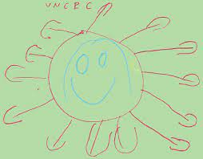


Child’s emotional and psychological well being affects their mental state
John may have suffered with the lack of care from his mother who had mental health issues
A father who did not have any approach in his care plan
A child and young person’s well -being can differ from a child with complex needs to one who has none.
( Drawing by Olivia
Queen’s University Belfast )
Study shows an adolescent with cerebral palsy has a reduced quality of life, (G, Kelly, et al 2016) especially with adolescents such as John who had more complex health issues.
A common domain of children’s and young people’s well being is:
psychological and emotional well-being
( Empowered parents.com )
One element of psychological and emotional well-being is behaviour that challenges.
A person may display behaviours that are challenging and difficult for loved ones to understand, such as john’s mother dealing with changes to his complex care needs, finds it overwhelming and declines.
Although john’s mother had mental capacity, the health care could’ve trusted her decisions
However, when she declined care maybe the multidisciplinary team should have taken her mental health into account and gone under the capacity route and made the decision on her behalf for the benefit of john's health as he was the patient. (NICE, 2017)
( New era, 2022 )
A child will be likely to suffer anxiety and depression.
Any changes in their medical condition which are not followed correctly can have a detriment effect on their health
As it shows in the case study, the mother was hostile to the healthcare staff which led to the well being of john being compromised.

Slide 6
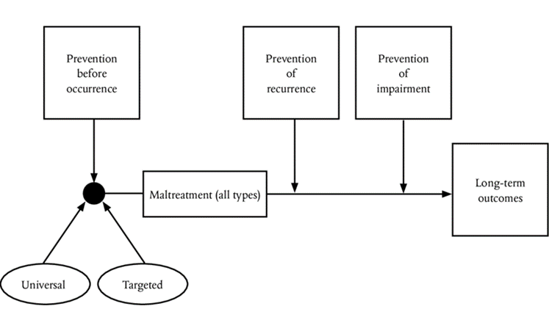
ANNALYSIS OF POLICIES AND PROFFESSIOAL INTERVENTION
Hallet and Birchall (1995) " identifies needs for adult and children services to work together where family may impact on a child welfare", some criteria's by parents might have a lasting and negative effect on a child resulting in future serious damage.
The UNCRC act of 1989 emphasis that children and young people has the right to happiness ,staying healthy , safe, making contributions and achieving economic wellbeing and this was supported by government EVERY CHILD MATTERS and the protection of children act 1978.
Based on the case study , there was no holistic assessments between john mothers and the administrators, yes everything points to her loving her son, but solid agreement was needed during the referrals and acceptance process as this might have stop her constant interferences and involvement Healthwise and her hostility towards care staff.
The 1989 act also provide a comprehensive framework of court orders dealing with contact, residence and the exercise of parental responsibilities when it is not the best interest to deal with family section 22 (1), section (15) " also explain the need for local authority to promote contact unless it is not reasonably practicable between child and family especially if it is detrimental to the child.
Health workers should have stop the hostile environment from john mother and the concerns of john condition dating back years with the relevant acts, laws and safeguarding against her for development in his health and knowing her background of mental illness as she was not in the right frame to make judgements.
Cleaver, Unwell,& Aldgate (1999)" the behaviour of parents impact on children's vulnerability to later life events and circumstances".
(Framework of intervention and prevention of child abuse).

Slide 7
Discussing and evaluating current policy and professional interventions
The lack of communication between the healthcare staff and johns’ mother was very poor. John’s mother felt that the healthcare staff didn’t listen to her concerns about her son, which could have made her feel discriminated against due to her suffering with mental health.
As the main carer of john, the staff should have shown more empathy towards her due to her health conditions.

Slide 8
Johns case study.
John was on a child in need ( The plan) :
(section17 of the children act 1989 imposes a general duty on local authorities to safeguard and promote the welfare of children who are ‘in need’ and to promote the upbringing of such families by providing a range and level of services appropriate to those children’s needs. Other agencies have a duty to co-operate with social care in carrying out their duty to assess the needs of children and to provide services as necessary) another meeting should have been held (after any significant change in circumstances in the child’s life or fresh concerns about the child) (Anon., n.d.) should have been raised sooner as the case study states that there were concerns about his needs and medical care a few years ago. (Killian, M. 2017)
As multiple agencies would have been involved, due to him being on a child in need plan there should have been more things put in place.
For a better system all round there should have been more:
More communication
Professionals to talk more
Sharing information
John’s social worker should of being more involved and tired discussing with his mother about changes in his need and medical care.
Other agencies such as family support worker to help johns mother with other ongoing issues that might be affecting her mental health.
Doctors or counselling support so that she can talk to someone about how she feels or even be put on some medication.

Slide 9
Summary
During this presentation, we was able to show understanding of children, young people & families. We was able to discuss the wellbeing of this. Having included a domain we was able to share knowledge on phycological and emotional well being, followed by the polices and professional interventions. Lastly, discussing and elevating johns case study, we was able to identify the wrong doing within the case study which led to johns death, along with promoting ways in which this could have been prevented.

Slide 10
References
Cerebral palsy in under 25s: assessment and management NICE guideline (NG62) Published: (2017) Inspiring, Transforming and connecting communities one life at a time. Children & Young People’s Mental Health.
Cleaver, H. Unell, I. & Aldgate, J (1999) Children needs—Parenting capacity: the impact of parental mental illness, alcohol problem , drug use and domestic violence on children development. London TSO.
Hallet, C.& Birchall, E. (1995) Co-ordination and child protection, LONDON :HMSO.
Kelly, G.,Kelly, B., & MacDonald, g. (2016). Improving the Well-being of Disabled Young People. Queens University Belfast
Killian, M., Forrester, D., Westlake, D. and Antonopoulou, P. (2015). Validity of the working alliance inventory within child protection services Research on Social Work Practice. July (viewed on 23 February 2017).
New Era., (2022) https://empoweredparents.co/emotional-development-stages/ The Stages of Emotional Development in Early Childhood. Bt Tanja Mcilroy.
NSPCC (2020). Children and the law | NSPCC Learning. [online] NSPCC Learning. Available at: https://learning.nspcc.org.uk/child-protection-system/children-the-law
Rigby, E., Hagell, A. and Starbuck, L. (2018). What do children and young people tell us about what supports their wellbeing? Evidence from existing research. [online] Available at: http://www.youngpeopleshealth.org.uk/wp-content/uploads/2019/10/Scoping-paper-CYP-views-on-wellbeing-FINAL.pdf

