Slide 1

QUALATATIVE AND QUANTATATIVE RESEARCH
Student name – Chris Jones
Student number - 1810318
Module - Advanced Research Methods in Counselling
Module code - ECAC7003

Slide 2


What are counsellors’ attitudes towards working autonomously in large organization such as the NHS?

Slide 3

Research assumptions
Aims
Arguments
Strengths
Limitations
Relevance

Slide 4
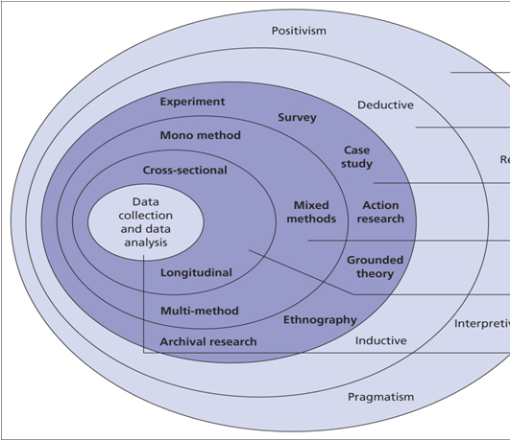
Research position
My research assumptions are based on my philosophical position also known as a research paradigm ( world view) i.e., Positivist or subjectivist
My own philosophical stance is that of pragmatism and constructivism , it is argued that this influences the research methodology I would potentially use. “Whether we are aware of it or not, we always bring certain beliefs and philosophical assumptions to our research” (Creswell and Poth, 2018, p.15).

Slide 5
Systematic literature review
Recent studies suggest that there is limited research into this topic
Many studies relating to client autonomy , however little on counsellors working in large organisations
This suggests that there is a gap in knowledge around topic and a potential value in research around this area

Slide 6
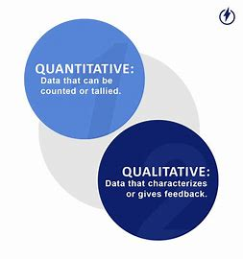
Qualitative & Quantitative

Slide 7

Definitions
Qualitative research has often been defined in terms of what it is not: that is, its research that does not involve the use of measurements or statistical techniques (McLeod ,2013).
Quantitative research can be defined as research that explains phenomena according to numerical data which are analysed by means of mathematically based methods, especially statistics ( Yilmaz, 2013)

Slide 8
Quantitative research overview
Gathering, analysing and reporting the results
Only specific methods are used
Larger more genialised sample size used
Numerical
Statistical and scientific
Researcher’s can distance themselves from their participants .

Slide 9
Qualitative research overview
Develops a social construct.
Relational and experiential
Language, meaning and story telling
Like some aspects of social life
Recreates elements of counselling skills used in practice i.e., narrative of story.

Slide 10
Comparing and contrasting methodologies and theoretical background
Quantitative – Deductive / evidence based / scientific / Surveys / Cognitive behavioural therapy
Qualitative – Constructionist / experience / humanistic / interviews / person centred approach

Slide 11
Example of a quantitative method of data collection
Randomised control trial – A study which uses a procedure to compare the effectiveness of a different intervention is called a randomised control trial (RCT) and is considered by many to be the ‘gold standard’ of research (Mick Cooper & Sage, 2008, p. 17)
Control group – counsellors in private practice compared to counsellors that work for a large organisation?
Correlation – effect size and variables – i.e – the level of autonomy that a counsellor may feel within an organisation.

Slide 12
Example of a qualitative methods of data collection
Interview- “The research interview is a flexible way of gathering research data that are detailed and personal” (Mcleod, 2013, p. 115)
Subjective experiences- offering significantly rich data set. This could be a positive was of exploring what it is like for counsellors to work in various organizations and comparing the differences.
The data- having true meaning and interpretation , bringing the research to life, i.e. Methodologies such as IPA.

Slide 13
What do we know this far
Ontological and epistemological positions
Methods of enquiry
Aims of the approach
Methodology

Slide 14
Strength and limitation of quantitative research in counselling
Larger target audience
Too objective
Numerical data that is easily displayed
No feeling or meaning involved
Distance from participants
Unpersonal
More generalised outcome to the study
less subjective and real

Slide 15
Strength and limitation of qualitative research in counselling
Richer data from language
More time spent analysing data
Participants feel supported personally by the researcher
More ethical considerations and risk factors
Gathering real life subjective experiences of counsellor
Study could be seen as biased
More autonomy for participants
Possible recruitment and consensual issues

Slide 16
Ethical considerations
What are the ethical challenges in using quantitative or qualitative research?
Safety of participants
( Debriefing , support , moral ethics )
Recruitment
Organizational factors/ policies
BACP ethical principles

Slide 17
Literature search
“BACP actively values different approaches to research, promoting dialogue and collaboration across different research traditions”(BACP,2019).
“The main area in which qualitative methods have been used in research in counselling and psychotherapy has been in relation to client and therapist experiences of the process and outcomes of therapy” (Mcleod, 2013, p. 112).
Sanders (2010) suggests that as much as there is definitive theoretical factors involved regarding the best methods of research in counselling , the two methodologies are essential tools in which to use to research different aspects of the topic (Sanders & Wilkins, 2010, p. 11).
“Quantitative and qualitative research approaches represent the two ends of the research continuum. They differ in terms of their epistemological assumptions, theoretical frameworks, methodological procedures and research methods” (Yilmaz, 2013).
“Any research methodology , be it quantitative or qualitative , consist of a series of steps that lead to credible findings (Vossler, 2015, p. 78).

Slide 18
Conclusion
Qualitative research may best support my question
Quantitative may offer my study a greater objectivity on a larger scale
Mixed method approach could offer a good balance
Gap in literature around practitioner autonomy in large organisational settings

Slide 19
Reference list
Creswell, J.W. and Poth, C.N. (2018). Qualitative inquiry & research design: Choosing among five approaches. 3rd ed. Los Angeles: SAGE Publications, p.15.
Ethical Guidelines for Research in the Counselling Professions 2 Back to contents bacp Ethical Guidelines for Research in the Counselling Professions Acknowledgements. (2019). [online] Available at: https://www.bacp.co.uk/media/3908/bacp-ethical-guidelines-for-research-in-counselling-professions-feb19.pdf.
Mcleod, J. (2013). An introduction to counselling and psychotherapy research. London: Sage, p.112.
Mick Cooper and Sage (2008). Essential research findings in counselling and psychotherapy : the facts are friendly. Los Angeles: Sage, p.17.

Slide 20
Sanders, P. and Wilkins, P. (2010). First steps in practitioner research : a guide to understanding and doing research in counselling and health and social care. Ross-On-Wye: Pccs Books, p.11.
Vossler, A. (2015). The counselling and psychotherapy research handbook. London: Sage Publications Ltd, p.78.
Yilmaz, K. (2013). Comparison of quantitative and qualitative research traditions: Epistemological, theoretical, and methodological differences. European Journal of Education, 48(2), pp.311–325.

Slide 21
The end
Thank you for listening ☺

