Slide 1



Critical review of the journal article in the field of the Neuroscience of Language
Satoh, M., Yuba, T., Tabei, K. I., Okubo, Y., Kida, H., Sakuma, H., & Tomimoto, H. (2015). Music therapy using singing training improves psychomotor speed in patients with Alzheimer's disease: a neuropsychological and fMRI study. Dementia and geriatric cognitive disorders extra, 5(3), 296-308.
Link for presentation
https://uowtsd-my.sharepoint.com/:p:/g/personal/2007586_student_uwtsd_ac_uk/EQ_DKuM-YK1Mgo96GW2YMiEBVSOCOBlzCly0n7I8rzZLiQ?email=S.A.Jones%40uwtsd.ac.uk&e=A703J4

Slide 2
Main points of the presentation
Critically review of the peer viewed journal article from the Dementia and geriatric cognitive disorders extra published in 2015.
Examine and critically assess the authors' state of knowledge and their essential concepts
Evaluate the materials and the process they used to utilise to generate the study
Analysed the validity and findings

Slide 3
The Aim of the Satoh et al. (2015) study
Satoh et al. (2015) aimed to investigate and detect the changes in the cognitive processing caused by music therapy by comparing the results of the assessments and fMRI between the patients who took part in the MT and those who did not.
The study used six months signing training, such as Karaoke for Music Therapy (MT) in patients with Alzheimer’s Disease (AD).
Participants sang songs familiar to them
Each session lasted one hour; however, participants also practised signing at home for approximately 60 minutes per week.
Different neuropsychological batteries to asses memory and intellectual function and functional magnetic resonance imaging (fMRI) has been used before and after the treatment to assess changes in the cognitive functioning of AD patients.

Slide 4

Results of the Satoh et al. (2015) study
Performance time of the assessment tasks decreased in the MT group, linked to improved psychomotor speed; however, no other significant differences were found in the MT and control groups
(no significant differences in memory and cognitive functioning)
Caregivers recognised the improvement in AD patients as they were more open to social interaction.
Patients wanted to sign without prompting
joked,
shared their opinions,
used the cell phone for the first long time,
Caregivers also reported changes; they felt happy seeing the patient enjoying and progressing in signing.
Systematic review of the impact of signing on dementia patients by Thompson et al. (2021) shows that signing positively impacts not just the patient's lives but also their caregivers.

Slide 5


“Music therapy using singing training improves psychomotor speed in patients with Alzheimer's disease: a neuropsychological and fMRI study”.
The article title is very informative, as well as the abstract, as it gives the reader brief but essential information about the aim of the study, the method they used and view of the findings.
The introduction explains the aim of music therapy as a form of non-pharmacological intervention; however, discussing more the impact on dementia patients in general, forgetting that the article is about individuals with AD, resulting in a lack of explanation about AD.

Slide 6
Alzheimer's disease
Matziorinis & Koelsch (2022) described Alzheimer's disease as a neurodegenerative disease which progress and is strongly associated with cognitive decline
AD is a progressive decline in cognition and language, including speech memory, visuospatial ability and executive function. Patients with AD describe behavioural and psychological signs of dementia, such as anxiety, agitation, apathy, emotional instability, sleep issues, and difficulties sustaining independent living.
(Scharre.,2019)
Many brain regions experience more atrophy as the AD worsens displaying the most significant increases in neurodegeneration.
However, auditory areas, the sensorimotor cortex, and the pre-and supplementary motor areas remain unaffected.
(Veitch et al. ,2019)

Slide 7
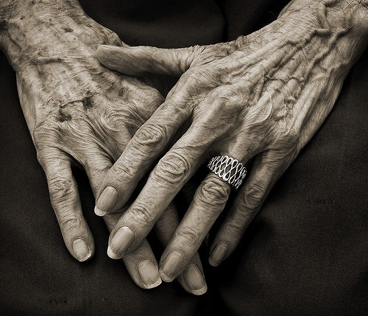
Studying the impact of music therapy on the psychomotor speed in patients with Alzheimer's seemed crucial.
AD it constitutes almost 80% of the dementia cases in the elderly population.
The statistics predict a 153 million estimated global dementia population in 2050, up from the present estimate of 55 million.
(Matziorinis & Koelsch,2022)

Slide 8
The Satoh et al. (2015) study used 20 patients with mild to moderate AD (six males and 14 females).
Participants were divided into groups according to the inclusion and exclusion criteria such as diagnosis, ability to attend a therapy session, physical health and pharmacological treatment; however, educational history was a factor which significantly drew differences between participants.
Positive association between education duration and total brain volume has been found by Wada et al. (2018).
Wada et al. (2018) argue that education through brain reserve can prevent the individual from the onset of dementia; however, those findings related only to patients with mild cognitive decline.
Those findings align with the previous research of Roe et al. (2007), who stated that those with more cognitive reserve, as measured by years of education, can better manage AD brain pathology without noticeable cognitive impairments.
Those findings create the implication for Satoh et al. (2015) study, because the differences in psychomotor speed found in the study can partially be affected by the significantly longer educational history of patients in the MT group.
Small sample sizes limit statistical power, an issue in fMRI research. Grady et al. (2021) used a sample of 171 in their study and found that increasing the sample increases the stability of the spatial maps.

Slide 9
Benefits of Music Therapy in Alzheimer's Patients
Satoh et al. (2015) explained the benefits of music therapy for patients with Dementia in their introduction very well, emphasising the positive role of music in promoting communication, learning new skills or mobilising.
Satoh et al.,(2015) argue that the efficacy of music therapy with dementia patients had no evidence, and the attempt to draw a firm conclusion was impossible.
However there was empirical evidence that Music Therapy is beneficial in patients with AD

Slide 10
Music therapy has the form of psychosocial and non-pharmacological interventions essential for individuals with AD to improve their quality of life by improving their sensory, cognition and motor activity. Guetin et al. (2013) argue that this type of intervention must be proposed to the individual with AD first as effective non-pharmacological treatment could prevent the early introduction of psychotropic or antipsychotic drugs but also contribute to cognitive functions.
Previous research found
Music therapy was found as a tool in psycho-musical relaxation to treat anxiety, agitation and depression in patients with AD
(Guetin et al.,2009)
MRI performed before and after therapy showed that music and exercise had more effective results on the participant's cognition than exercise only (Satoh et al.,2014 )
Musicians have a substantially more developed corpus callosum than the general population, which is the hub of communication between the brain's two hemispheres (Parsons.,2000)

Slide 11
Dassa & Amir (2014) conducted a study exploring whether signing old tunes will encourage people with middle to late-stage AD to converse. They found that especially those who sang songs from their past with national and social content encouraged spontaneous speech.
The signing was beneficial in reducing depressive symptoms among AD patients (Ashida.,2000).
Skills related to music and language are longer preserved (Aldridge .,1996)
Adridge (1996) show that musical abilities often remain until the late dementia phase, whereas cognitive processes and language decline during Alzheimer'sused to aid in speech restoration for people with aphasia
Satoh et al.,(2015) mentioned other nonpharmaceutical treatments with scientific evidence for patients with Dementia, such as aerobics as a form of physical exercise. However, Herholz et al. (2013) illustrate other forms of a non-pharmacological promising treatment for patients with Alzheimer's disease, such as dancing or juggling.
Herholz et al. (2013) emphasise the psychosocial role of nonpharmaceutical treatment in improving cognitive processing through social interaction during the treatment.
Levitin (2006) illustrates how almost every known neural subsystem and region of the brain are involved in musical activity. The language centres of the brain are activated when music lyrics are remembered.

Slide 12
Moreover, Boso et al. (2006) found that music helps activate pathways in the brain associated with emotions and behaviour. Those parts of brain are:
hypothalamus
amygdala
insular and cingulate cortex
hippocampus
prefrontal cortex
The emotions seemed to be a key in patients with AD as they help to encode memories. Westermann et al. (1996) showed that memories from emotional events are better encoded than those from neutral. However, music linked to sad emotions was the most beneficial for recalling incredibly remote memories (García et al.,2012)

Slide 13
What is know now ?
Study discovered that language skills and memory in moderate AD patients were improved by active MT (singing), particularly on immediate and delayed recall on the auditory verbal learning test. Results show that MT may be helpful for patients' speech and language development and treat behavioural and mental problems in those with severe AD. (Lyu et al.,2018)
Music therapy seemed beneficial to maintain cognition; however, a study showed that signing is more effective than listening to music in enhancing episodic and working memory in patients with dementia. They also found benefits for caregivers of signing in reduction of stress and burnout, and signing, in contrast to listening to music, is more energising (Särkämö.,2018).
Karaoke improved individuals' cognition. However, the major limitation of this study was the lack of neuroimaging to see the changes in the brain. The tool used to assess cognitive function was 30 item Montreal Cognitive Assessment
(Miyazaki & Mori .,2020)
Meta-analyses found the benefit of music therapy on cognition in dementia patients and long-term depression and quality of life following the treatments
(Moreno-Morales et al. ,2020)

Slide 14
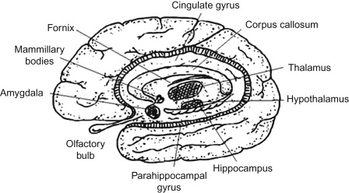
A meta-analysis of Koelsch's (2020) on music and emotion shows activation and hippocampus formation.
This relationship between the emotions that music evokes, and memory processes may be one of the ways that music might help with episodic memory recall (Matziorinis & Koelsch,2022).
Music therapy in AD patients generates new neurons and changes the brain's structure by formatting new sympathies known as neuroplasticity (Matziorinis & Koelsch,2022).

Slide 15






Satoh et al. (2015) found that music therapy can offer an alternative treatment method for patients with dementia who have lost the ability to speak or understand the language.
Music therapy offers this group of patients different forms of communication, such as playing music or humming (Vink et al.,2003)
Vink et al. (2003) argue that the right hemisphere is responsible for signing in contrast to the patients who experience aphasia after left-hemisphere lesions exhibit remarkably maintained vocal musical ability.
Vink et al. (2003) stated that by signing, especially in groups, an individual could improve their social skills; signing also helps reduce anxiety or fear and helps encourage patients to talk about their past.
The social aspect of the MT seemed to be forgotten in the Satoh et al.,(2015) study.

Slide 16
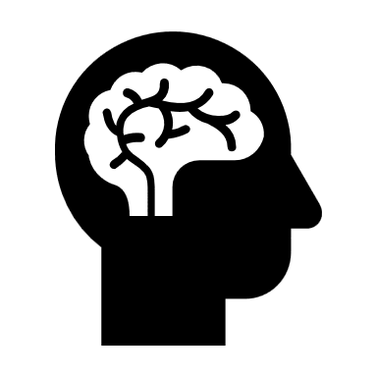
Criticism of fMRI
Satoh et al. (2015) found that challenges in the performance of fMRI in AD patients resulted in fewer participants.
The instruction of the task confused participants, and the MRI machine itself caused panic in AD patients, resulting in only 6 of 10 being able to perform the task.
Unfortunately, in Satoh et al. (2015) study, no control group of participants have included in the assessments due to the lack of the researcher's time. The control group were also excluded from the neuroimaging tests; therefore, the fMRI investigation did not assist in determining if brain alterations were particular to music therapy.

Slide 17
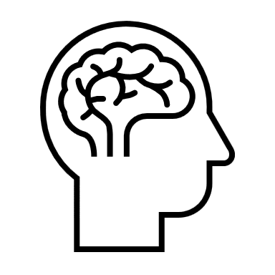
Criticism of fMRI
Using the fMRI in both conditions before and after the therapy will be crucial.
Canu et al. (2018) suggest that the same MRI should be used during all studies for the same participants as the repeatability of fMRI signal changes throughout memory tasks and resting state fMRI is only moderate.
Canu et al. (2018) argue that the MRI signal should be validated using pre- and post-reproducibility investigations, which will help to separate brain changes caused by repetition from those caused by music therapy.
Previously Johnson et al. (2012) criticised the use of fMRI in AD patients mainly due to sensitivity to head motion; fMRI is likely to remain challenging in studying individuals with more severe cognitive impairment

Slide 18
Conclusion
Satoh et al. (2015) journal article seemed to be important in the neuroscience field as it is investigative, one of the nonpharmacological forms of therapy for patients with AD. The predicted statistics of global dementia are shocking and seeking research.
However, despite several limitations of Satoh et al. (2015), there is an area for improvement.
Future research should concentrate on the combination of different treatment strategies. For example Herholz et al. (2013) argue that to slow neurodegeneration, there should be a treatment which combines pharmacology and electrophysiological stimulation with cognitive training and physical activity.

Slide 19
References
Aldridge, D. (1996). Music therapy research and practice in medicine: From out of the silence. Jessica Kingsley Publishers.
Ashida, S. (2000). The effect of reminiscence music therapy sessions on changes in depressive symptoms in elderly persons with Dementia. Journal of music therapy, 37(3), 170-182.
Boso, M., Politi, P., Barale, F. and Enzo, E. (2006). Neurophysiology and neurobiology of the musical experience. Functional Neurology, 2, 187-191.
Canu, E., Sarasso, E., Filippi, M., & Agosta, F. (2018). Effects of pharmacological and nonpharmacological treatments on brain functional magnetic resonance imaging in Alzheimer's disease and mild cognitive impairment: a critical review. Alzheimer's Research & Therapy, 10(1), 1-26.
Dassa, A., & Amir, D. (2014). The role of singing familiar songs in encouraging conversation among people with middle to late stage Alzheimer's disease. Journal of music therapy, 51(2), 131-153.
García, J. J. M., Iodice, R., Carro, J., Sánchez, J. A., Palmero, F., & Mateos, A. M. (2012). Improvement of autobiographic memory recovery by means of sad music in Alzheimer's disease type dementia. Aging clinical and experimental research, 24, 227-232.
Grady, C. L., Rieck, J. R., Nichol, D., Rodrigue, K. M., & Kennedy, K. M. (2021). Influence of sample size and analytic approach on stability and interpretation of brain‐behavior correlations in task‐related fMRI data. Human Brain Mapping, 42(1), 204-219.
Guétin, S., Portet, F., Picot, M. C., Pommié, C., Messaoudi, M., Djabelkir, L., et al. (2009b). Effect of music therapy on anxiety and depression in patients with Alzheimer's type dementia: Randomised, controlled study. Dementia and Geriatric Cognitive Disorders, 28, 36-46.[
Guetin, Charras, K., Berard, A., Arbus, C., Berthelon, P., Blanc, F., Blayac, J.-P., Bonte, F., Bouceffa, J.-P., Clement, S., Ducourneau, G., Gzil, F., Laeng, N., Lecourt, E., Ledoux, S., Platel, H., Thomas-Anterion, C., Touchon, J., Vrait, F.-X., & Leger, J.-M. (2013). An overview of the use of music therapy in the context of Alzheimer's disease: A report of a French expert group. Dementia : the International Journal of Social Research and Practice., 12(5), 619–634. https://doi.org/10.1177/1471301212438
Herholz, S. C., Herholz, R. S., & Herholz, K. (2013). Non-pharmacological interventions and neuroplasticity in early stage Alzheimer's disease. Expert review of neurotherapeutics, 13(11), 1235-1245.
Image of the brain drawing(n.a). Retrieved from: https://www.sciencedirect.com/topics/veterinary-science-and-veterinary-medicine/limbic-lobe
Johnson, K. A., Fox, N. C., Sperling, R. A., & Klunk, W. E. (2012). Brain imaging in Alzheimer disease. Cold Spring Harbor perspectives in medicine, 2(4), a006213.
Levitin, D. J. (2006). This is your brain on music. Plume, Penguin Books Group

Slide 20
Lyu, J., Zhang, J., Mu, H., Li, W., Champ, M., Xiong, Q., Gao, T., Xie, L., Jin, W., Yang, W., Cui, M., Gao, M., & Li, M. O. (2018). The effects of music therapy on cognition, psychiatric symptoms, and activities of daily living in patients with Alzheimer's disease. Journal of Alzheimer's Disease, 64, 1347–1358. PMID: 29991131.
Matziorinis, A. M., & Koelsch, S. (2022). The promise of music therapy for Alzheimer's disease: A review. Annals of the New York Academy of Sciences, 1516(1), 11-17.
Miyazaki, A., & Mori, H. (2020). Frequent karaoke training improves frontal executive cognitive skills, tongue pressure, and respiratory function in elderly people: pilot study from a randomised controlled trial. International Journal of Environmental Research and Public Health, 17(4), 1459.
Moreno-Morales, C., Calero, R., Moreno-Morales, P., & Pintado, C. (2020). Music therapy in the treatment of Dementia: A systematic review and meta-analysis. Frontiers in medicine, 7, 160.
Koelsch, S. (2020). A coordinate-based meta-analysis of music-evoked emotions. Neuroimage, 223, 117350. PMID: 32898679.43.
Parsons, L. M. (2000). Exploring the functional neuroanatomy of music performance, perception, and comprehension. Annals of the New York Academy of Sciences, 930, 211-231.Reference
Roe, C. M., Xiong, C., Miller, J. P., & Morris, J. C. (2007). Education and Alzheimer disease without dementia: support for the cognitive reserve hypothesis. Neurology, 68(3), 223-228.
Satoh, M., Ogawa, J. I., Tokita, T., Nakaguchi, N., Nakao, K., Kida, H., & Tomimoto, H. (2014). The effects of physical exercise with music on cognitive function of elderly people: Mihama-Kiho project. PloS one, 9(4), e95230.
Särkämö, T. (2018). Cognitive, emotional, and neural benefits of musical leisure activities in aging and neurological rehabilitation: A critical review. Annals of physical and rehabilitation medicine, 61(6), 414-418.
Scharre, B. DW (2019). Preclinical, prodromal, and Dementia stages of Alzheimer's disease. Practical Neurology, 15, 36–47. PMID: 30097552.
Thompson, Z., Baker, F. A., Tamplin, J., & Clark, I. N. (2021). How singing can help people with Dementia and their family care-partners: A mixed studies systematic review with narrative synthesis, thematic synthesis, and meta-integration. Frontiers in Psychology, 12, 764372.
Veitch, D. P., Weiner, M. W., Aisen, P. S., Beckett, L. A., Cairns, N. J.,Green, R. C., Harvey, D., Jack, C. R., Jagust, W., Morris, J. C., Petersen,R. C., Saykin, A. J., Shaw, L. M., Toga, A. W., & Trojanowski, J. Q. (2019).Understanding disease progression and improving Alzheimer's disease clinical trials: Recent highlights from the Alzheimer's Disease Neuroimaging Initiative. Alzheimer's & Dementia, 15, 106–152

Slide 21
Vink, A. C., Bruinsma, M. S., & Scholten, R. J. (2003). Music therapy for people with Dementia. Cochrane database of systematic reviews, (4).
Wada, M., Noda, Y., Shinagawa, S., Chung, J. K., Sawada, K., Ogyu, K., ... & Alzheimer's Disease Neuroimaging Initiative. (2018). Effect of education on Alzheimer's disease-related neuroimaging biomarkers in healthy controls, and participants with mild cognitive impairment and Alzheimer's disease: a cross-sectional study. Journal of Alzheimer's Disease, 63(2), 861-869.
Westermann, R., Spies, K., Stahl, G. and Hesse, F. W. (1996). Relative effectiveness and validity of mood induction procedures: a meta-analysis. European Journal of Social Psychology, 26, 557-580.

