Slide 1


Employment Law
MA/PGDip in HRM
—Level 7

Slide 2
Employment Law
Capability and performance
09.02.2021
Alison Flett
Associate
Employment
Capital Law

Slide 3
Agenda
01 Performance management? What is it, what are the benefits?
02 Achieving effective performance management – the Do’s and Don’ts
Capability (poor performance)
03 Fair reason / procedure
04 Conduct v capability
05 Informal management
06 Formal management
07 Decision to dismiss, common issues
Capability (ill-health)
08 Procedural fairness
09 Informal management
10 Formal management
11 Decision to dismiss

Slide 4
No standard definition, it describes activities that:
    aim to monitor, maintain and improve employee performance
    improve performance of the organisation overall
    hold employees to account for their performance by linking it to reward, career progression and, sometimes, termination of contracts
    ensure employees have the opportunity to discuss their performance
    compare employees’ performance against performance measures and record it as an ongoing process
  01. Performance management:
  What is it?

Slide 5
  01. Performance management:
  What are the benefits?
If done effectively, it has huge benefits including:
    reinforcing the link between organisational and individual objectives
    providing feedback that motivates employees and helps them improve (personally and by making a valuable contribution towards organisation goals)
    developing staff (internally)
    recognising and acknowledging the good work of employees
    identifying and improving poor performance quickly
CIPD Technical Report (2016) ‘Rapid evidence assessment of the research literature on the effect of performance appraisal on workplace performance’

Slide 6
Achieving effective performance management

Slide 7
  02. The Do’s…
DO be clear of your aims:
The purpose of performance management can vary from organisation to organisation. Is the aim to:
celebrate good work?
reward employees?
better meet organisational goals?
support and improve staff performance?
develop staff?
identify and remedy problems with performance?
Need to be flexible!
ACAS Research (2018) - 'Improvement required'? A mixed-methods study of employers’ use of Performance Management systems’

Slide 8
DO set clear objectives:
Definable achievements that an employee is expected to accomplish. They should be:
accurate in reflecting the employees’ role and the tasks they actually carry out
fair and focused on areas where the employee has control over the outcome
SMART
    Specific
    Measurable
    Achievable
    Relevant
    Timebound
  agreed with each employee
  0.2 The Do’s…

Slide 9
DO consider expected behaviours:
How an employee carries out their work can be as important as the end result.
Behaviours focus on how an employee should approach the work and duties that their role requires.
Example:
A sales rep will have a sales target as their main SMART objective. What behaviours would be expected of them?
  02. The Do’s…

Slide 10
DO try to be:
transparent
consistent
fair
  02. The Do’s…

Slide 11
    DO engage employees’ in performance conversations.
    Essential part of performance management arrangements.
    Time must be set aside to allow performance to be reviewed and plans agreed to move forward
    Meetings should be planned in advance, in private and free from interruptions. Both the manager and the employee should be prepared to discuss:
          what things have gone well during the year, and what has been more challenging.
          any concerns or areas where further help may be useful e.g. further training
          how they have performed against their performance measurements
          ways to build on their achievements next year.
  02. The Do’s…

Slide 12
    DO keep a record
Keeping a record of an employee’s performance can be important.
It can:
assist discussions between a manager and employee when they have performance-related meetings
be used as evidence for promotion or other job opportunities
be used as evidence in future capability/disciplinary related issues
  02. The Do’s…

Slide 13
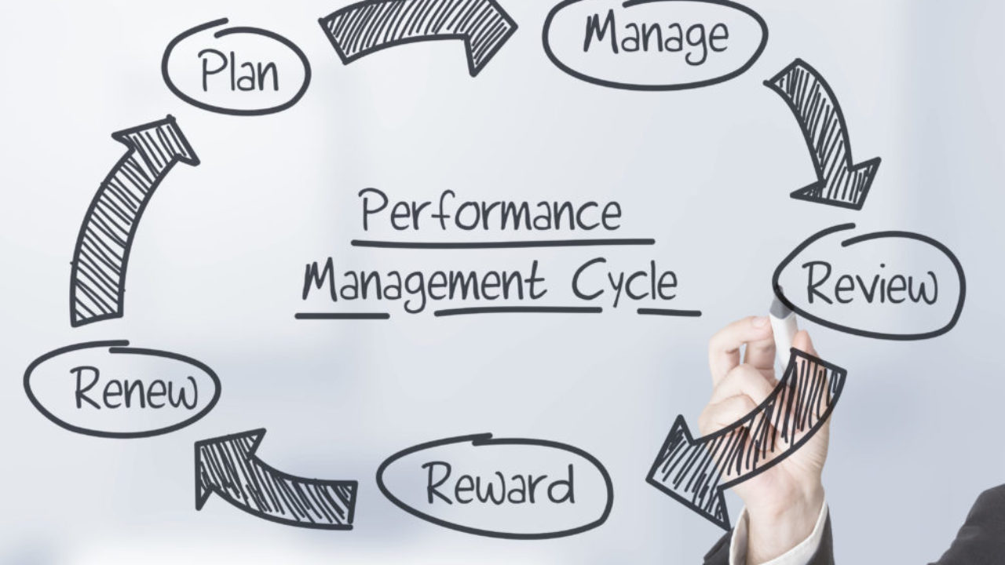
    DO NOT see performance management as a one-off exercise
  02. The Don’ts…

Slide 14
  02. The Don’ts…
DO NOT engage in performance measurement that discriminates against employees because of their:
age
race
sex
gender reassignment
disability
religion or belief
sexual orientation
marriage and civil partnership
pregnancy and maternity

Slide 15
  02. Other “top tips”…
Effective management
Identify training needs for managers and employees on how to effectively utilise performance management
Allow time
Get everyone onboard
Keep performance management aligned with organisational values and aims
Keep it under review

Slide 16
When things go wrong…
Capability – poor performance

Slide 17
  03. Dealing with Poor Performance: fair reason for dismissal
One of the five potentially fair reasons for dismissal (section 98 Employment Rights Act 1996)
conduct
capability and qualifications
redundancy
breach of statutory restriction
“some of substantial reason
The Act gives a statutory definition of “capability” which encompasses competence, health and qualifications.

Slide 18
  03. Fair procedure
Points a tribunal will consider :
whether the employer honestly believed, on reasonable grounds, that the employee was incapable of performing their job; and
whether management failed to discharge its own responsibilities towards the employee
Fairness – what are the key elements?
Acas Code of Practice on Disciplinary and Grievance Procedures and Discipline and grievances at work: The Acas guide (non-statutory).

Slide 19
  03. More Do’s and Don’ts…
Do…
  intervene early
  check performance is really the issue
Don’t…
avoid the problem
be heavy-handed in your approach

Slide 20
  03. Managing performance before it becomes a problem
Setting the required standard
Probationary periods
Appraisal system

Slide 21
Conduct is about an employees’ behaviour at work.
It can usually be identified as actions which the employee has control over e.g. calling in sick when they are not genuinely ill.
Capability is about an employees’ ability to do their job.
It can usually be identified as an issue which the employee has no control over e.g. unable to do their job due to an illness or underlying work or personal issues.
Not always clear!
  04. Conduct v Capability

Slide 22
A driver goes deliberately slowly to his last job to avoid having to do another delivery within his prescribed working hours
A local delivery driver is slower on his route because he is unfamiliar with the area
A factory worker’s output is poor because he takes smoke breaks and exceeds his breaks allowance
A technician doesn’t complete paperwork because he perceives it as being a waste of time
A warehouse worker whose output is low because of a back condition
A care worker who takes longer to dispense medication because his English is poor
  04. Conduct v Capability:
  Examples

Slide 23
Mr A was employed as a contract manager for shopfitters. He was competent and experienced. He had "detailed knowledge of building law and was loyal, conscientious and meticulous". However, he was argumentative with clients and unable to compromise with them on their particular requirements. Some of the clients refused to deal with him.
  04. Conduct v Capability:
  Examples
Conduct?
OR
Capability?

Slide 24
Ms B is dismissed for assembling 471 out of 500 components incorrectly. She claimed this was the way she had been shown how to assemble them.
The employer denied having ever shown her how to do it.
  04. Conduct v Capability:
  Examples
Conduct?
OR
Capability?

Slide 25
  05. Informal management
Step one:
Performance issue identified - arrange informal meeting with employee.
Purpose of the meeting
Preparing for the meeting

Slide 26
  05. Informal management
Step Two:
Follow up with the employee, in writing:
exactly how their work is not meeting the required standard
the expected standard(s)
the timescale of expected improvement
support, coaching and/or training that will be given to the employee
that formal action may follow if there is no improvement

Slide 27
  05. Informal management
Step Three:
Invite the employee to attend a review meeting to assess performance against agreed action plan.
Possible outcomes:
action plan achieved to a satisfactory standard
action plan partly met
action plan not met, reasons given not reasonable and/or acceptable

Slide 28
  06. Formal management
Step One:
Invite the employee to attend a first formal capability meeting.
Before the meeting, the employee should be notified (in writing), of the:
shortcomings in their performance
date, time and place of the capability meeting
relevant information and any documents to be relied on at the hearing
procedure to be followed
possible consequences if performance is found to have fallen short of the required standard
right to be accompanied by a trade union official or a fellow worker

Slide 29
  06. Formal management
The aim of the meeting will be to:
clarify the required standards the employee has failed to meet and examine the evidence
allow the employee to ask questions, respond to the evidence put forward, provide any evidence they may have and put their views across
establish the likely reasons for the employee’s poor performance
identify what can be done to assist them in improving their performance, such as additional training or supervision
set targets for improvement and a timescale for review

Slide 30
  06. Formal management
Decide on the outcome and confirm the decision in writing.
If no sufficient improvement, give the employee a first written warning
Review period
Right of appeal

Slide 31
  06. Formal management
Step Two:
Invite employee to a second capability meeting.
The employee will have the same rights as at the first meeting
Advise the employee there has been insufficient improvement
Check again there are no training or other issues affecting performance and ask for their views.
If the performance hasn’t improved sufficiently, give the employee a final written warning, setting out the required performance improvement and new timescale for improvement and next review date.

Slide 32
  06. Formal management
Step Three:
If the decision is whether to proceed to dismissal:
Write to employee inviting them to disciplinary meeting and provide copies of relevant supporting documents
Hold disciplinary meeting
Decide on the outcome

Slide 33
Considerations:
Have you provided support and training?
Have you given reasonable time for the employee to improve?
Have you considered alternative employment or redeployment?
Has the employee received appropriate warnings in line with the disciplinary procedure?
Right of appeal
  07. The decision to Dismiss

Slide 34
  07. Decision to dismiss:
Potential claims:
A capability dismissal may give rise to possible employment tribunal claims such as:
Breach of contract
Constructive Dismissal
Unfair dismissal
Discrimination or harassment
An employer can defend the claim if they are able to show the dismissal was fair

Slide 35
Is it possible to fairly dismiss instantly for a single act of incompetence?
Can a final written warning be given for the first instance of poor performance?
How do you deal with employees whose performance lapse once the warning period finishes?
  07. Common Issues

Slide 36
When things go wrong…
Capability – ill-health

Slide 37
  08. Procedural fairness:
  General principles
Need to follow a fair procedure
Governed by case law - Acas Code of Practice does not apply to genuine ill health dismissals
Need to investigate medical condition and consult with employee:
  "Unless there are wholly exceptional circumstances, before an employee is dismissed on the ground of ill-health it is necessary that he should be consulted and the matter discussed with him, and that in one way or another steps be taken by the employer to discover the true medical position".

Slide 38
  08. Procedural fairness:
  Key aspects
Ascertaining the medical position:
Seek up-to-date information about the nature of the illness and the likely length of absence or prognosis.
Report may be obtained from more than one health professional
The onus is on the employer to take reasonable steps to ascertain the medical position
Access to Medical Reports Act 1988
Confidentiality of medical information

Slide 39
  08. Procedural fairness:
  Key aspects
Consulting with the employee:
Key to the fairness of any dismissal for ill health
Only in exceptional cases consultation will not be necessary
Consider arrangements for meetings
Length of service:
Length of service should be weighed in the balance
Consider reasonable adjustments or alternative employment:

Slide 40
  09. When absence becomes a
  problem
Most absence issues can be managed without the need for escalating matters.
An employer should deal with matters formally when the absence levels present an unacceptable level of disruption to the business.
Sickness absence policies and use of “trigger” points

Slide 41
  10. Formal management:
  Long-term absence
First formal meeting to discuss long-term absence:
Employer should explore:
The likely date of return (arrangements for future contact, further medical review and further meetings under the procedure) and whether the employer can continue to wait for the employee to return
Whether the employee has a disability
Whether the employee perceives they can return to their previous job, without adjustments

Slide 42
  10. Formal management:
  Long-term absence
Whether the employee perceives they can return to their previous job, provided that adjustments are made
.
What alternatives the employee may wish to explore: redeployment or application for employment benefits
The mechanics of a return to work programme.
A second or further meeting would be called for in cases where dismissal is contemplated.

Slide 43
First formal meeting to discuss short-term absence:
Employer should explore:
The effect of the pattern of absences on the employee's colleagues, department and the employer's business
The likelihood of continuing absences and the impact they are likely to have
Whether there are changes to the employee's job or redeployment opportunities that would assist in attendance, reduce the effect on colleagues or the employer's business
Whether the employee has a disability and, if so, whether there are any reasonable adjustments that could be made
Whether it is appropriate to give the employee a formal warning that their attendance levels need to improve
A second or further meeting would be called for in cases where dismissal is contemplated.
  10. Formal management: Persistent short-term absence

Slide 44
  11. The decision to dismiss
In cases of long-term absence, case law has established fairness will involve the following key elements:
Ascertaining the up-to-date medical position.
Consulting with the employee.
Considering the availability of alternative employment.
Can the employer be expected to keep the employee’s job open any longer?

Slide 45
  11. The decision to dismiss
Need to write to employee.
For long-term absence, the letter should set out:
the length of their absence
the effect it has had on the business
any medical advice
the result of previous consultations with the employee regarding the duration of their absence and the possibility of any adjustments to their work or working environment.

Slide 46
  11. The decision to dismiss
In the case of persistent short-term absence, case law has established the proper approach is to:
Review the pattern of absences and the reason for them.
Warn the employee of the required improvement in attendance, giving them the chance to make representations.
Consider whether there is the required improvement in attendance; if there is not, dismissal is likely to be reasonable.

Slide 47
  11. The decision to dismiss
Need to write to employee.
For short-term persistent absence, the letter should set out:
the fact that the employee's attendance is unacceptable and the reason(s) why.
details of the employee's absences and the steps taken to deal with them to date
Copies of any relevant documentation should be included

Slide 48
  11. Decision to dismiss
Relevant factors when considering reasonableness of decision to dismiss:
The nature of the employee's illness.
The prospects of the employee returning to work and the likelihood of the recurrence of the illness.
The need for the employer to have someone doing the work.
The effect of the absences on the rest of the workforce.
The extent to which the employee was made aware of the position.
The employee's length of service.

Slide 49
  11. Decision to dismiss
Alternatives to dismissal:
Possible alternatives to be considered:
Alternative employment
Ill-health retirement
Permanent health insurance

Slide 50
  11. Decision to dismiss
Potential claims:
A capability dismissal may give rise to possible employment tribunal claims such as:
Breach of contract
Constructive Dismissal
Unfair dismissal
Discrimination or harassment
An employer can defend the claim if they are able to show the dismissal was fair

Slide 51
Thank you for listening, any questions?

